Slide 1
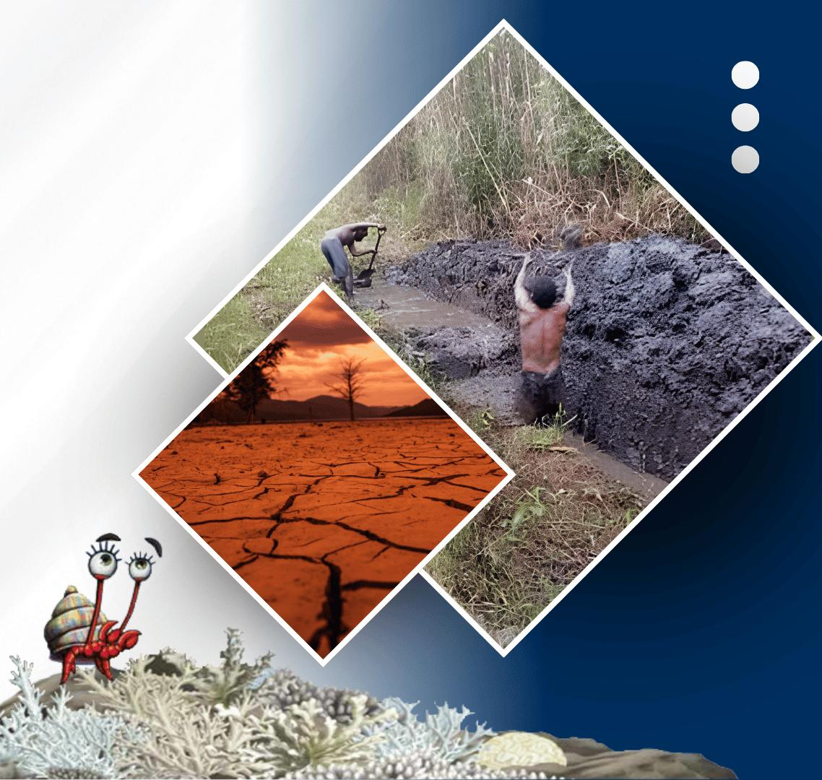




PACIFIC ISLANDS climate & OCEAN forum-19
20 - 21 OCTOBER, 2026
HYBRID
PORT MORESBY, PAPUA NEW GUINEA
& ZOOM
www.pacificrcc.net

Slide 2
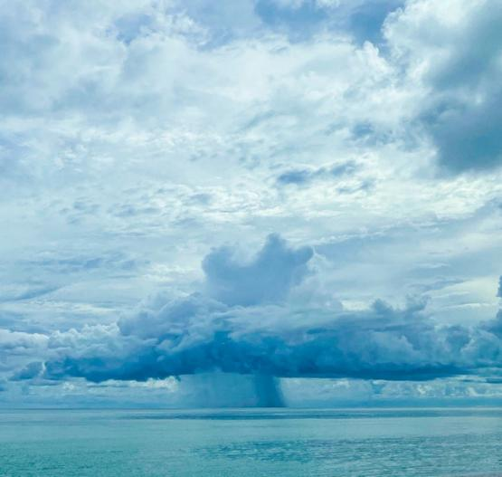
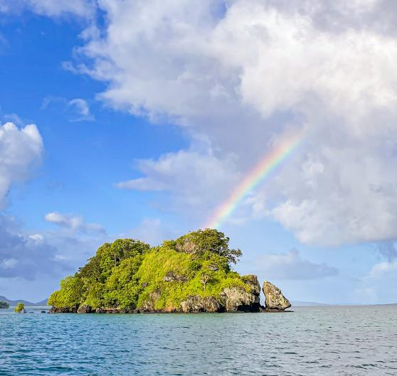





PICOF-19
Looking back long-term
Rainfall and temperature
Nicholas Herold and Simon McGree
21st October, 2026
Bureau of Meteorology

Slide 3
Temperature

Slide 4

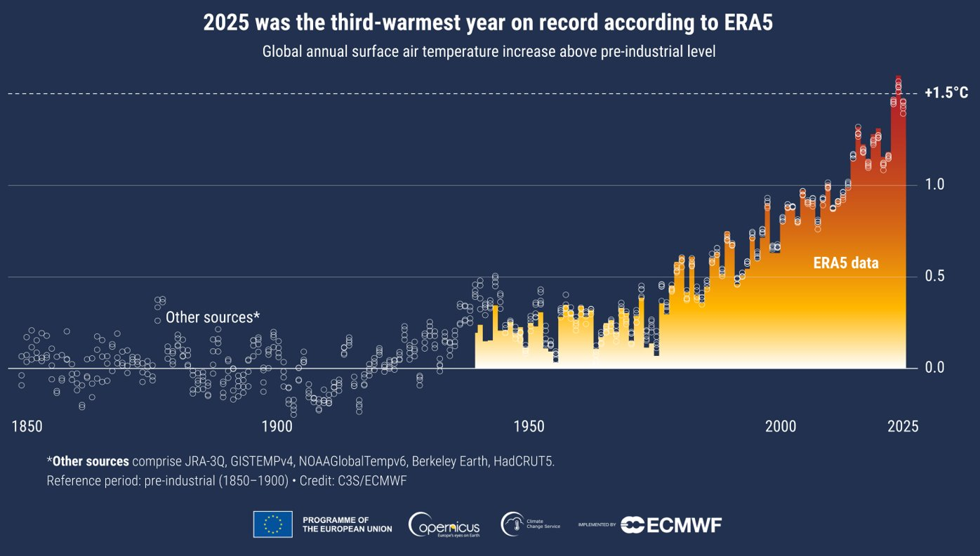
Global temperature anomalies

Slide 5
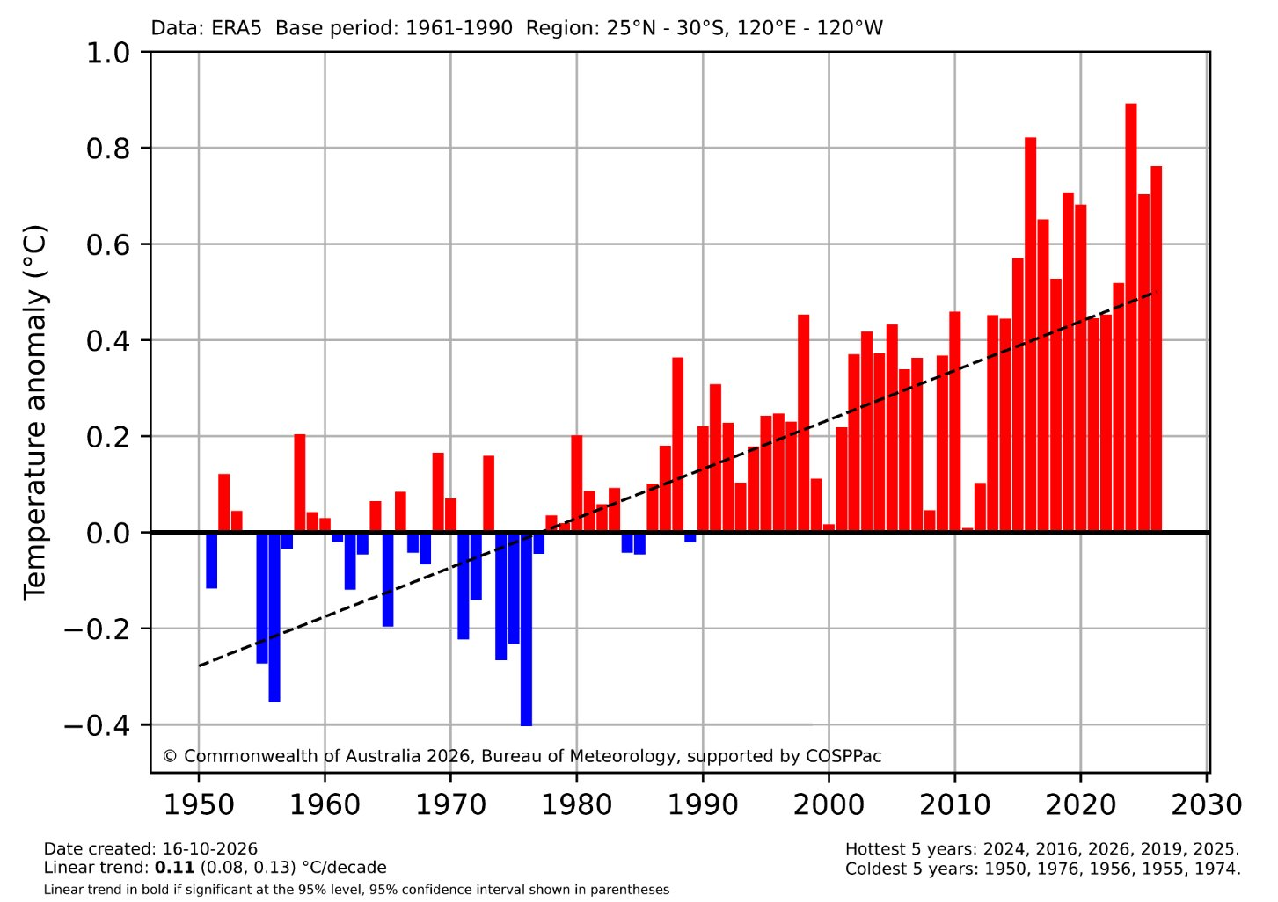
Pacific temperature anomalies (ERA5)
October-September 12-month averages to 2026

Slide 6
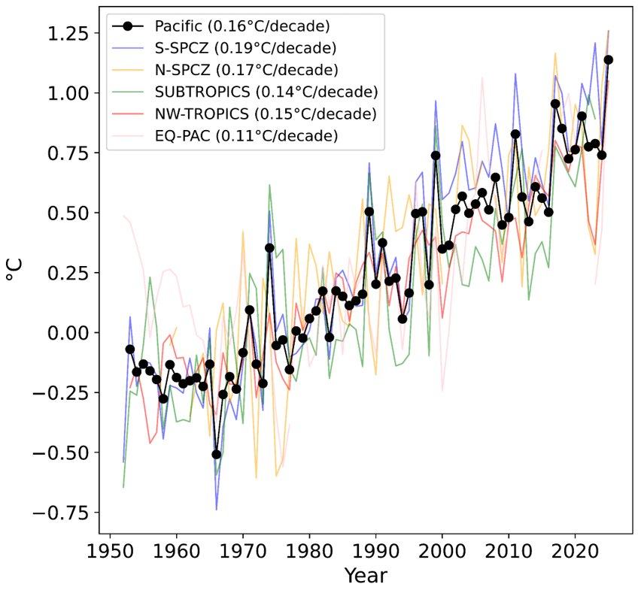
Pacific temperature anomalies (stations)

Slide 7
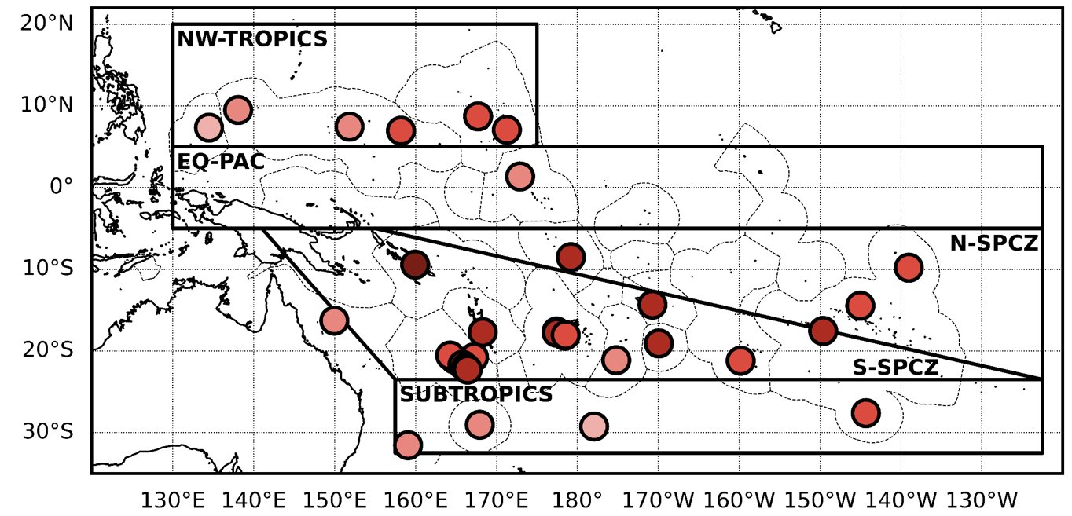
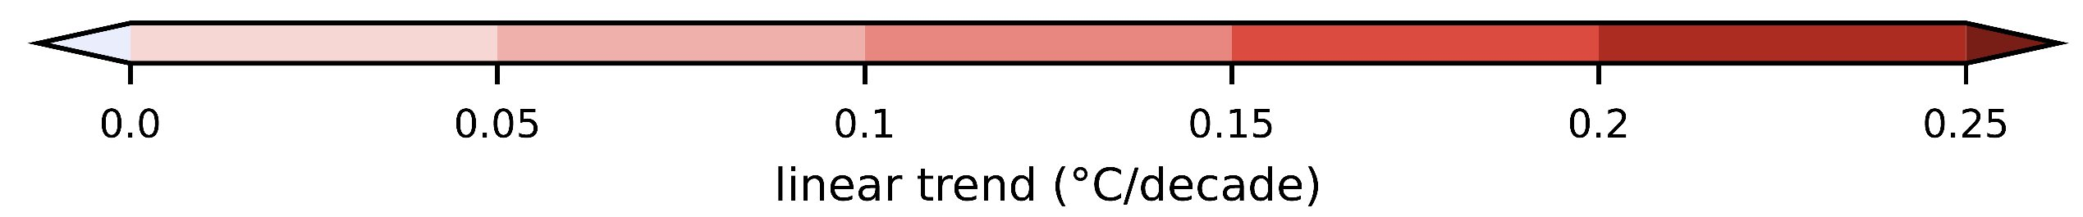
Station temperature trends (1951-2024)

Slide 8
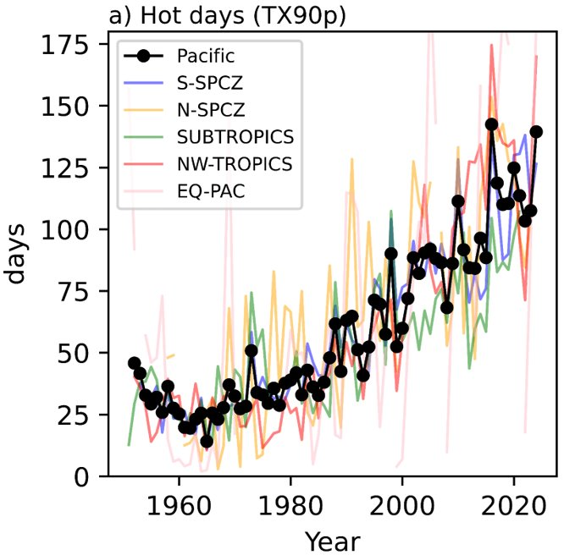
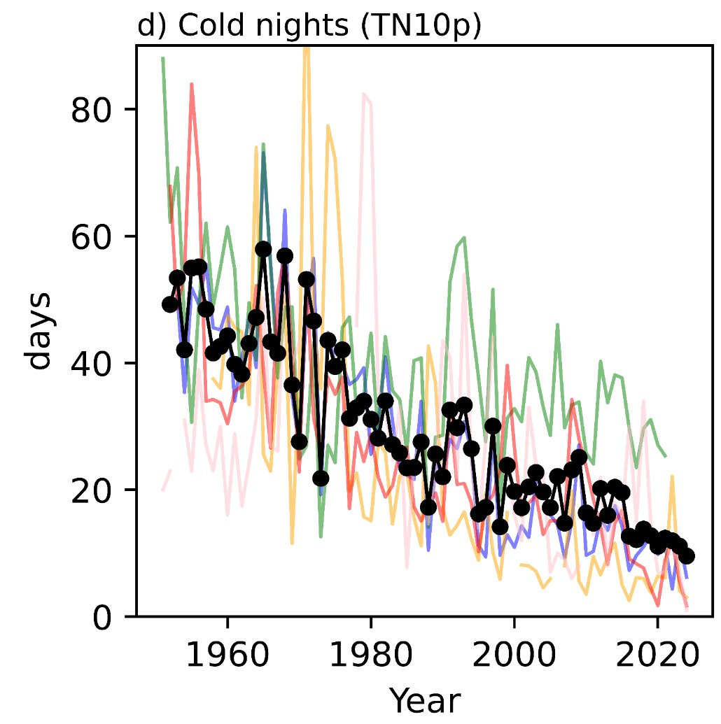
Pacific hot days and cold nights (stations)

Slide 9
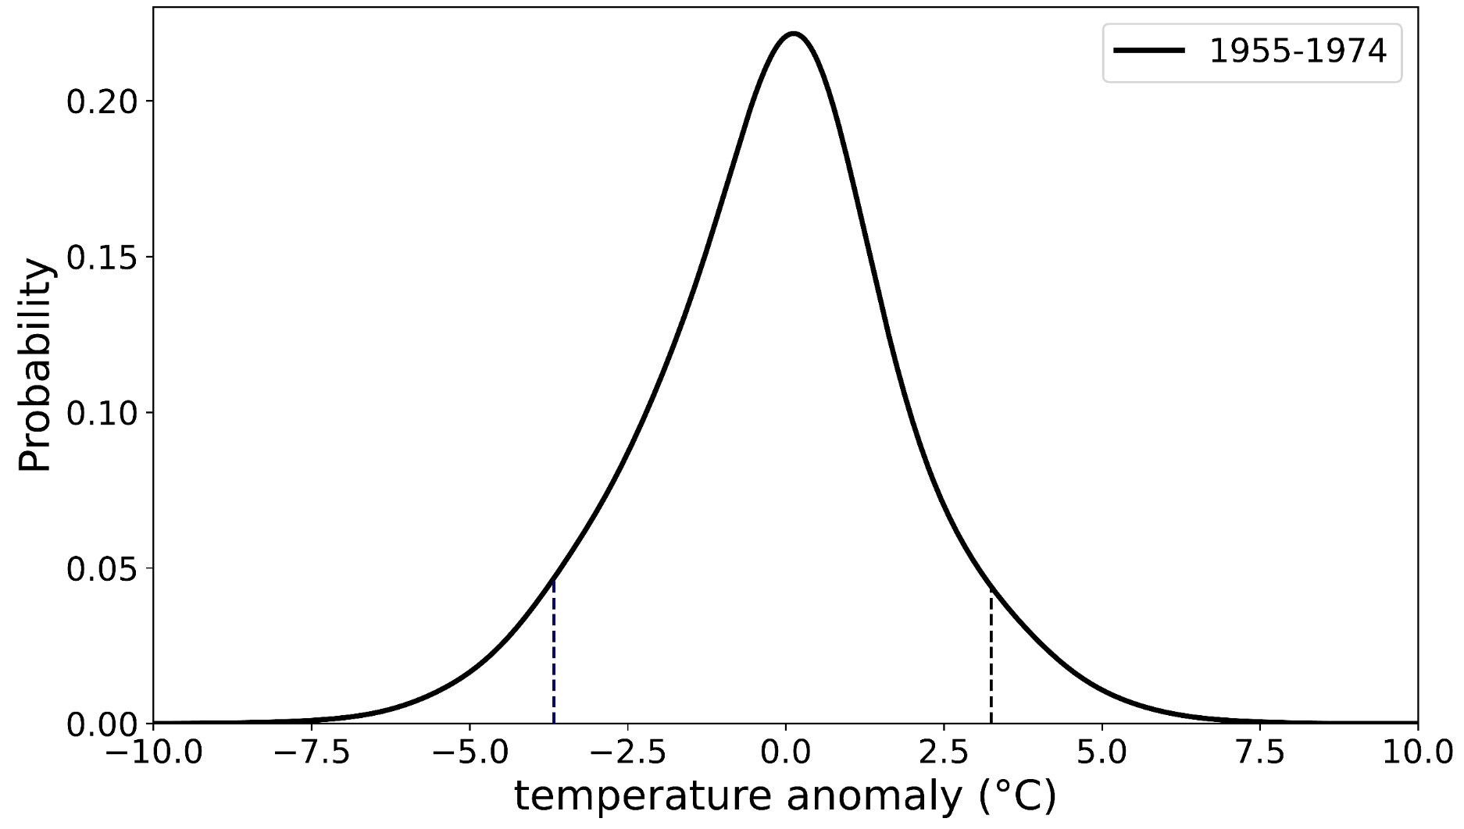
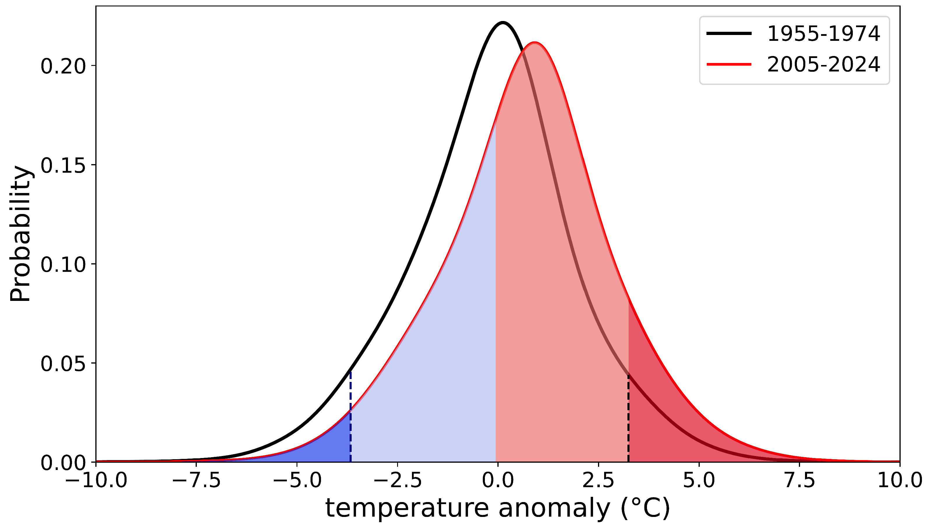
Changing extremes over past 70 years
Anomalies of daily maximum station temperatures
18 days per year (5%)
40 days per year (11%)
10 days per year (2.7%)
18 days per year (5%)
5th percentile
95th percentile

Slide 10
Rainfall​

Slide 11
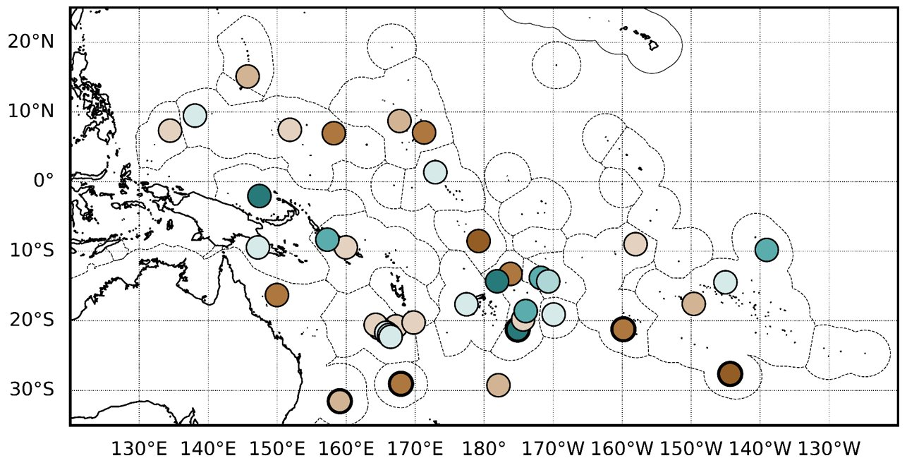
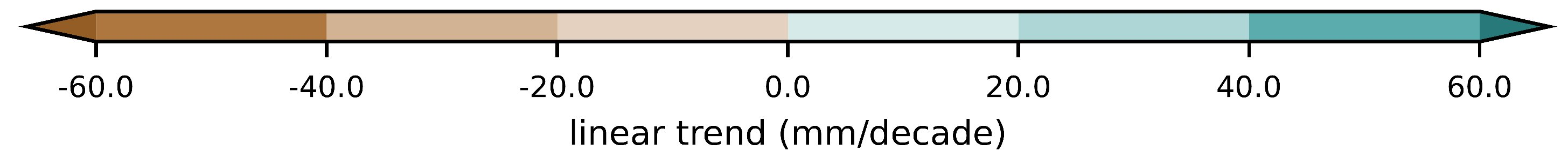
Annual rainfall trends (1951-2020)

Slide 12
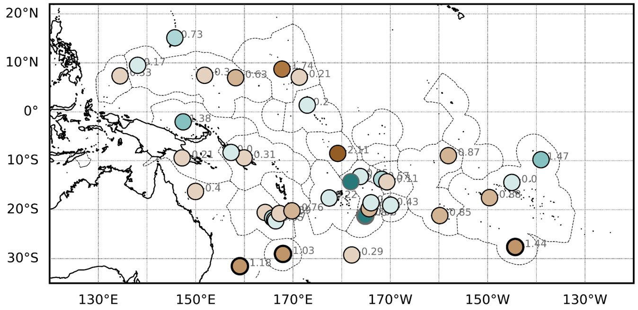
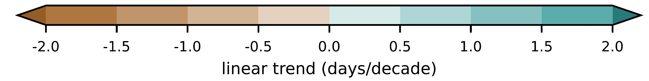
Trends in days above 10 mm (1951-2020)

Slide 13
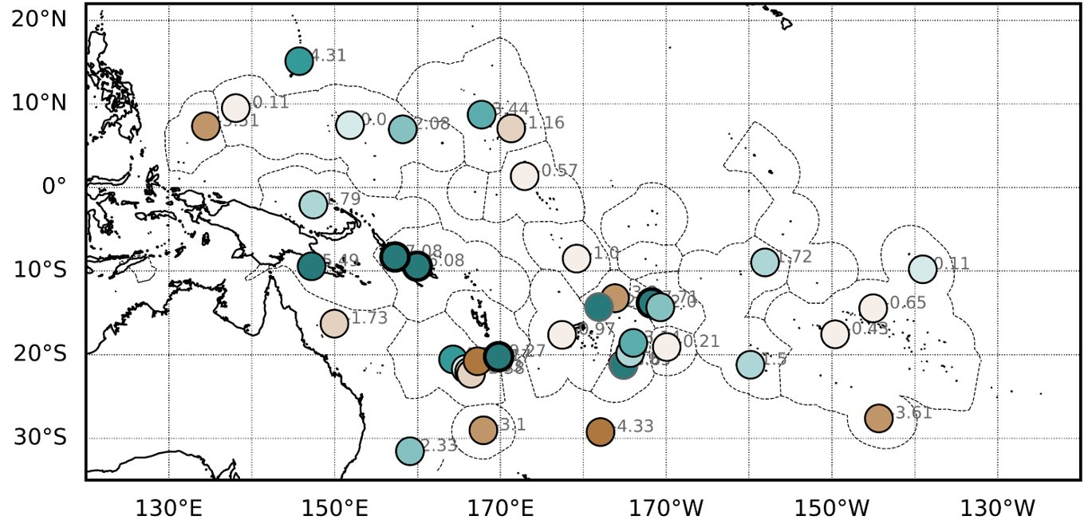
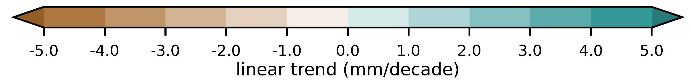
Trends in max daily rainfall (1951-2020)

Slide 14

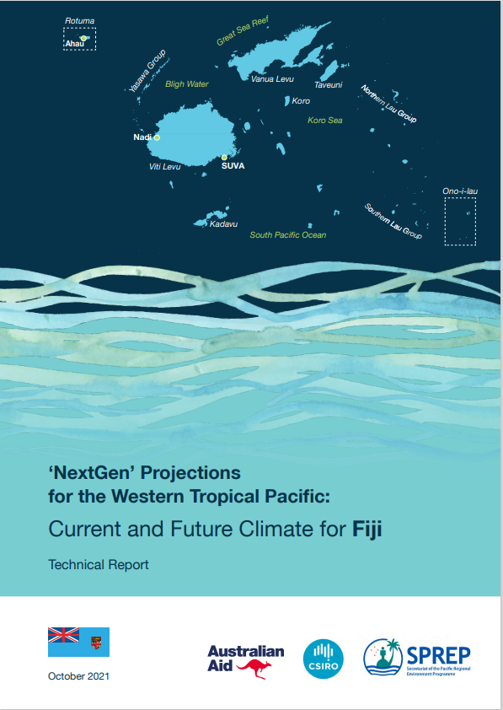
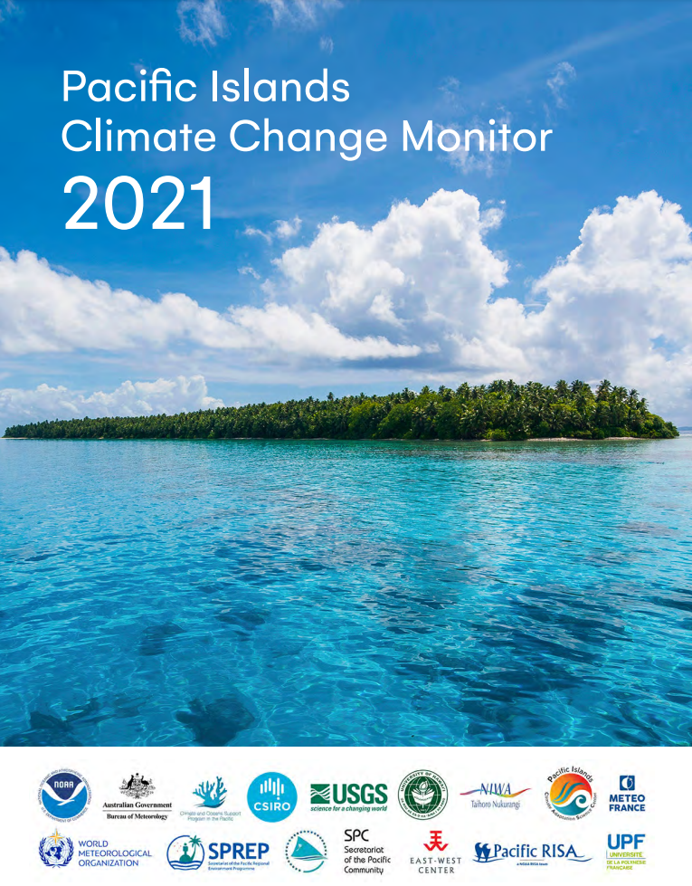
Updated country-specific climate change briefs coming in 2027
Further information
Climate Change in the Pacific 2022: Historical and recent variability, extremes and change
NextGen Climate Change Projections
Pacific Islands Climate Change Monitor 2021

Slide 15
data availability crisis

Slide 16
Station data availability
Significant decline in long-term station data since 1990's.
Back at 1960's level of data.
If not reversed we will lose the ability to characterise climate change at the local scale.

Slide 17
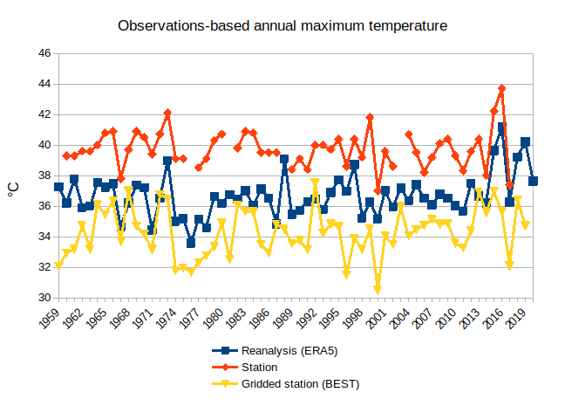
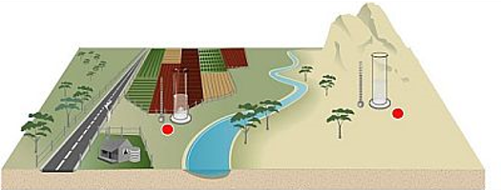
Gridded vs station data
Gridded products give different values to station data.
Remote-sensing and reanalysis products need station data for bias correction and assimilation.
Without station data these gridded products won't perform as well as they do over the Pacific.

Slide 18
Influence on air temperature and rainfall over the last 6 months

Slide 19
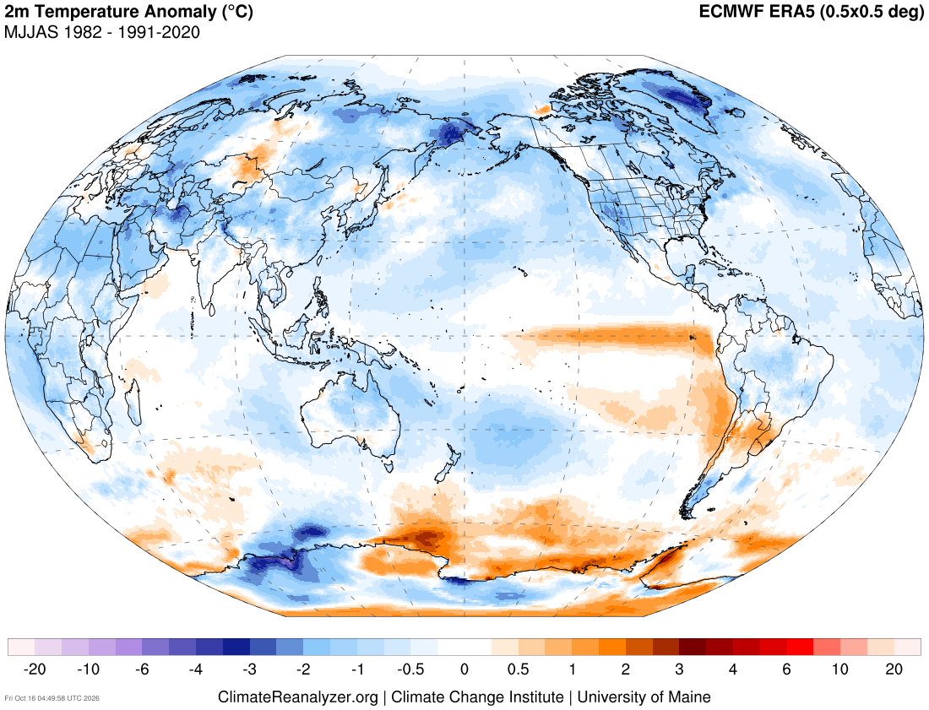
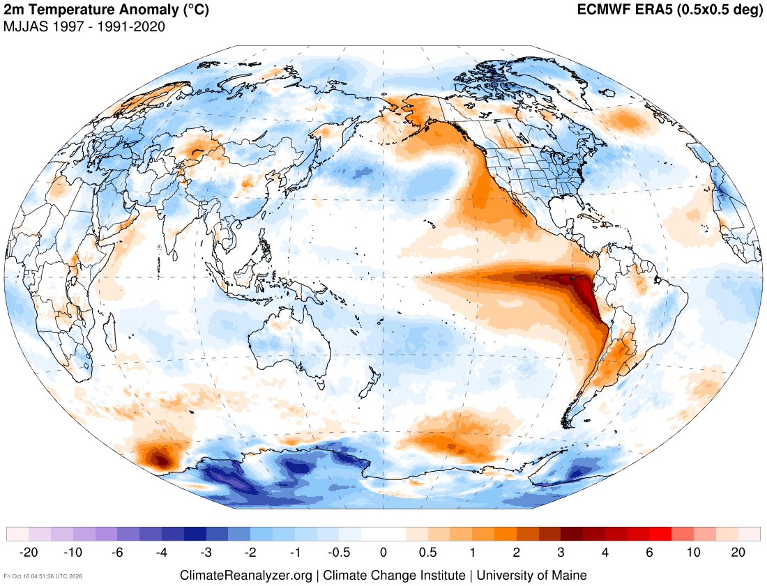
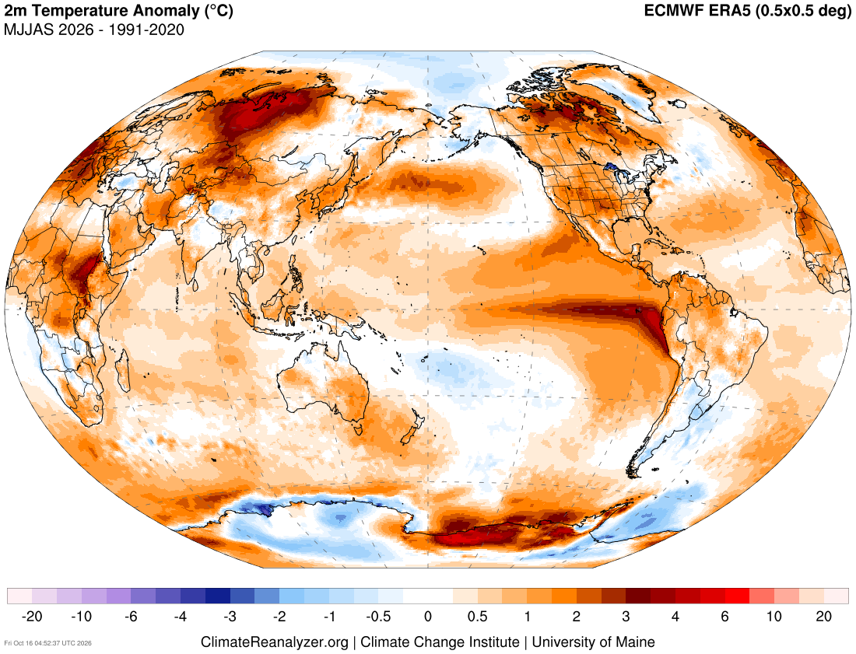
Influence of climate change on air temperatures over the last 6 months

Slide 20
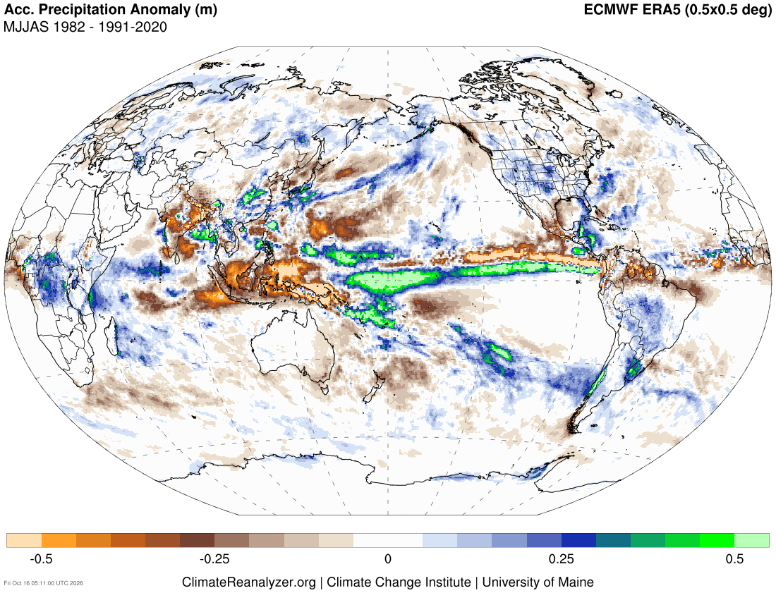
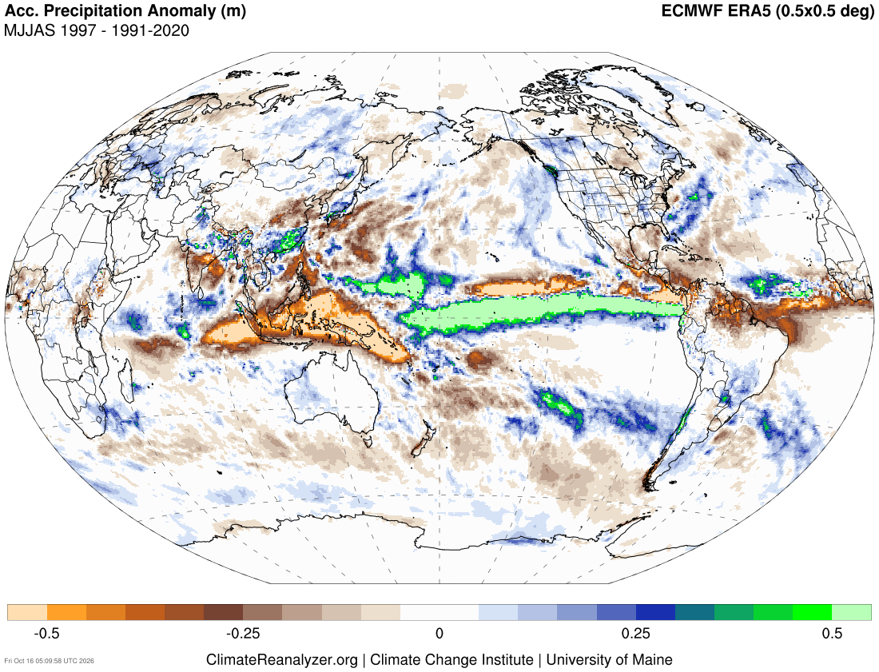
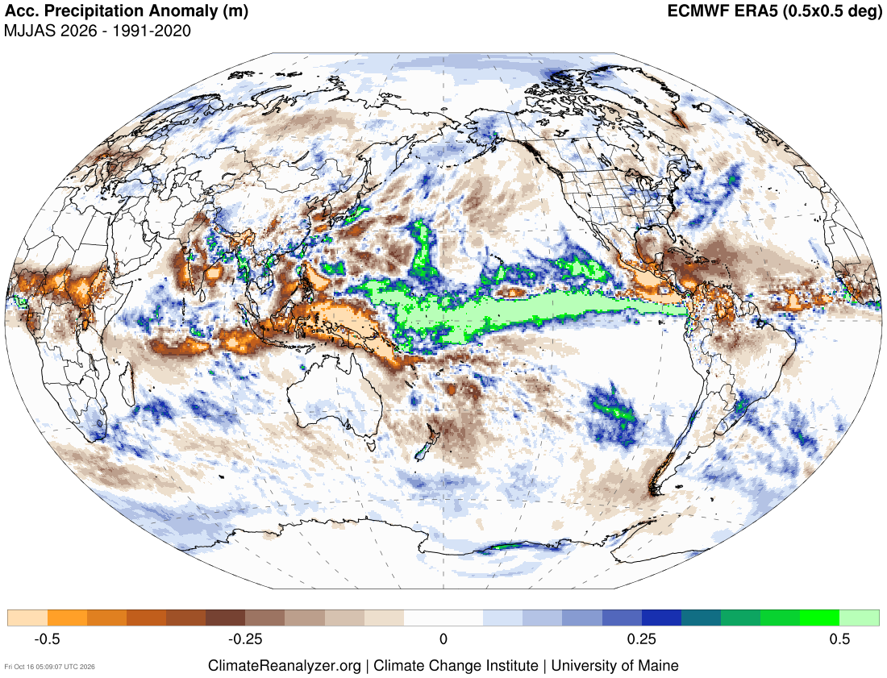
Influence of climate change on rainfall over the last 6 months

Slide 21
Summary
2025 was 3rd warmest year globally and the 5th warmest year in the western Pacific, according to ERA5.
Station data shows regional mean temperatures have increased by 0.16°C/decade since the 1950's. Compared to 1961-1990, hot days now occur approximately three times as often. Cold nights now occur approximately one third as often as they did during 1961-1990.
There are no consistent trends in annual total rainfall, except for significant drying in the subtropics which happens mostly during winter. There are few significant trends in maximum daily rainfall, but all the trends that are significant are positive and there are more increasing than decreasing extreme rainfall trends. This is consistent with a warmer atmosphere holding more moisture.
Long-term high-quality station data is in a rapid decline across most of the Pacific. We now have approximately the same amount of long-term high-quality station data as we did in the 1960's. The increasing availability of remote sensing and reanalysis datasets does not negate the need for long-term high-quality stations. In fact, these gridded products rely on station data for assimilation and bias correction, therefore it is in the community's interest to maintain and share high-quality station records.
The 2026 El Niño has developed in a substantially warmer world compared with the major El Niño events of 1982–83 and 1997–98. Long-term climate change has contributed to higher background air temperatures across the Pacific, meaning temperatures during the current El Niño are likely to be higher than during comparable events in the past. Climate change has also increased the likelihood of hot days and warm nights, potentially exacerbating heat-related impacts during El Niño. In parts of the Pacific where El Niño typically brings cooler-than-normal conditions, long-term warming may partly offset this cooling, resulting in temperatures that are warmer than those experienced during similar El Niño events in previous decades.
Climate change is expected to intensify ENSO-related rainfall variability, potentially increasing rainfall during El Niño in parts of the central and eastern equatorial Pacific. However, changes in rainfall across the wider Pacific are less certain.
In areas where El Niño typically brings below-average rainfall, higher temperatures may increase evaporation, potentially exacerbating drought conditions. While the rainfall patterns during May to September 1982, 1997 and 2026 show similarities and differences, these cannot be attributed to climate change without further analysis.

Slide 22





Nicholas Herold
Simon McGree
nicholas.herold@bom.gov.au
simon.mcgree@bom.gov.au

Slide 23
Additional slides

Slide 24
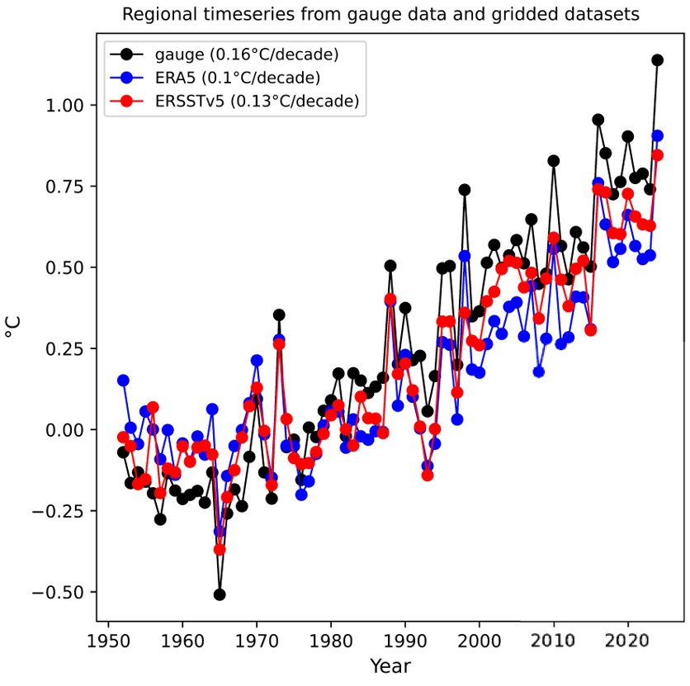
Regional temperatures using station locations

