Slide 1
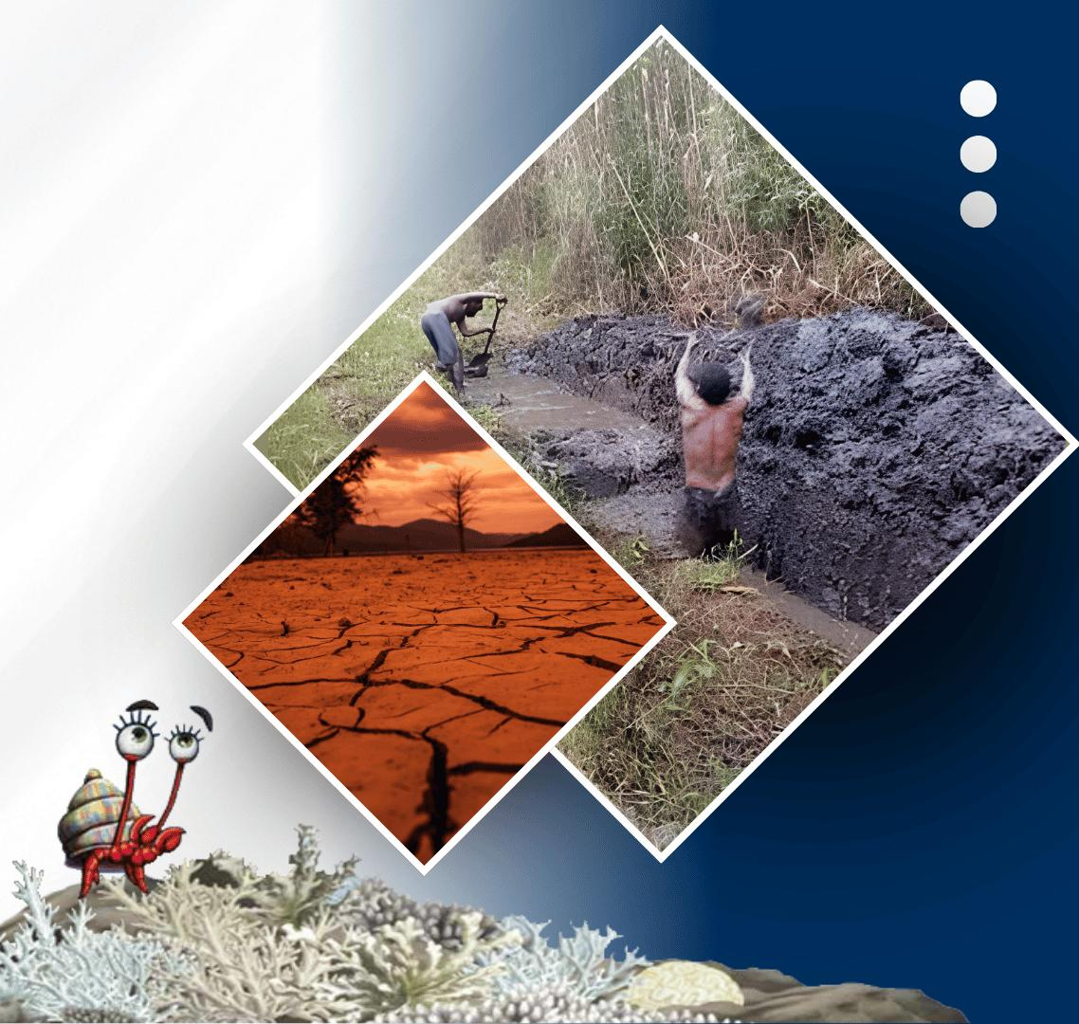




PACIFIC ISLANDS climate outlook forum-19
20 - 21 OCTOBER, 2026
HYBRID
PORT MORESBY, PAPUA NEW GUINEA
& ZOOM
www.pacificrcc.net

Slide 2
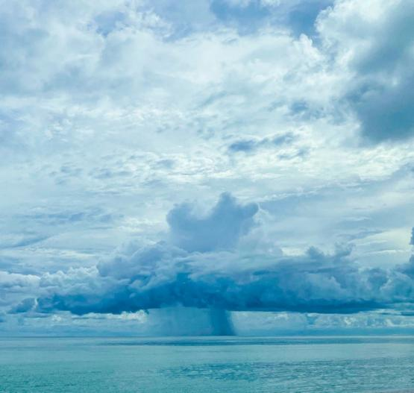
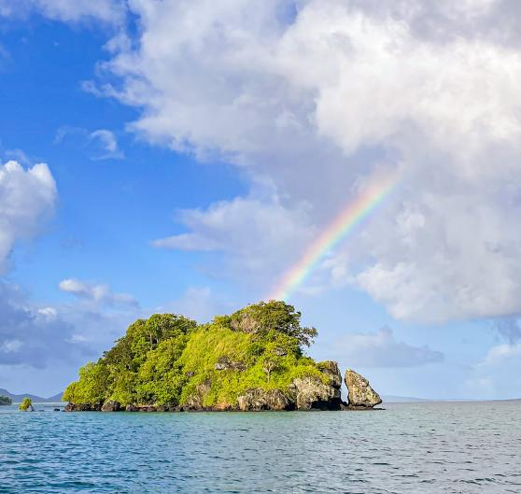





PICOF-19
PICOF (Pacific Islands Climate Ocean Forum) Statement
Hannah Marley (Climate Applications Scientist)
Earth Sciences New Zealand

Slide 3
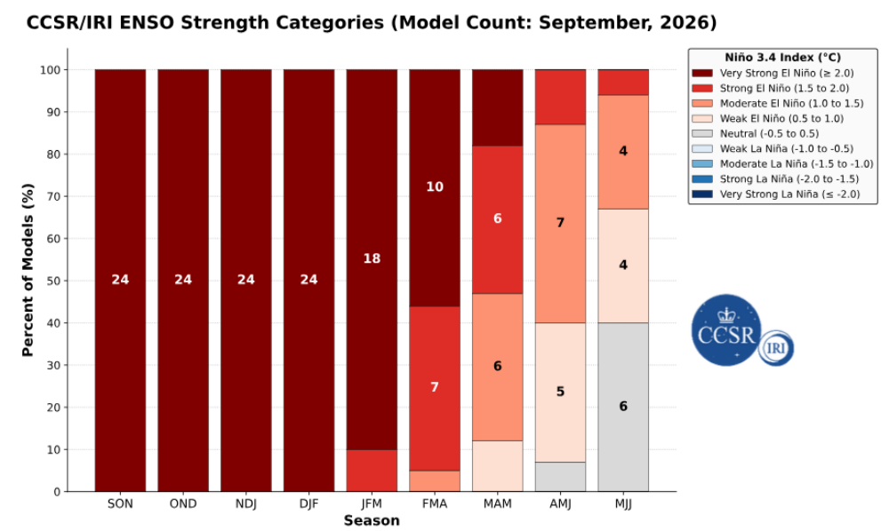
ENSO overview
El Niño is currently present. The event continues to strengthen, with a strong to very strong El Niño likely through January to March 2027. There is a high likelihood that the 2026 El Niño will exceed the strength of all previous El Niño events recorded since 1950.
This event based on experience is expected to persist through March to May 2027. There is a greater chance of neutral conditions in April to June and May to July 2027.
Forecast ENSO evolution:
El Niño related impacts are already occurring in the Pacific and are very likely to persist into 2027. Impact may continue in some countries after the event has ended.
Notes:
CHECK the points on this slide... Updated now?

Slide 4
Looking back

Slide 5
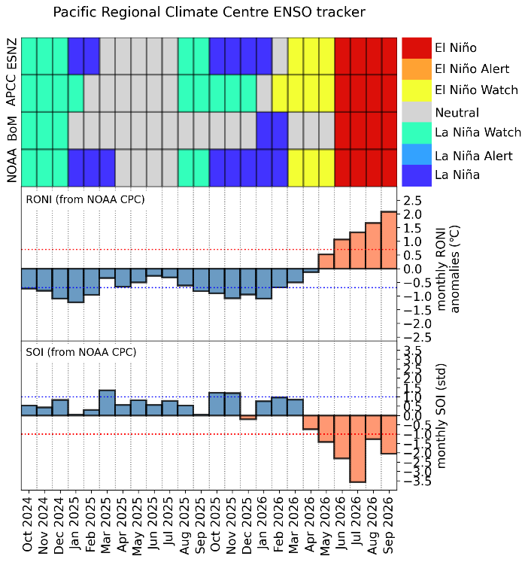
Climate in review – May to October 2026
From May to October 2026, climate conditions across the Pacific were impacted by a rapidly developing El Niño, this was consistent with the climate outlook issued in April 2026 during PICOF-18.
Rainfall, trade wind, and atmospheric pressure patterns over the last 3-6 months were typical of a developing El Niño.

Slide 6
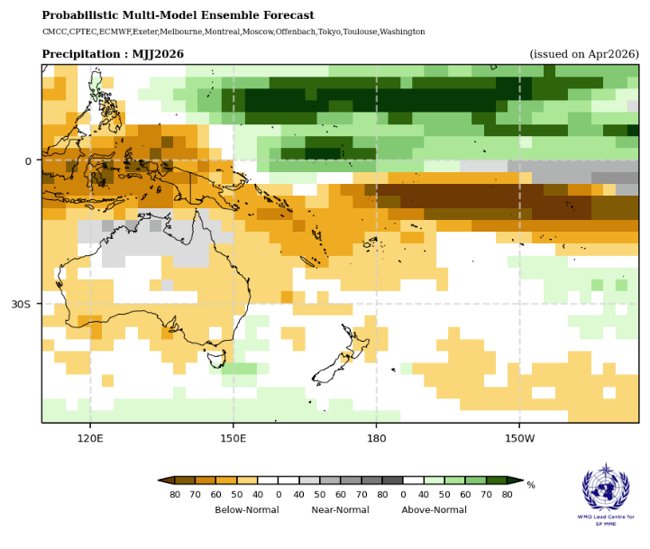
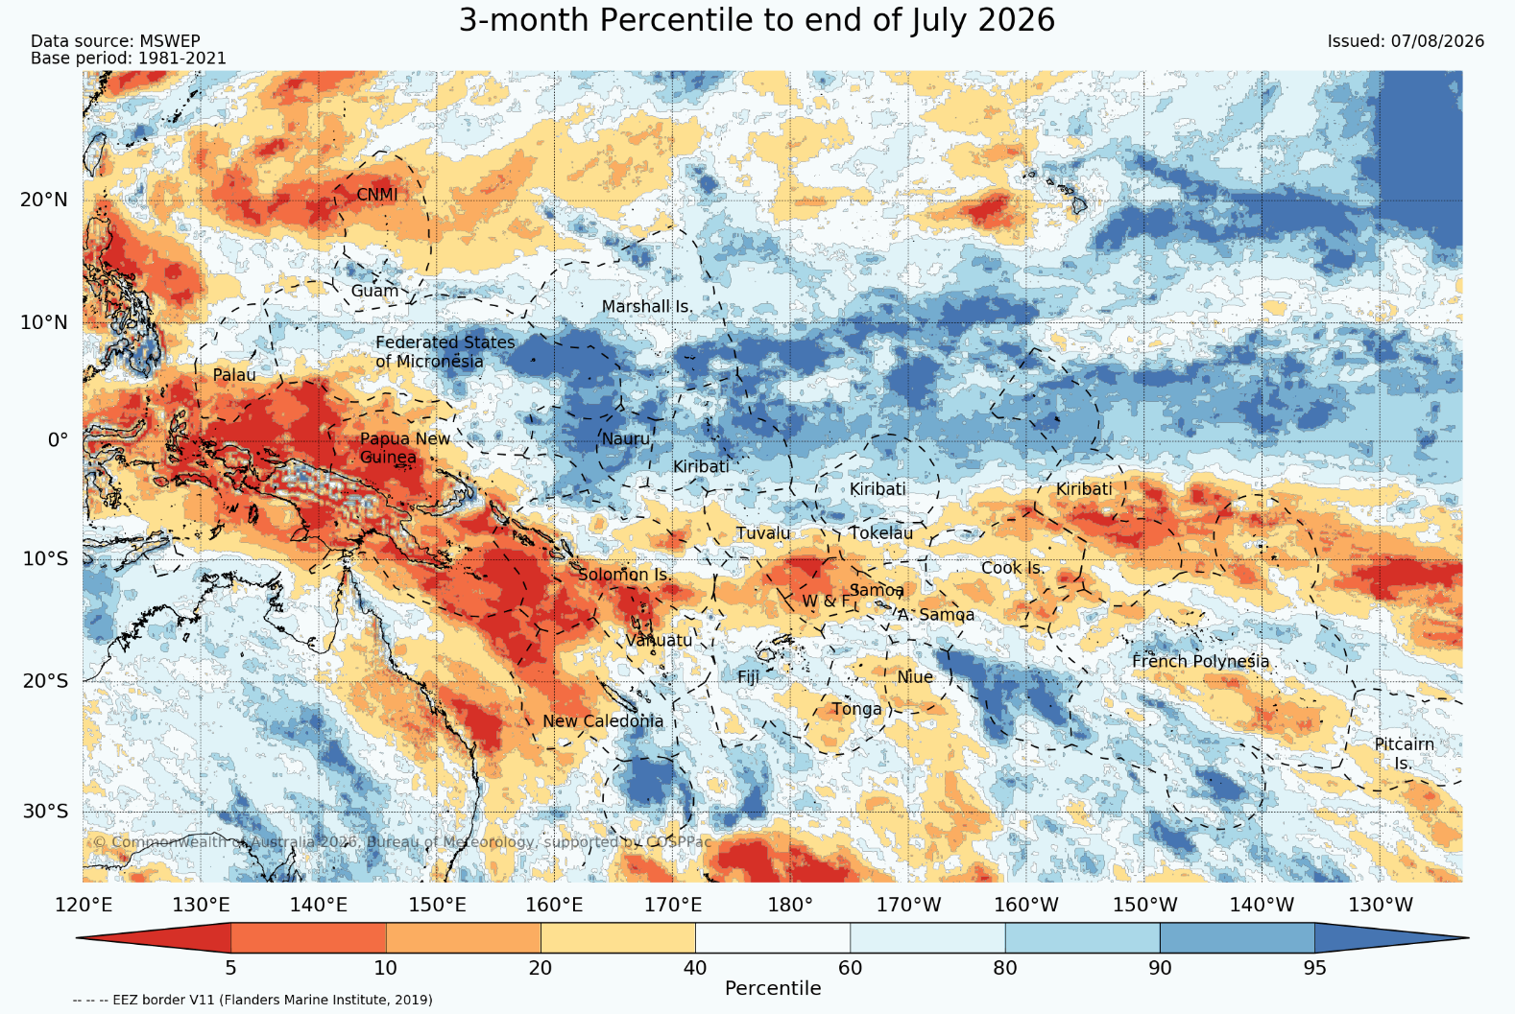
Looking back: Rainfall
PICOF-18 rainfall forecast for May–July 2026:
Observed rainfall for May–July 2026:
Overall, rainfall outlooks from PICOF-18 for May to October 2026 verified well when compared to observations over the same period, reflecting a typical El Niño with above average rainfall across the equatorial central and eastern Pacific, and below average rainfall in off-equatorial regions.

Slide 7
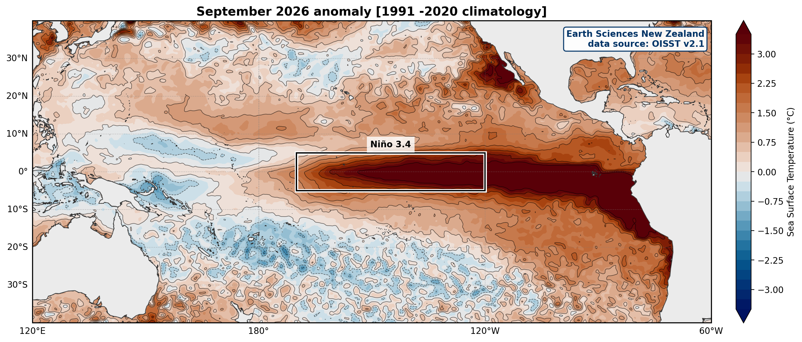
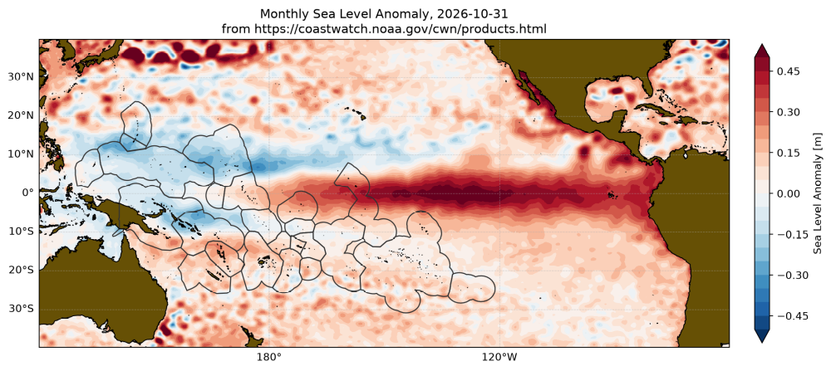
Looking back: ocean conditions
Observed SST anomalies, September 2026:
Over the past 6 months, warmer than normal Sea Surface Temperatures (SSTs) were present across much of the Pacific, with a section of lower-than-normal SSTs in the southern and western Pacific. Much higher-than-normal SSTs were present in the central and eastern Pacific.
Observed sea-level anomalies:
Lower than normal sea levels were present across the Maritime Continent, expanding eastward across the Western Warm Pool by July 2026 and further into the south Pacific in August and September 2026. There was a section of higher-than-normal sea levels in the central and eastern equatorial Pacific.

Slide 8
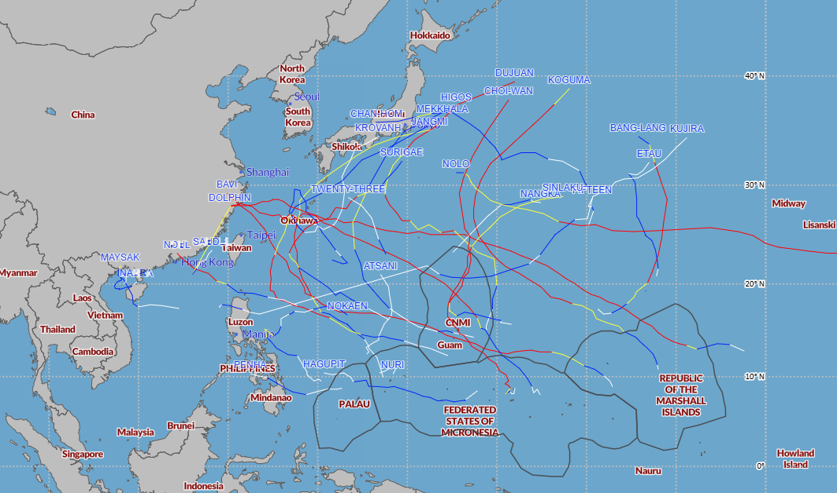
Looking-back: TCs
Western North Pacific tropical cyclone tracks through mid-October 2026:
Tropical cyclone activity in the Western North Pacific (WNP) basin so far this year has been above normal, following the trends often observed during the onset year of a developing strong El Nino.
Through mid-October, there have been 25 named TCs.

Slide 9
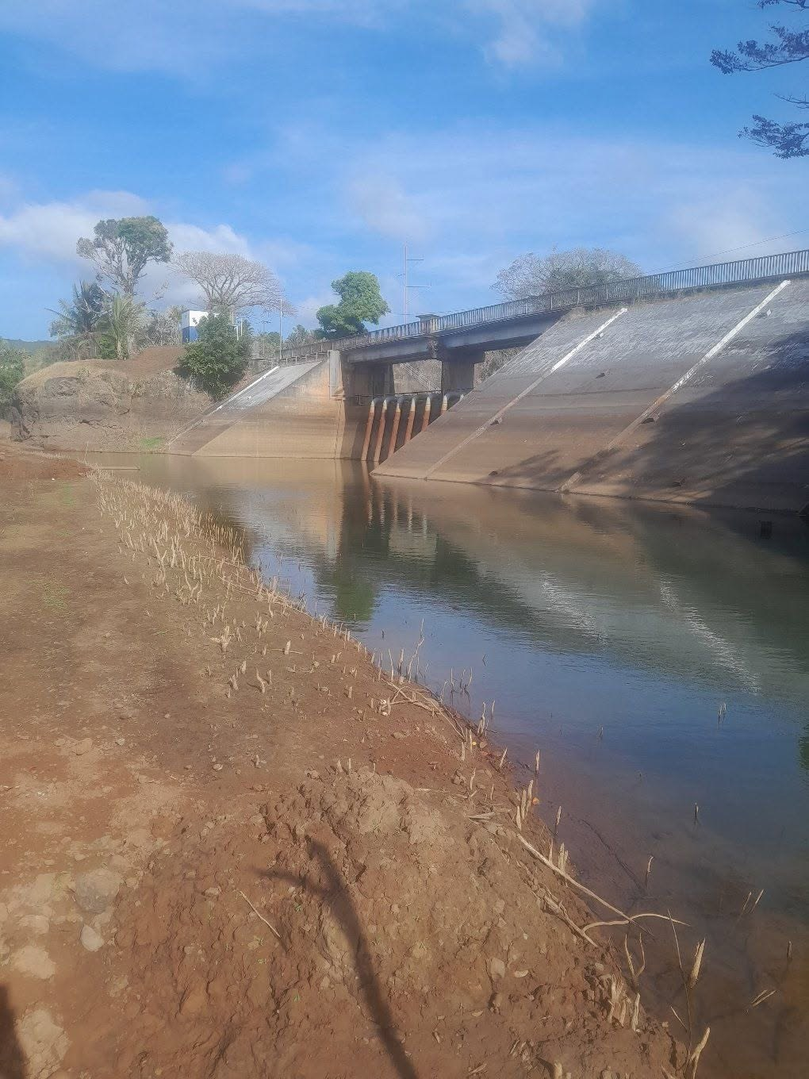
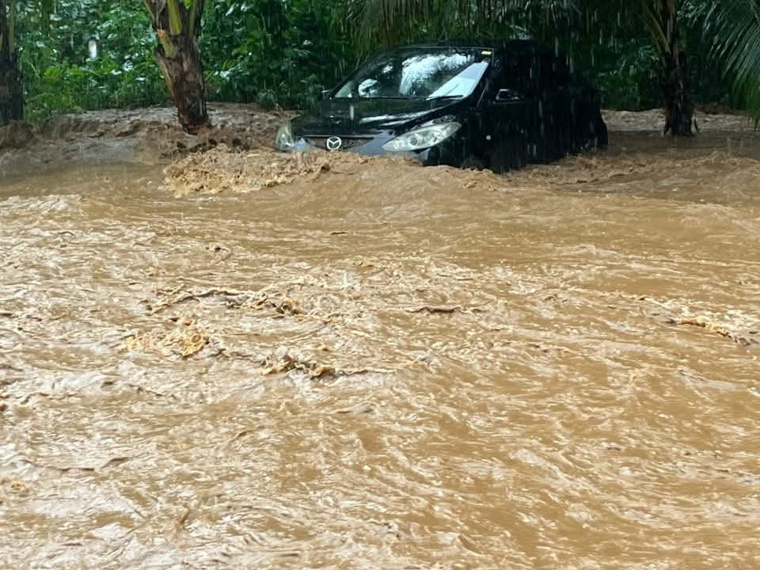
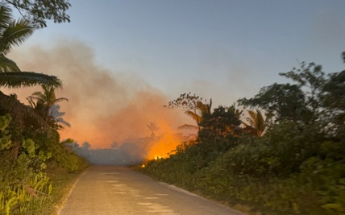
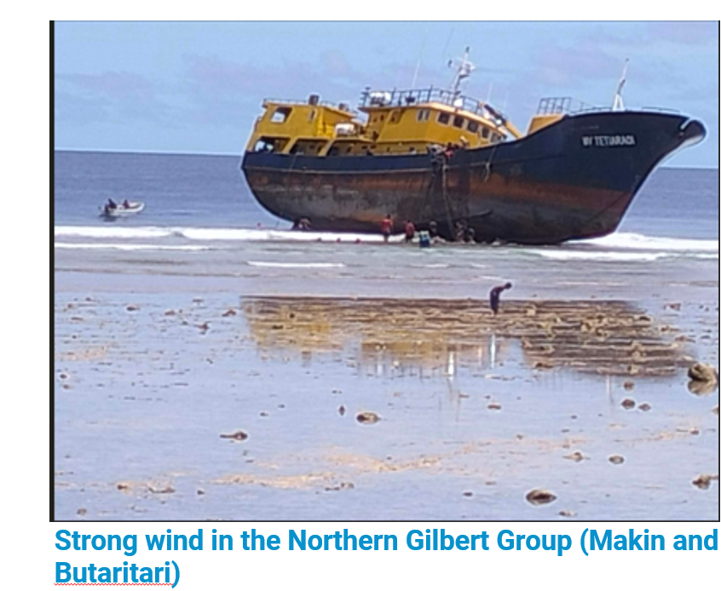
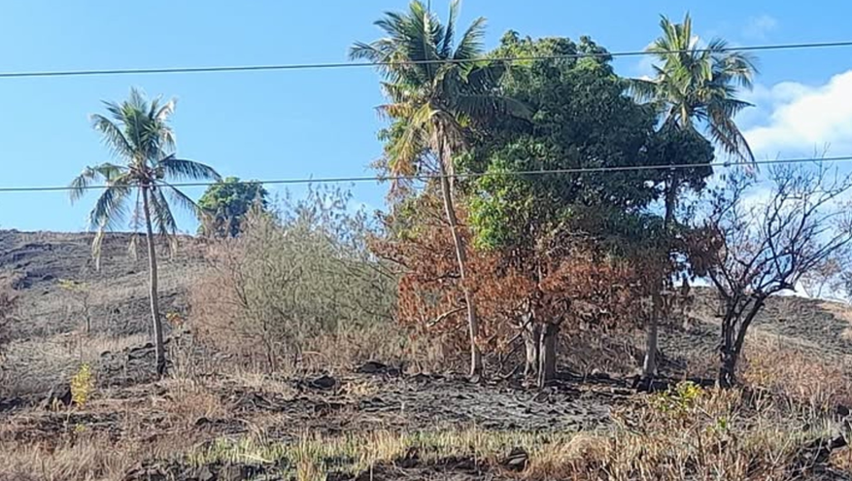
Looking-back sector impacts
Examples of impacts reported by Pacific NMHSs during May–October 2026:
The impacts of weather and climate events recorded by National Meteorological and Hydrological Services (NMHS) for May to October 2026 were noted to impact the water, agriculture, fisheries, marine and air transportation, infrastructure, health, education, and tourism sectors.
Notes:
Continued monitoring of sub-seasonal guidance and official warnings is important. Even areas with normal or reduced seasonal risk can experience damaging cyclones.

Slide 10
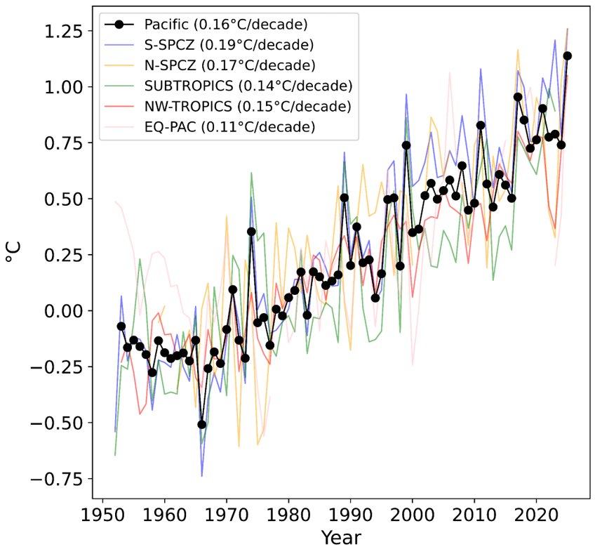
Historical climate context
Regional air-temperature change since the 1950s:
Station data shows regional mean temperatures have increased by 0.16°C/decade since the 1950’s.
Compared to 1961-1990, hot days now occur approximately three times as often.
Cold nights now occur approximately one third as often as they did during 1961-1990.

Slide 11
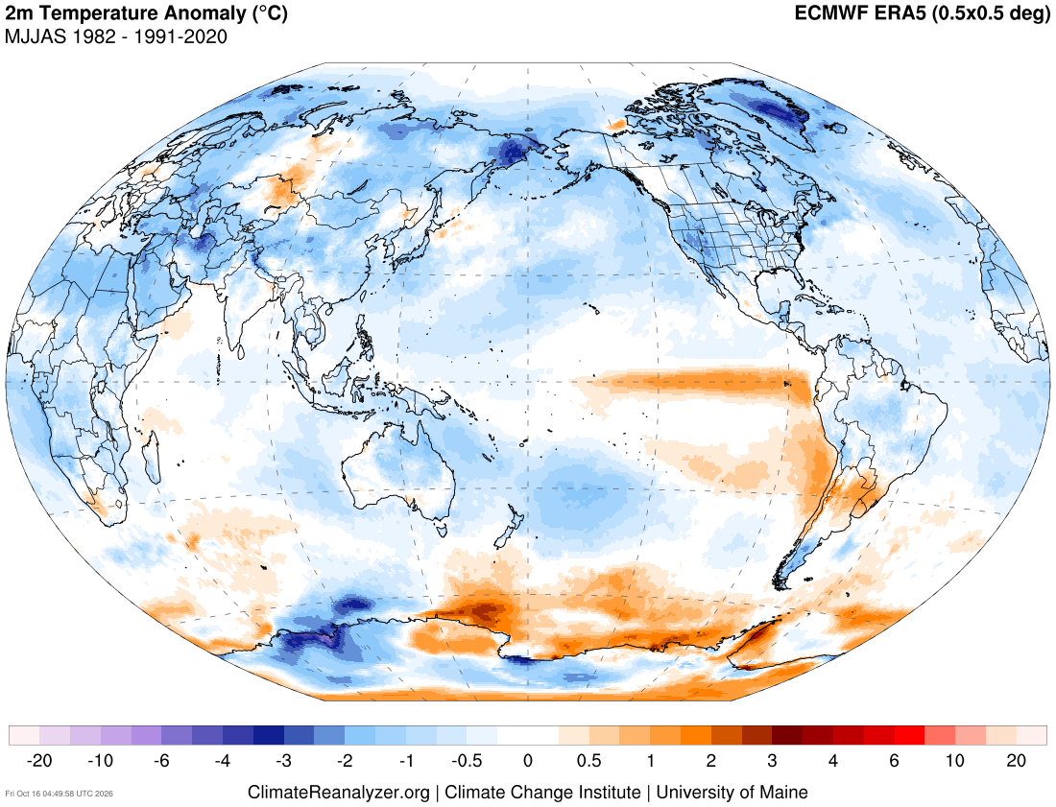
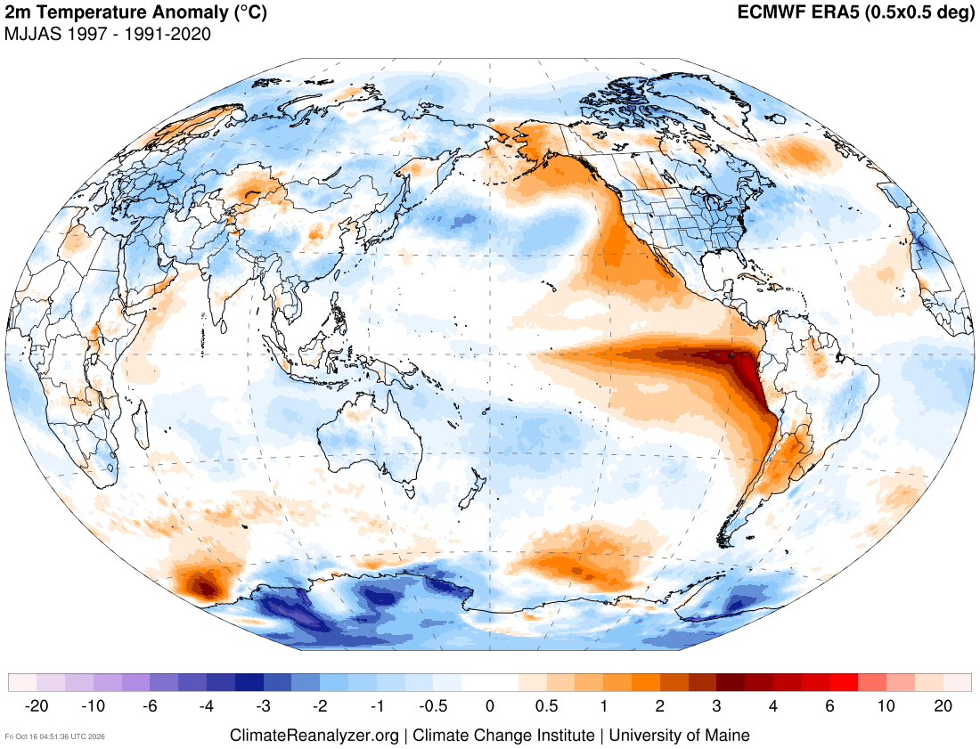
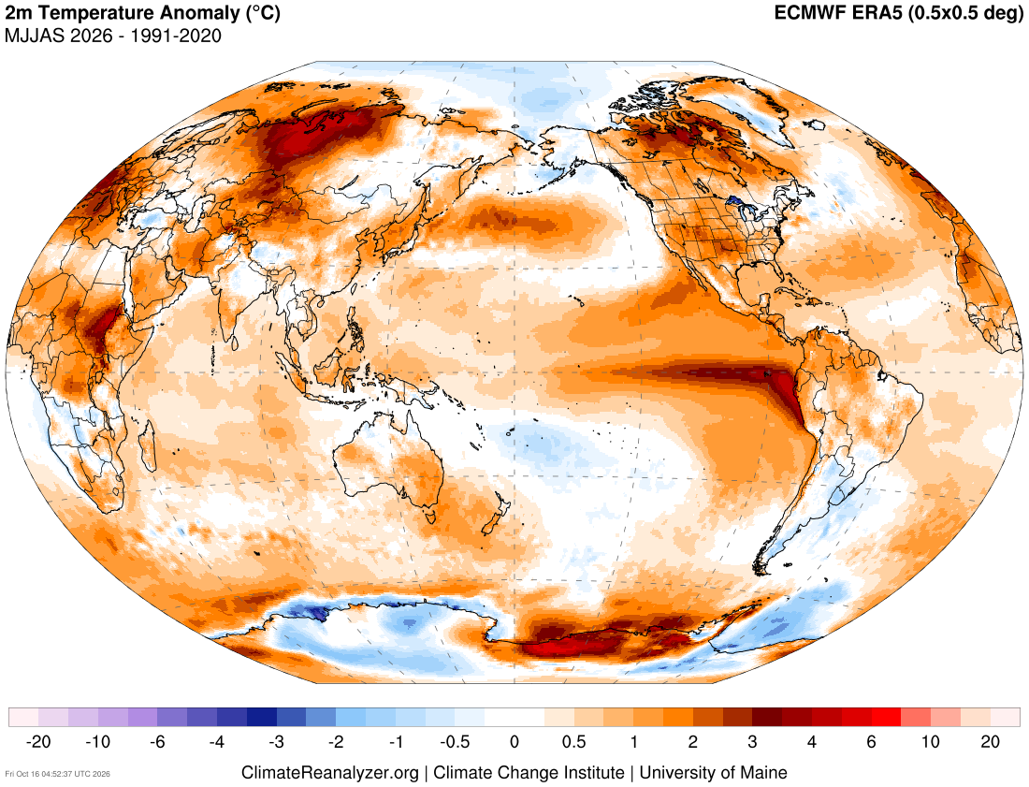
Historical climate context
2m Temperature Anomaly:
May-Sept 1982
May-Sept 1997
May-Sept 2026
The 2026 El Niño has developed in a substantially warmer world compared with the major El Niño events of 1982–83 and 1997–98.

Slide 12
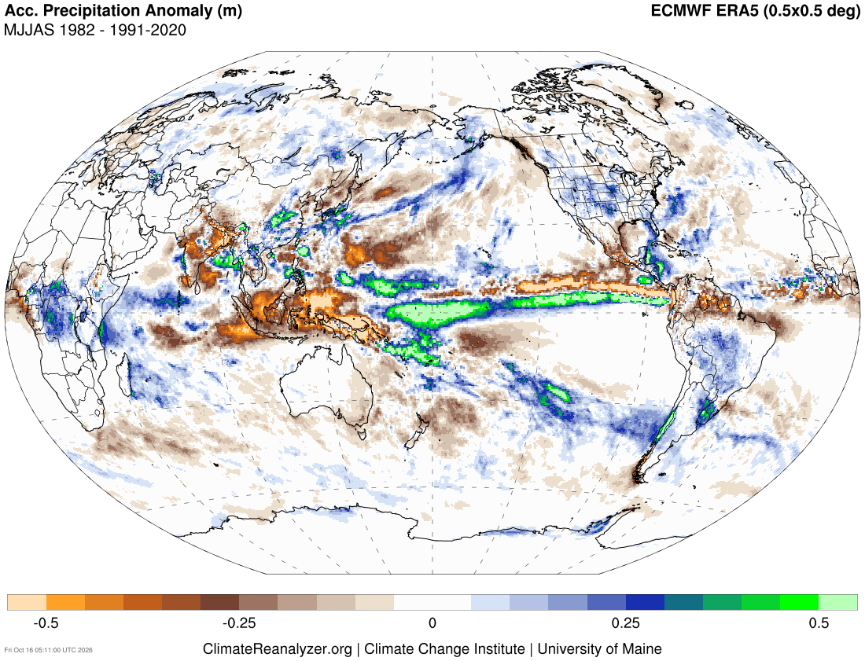
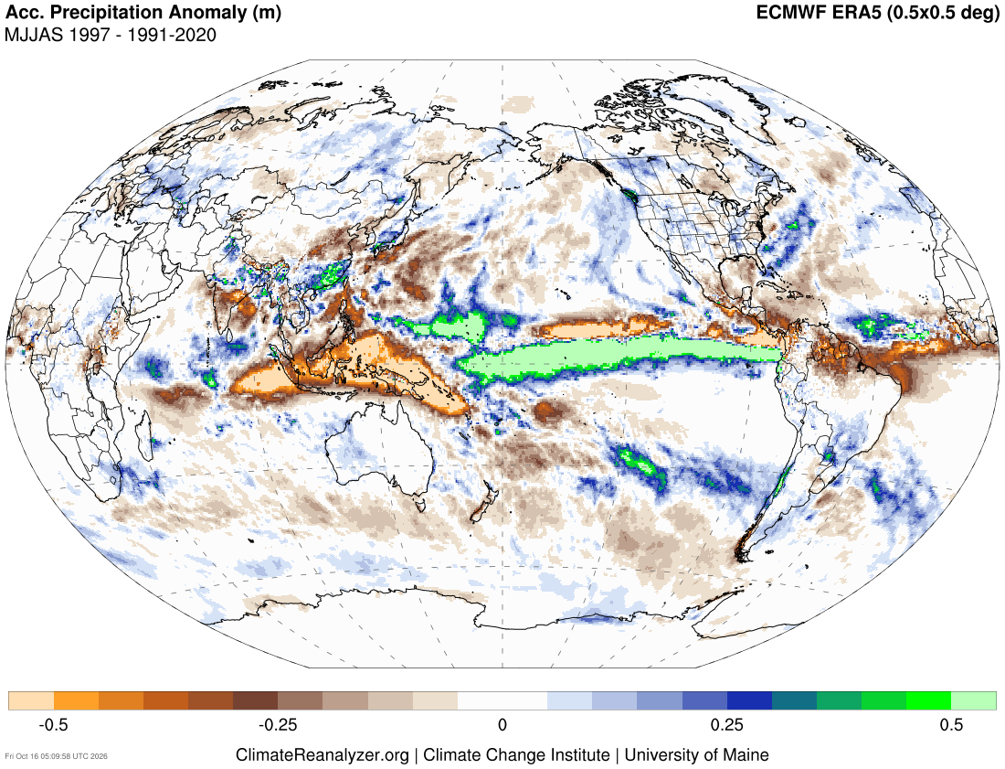
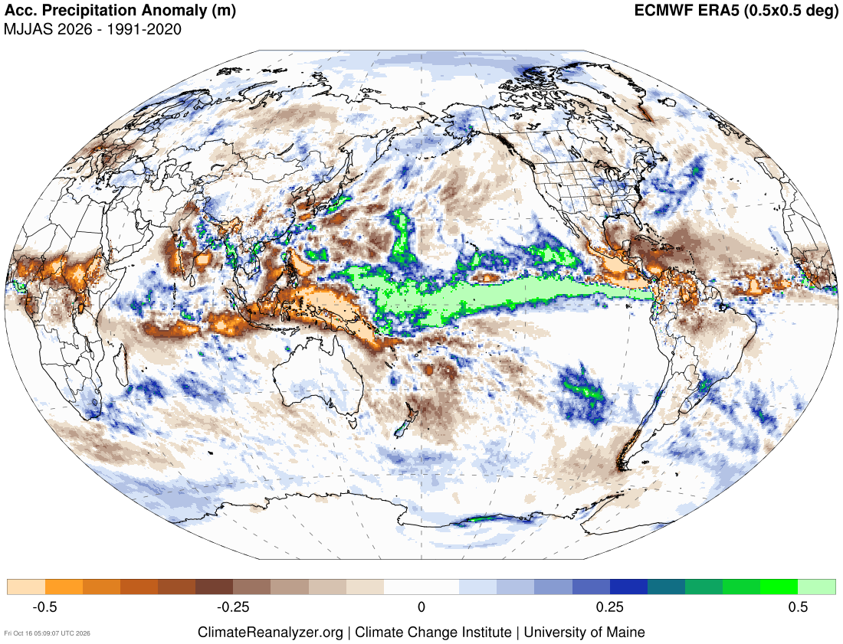
Historical climate context
Accumulated Precipitation Anomaly:
May-Sept 1982
May-Sept 1997
May-Sept 2026
In areas where El Niño typically brings below-average rainfall, higher temperatures may increase evaporation, potentially exacerbating drought conditions.

Slide 13
Looking forward

Slide 14
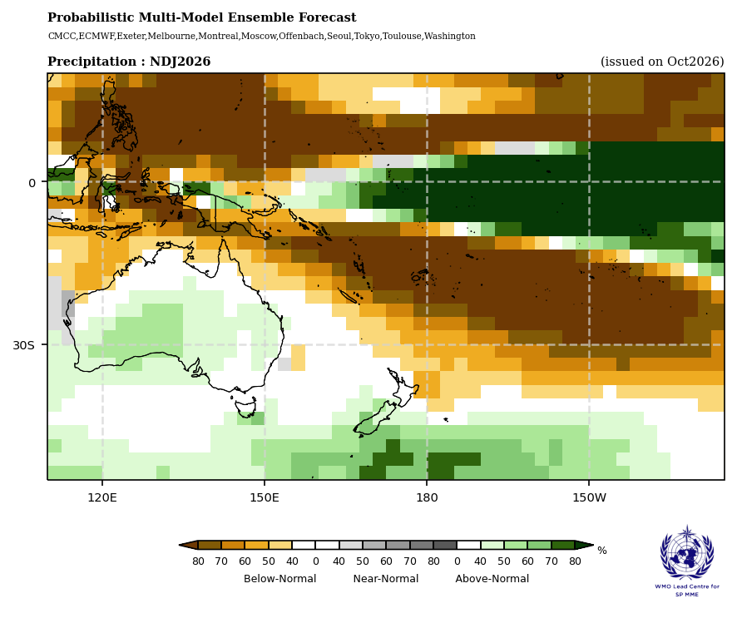
Rainfall outlook: November 2026–January 2027
Rainfall outlook, November 2026–January 2027:
Seasonal forecasts for November 2026–January 2027 and February–April 2027 indicate strong El Niño-like rainfall patterns, characterized by enhanced rainfall across the central and eastern equatorial Pacific and suppressed rainfall over much of the western and southwestern Pacific.

Slide 15
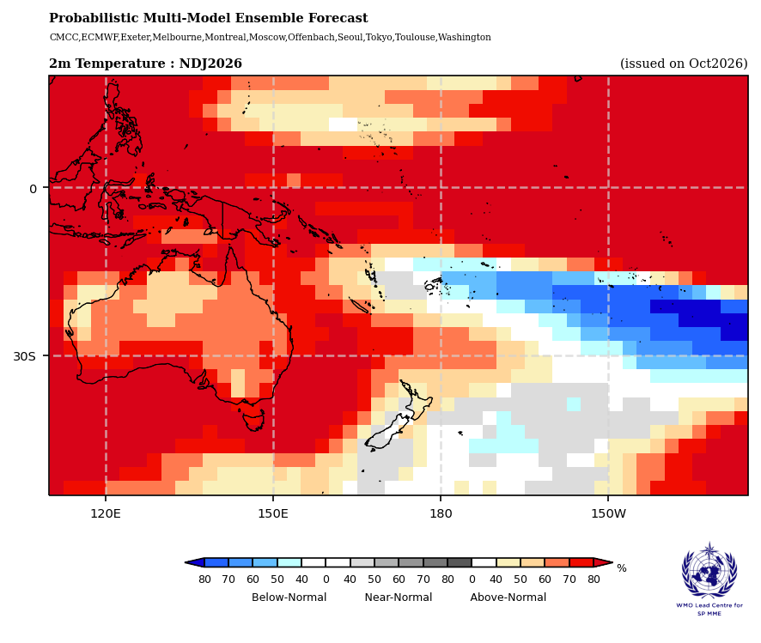
Air temperature outlook: November 2026–January 2027
Air temperature outlook, Nov 2026–Jan 2027:
Above-normal air temperatures are favoured across most of the western and central tropical Pacific and from PNG southeast to New Caledonia over November 2026–January 2027. Below-normal air temperatures are favoured between Fiji and southern French Polynesia.
Regional differences remain, particularly over the central and southeastern Pacific.

Slide 16
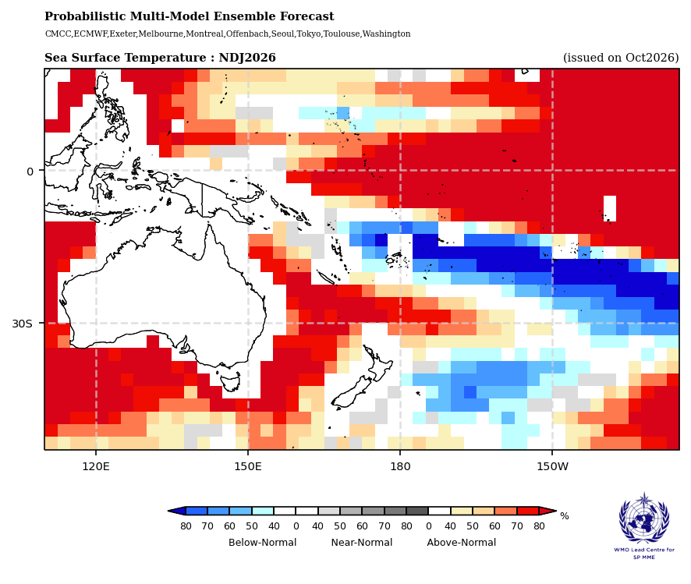
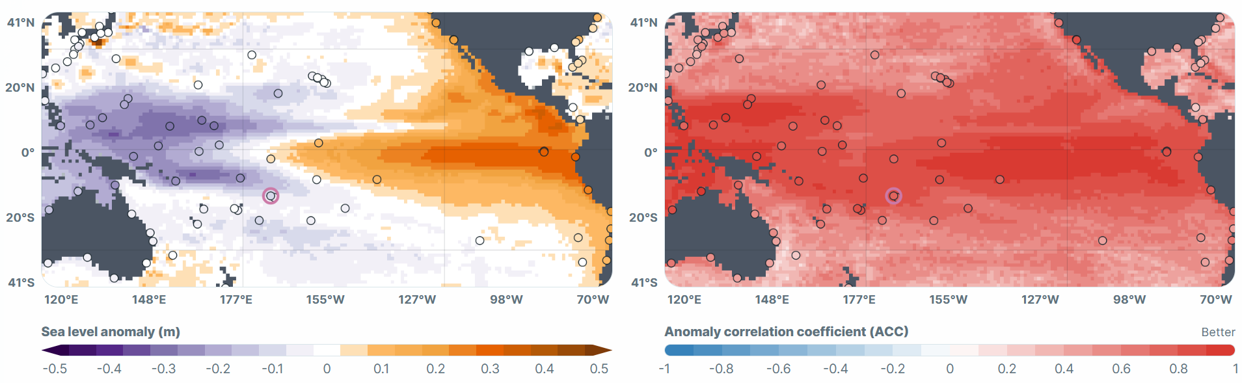
Ocean surface temperature and sea level outlook
SST outlook, November 2026–January 2027:
Sea-level outlook, December 2026:
Above-normal sea level in the central/eastern equatorial Pacific.
Below-normal sea level across the western Pacific.
Greatest anomalies around December, weakening toward March.
Low-tide reef exposure likely where sea level is lowest.
Above-normal SSTs along the equatorial Pacific.
Cooler SST band across the southwestern Pacific, retreating southeastward.
Notes:
CHECK this slide points against updated non-country

Slide 17
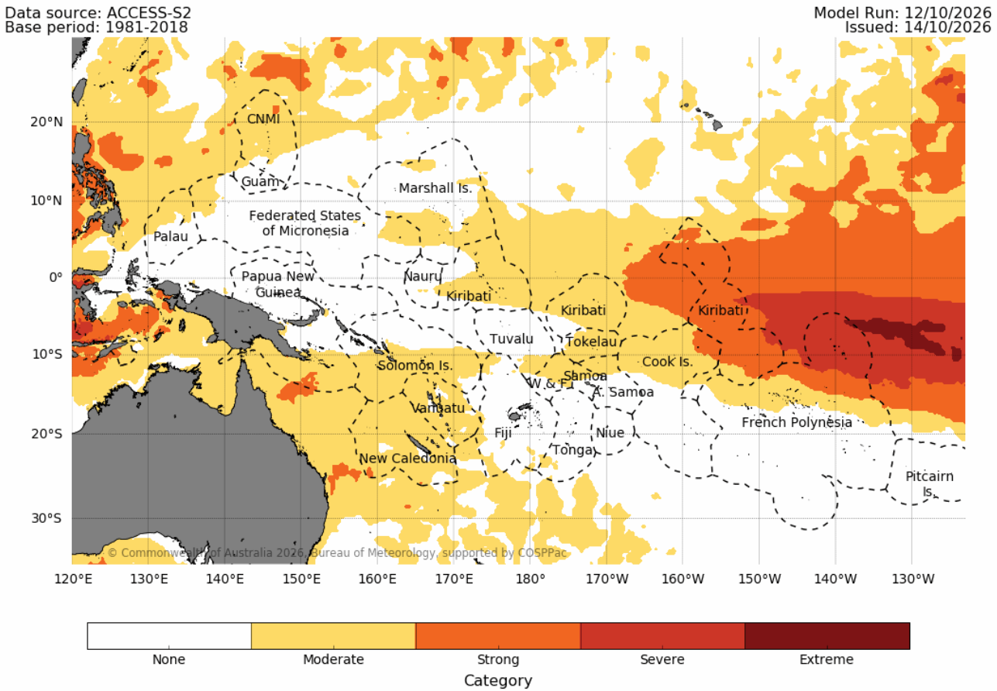
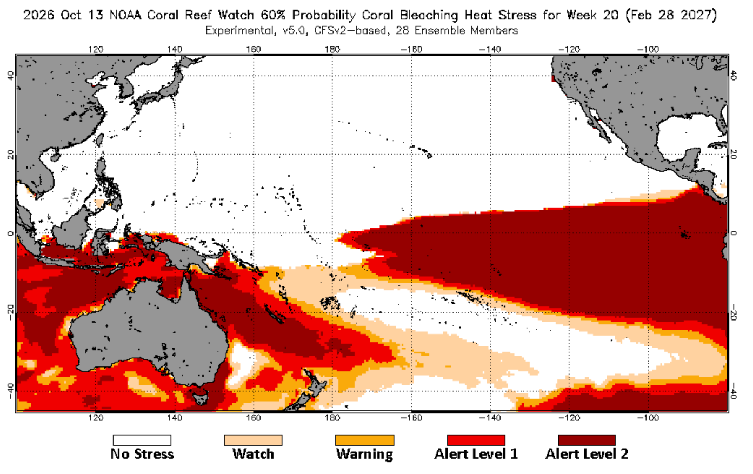
Marine heatwaves and coral bleaching outlook
Marine heatwave outlook, January 2027:
Coral-bleaching heat-stress outlook, 28 February 2027:
Coral-bleaching risk continuing across the central and eastern equatorial Pacific and developing in parts of the southwestern Pacific.
Localised marine heatwaves remain possible where conditions are favourable.
Strong-to-extreme marine heatwaves across parts of the eastern equatorial Pacific.
Moderate marine heatwaves elsewhere in the central and southwestern Pacific.
Notes:
CHECK this slide points against updated non-country

Slide 18
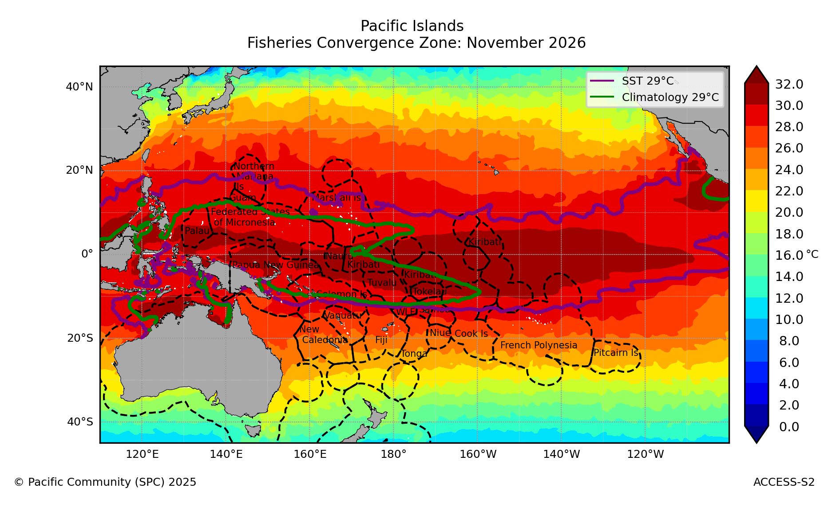
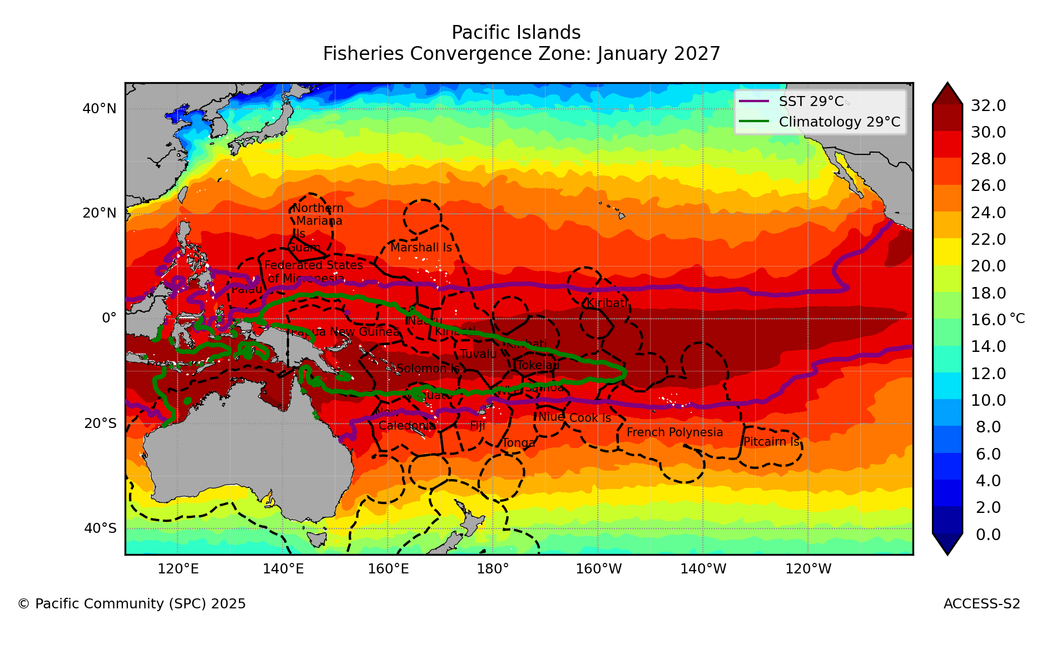
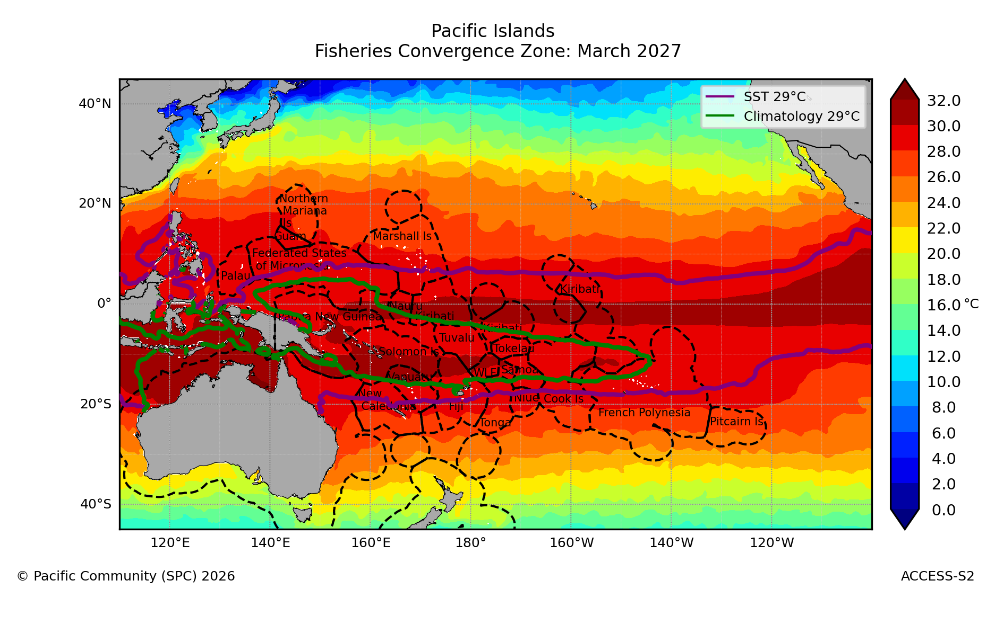
Fisheries convergence zone forecast
NOV 2026
JAN 2027
MAR 2027
The fisheries convergence zone is predicted to shift east to about 100°W, well beyond its climatological position near 160°W, and widen to 10°N–15°S between November 2026 and March 2027; skipjack likely to follow the warm pool edge east along the equator.

Slide 19
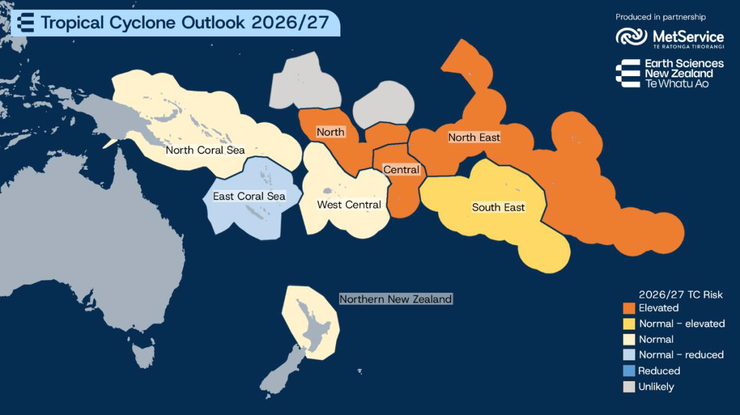
Tropical cyclone Outlook
Southwest Pacific tropical cyclone risk, November 2026–April 2027:
Normal to above-normal tropical cyclone (TC) activity is favoured across the southwest Pacific during the November 2026–April 2027 season.
Elevated TC activity is favoured near and east of the International Date Line, while normal or below-normal activity is expected across western parts of the basin.
Some El Nino events are associated with extended TC seasons with TCs in October, May and June.
TC Wati the first TC in the 2027/27 season occurred in mid-October.

Slide 20
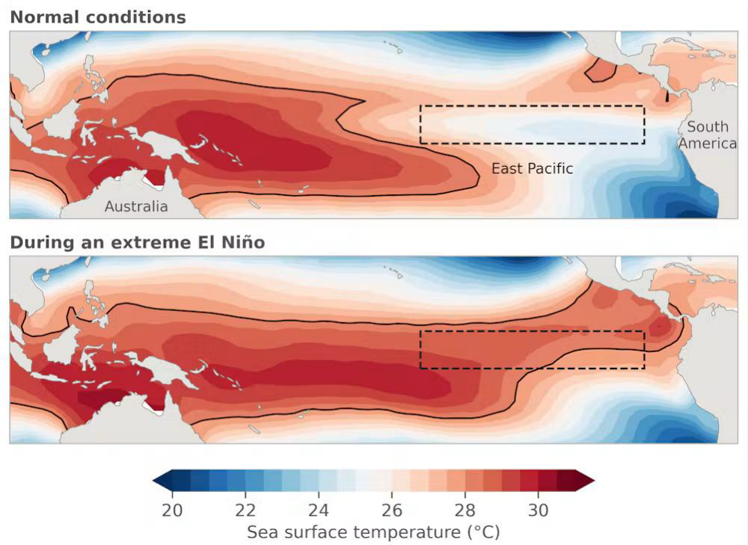
Projected climate context
Pacific SST patterns under normal conditions and during an extreme El Niño:
Global air temperatures are at record levels, and continue to trend upwards.
Greater emissions reductions now will have long-term benefits for many centuries to come.
Climate projections indicate an elevated frequency of extreme El Niño events across studies.
However, despite the profound influence of ENSO events on the global climate system, its response to greenhouse warming remains uncertain.

Slide 21





Contact
My Email
hannah.marley@earthsciences.nz

