Slide 1
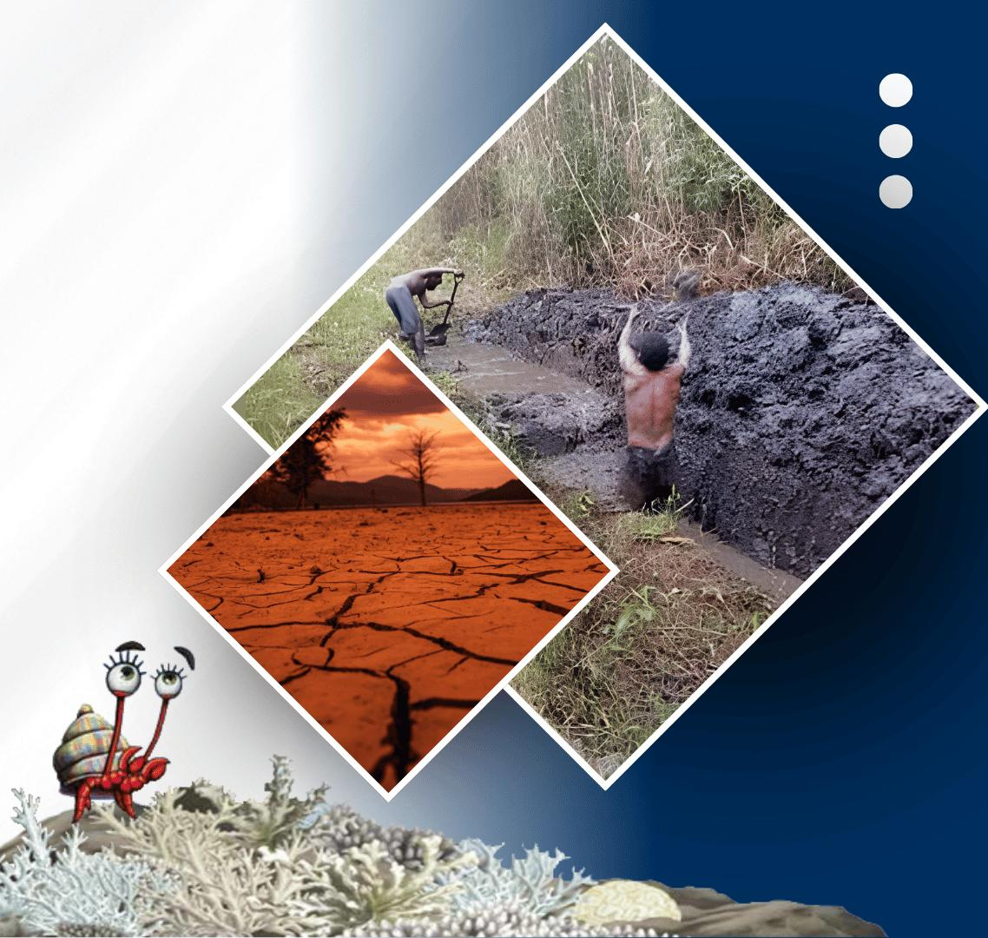




PACIFIC ISLANDS climate outlook forum-19
20 - 21 OCTOBER, 2026
HYBRID
PORT MORESBY, PAPUA NEW GUINEA
& ZOOM
www.pacificrcc.net

Slide 2
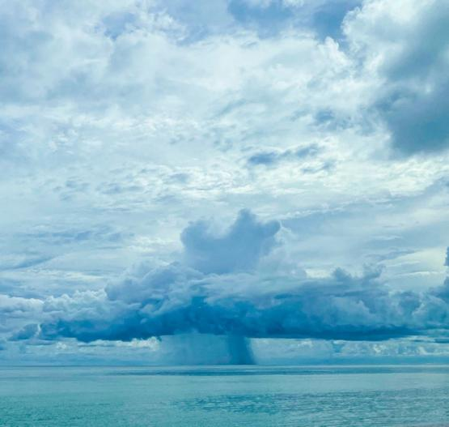
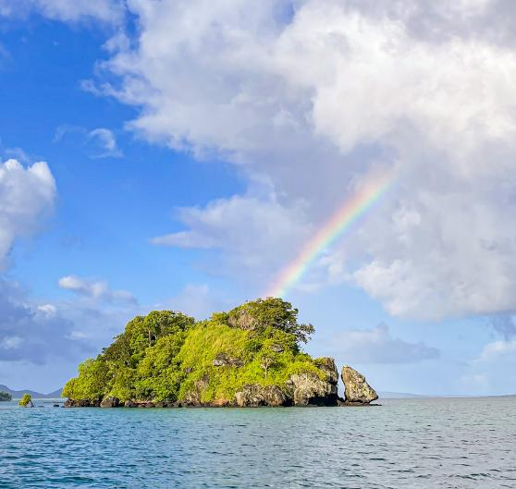




PICOF-19
Polynesia Subregion Impacts
SPREP

Slide 3
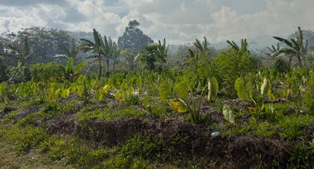
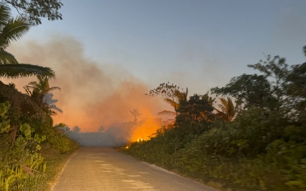
POLYNESIA SUBREGION
Overview of Extreme Events and Their Impacts
Environment and society over the last six months
Tonga · Tuvalu · Samoa · Cook Islands
May–October 2026
OCTOBER 2026

Slide 4
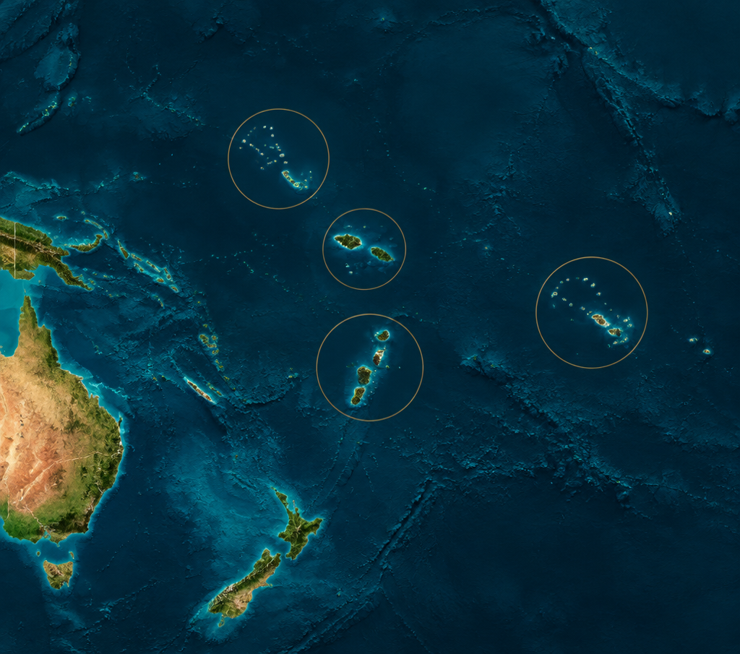
A region shaped by water
Drought · flooding · storms
Coral bleaching · temperature extremes
Transport disruption · bushfire risk
El Niño is a consistent background pattern — not evidence of direct causation for individual events.
ATTRIBUTION REQUIRES CAUTION

Slide 5
Compound-risk for Polynesia
RAPID-ONSET
Tornado · flooding · strong winds
SLOW-ONSET
Drought · water shortage · dry conditions
ECOSYSTEM
Coral bleaching · agricultural stress · bushfire risk
SERVICES
Aviation · transport · tourism interruption

Slide 6
May — pressure builds
MAY
JUN
JUL
AUG
SEP
TONGA
TUVALU
Tornado in Haʻafeva caused minor damage and no deaths. Drought and water shortages were already affecting vegetation, crops and households.
A dry spell on Niulakita required water rationing, emergency response and desalination support.
Rapid onset
Slow onset

Slide 7
June — monitor, verify, prepare
MAY
JUN
JUL
AUG
SEP
MONITORING / CONTEXT PERIOD
No specific major event was documented across the four countries. Tuvalu reporting contains ambiguity in ENSO status for May–June.

Slide 8
July — compound hazards emerge
MAY
JUN
JUL
AUG
SEP
TONGA
TUVALU
SAMOA
COOK ISLANDS
ʻEua: 8.6°C national record low. Vavaʻu: coral bleaching. Vavaʻu and Haʻapai: drought impacts.
Heavy rainfall in Funafuti disrupted aviation operations.
Flooding, landslides and strong winds; precise dates not reported.
Coastal inundation and erosion linked to a July 2025 system — year requires verification.

Slide 9
August — wind, water and fire risk
MAY
JUN
JUL
AUG
SEP
TUVALU
COOK ISLANDS
SAMOA
Strong winds and 2–3 m swells brought flooding and transport disruption in southern areas.
A prolonged August–September dry spell intensified water shortages, drought and bushfire risk.
Severe weather warnings continued for heavy rain, flooding and strong winds.

Slide 10
September — latest documented impacts
MAY
JUN
JUL
AUG
SEP
TUVALU
COOK ISLANDS
Strong winds, large swells, flooding and transport disruption continued.
Dry conditions persisted in the southern islands; the reporting year remains inconsistent.
TIMELINE ENDS HERE

Slide 11
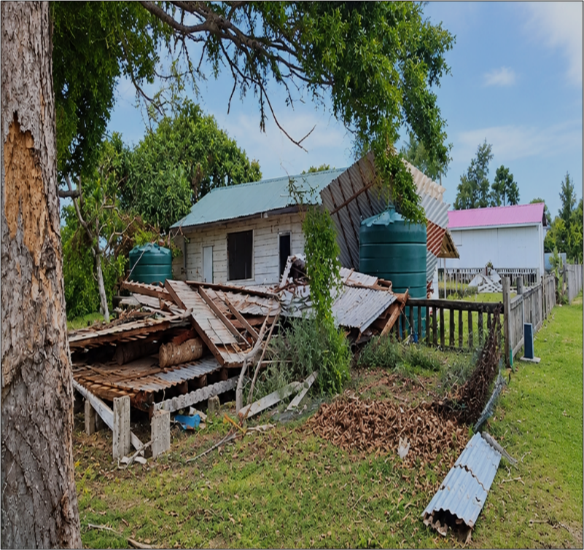
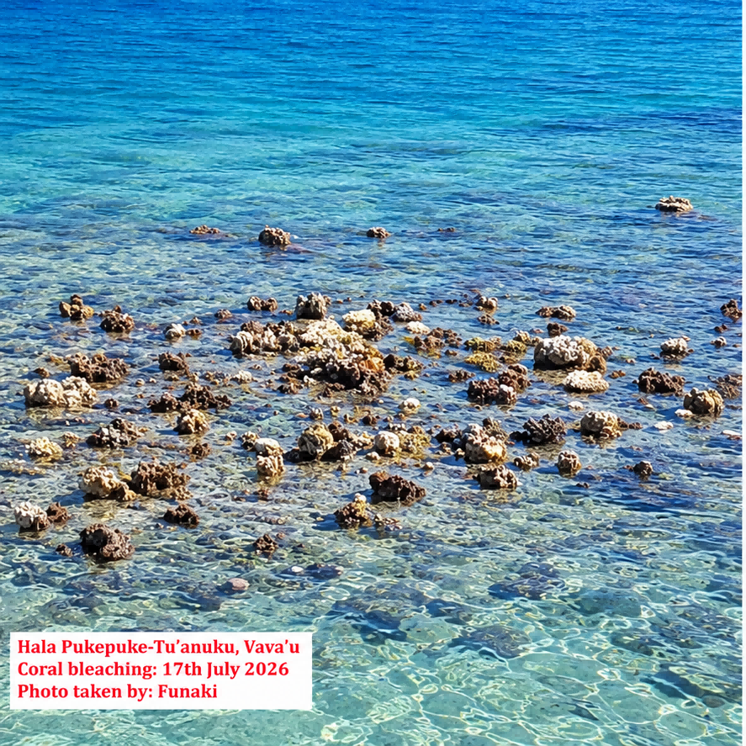
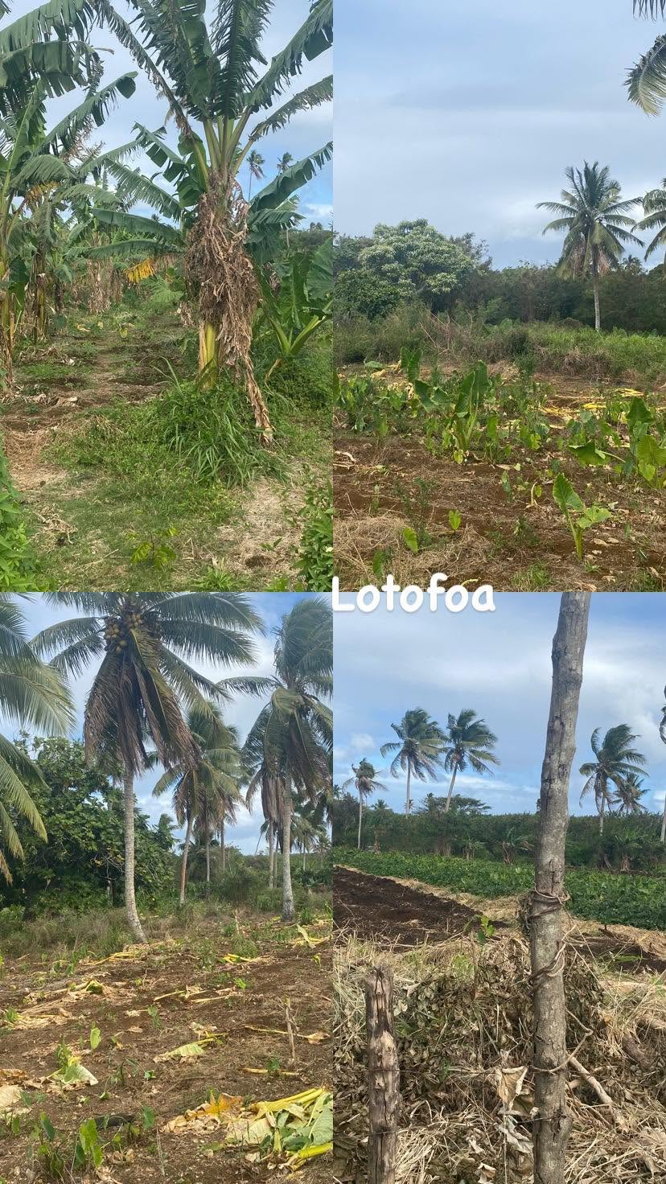
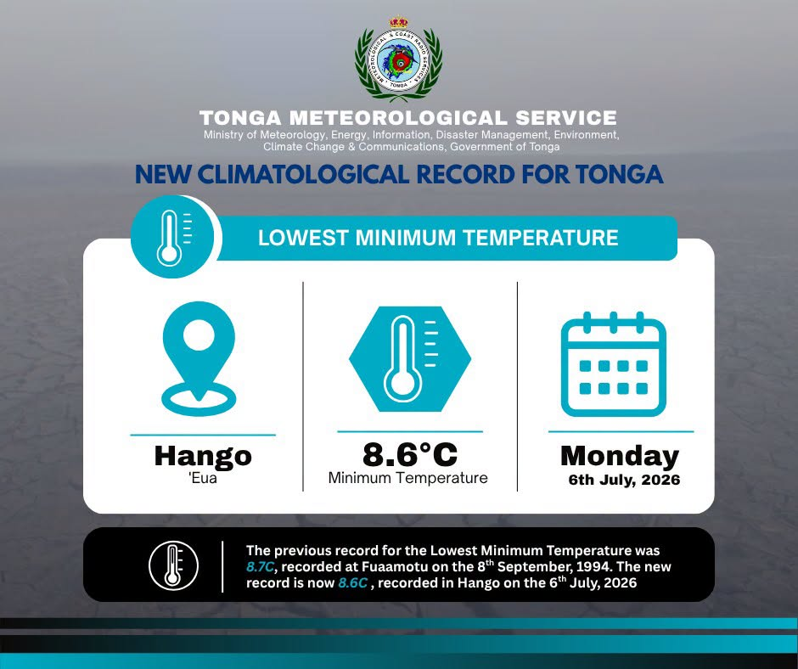
Tonga
Environmental stress spanned atmosphere, land and reef.
01
02
03
04
May · Haʻafeva tornado; minor damage, zero deaths.
July · ʻEua reached a national record low of 8.6°C.
July · Coral bleaching in Vavaʻu threatened ecosystems and tourism.
May–October · Drought stressed vegetation and crops.
SECTORS AGRICULTURE · FISHERIES · TOURISM · HOUSEHOLDS · INFRASTRUCTURE

Slide 12
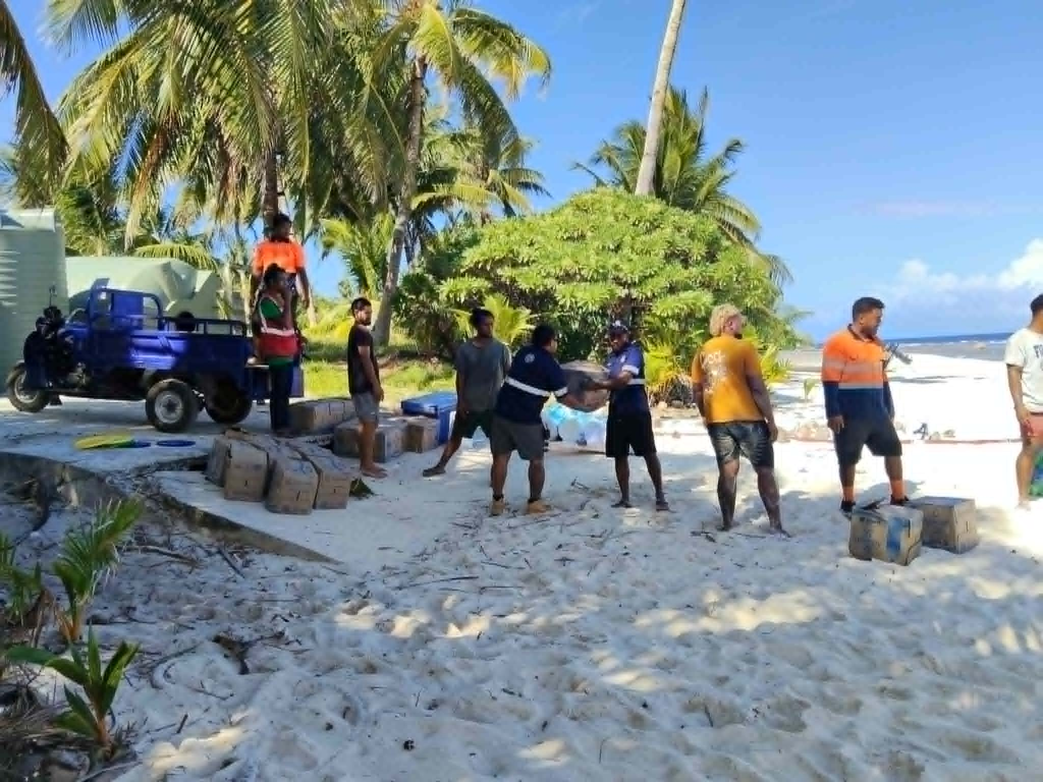
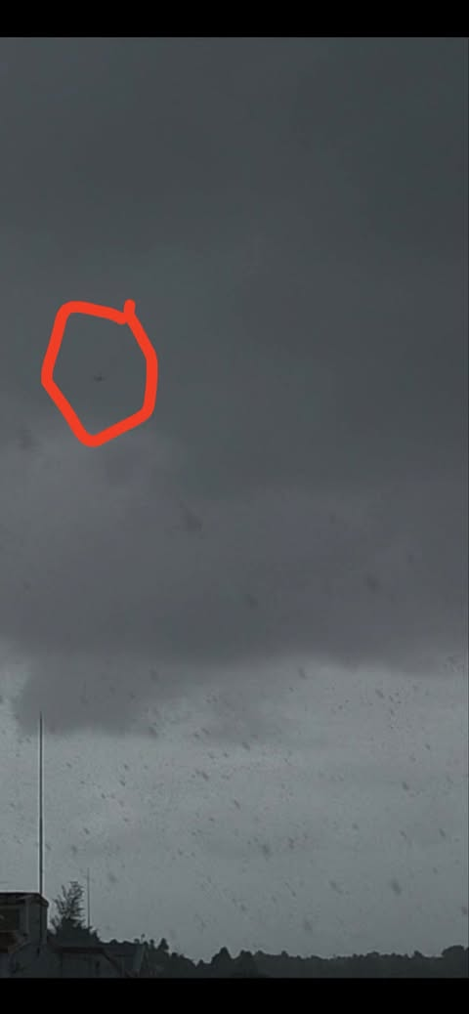
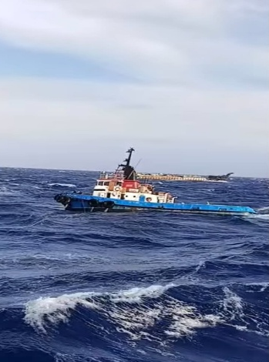
Tuvalu
Water security and mobility were repeatedly disrupted.
01
02
03
04
May · Niulakita water shortage triggered rationing and desalination.
July · Heavy rainfall disrupted aviation in Funafuti.
September · Strong winds and 2–3 m swells drove flooding.
Caveat · ENSO status is inconsistent across reporting.
SECTORS WATER SECURITY · TRANSPORT · HOUSEHOLDS · MARINE SERVICES

Slide 13
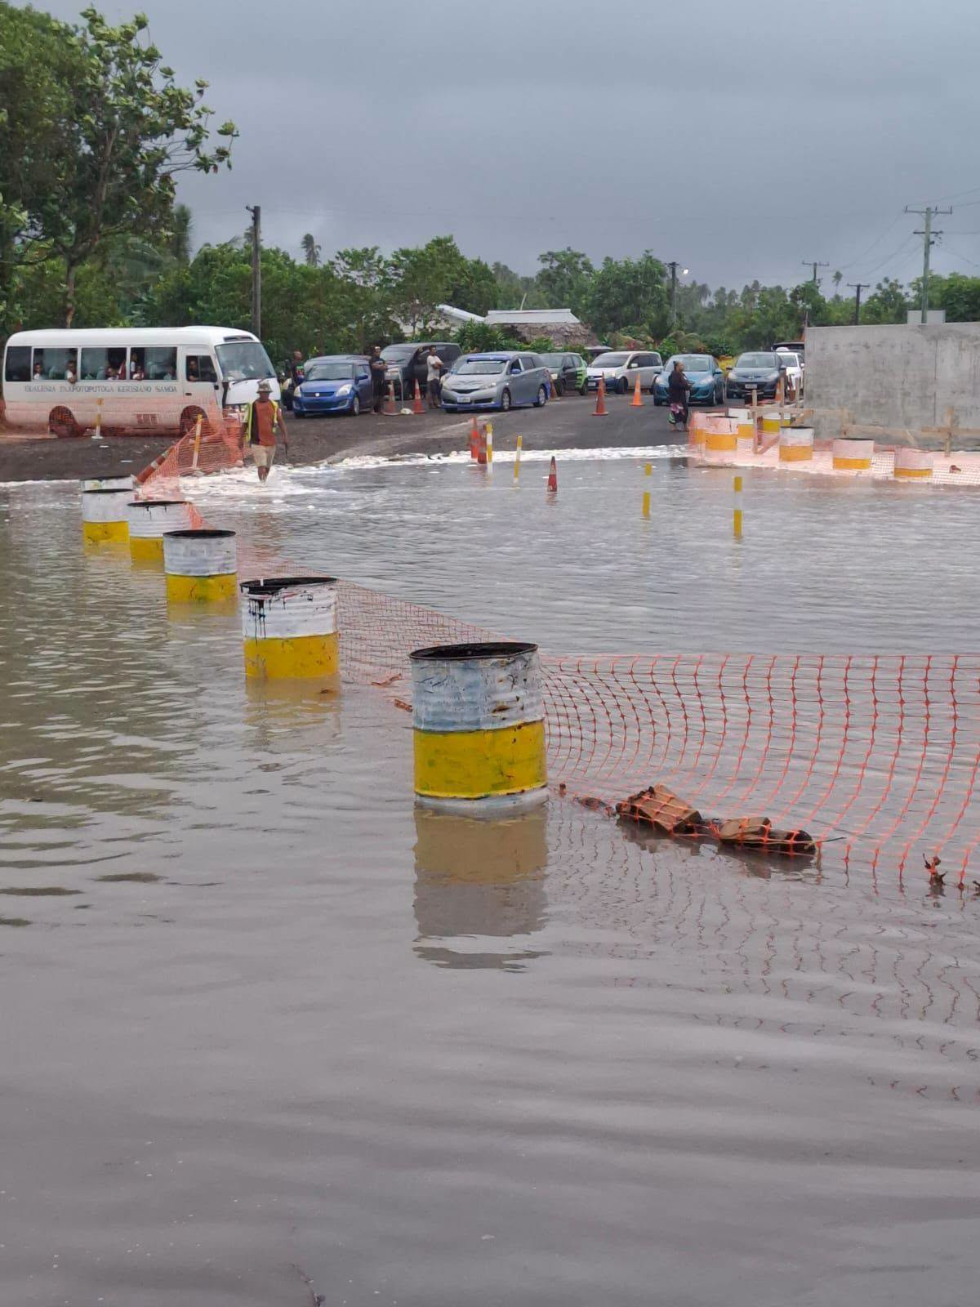
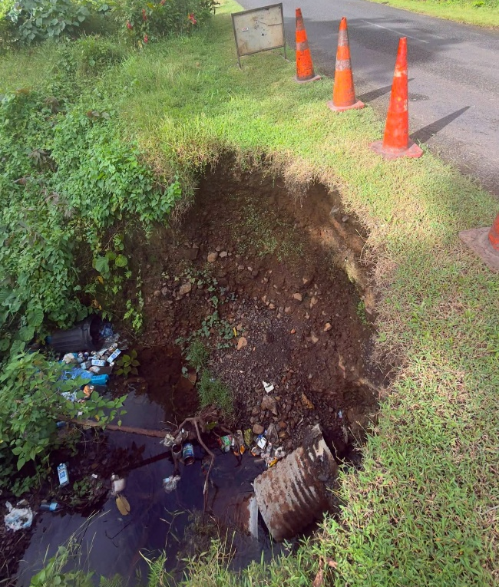
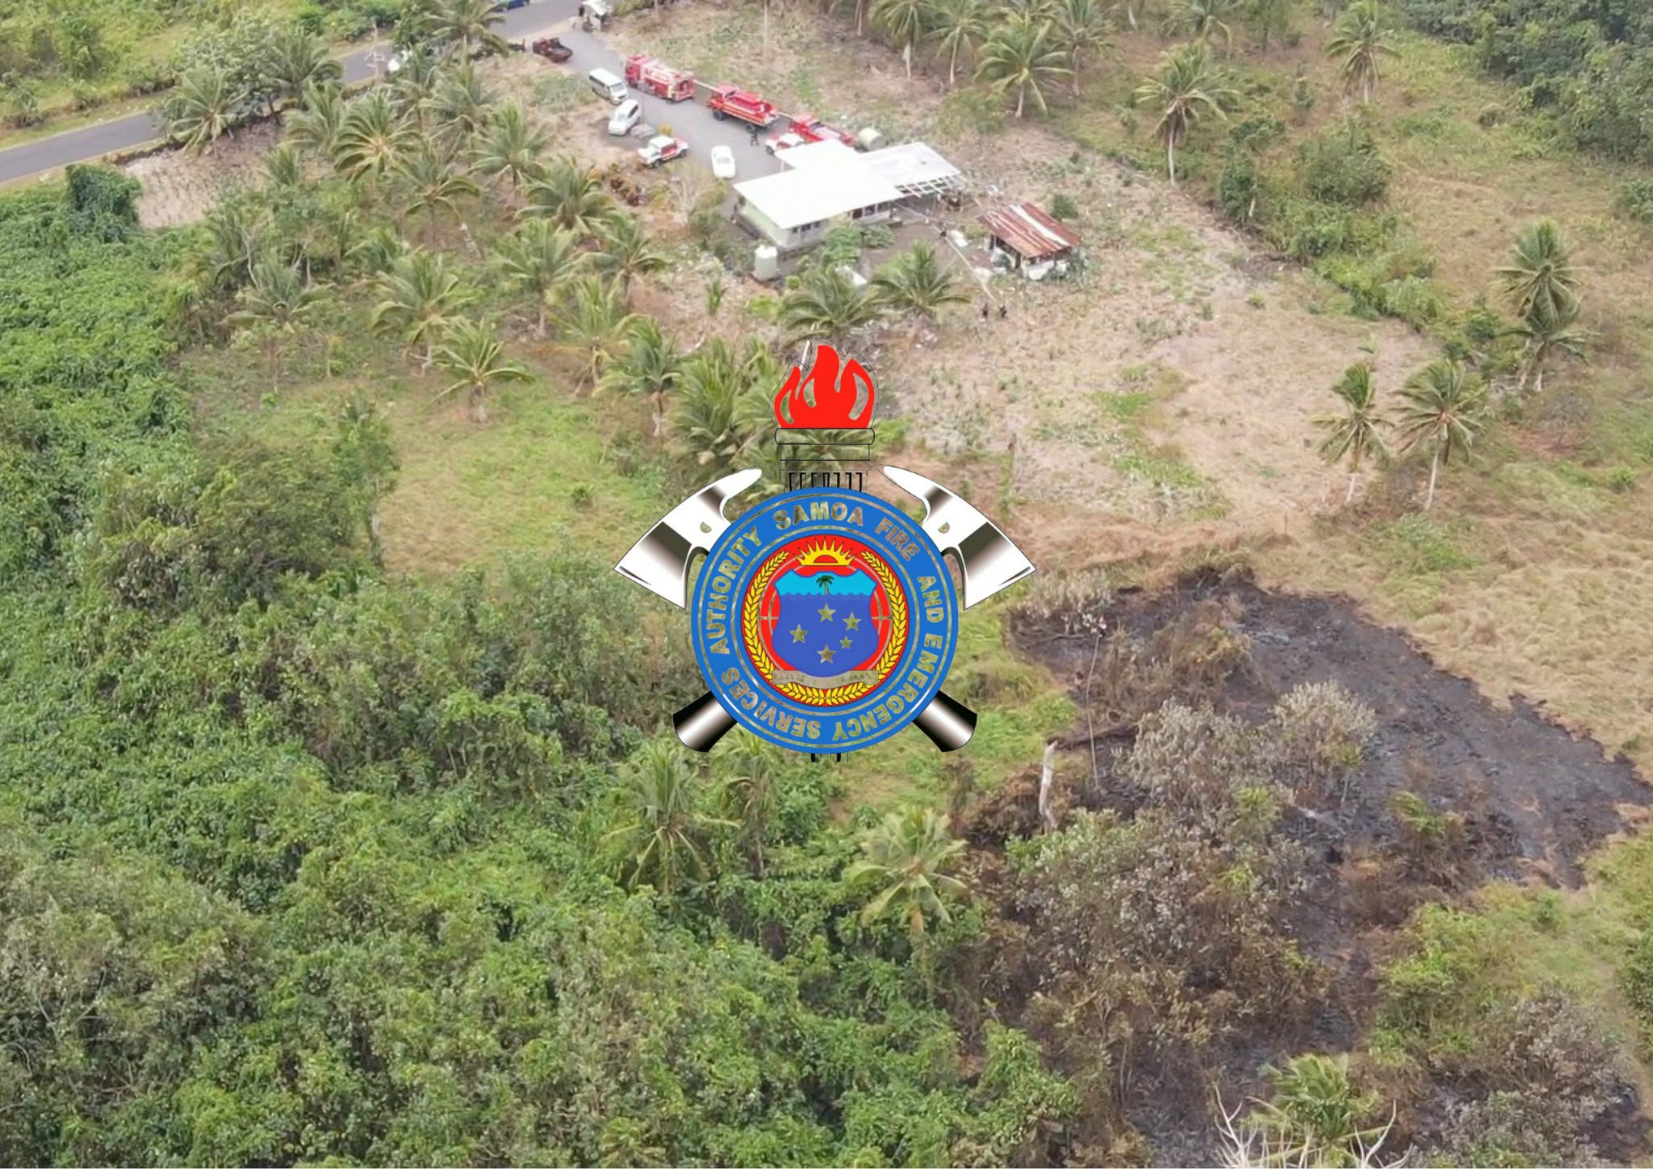
Samoa
Severe weather cascaded from slopes to roads and coast.
01
02
03
04
Heavy rainfall and flooding affected communities.
Landslides and strong winds increased infrastructure risk.
Rough seas and bushfire risk widened the hazard mix.
Warnings and agency response supported early action.
SECTORS TRANSPORT · AGRICULTURE · INFRASTRUCTURE · COMMUNITIES

Slide 14
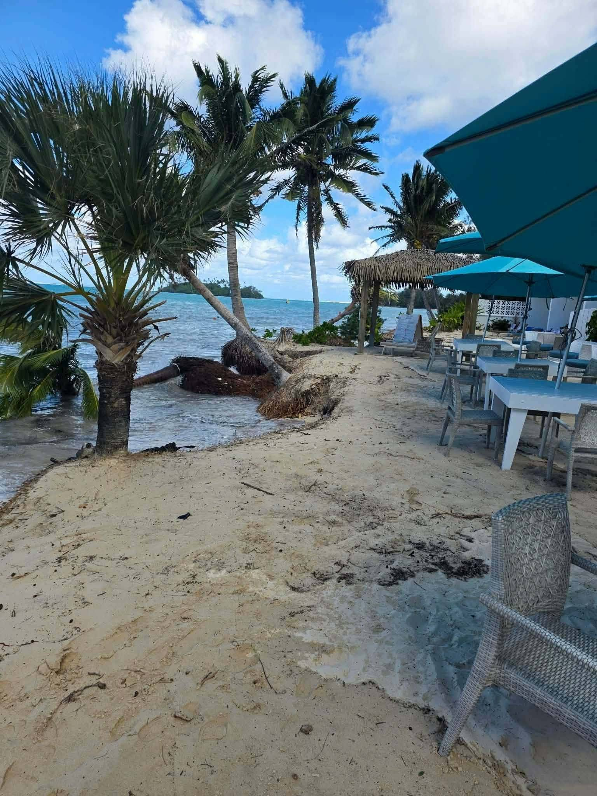
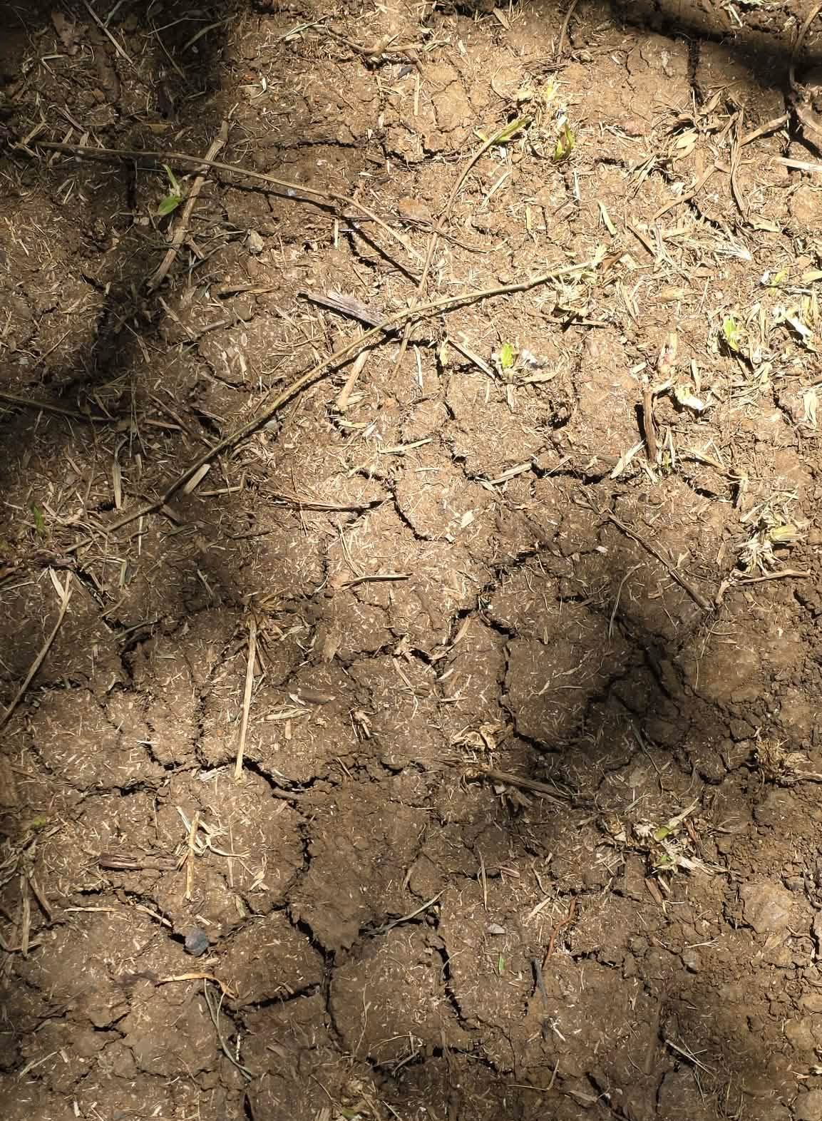
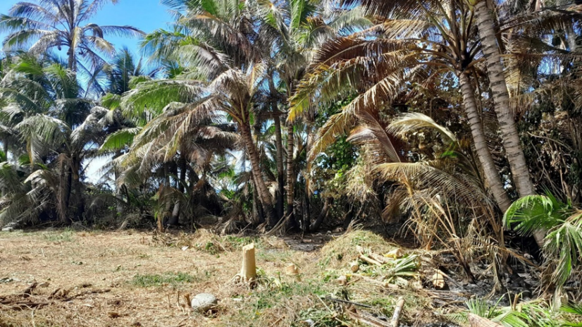
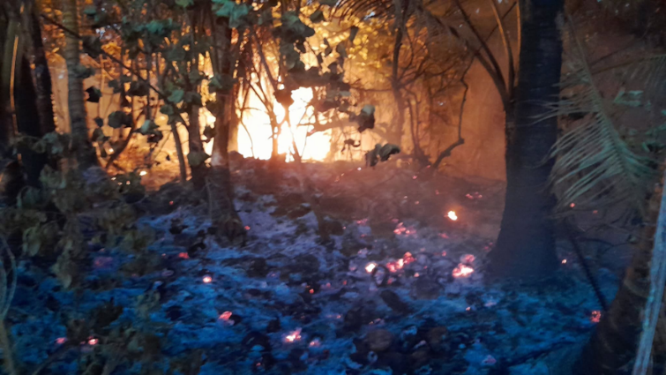
Cook Islands
Coastal exposure met a prolonged dry spell.
01
02
03
04
July 2025 · Coastal inundation and erosion disrupted tourism — year flagged.
August–September · Dry conditions increased water shortages.
Agricultural stress grew across southern islands.
Bushfire risk rose as dry conditions persisted.
SECTORS TOURISM · HOUSEHOLDS · AGRICULTURE · INFRASTRUCTURE · WATER

Slide 15
Four island groups. Distinct impact signatures.
Overview
TUVALU
SAMOA
Water shortage · rain · swells · transport disruption
Floods · landslides · winds · rough seas · fire risk
COOK ISLANDS
TONGA
Erosion · tourism impacts · drought · water stress
Drought · crop stress · bleaching · cold record · tornado

