Slide 1
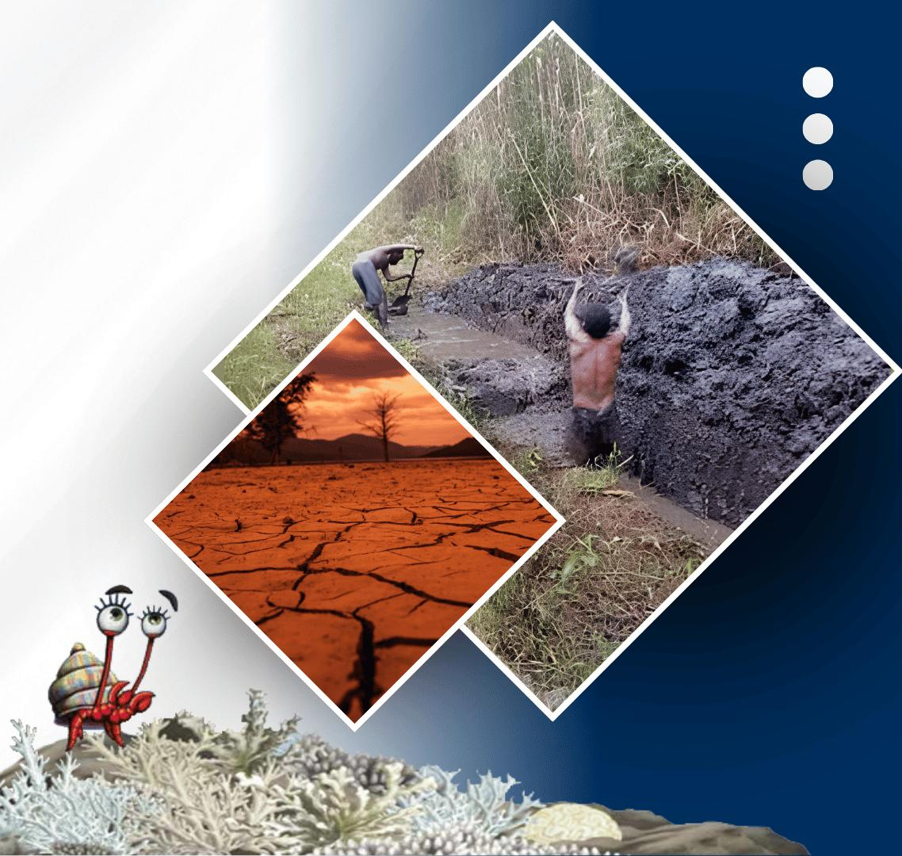






PACIFIC ISLANDS climate outlook forum-19
20 - 21 OCTOBER, 2026
HYBRID
PORT MORESBY, PAPUA NEW GUINEA
& ZOOM
www.pacificrcc.net

Slide 2
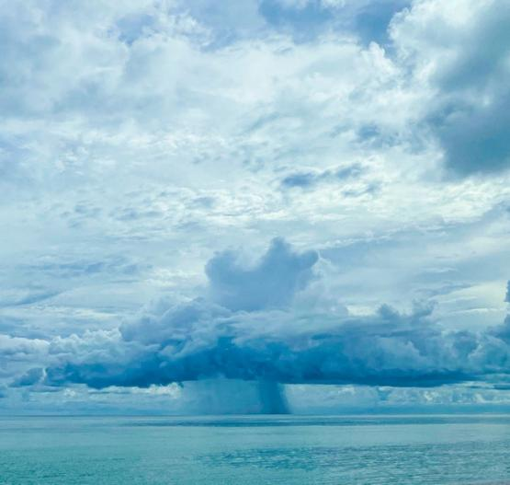
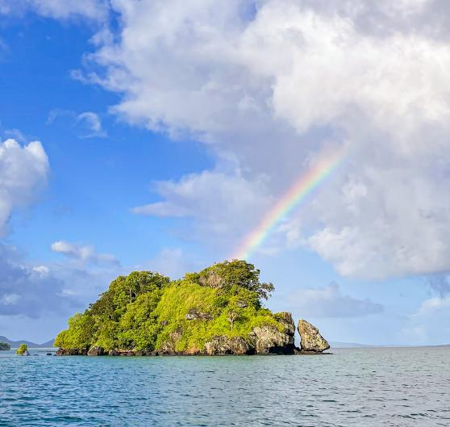













PICOF-19
Session 3: Looking Forward
i. Atmosphere
Suyeon Moon
APEC Climate Center
Thanks to NIWA, BoM, Meteo-France, NOAA, University of Hawaii, SPREP, and SPC

Slide 3
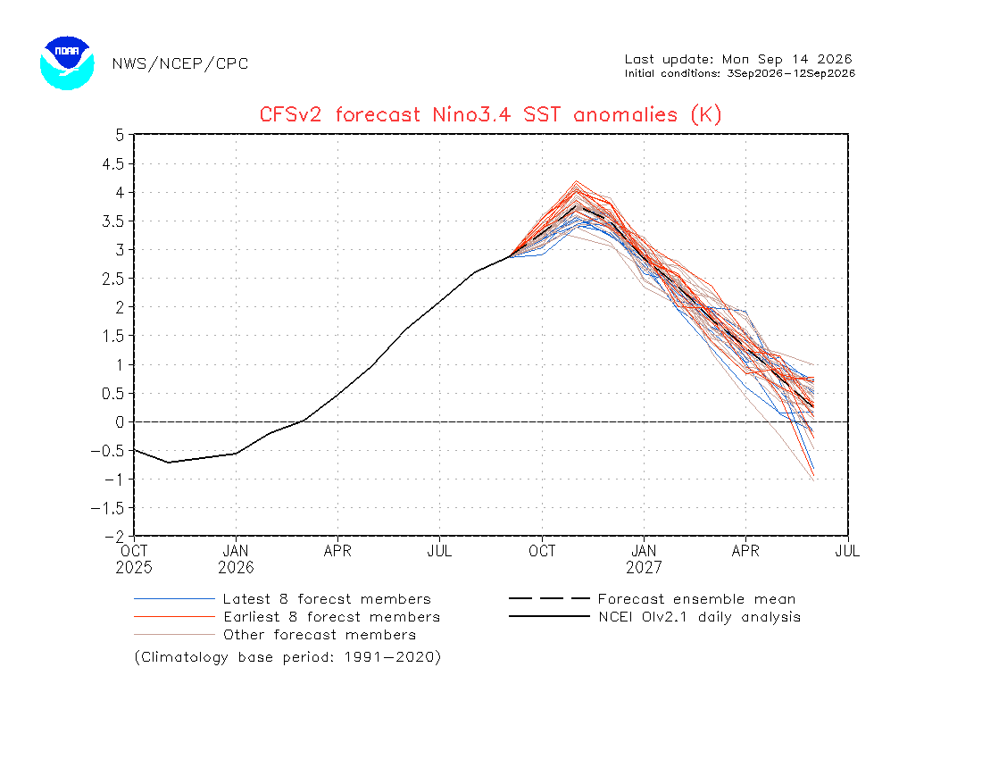
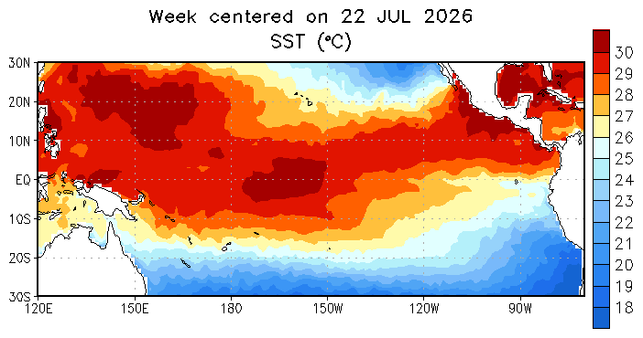
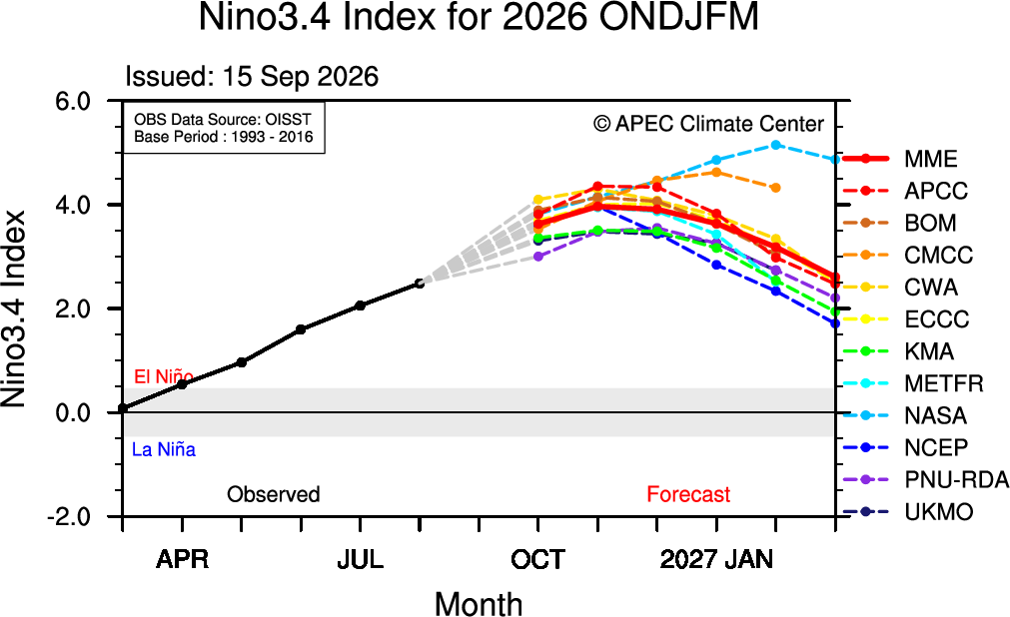
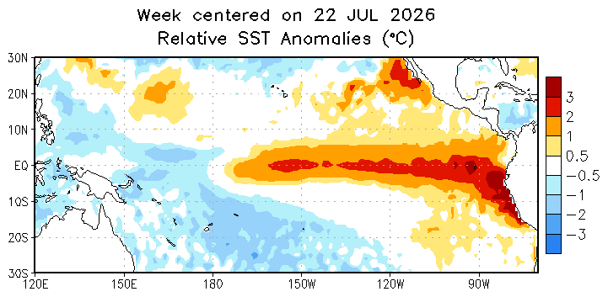
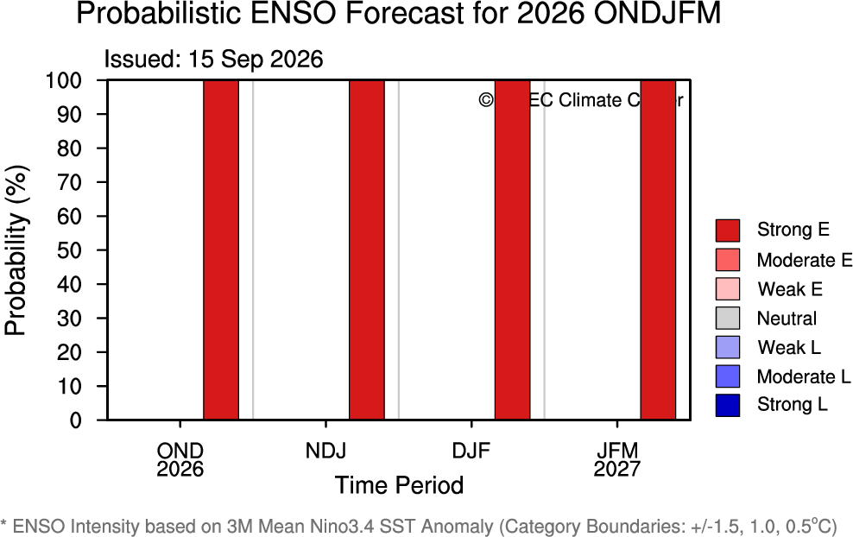
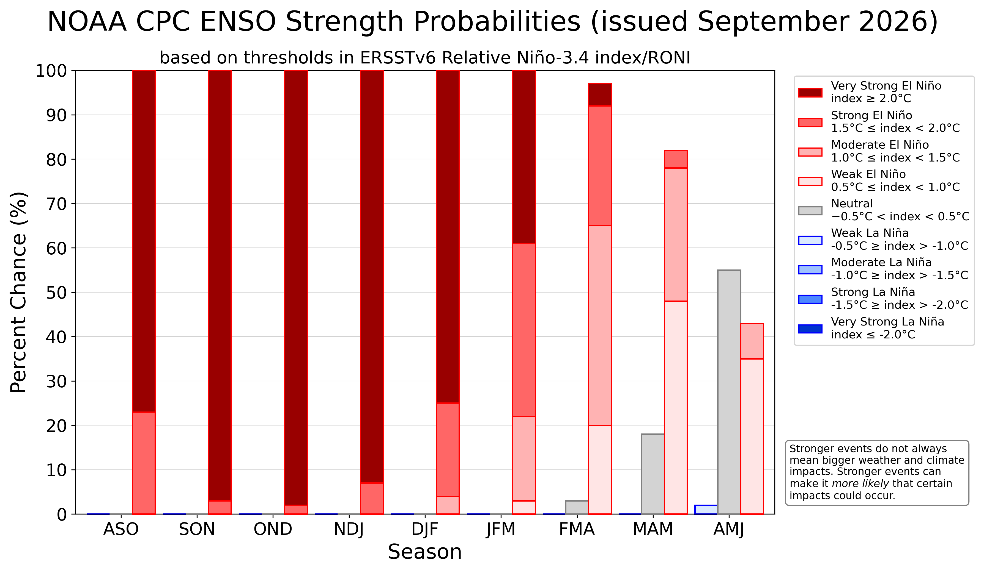
ENSO status
Source: APCC & NOAA
  Current ENSO state
  ENSO Outlook

Slide 4
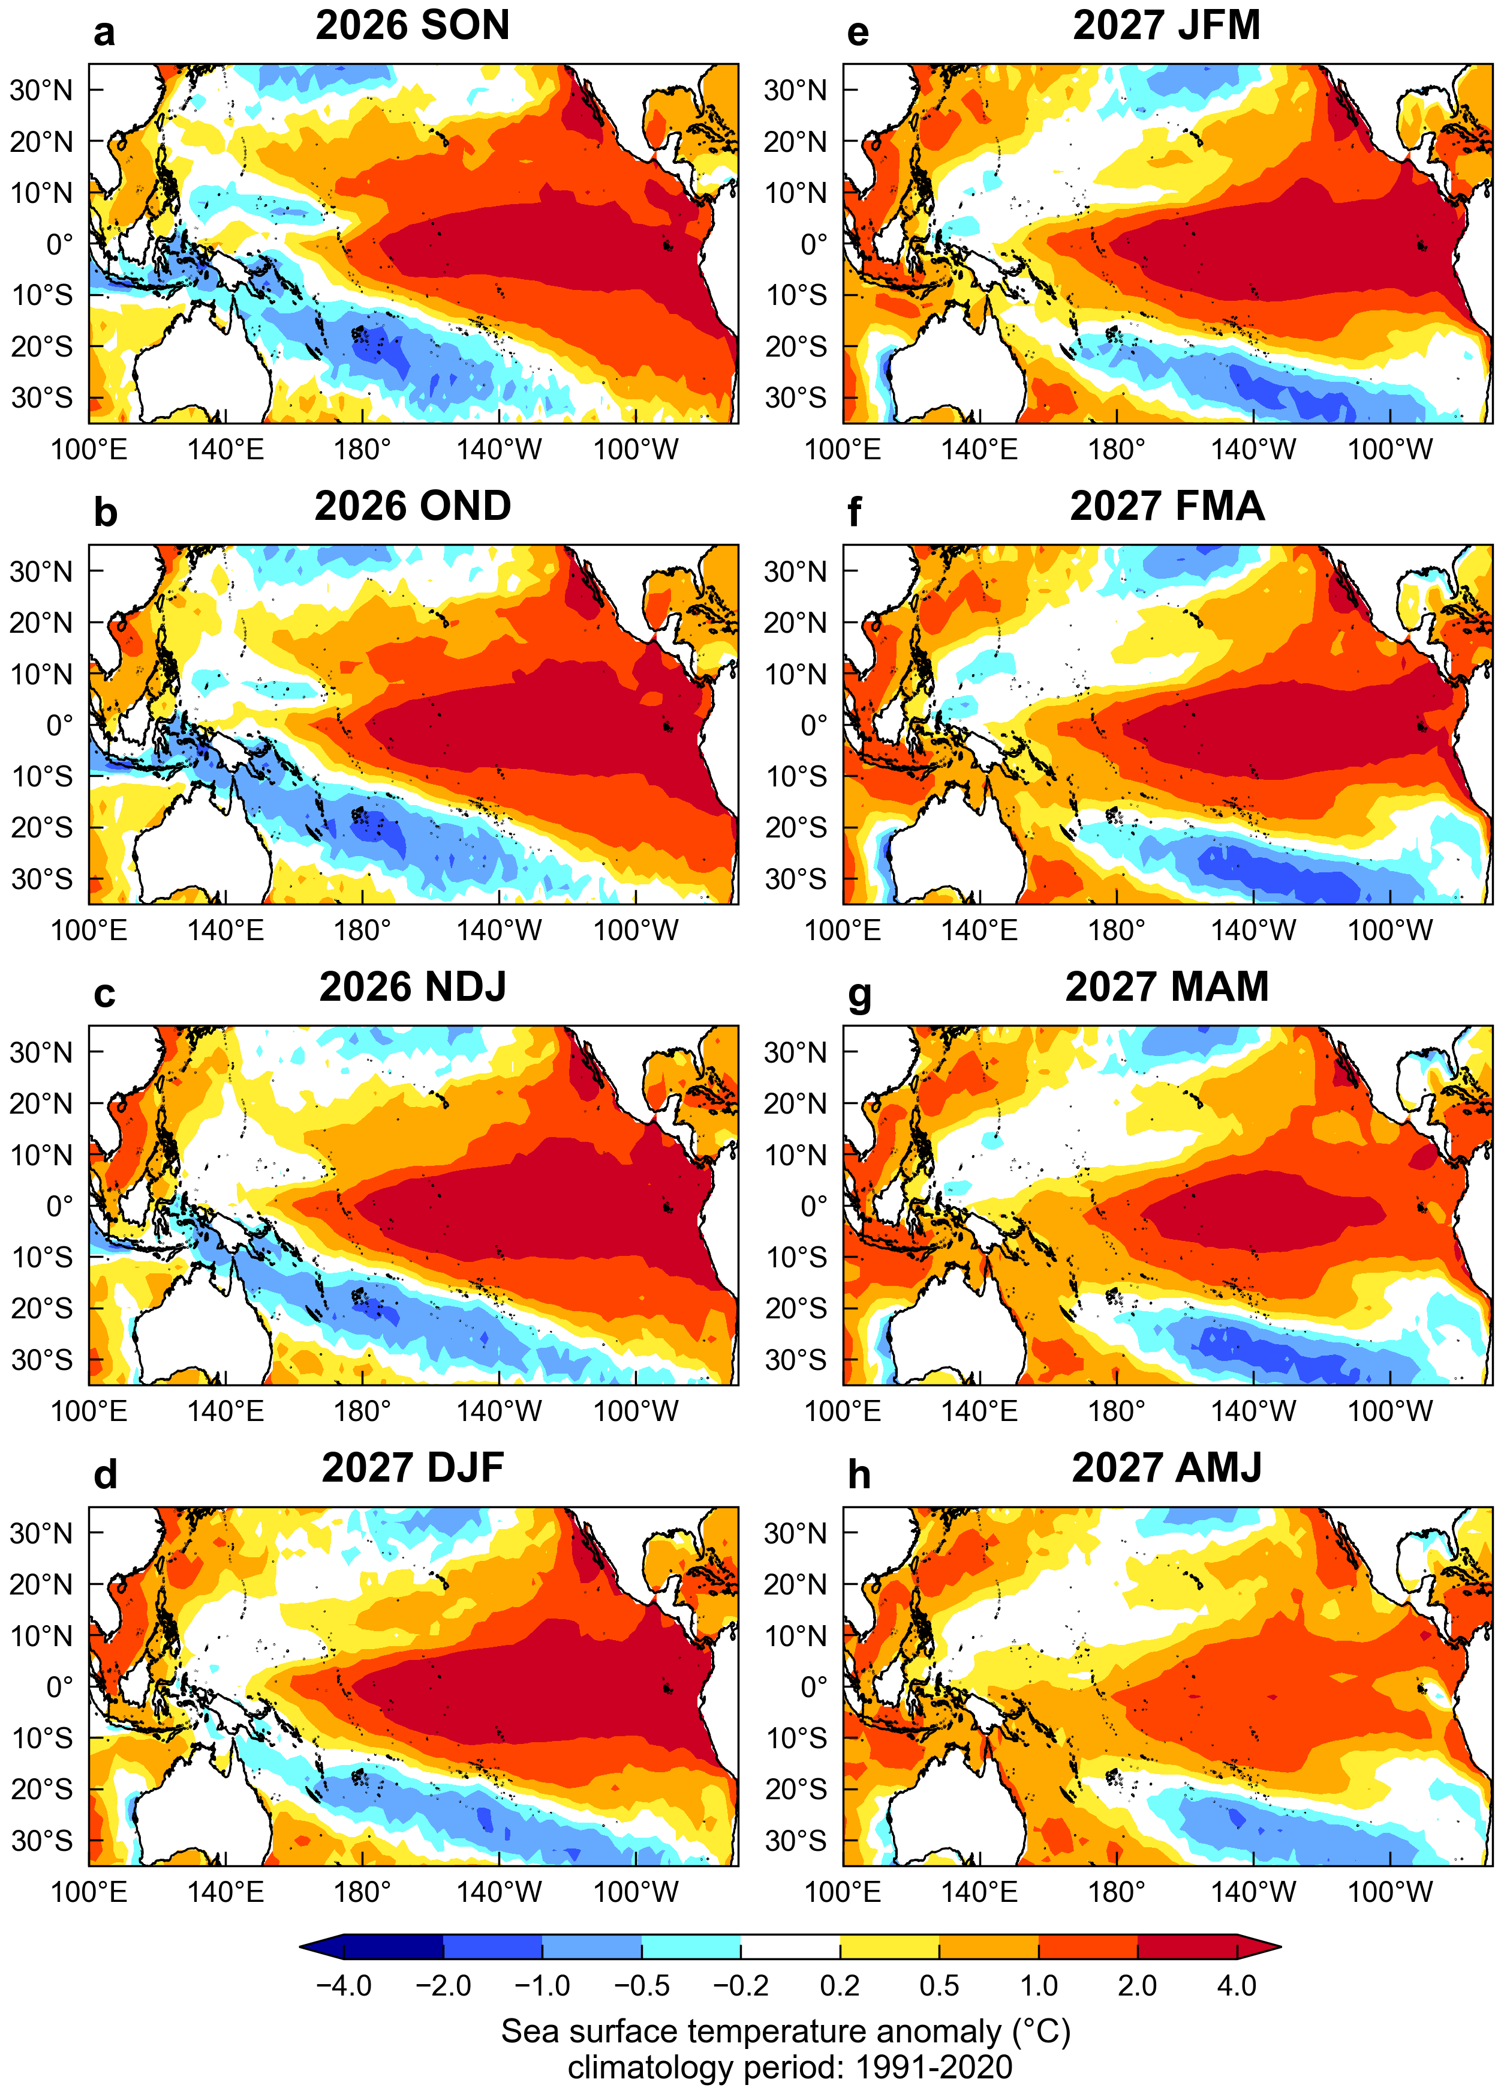
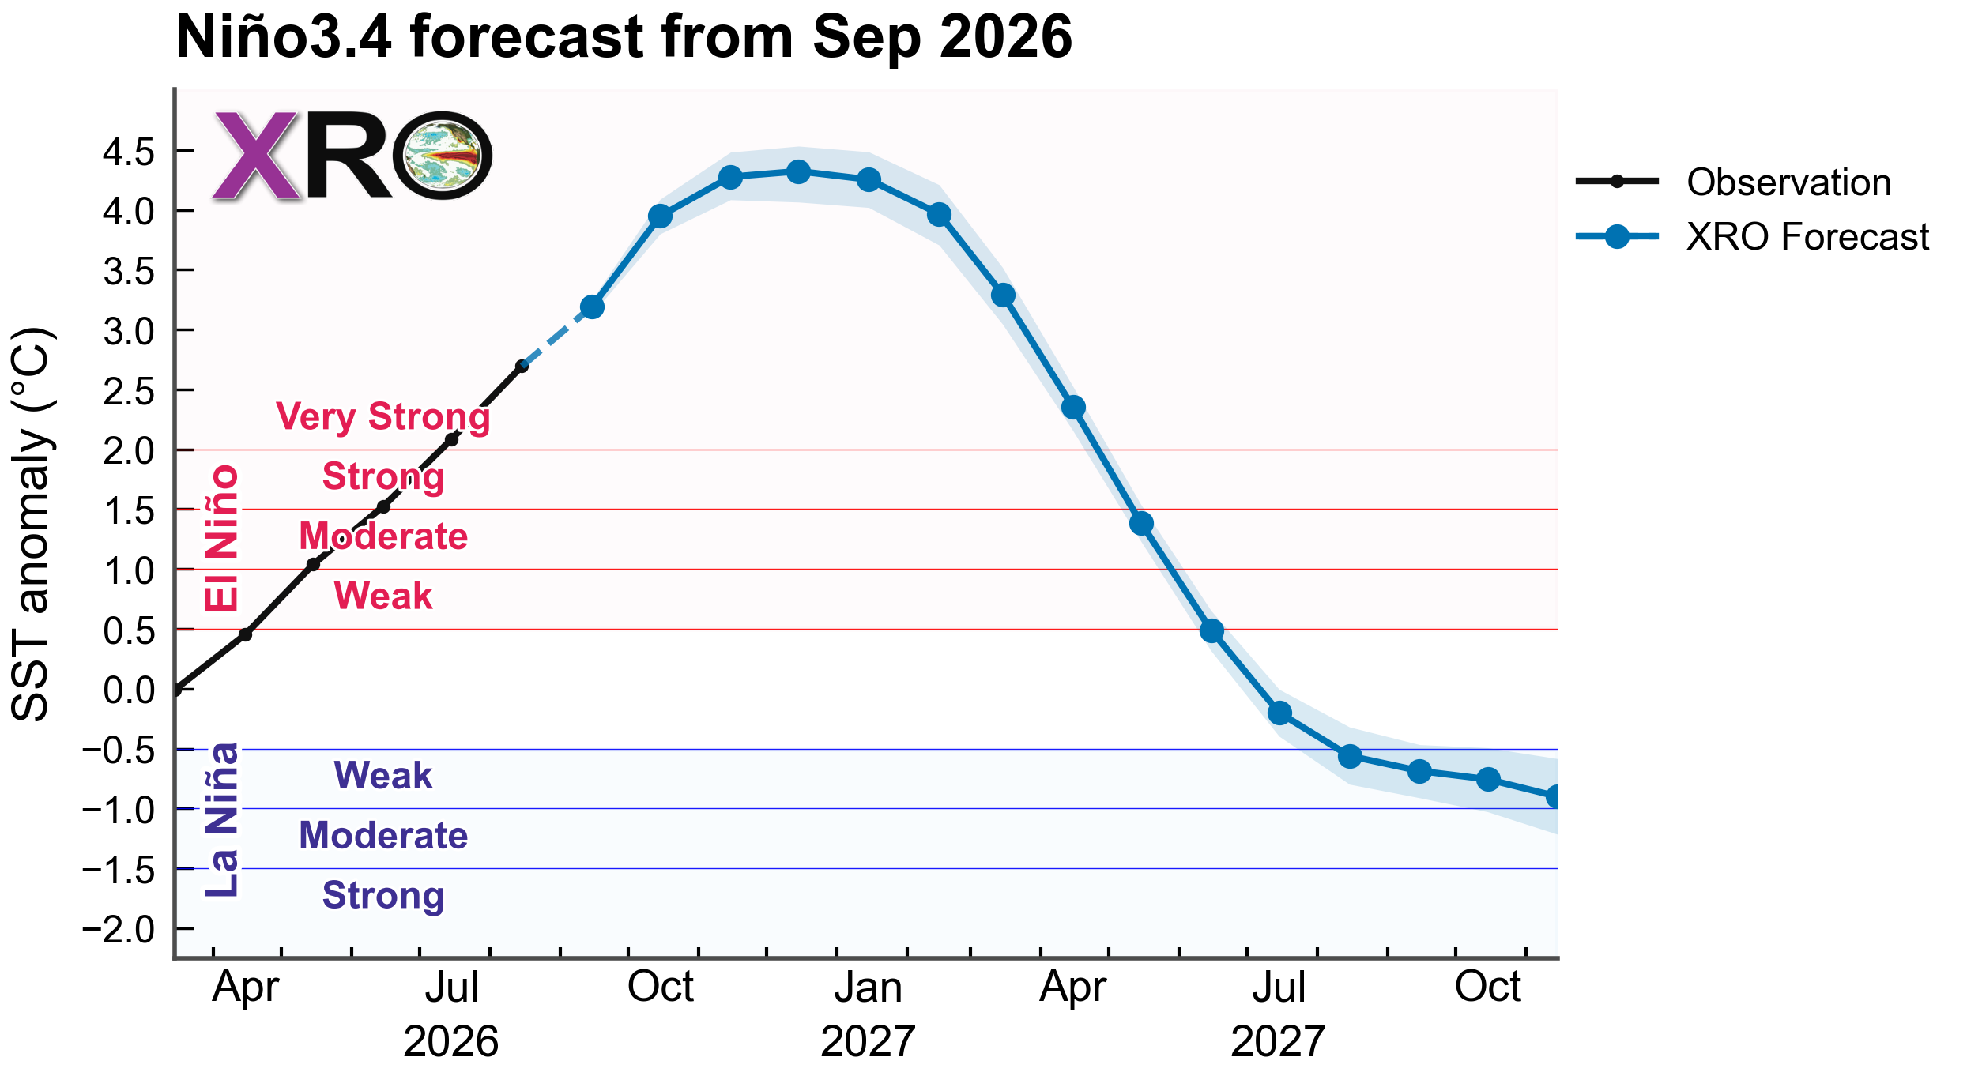
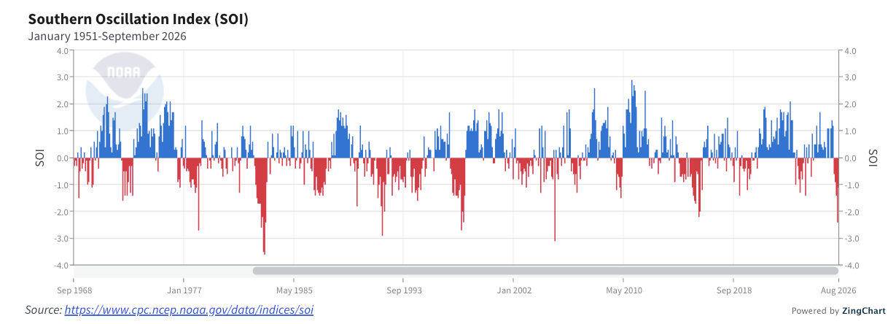
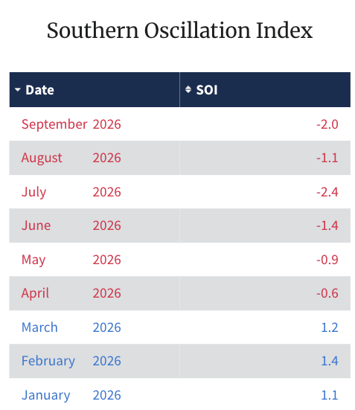
ENSO status
Source: NOAA
Very strong El Niño
N

Slide 5
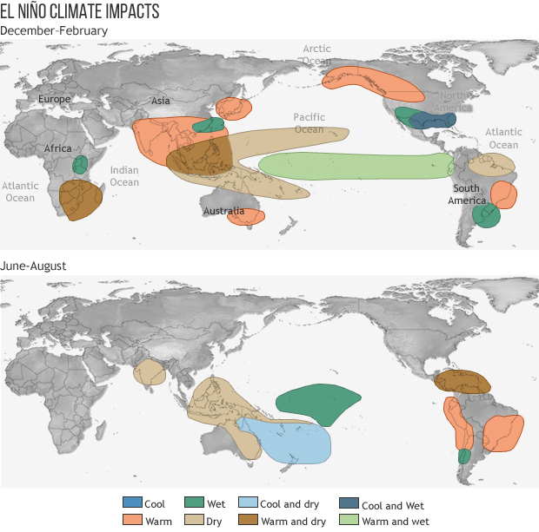
El Niño impacts
Source: NOAA
Dry
Warm & Dry
Warm & Wet

Slide 6
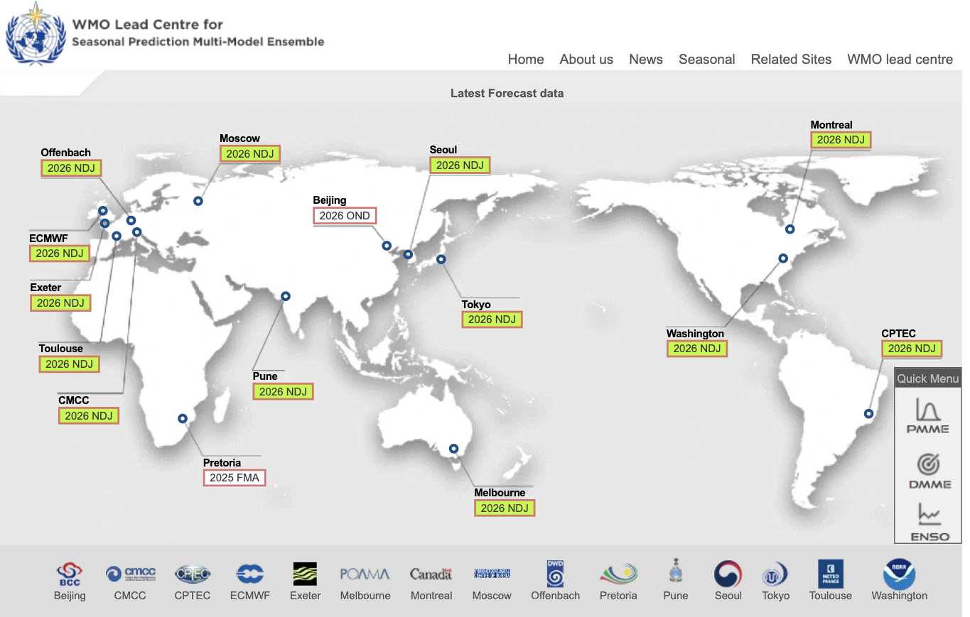
WMO Lead Centre for Seasonal Prediction Multi-Model Ensemble
Source: WMO SP MME
  WMO LC MME official outlooks for PICOF
  WMO LC MME based on 13 GPC LRF models
  Model skill varies significantly from model to model depending on a range of factors

Slide 7
Precipitation Outlook

Slide 8
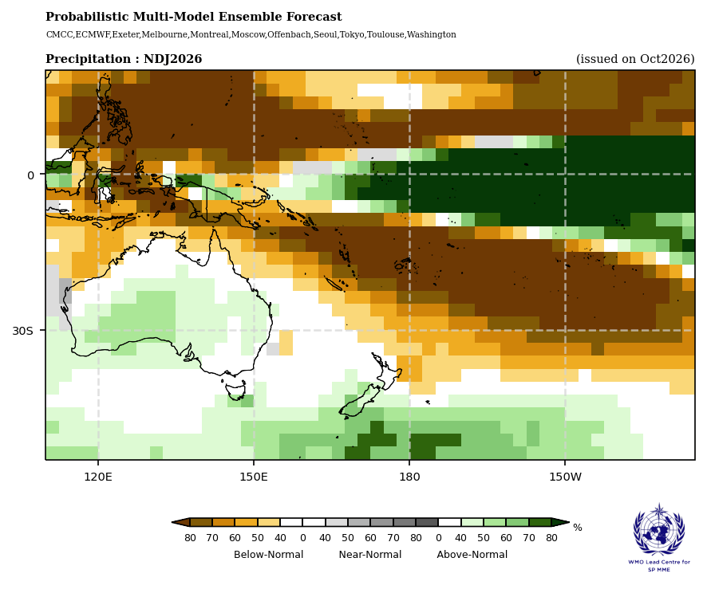
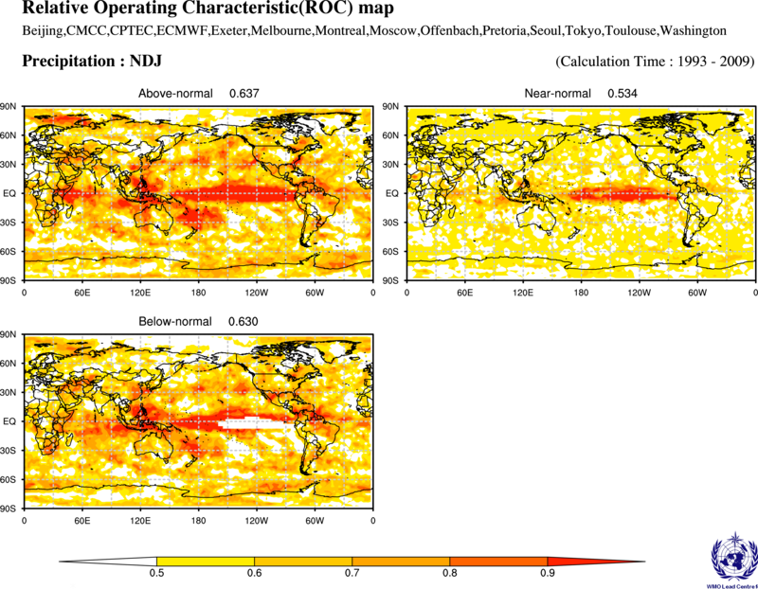
Precipitation Outlook: November 2026 – January 2027
Source: WMO Lead Center for Seasonal Prediction Multi-Model Ensemble
  The precipitation outlook is characterized by an El Niño-like pattern across the tropical Pacific, with enhanced precipitation in the central and eastern Pacific and suppressed precipitation over much of the western Pacific.
  Above-normal rainfall is favored for the central and eastern equatorial Pacific, including parts of the Line Islands (Kiribati). Below-normal precipitation is favored for PNG, Palau, Solomon island, Vanuatu, Nauru, Gilbert Islands (Kiribati), FSM, RMI, Tuvalu, Tokelau, Fiji, Tonga, Samoa, Niue, Cook islands, and much of French Polynesia. Near-normal precipitation is favored for parts of New Caledonia and southern French Polynesia.
  Hindcast skill is generally good for Nauru, Kiribati, Tuvalu, Tokelau, FSM, RMI, PNG, Solomon Islands, and Vanuatu, while relatively lower skill is found in parts of the Cook Islands and southern French Polynesia.

Slide 9
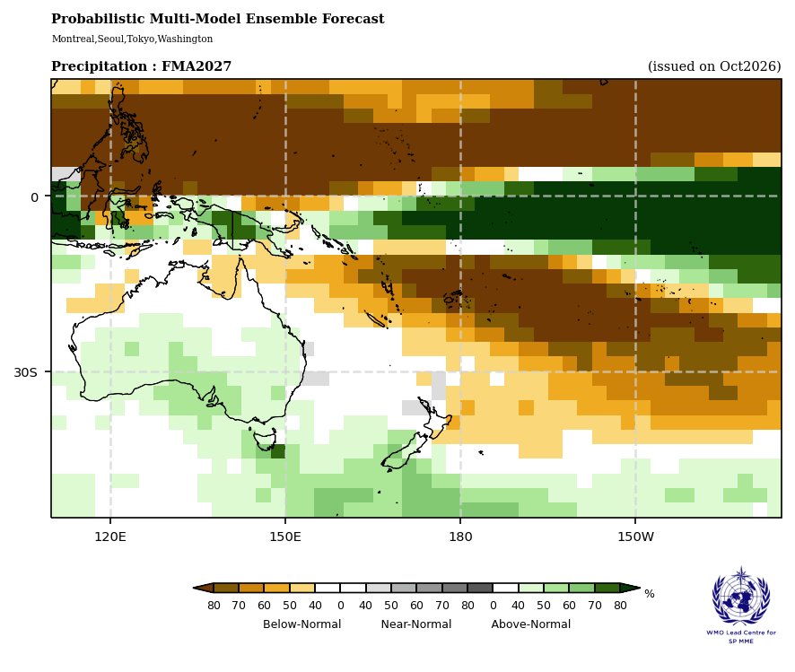
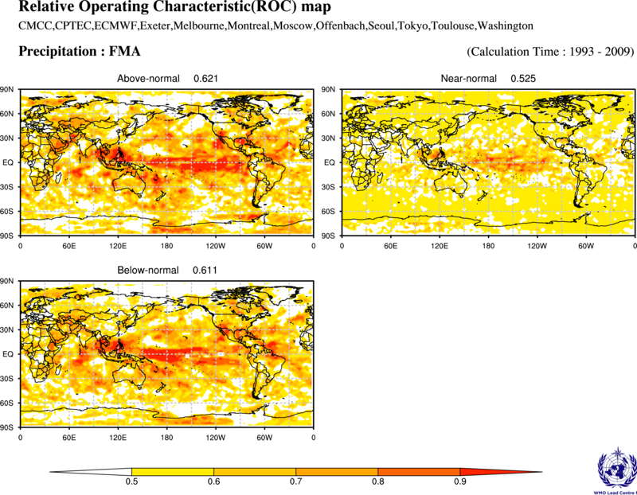
Precipitation Outlook: February 2027 – April 2027
Source: WMO Lead Center for Seasonal Prediction Multi-Model Ensemble
  The tercile rainfall outlook for February–April 2027 generally continues the pattern projected for November 2026–January 2027, with below-normal precipitation favored across much of the western and southwestern Pacific and above-normal precipitation along the central and eastern equatorial Pacific.
  Below-normal rainfall is favored for Palau, most of FSM and RMI, Nauru, Gilbert Islands (Kiribati), northern PNG, Solomon Islands, Vanuatu, Fiji, Tuvalu, Tokelau, Samoa, Tonga, Niue, northern Cook Islands, and northern French Polynesia. Above-normal rainfall is favored for parts of the Line Islands (Kiribati), while near-normal rainfall or no clear guidance is indicated for New Caledonia, southern Cook Islands, and southern French Polynesia.
  Hindcast skill is generally good for Nauru, Kiribati, Tuvalu, Tokelau, and parts of FSM and RMI. Skill is acceptable for Palau, PNG, Solomon Islands, Vanuatu, Fiji, Samoa, Tonga, Niue, and the Cook Islands, while relatively lower skill is found in parts of New Caledonia and French Polynesia.

Slide 10
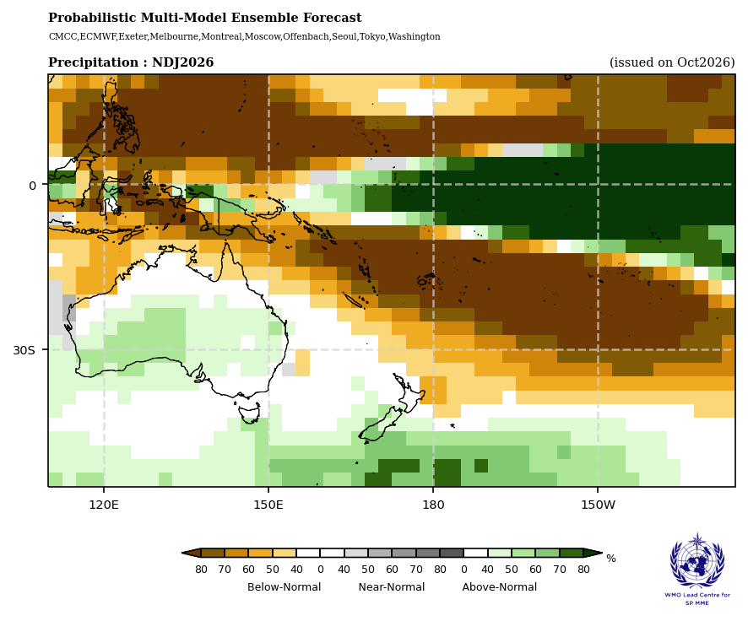
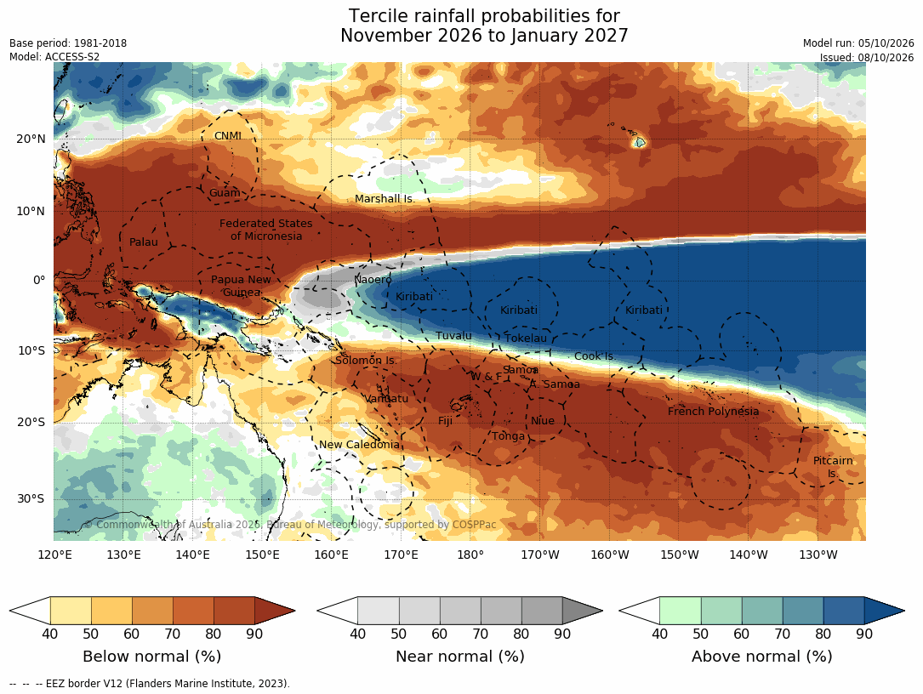
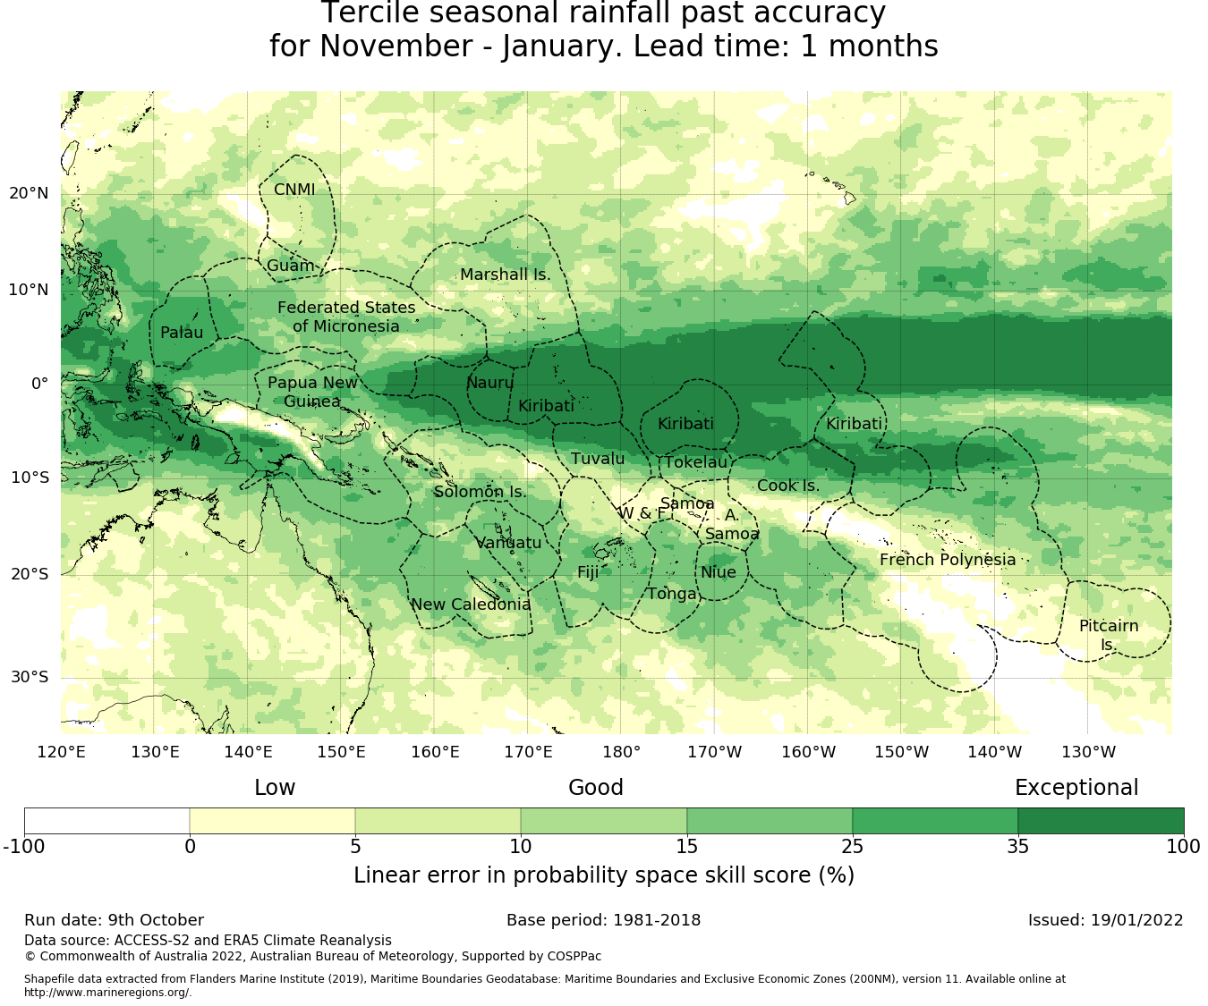
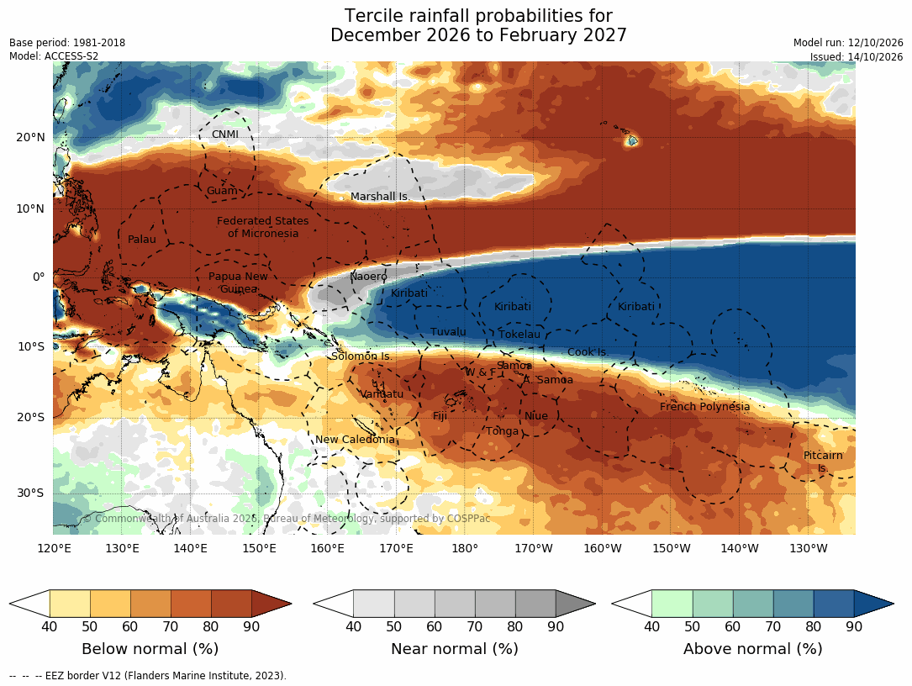
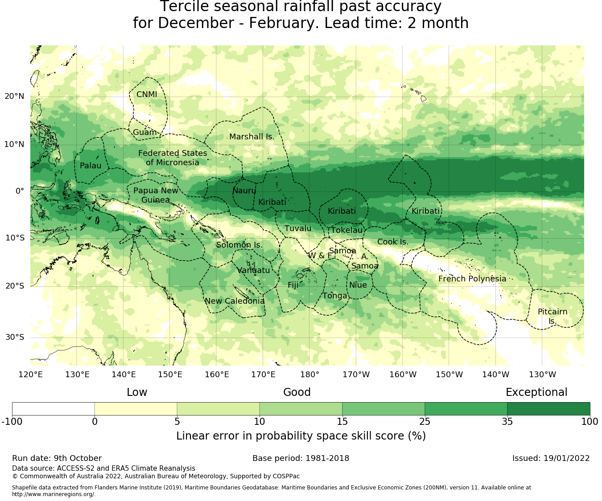
Precipitation Outlook
Source: BoM
Nov to Jan
Dec to Feb

Slide 11
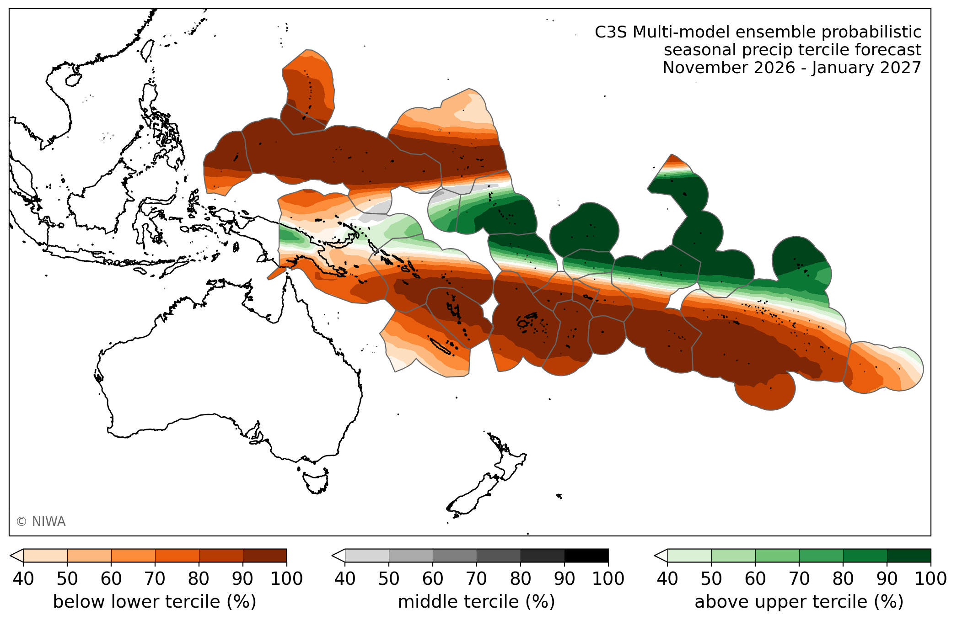
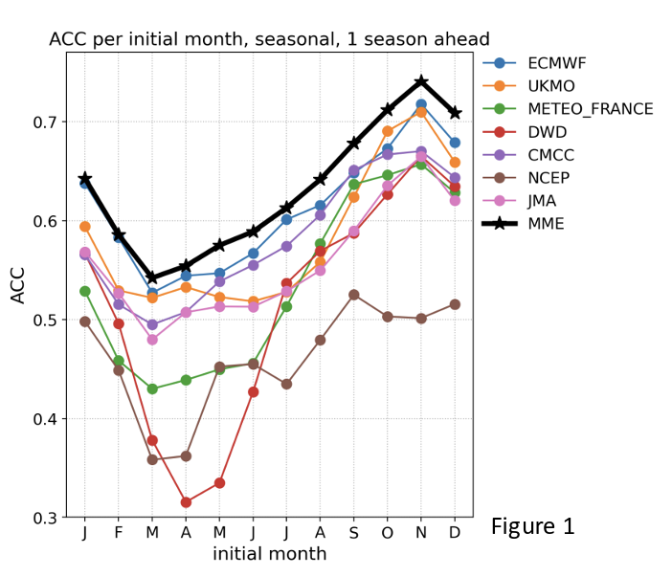
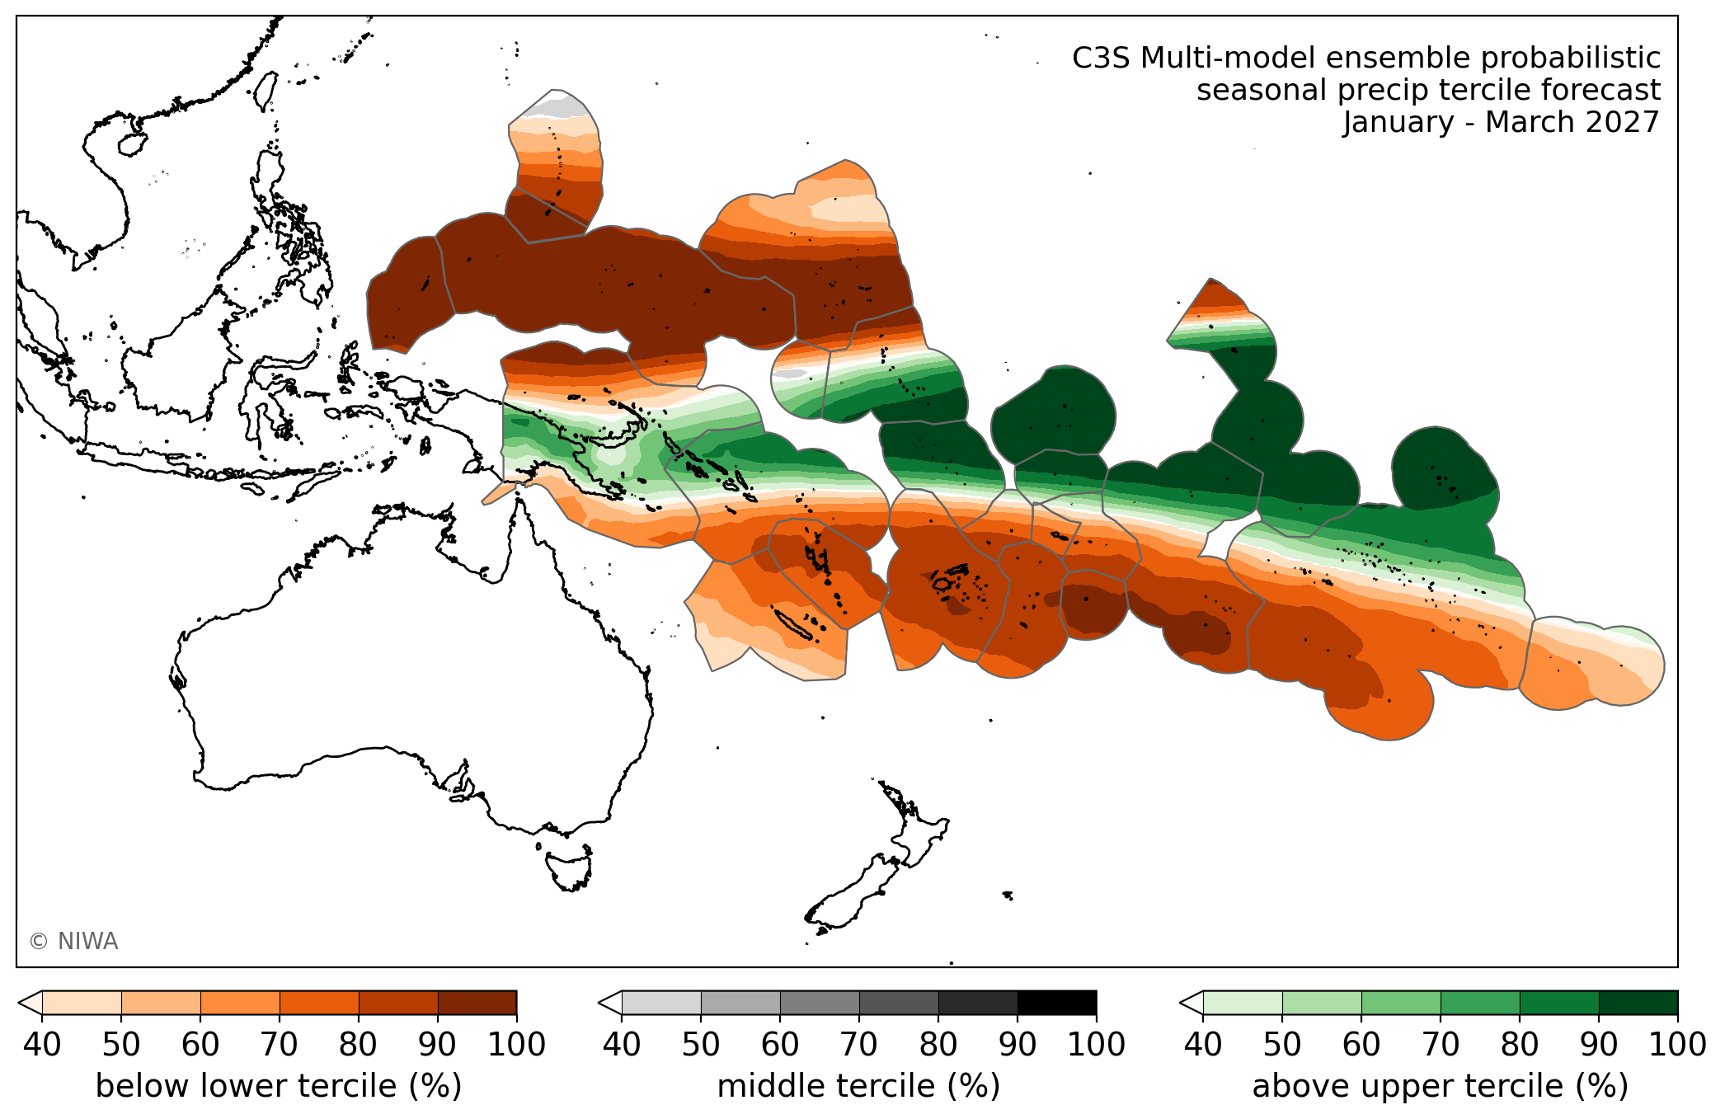
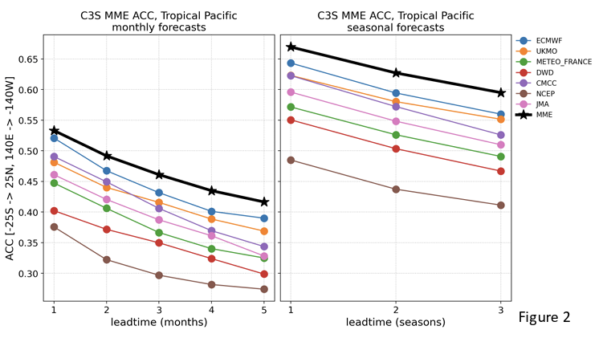
Precipitation Outlook
Source: NIWA
Nov to Jan
Jan to Mar

Slide 12
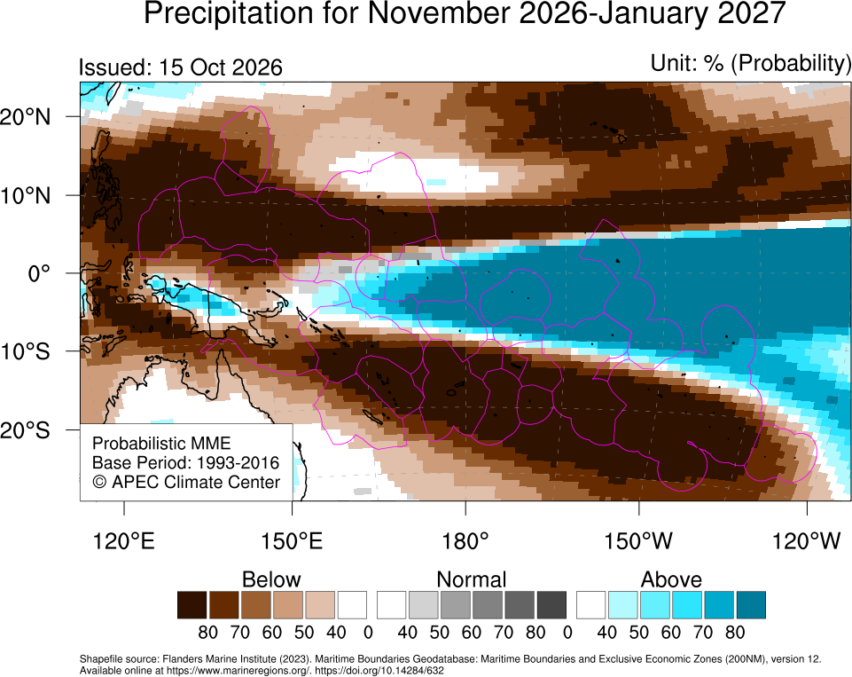
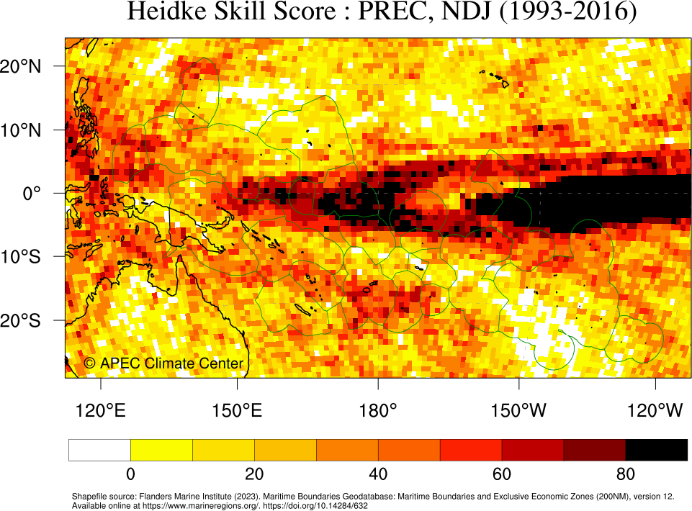
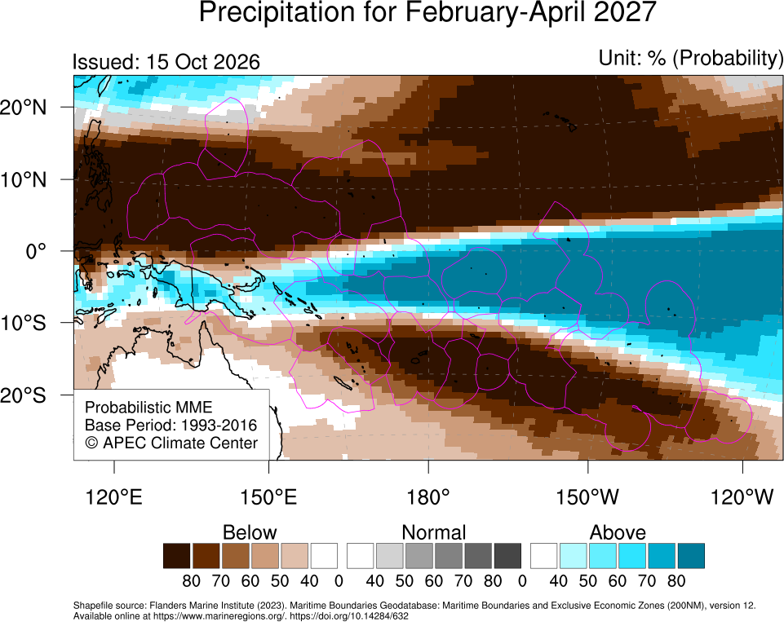
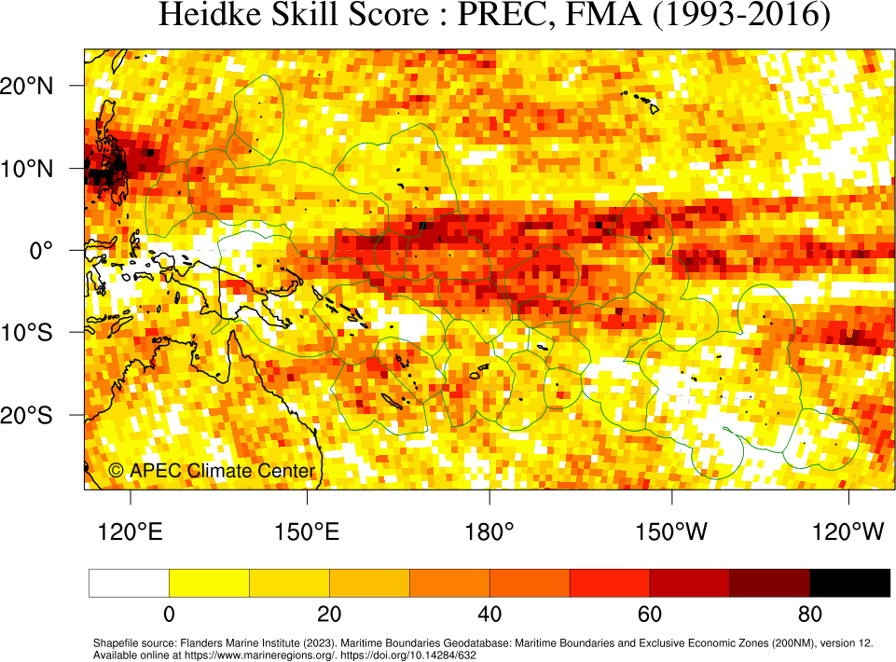
Precipitation Outlook
Source: APCC
Nov to Jan
Feb to Apr

Slide 13
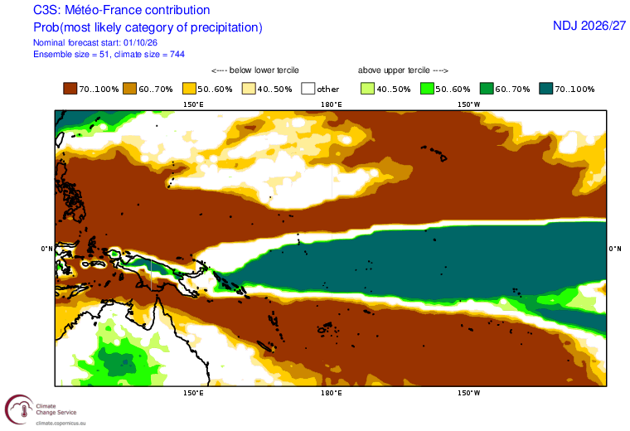
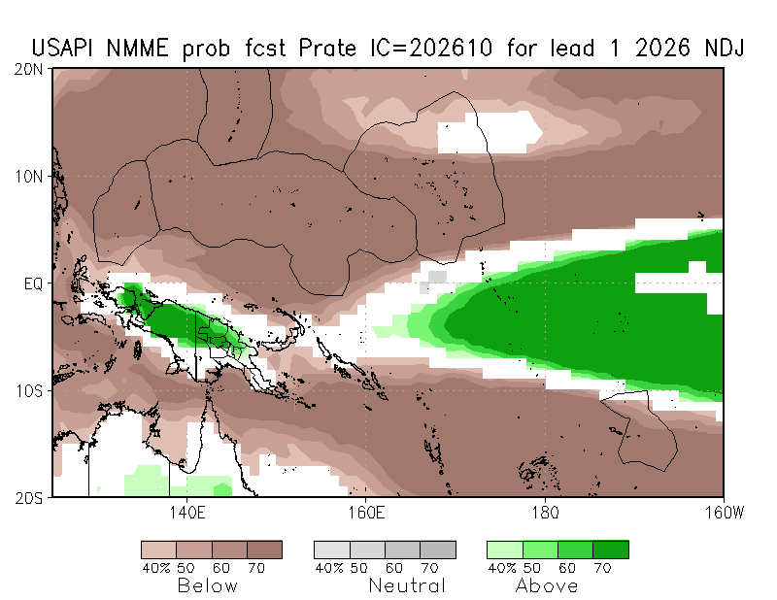
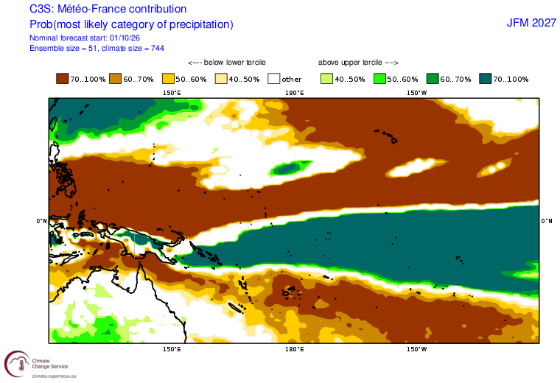
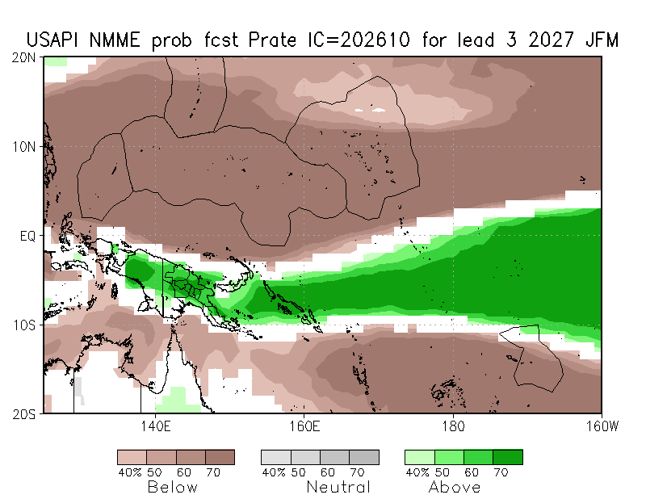
Precipitation Outlook
Source: NMME (NOAA)
Source: Meteo-France
Nov to Jan
Nov to Jan
Jan to Mar
Jan to Mar

Slide 14
Temperature Outlook

Slide 15
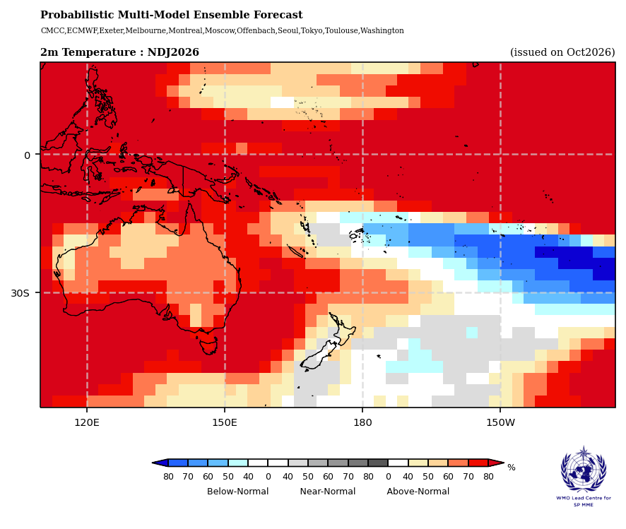
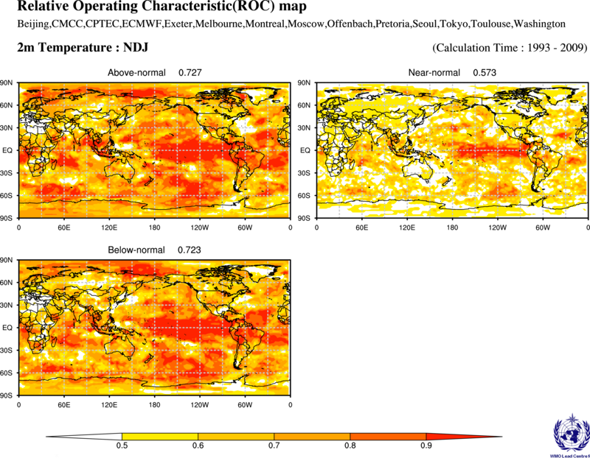
Temperature Outlook: November 2026 – January 2027
Source: WMO Lead Center for Seasonal Prediction Multi-Model Ensemble
  The tercile air temperature outlook for November 2026–January 2027 shows a broad pattern of above-normal temperatures across the western and northern tropical Pacific, with below-normal temperatures favored over parts of the southeastern tropical Pacific.
  Above-normal air temperatures are favored for Palau, Guam, CNMI, FSM, RMI, PNG, Solomon Islands, Vanuatu, Nauru, Kiribati, Tuvalu, Tokelau, Fiji, Samoa, Tonga, and much of the Cook Islands and French Polynesia. Near-normal or below-normal temperatures are favored for parts of the southern Cook Islands and southern French Polynesia, with some spatial variations across New Caledonia.
  Hindcast skill is generally good over much of the western and central tropical Pacific, including PNG, Solomon Islands, FSM, RMI, Kiribati, Tuvalu, and Vanuatu. Skill is relatively lower in parts of the subtropical South Pacific, particularly around the southern Cook Islands and southern French Polynesia.

Slide 16
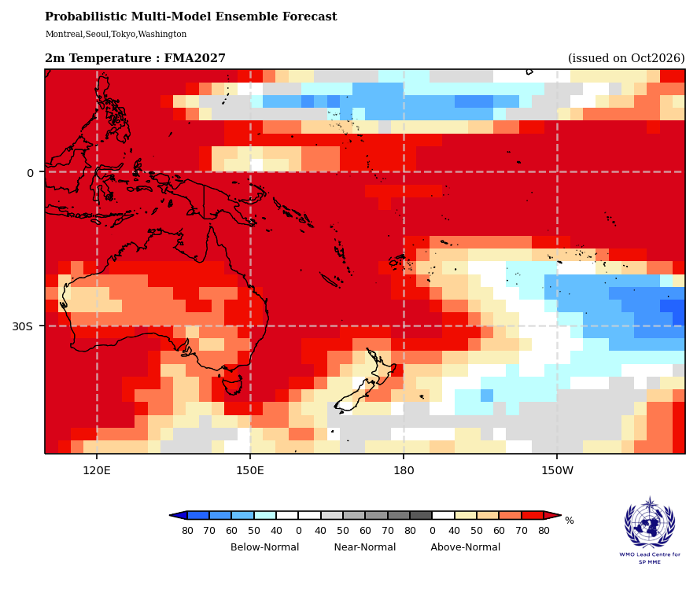
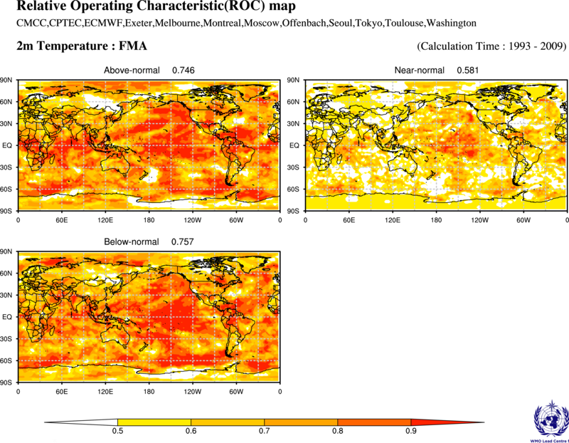
Temperature Outlook: February 2027 – April 2027
Source: WMO Lead Center for Seasonal Prediction Multi-Model Ensemble
  The tercile air temperature outlook for February–April 2027 shows a similar pattern to the preceding season, with above-normal temperatures favored across much of the western and central tropical Pacific and below-normal temperatures favored over parts of the eastern and southeastern Pacific.
  Above-normal air temperatures are favored for Palau, Guam, CNMI, FSM, RMI, PNG, Solomon Islands, Vanuatu, New Caledonia, Nauru, Kiribati, Tuvalu, Tokelau, Fiji, Samoa, Tonga, Niue, and much of the Cook Islands and French Polynesia. Near-normal or below-normal temperatures are favored for parts of the southern Cook Islands and southern French Polynesia.
  Hindcast skill is generally good over much of the equatorial Pacific, including Nauru, Kiribati, Tuvalu, and Tokelau. Skill is considered acceptable across much of FSM, RMI, PNG, Solomon Islands, Vanuatu, and Fiji, while relatively lower skill is found in parts of the Cook Islands and French Polynesia.

Slide 17
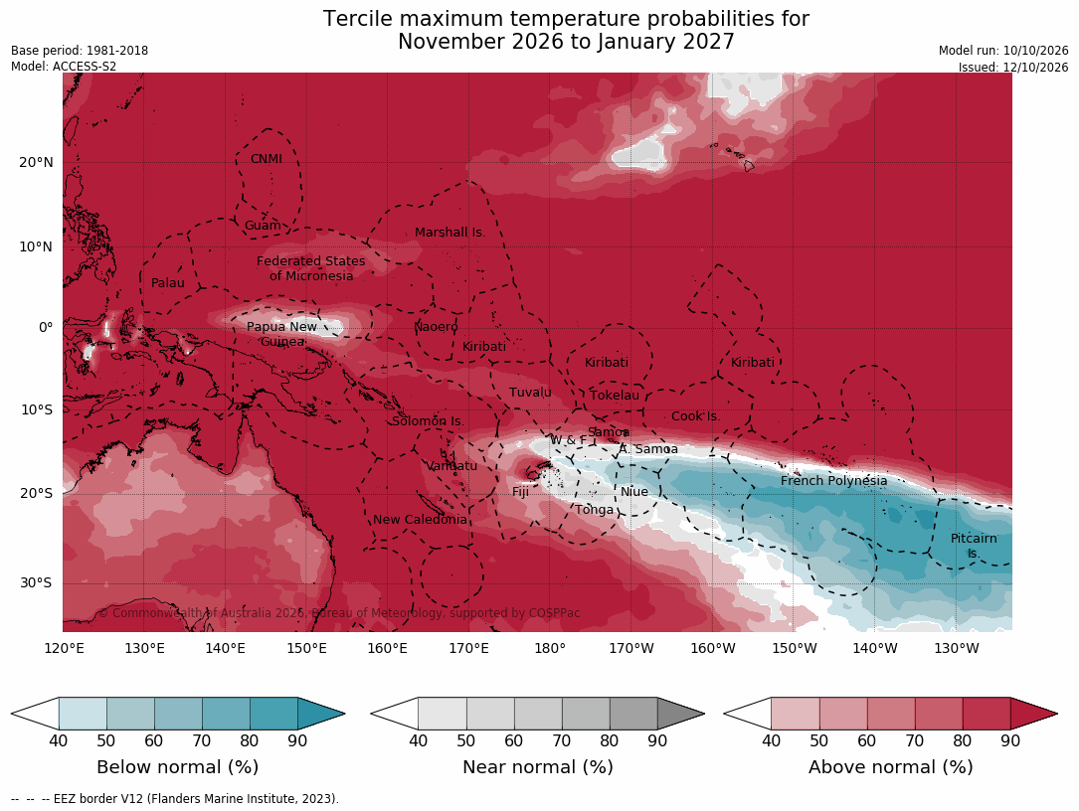
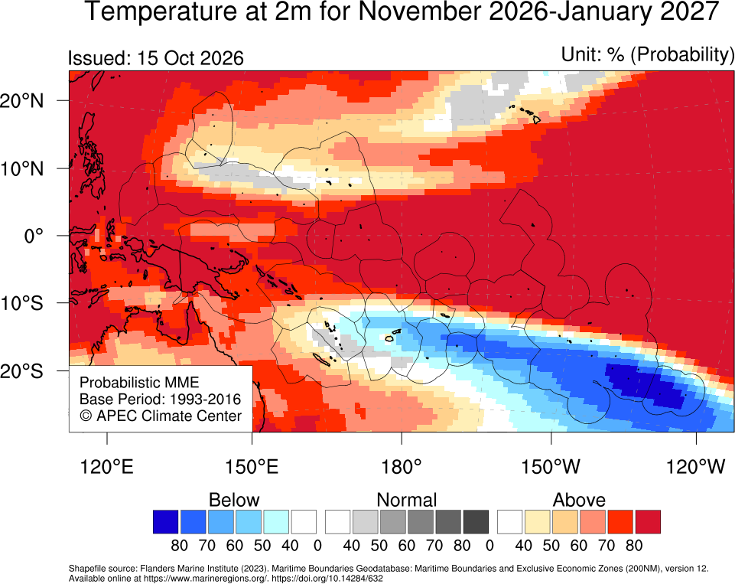
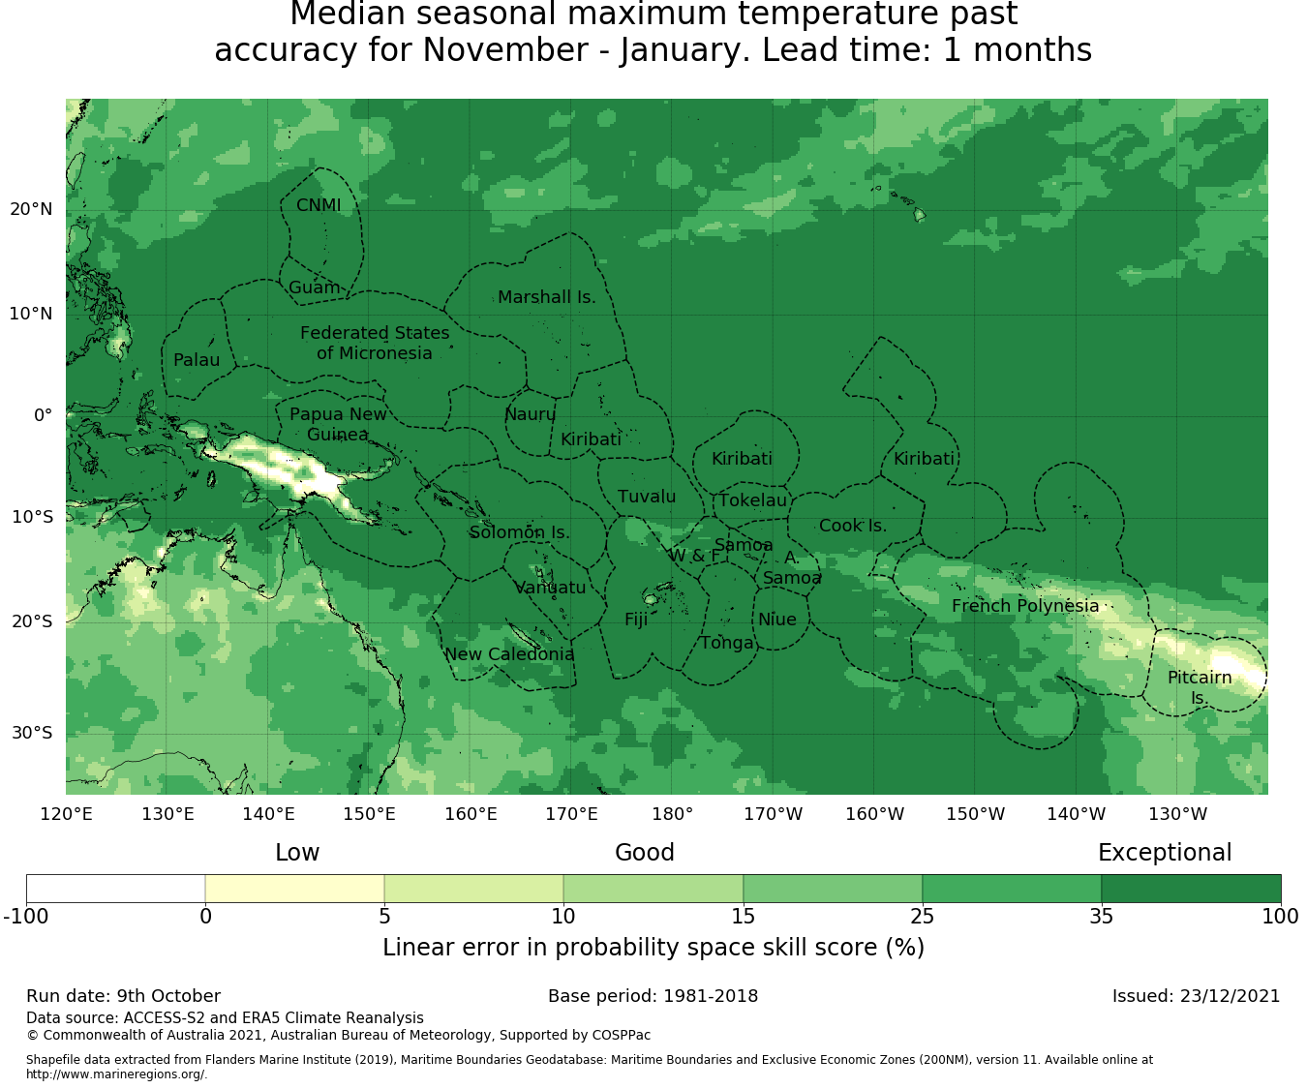
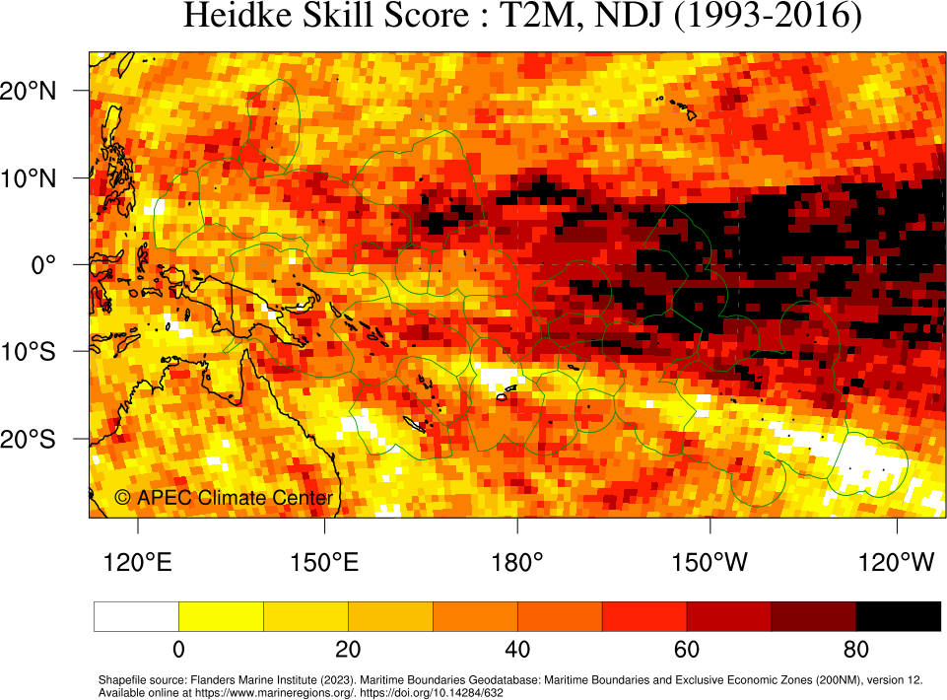
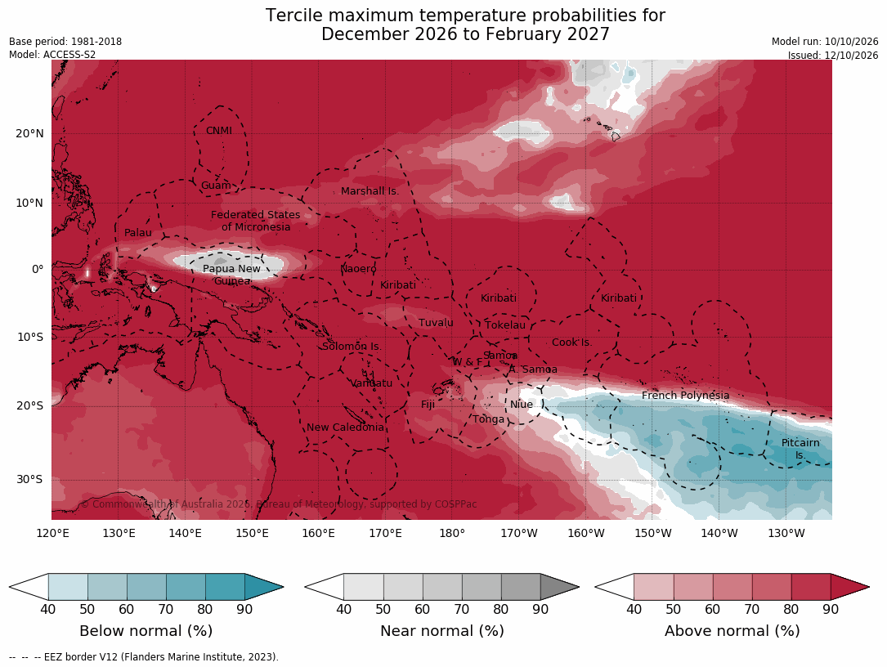
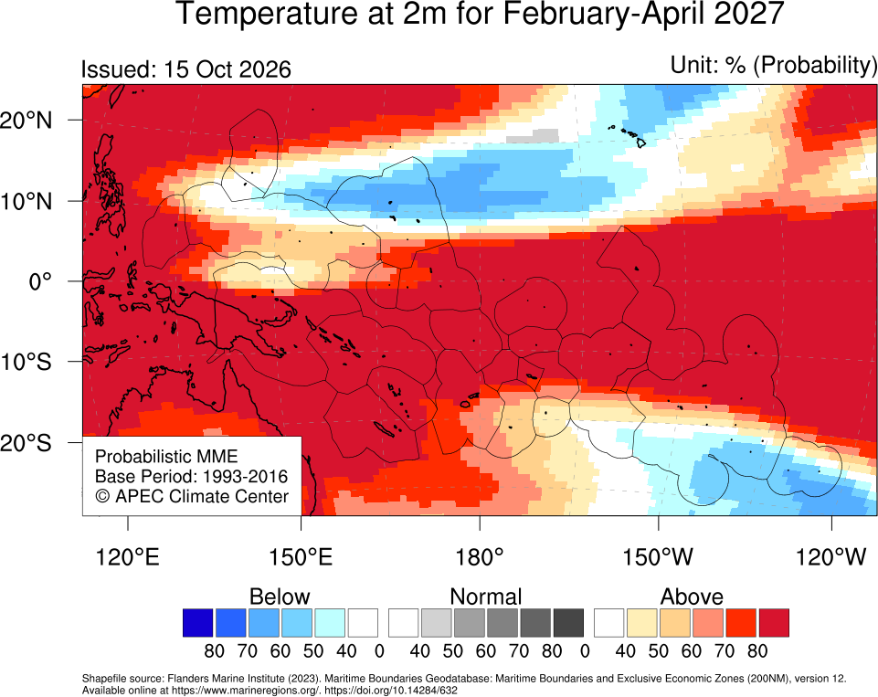
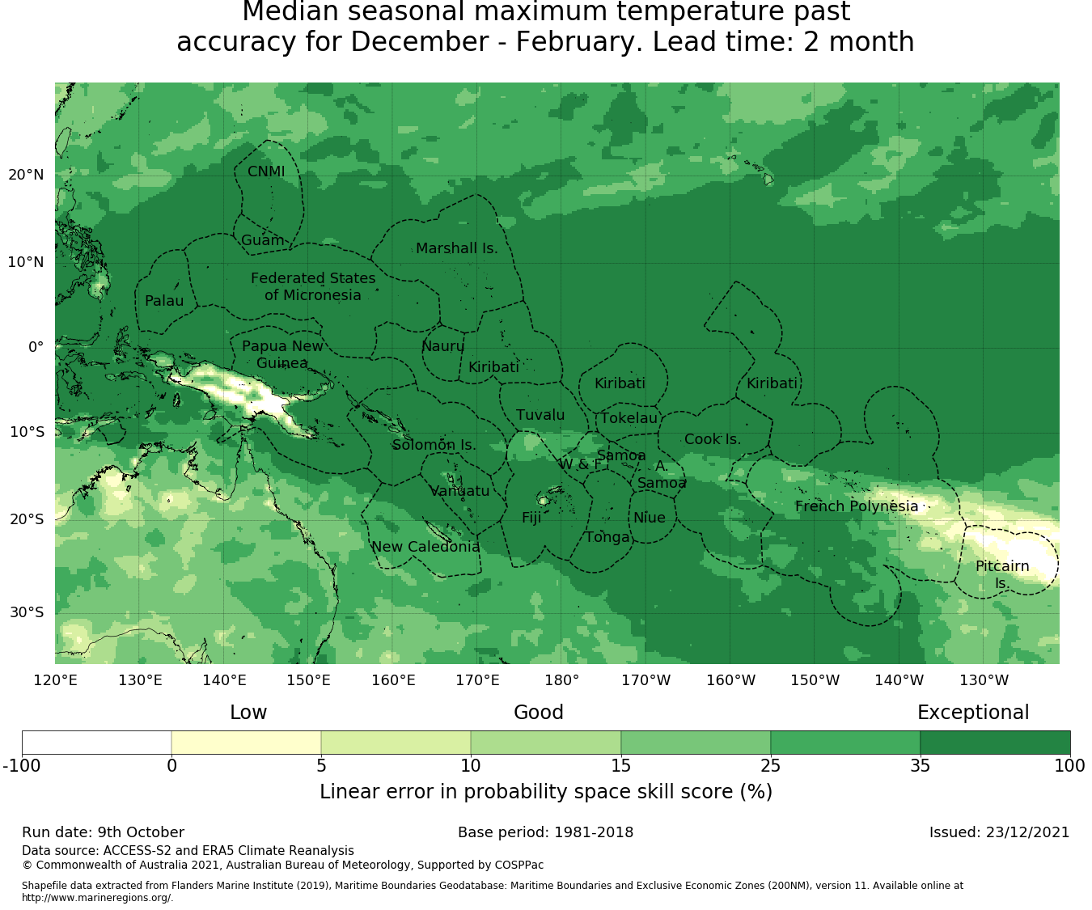
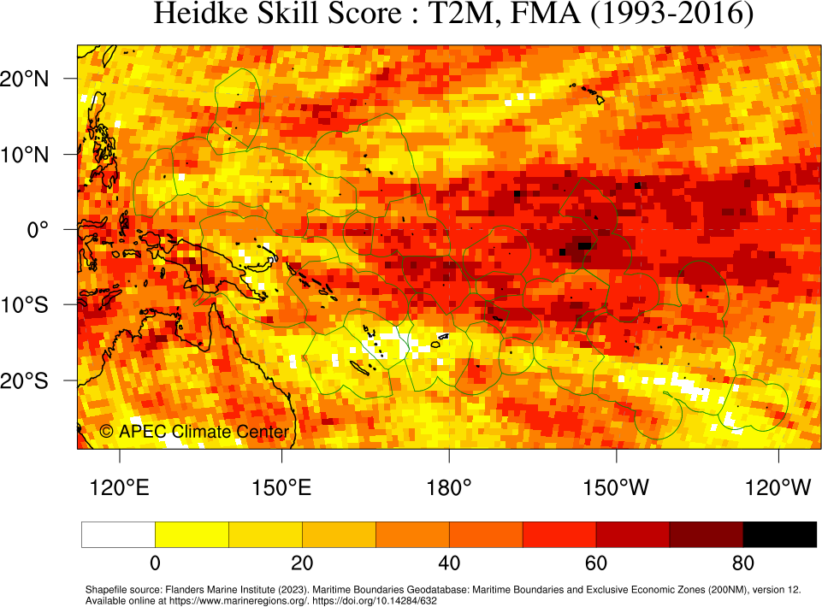
Temperature Outlook
Source: BoM & APCC
NDJ
NDJ
DJF
FMA

Slide 18
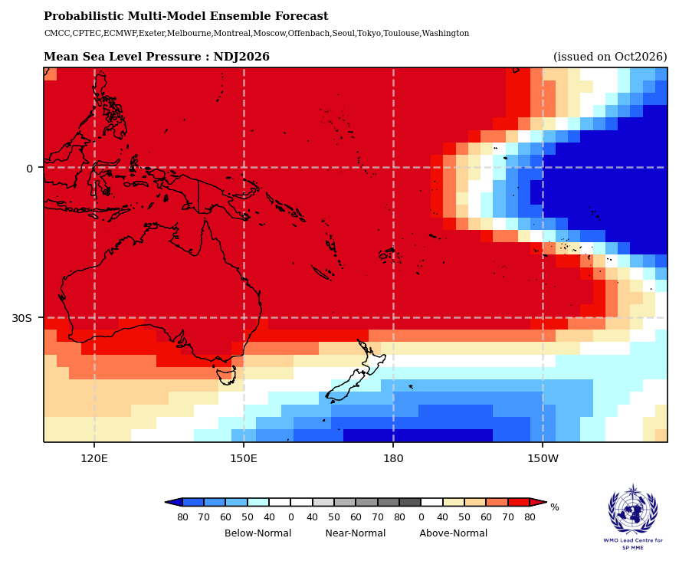
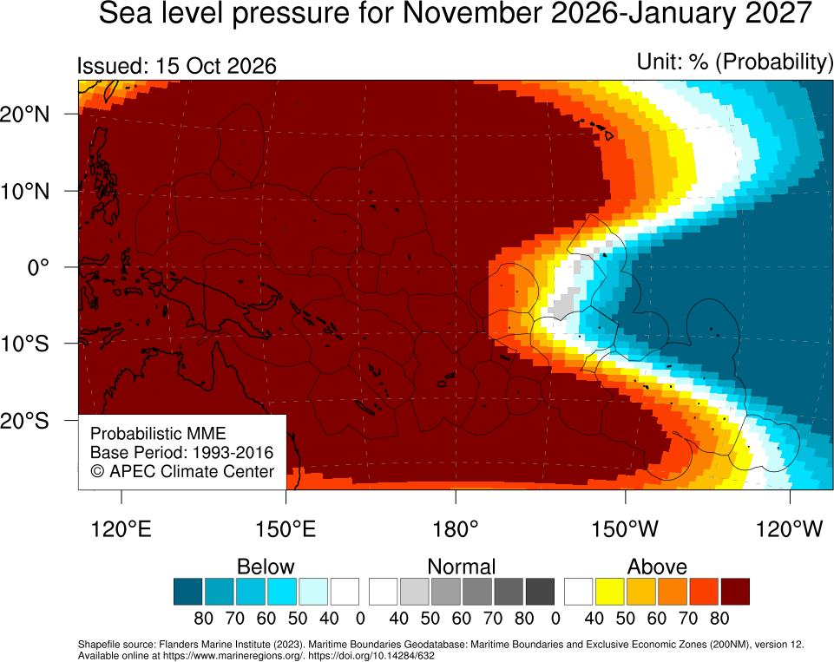
Forecast Mean Sea Level Pressure: November 2026 – January 2027
  Above-normal mean sea level pressure (MSLP) is strongly favored across the western and central tropical Pacific, including Palau, PNG, FSM, Solomon Islands, Vanuatu, New Caledonia, Fiji, Tonga, and Samoa, suggesting relatively suppressed convection and more stable atmospheric conditions.
  Below normal MSLP is favored over the eastern equatorial Pacific, particularly east of 160ºW, indicating conditions conducive to enhanced atmospheric convection and potentially increased cloudiness and rainfall.

Slide 19

Summary
Add key points which will be included in the PICOF outcomes statement
  Seasonal forecasts for November 2026–January 2027 and February–April 2027 indicate strong El Niño-like rainfall patterns, characterized by enhanced rainfall across the central and eastern equatorial Pacific and suppressed rainfall over much of the western and southwestern Pacific.
  The rainfall outlook for November 2026–January 2027 favors below-normal rainfall across Palau, PNG, FSM, RMI, Nauru, the Gilbert Islands (Kiribati), Solomon Islands, Vanuatu, Tuvalu, Tokelau, Fiji, Tonga, Samoa, Niue, the Cook Islands, and much of French Polynesia. Above-normal rainfall is favored along the central and eastern equatorial Pacific, including parts of the Line Islands (Kiribati), while near-normal rainfall is favored for parts of New Caledonia and southern French Polynesia.
  The El Niño-like rainfall pattern is expected to continue into February–April 2027, with below-normal rainfall persisting across much of the western and southwestern Pacific. Above-normal rainfall remains favored for parts of the Line Islands (Kiribati), while near-normal rainfall or no clear forecast signal is indicated for New Caledonia, the southern Cook Islands, and southern French Polynesia. Confidence in this outlook is generally lower due to the longer forecast lead time.

Slide 20
Summary
Add key points which will be included in the PICOF outcomes statement
  Above-normal air temperatures are strongly favored across most of the western and central tropical Pacific during November 2026–January 2027, including Palau, FSM, RMI, PNG, Solomon Islands, Vanuatu, New Caledonia, Fiji, Tonga, and Samoa. Below-normal temperatures are favored in parts of the southern tropical Pacific.
  The air temperature outlook for February–April 2027 indicates a continuation of above-normal temperatures across much of the western and central Pacific, broadly consistent with the preceding season. Regional differences remain, particularly over the central and southeastern Pacific.
  There is broad agreement among major seasonal prediction systems, including the WMO Lead centre multi-model ensemble and forecasts from APCC, BoM, NIWA, NOAA, and Meteo-France, on the overall El Niño-like rainfall pattern. Hindcast verification indicates generally good rainfall prediction skill across the equatorial Pacific, although forecast confidence varies by region and lead time.
  Forecasts of mean sea level pressure are consistent with an El Niño-like pattern, with above-normal pressure favored across the western and central tropical Pacific and below-normal pressure over the eastern equatorial Pacific. This pattern supports suppressed convection and reduced rainfall in the western Pacific and enhanced convection and rainfall farther east.

Slide 21
Regional statement
Add key points which will be included in the PICOF outcomes statement
  Seasonal forecasts for November 2026–January 2027 and February–April 2027 indicate a pronounced El Niño-like climate pattern across the tropical Pacific, associated with the forecast development of a strong to very strong El Niño event. Below-normal rainfall is favored across much of the western and southwestern Pacific, including Papua New Guinea, Palau, the Federated States of Micronesia, the Marshall Islands, Solomon Islands, Vanuatu, Fiji, Samoa, Tonga, and several other Pacific Island countries, while above-normal rainfall is favored along the central and eastern equatorial Pacific, including parts of the Line Islands (Kiribati). This rainfall pattern is expected to persist into February–April 2027, although forecast confidence varies by region and lead time. Above-normal air temperatures are favored across most of the western and central tropical Pacific during both seasons. Forecast mean sea level pressure patterns and broad agreement among major seasonal prediction systems support the overall El Niño-like outlook, characterized by suppressed convection over the western Pacific and enhanced convection farther east.

Slide 22






Contact
symoon@apcc21.org

