Slide 1
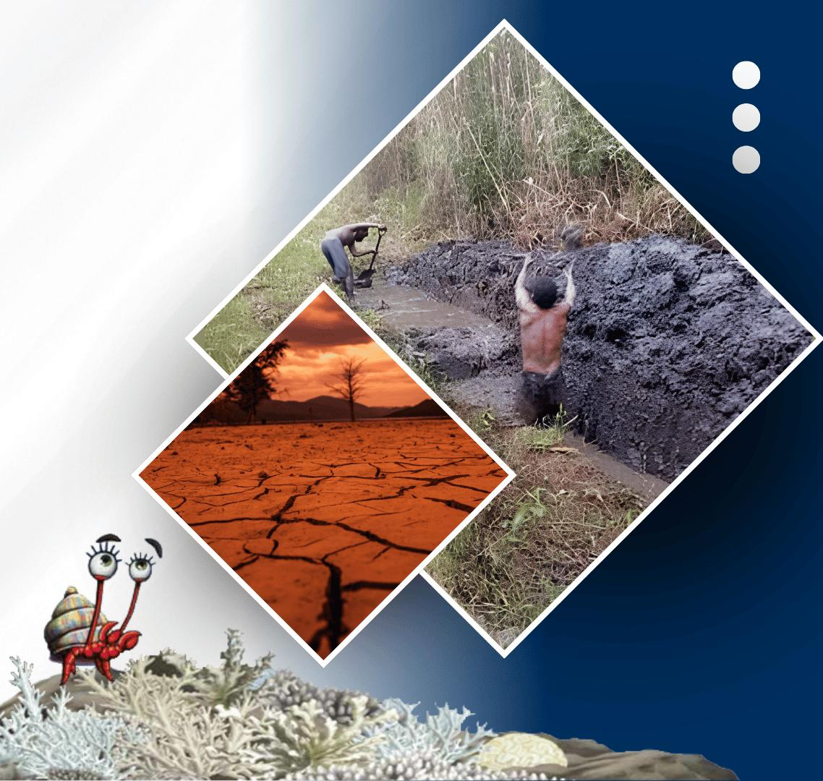




PACIFIC ISLANDS climate & Ocean forum-19
20 - 21 OCTOBER, 2026
HYBRID
PORT MORESBY, PAPUA NEW GUINEA
& ZOOM
www.pacificrcc.net

Slide 2
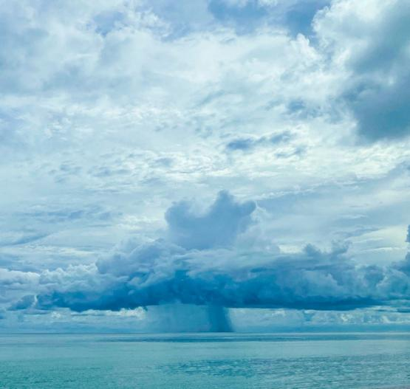
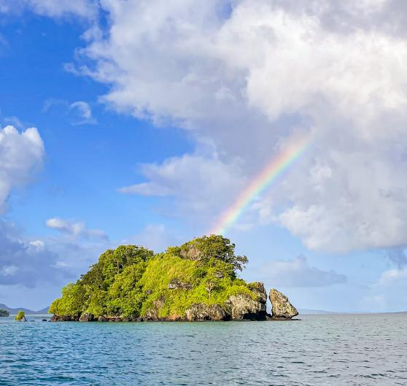




PICOF-19
Objectives
Simon McGree
PICS Panel Chair/RCC Network Management Committee Chair

Slide 3

Pacific Islands Climate & Ocean Forum-19
Regional Climate Forums/Regional Climate Outlook Forums (RCF/RCOF) is a WMO concept delivered mainly via WMO Regional Climate Centres
Aimed at producing objective, user-relevant climate outlooks in order to members reduce climate-related risks and support sustainable development for in climate-sensitive sectors of critical socioeconomic significance
NMHSs and regional stakeholders are the primary participants of PICOF but the focus remains on delivering climate information to national climate-sensitive sectors and the community

Slide 4
PICOF-19 Objectives
Review the climate of May to October 2026 including performance of the PICOF-18 outlooks
Present regional climate, ocean and tropical cyclone outlooks and confidence in these outlooks for November 2026 to April 2027
Present and discuss long-term trends and projections for rainfall and air temperature. Focusing specifically on how long-term change has/may influence the climate of the last and coming six months

Slide 5
PICOF-19 outcomes
Improved understanding of climate and ocean monitoring and prediction specifically for the target monitoring and prediction periods
Enhanced understanding of outlook confidence/skill for the period in question
Regional and national statements containing climate, ocean and tropical cyclone outlooks for November 2026 to April 2027
A PICOF-19 report
Content for regional partner and NMHSs climate and ocean bulletins as well as media and social media releases

Slide 6
What's different this time?
PICOF-19 is two days. Longer sessions with more time for questions and discussion. PICOF-18 was 1.5 days. PICOF-17 was 1 day
A new session under Locking Back. Attribution of impacts (second attempt) More than listing weather and climate impacts. Need know what's different
Group work identifying potential climate and ocean impacts in the Looking Forward session (trial)
NMHSs produce national statements

Slide 7
Pacific Islands ENSO Forum
When: 22-23 November 2026
Goal: To improve awareness of the 2026 El Niño event, strengthen regional coordination, shared understanding and resource mobilisation across the Pacific, ahead of its forecast peak towards the end of 2026
Objectives
Share the PICOF-19 Statement which contains El Niño status and outlook and seasonal prediction information across international, regional and national levels.
Generate awareness of the products and services provided by the Pacific RCC Network and NMHSs.
Document and compare the sector-specific impacts already being experienced across Pacific sub-regions.
Showcase innovative financing and response mechanisms already active in the region, including parametric insurance, Anticipatory Action and flexible development funding.
Identify and register available funding sources to support country-level preparedness and response.
Strengthen connections between national meteorological and disaster management services, regional agencies and development and humanitarian partners.

Slide 8





Contact
My Email
simon.mcgree@bom.gov.au

