Slide 1
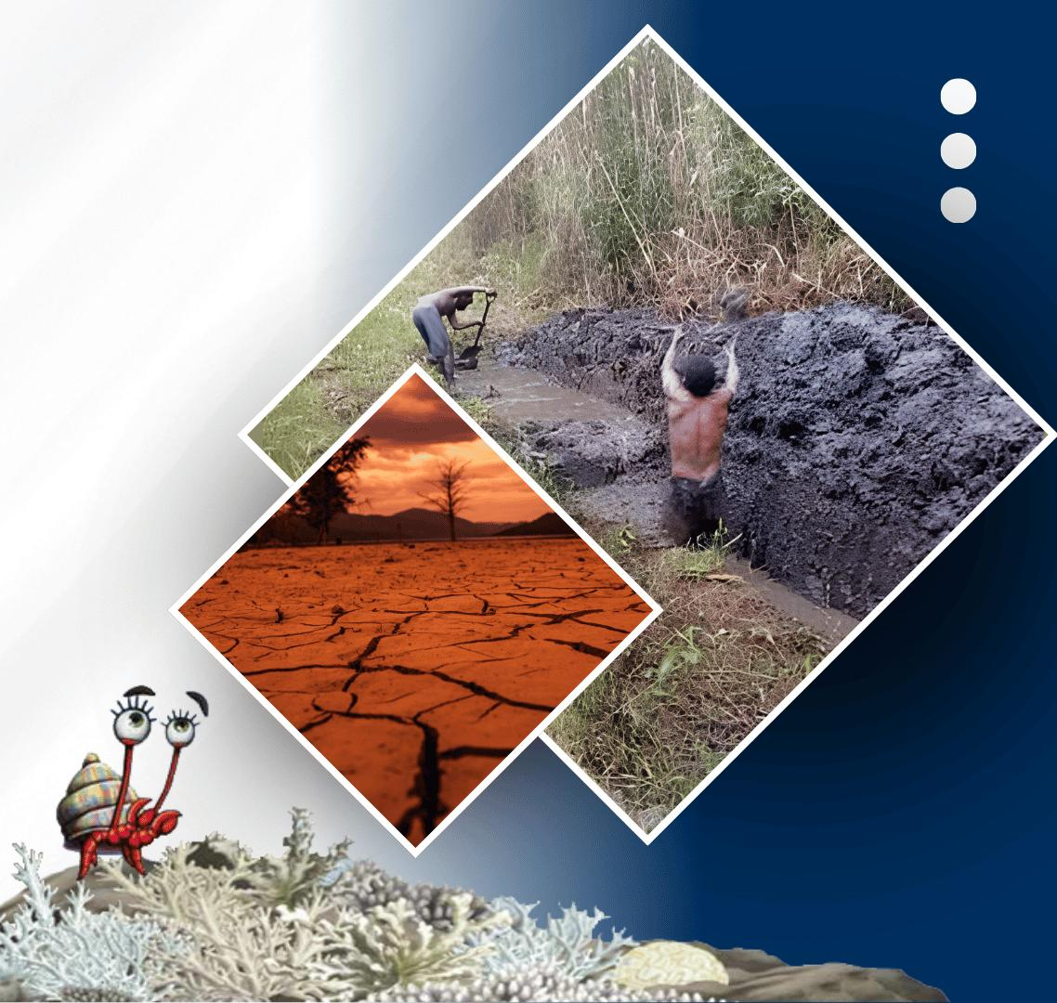




PACIFIC ISLANDS climate outlook forum-19
20 - 21 OCTOBER, 2026
HYBRID
PORT MORESBY, PAPUA NEW GUINEA
& ZOOM
www.pacificrcc.net
Notes:
Welcome, and thank you for joining this session of the nineteenth Pacific Islands Climate Outlook Forum.
Today we look at the regional ocean outlook for November 2026 to February 2027, during a strengthening El Niño, and what it means for Pacific Island countries.

Slide 2
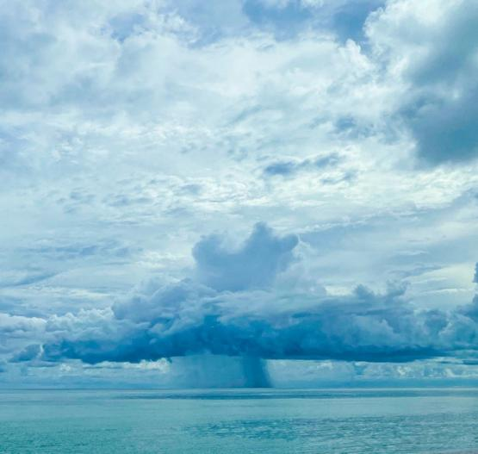
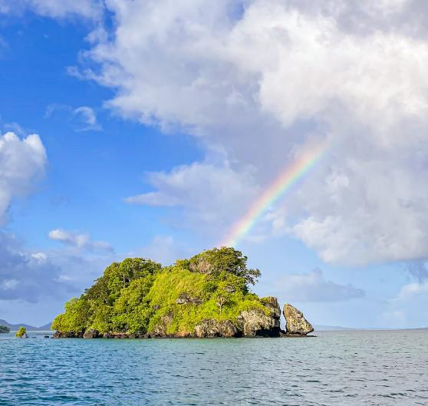






PICOF-19
Session 3iii. Ocean Outlook PICOF outlook and RCC Node for SP individual model/MME guidance and hindcast information
Presenter’s Name
Moleni Tu’uholoaki
Pacific Community (SPC)
Notes:
This is Session 3(iii), the ocean outlook. It brings together guidance from individual models and multi-model ensembles, through the RCC Node for the South Pacific, with hindcast skill information so we know how far to trust each forecast.
All of the forecasts were issued in October 2026.

Slide 3
Table of Contents
1.0 Sea Surface Temperature
WMO LC for Seasonal Prediction MME
Pacific Ocean Portal (data from BOM)
2.0 Sea Surface Heights
University of Hawaii (Top 5 MME)
Pacific Ocean Portal (data from BOM)
3.0 Marine Heat Wave
Pacific OceanPortal(data from BOM)
4.0 Coral Bleaching
Pacific Ocean Portal (NOAA)
NOAA Coral Reef Watch
5.0 Fisheries Convergence Zone
Pacific Ocean Portal (SST data from ACCESS-S)
6.0 Takeaway Message
Notes:
We will go through five ocean variables, each from the centres that produce them: sea surface temperature, sea surface height, marine heat waves, coral bleaching, and the fisheries convergence zone.
We finish with a country-by-country takeaway that can feed into the PICOF outcomes statement.

Slide 4
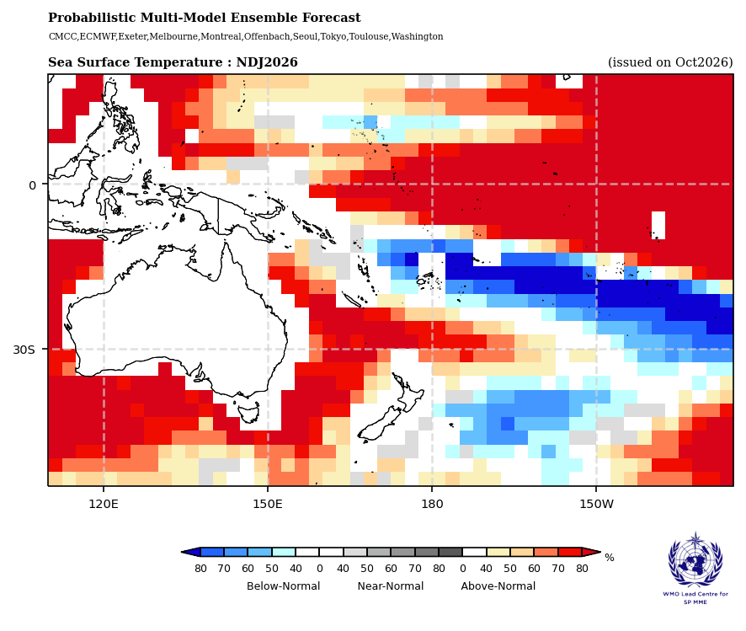
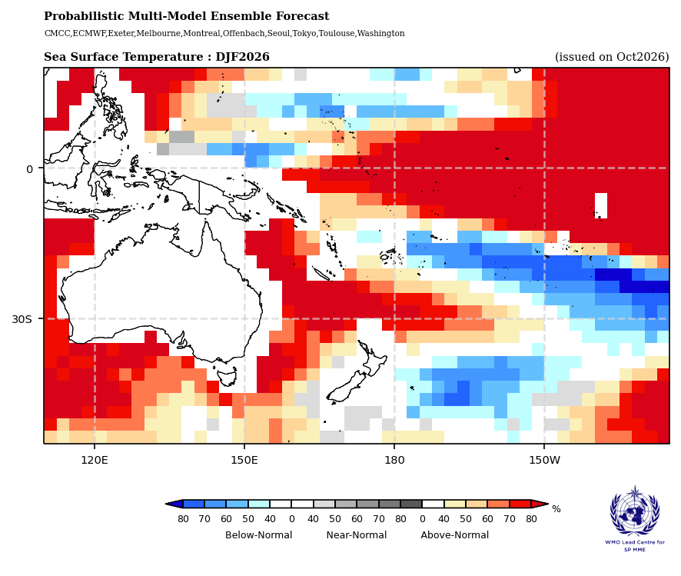
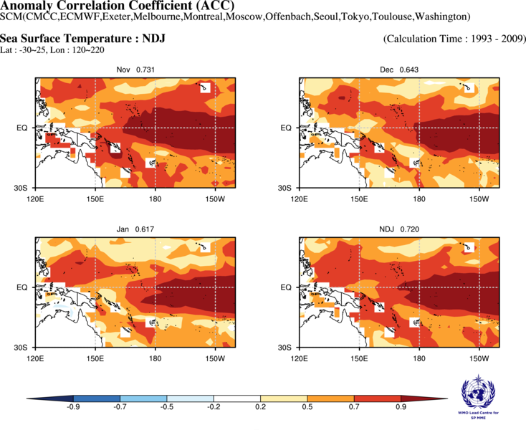
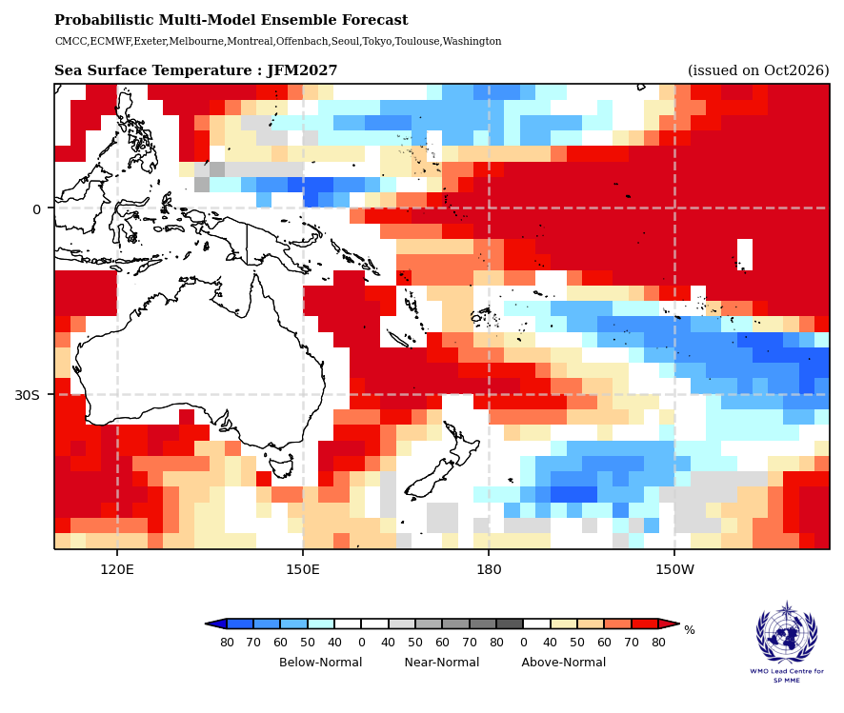
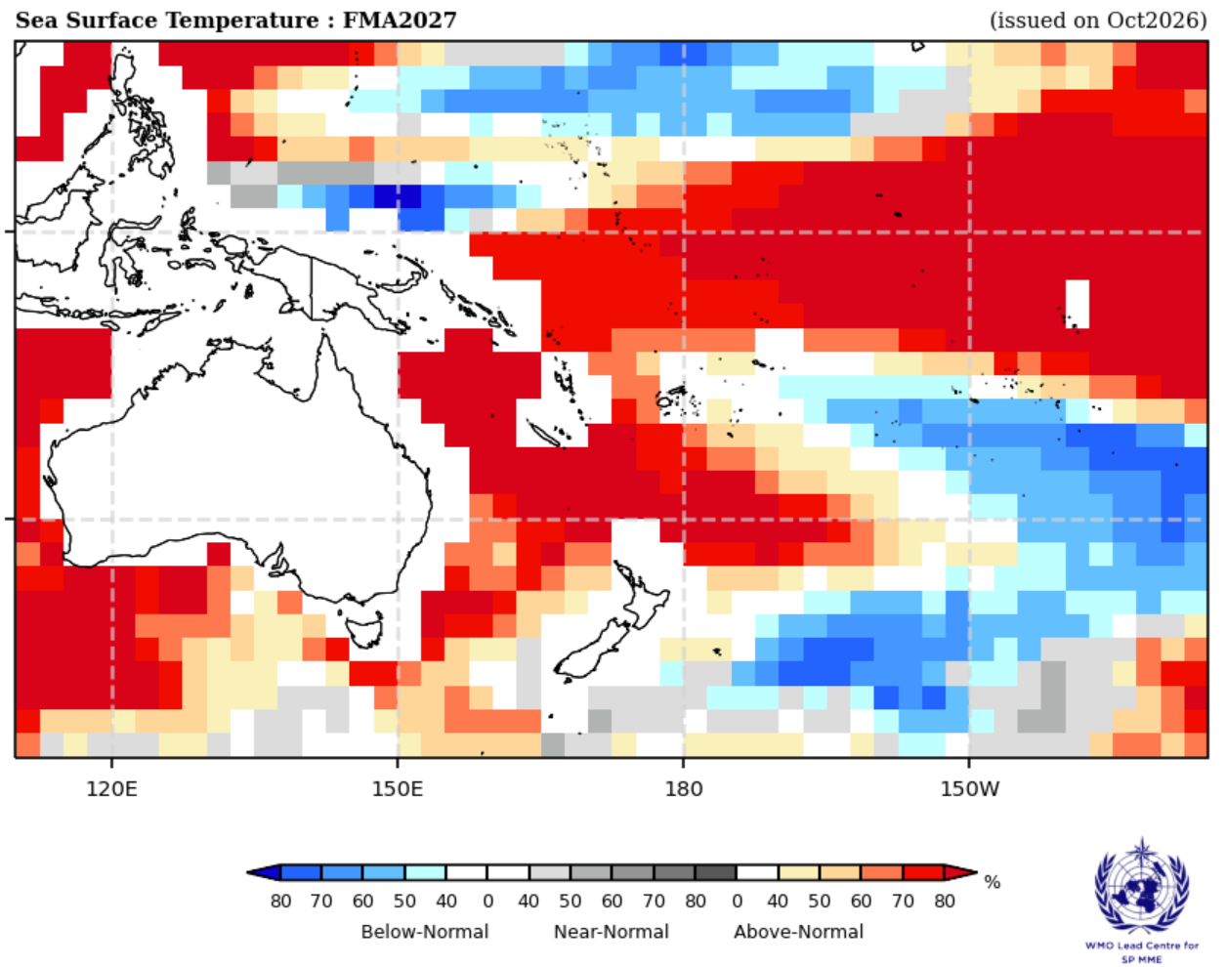
DELETTHIS BOX. PLACE MAP/DIAGRAM/IMAGE HERE
1.0 Sea Surface Temperature – WMO LC for Seasonal Prediction MME
NOV–JAN
DEC–FEB
JAN–MAR
FEB–APR
Equator: 70–80% chance of above-normal SST from east of PNG across Kiribati to South America, NDJ through FMA
Southwest Pacific: September's cool patches near PNG warm to above normal across PNG, Solomon Is, Vanuatu and New Caledonia by NDJ; Fiji, Samoa, Niue, Tonga, the Cook Is and French Polynesia stay below normal (60–80%) as the cool area retreats southeast by JFM
North Pacific: Palau is above normal in NDJ, then turns below normal (60–80%) with Yap (FSM) by FMA; the Marshall Is are below normal from JFM
Skill: ACC is 0.72 for NDJ (high above 0.7, good 0.5–0.7, low 0.2–0.5, none below 0.2): skill is high along the equator east of 180° and good across most of the southwest Pacific, but falls from 0.73 in Nov to 0.62 in Jan
Source: www.wmolc.org
Notes:
This slide shows the WMO Lead Centre multi-model ensemble outlook for sea surface temperature, issued October 2026, for four overlapping seasons from Nov–Jan to Feb–Apr.
Along the equator, from east of PNG across Kiribati to South America, there is a 70 to 80 percent chance of above-normal temperatures. This is the classic El Niño warm tongue.
In the SW pacific, we saw earlier months and so as near realtime daily SST up to yesterday, a below average band extending rom PNG and the Solomon Islands and continued on SE-wards with with more pronounced below SST band through Fiji, Samoa, Niue, Tonga, the Cook Islands and French Polynesia. This band of cool SST will near-normal over PNG and Solomon Islands in Nov-Jan, but maintain cooling SST with a 60 to 80 percent in Nov–Jan in Fiji, Samoa, Niue, Tonga, the Cook Islands and French Polynesia.. That band receded southeast from Jan-Mar
Fiji, Samoa, Niue, Tonga, the Cook Islands and French Polynesia have a 60 to 80 percent in Nov–Jan. In the North Pacific, Palau is warm early in the season, then turns below normal with Yap by Feb–Apr. The Marshall Islands turn below normal from Jan–Mar.
On skill: an ACC above 0.7 is high and 0.5 to 0.7 is good. For Nov–Jan the score is 0.72, high along the equator and good across most of the southwest Pacific, so we can have reasonable confidence in this pattern. Skill drops off from November to January.

Slide 5
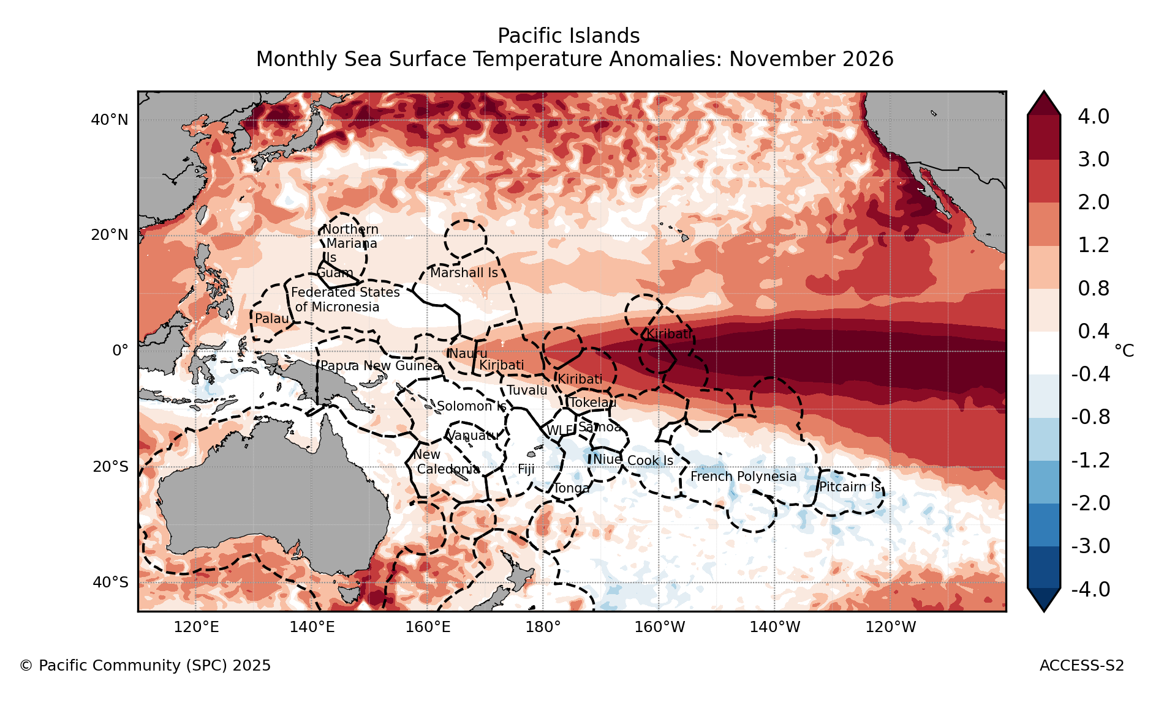
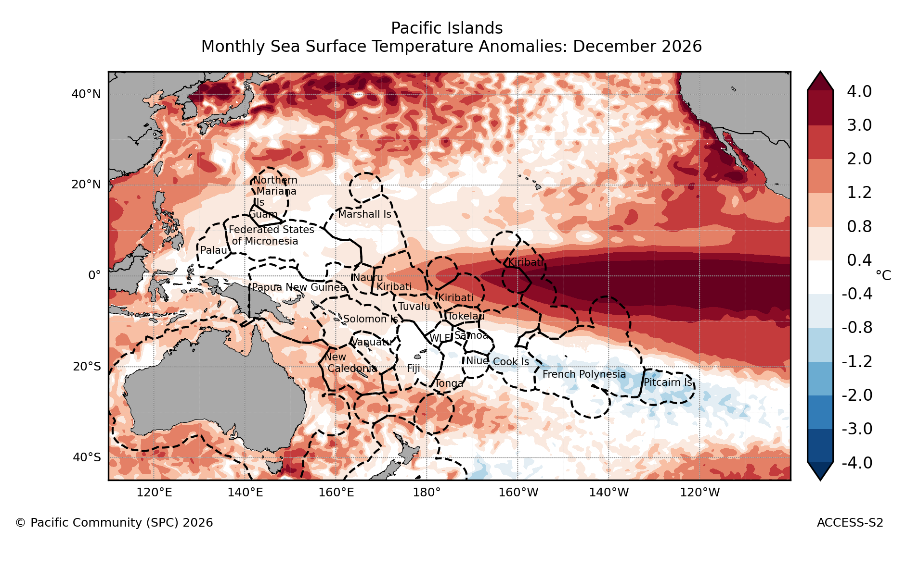
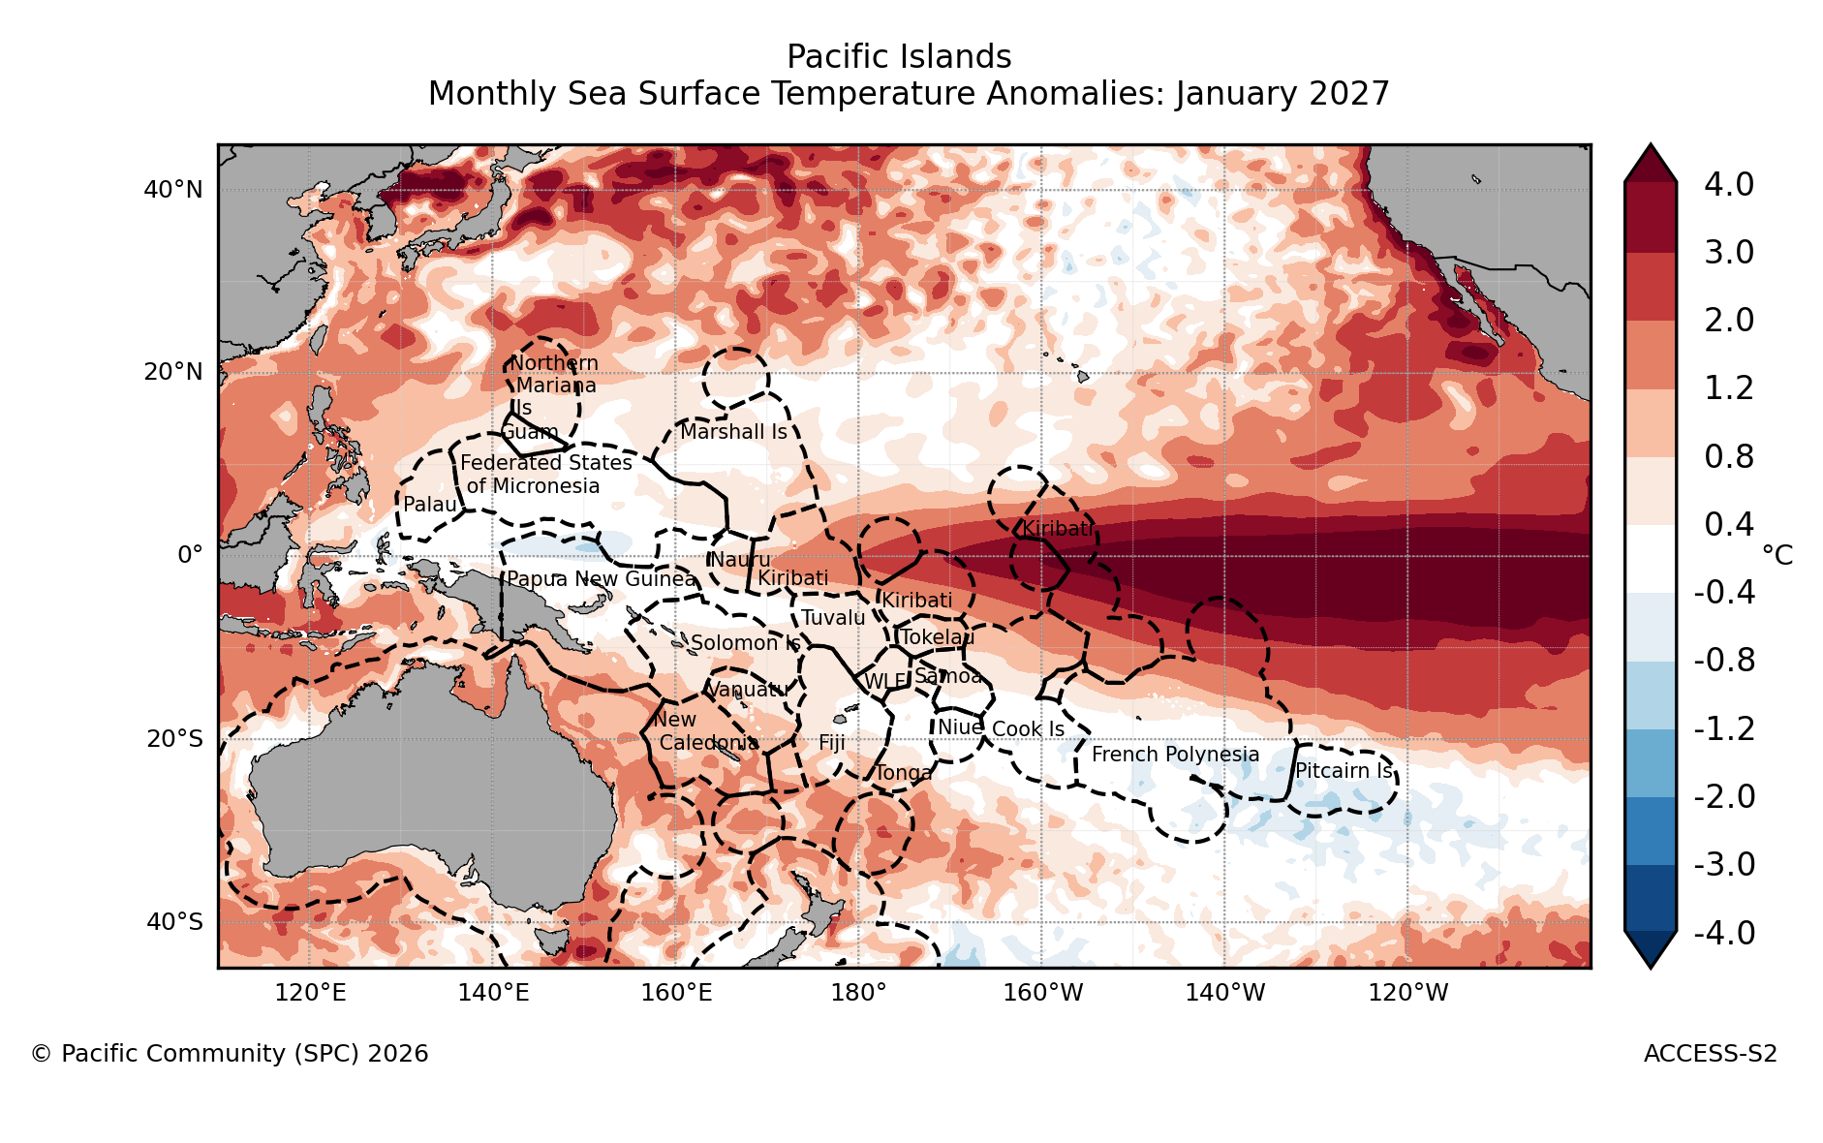
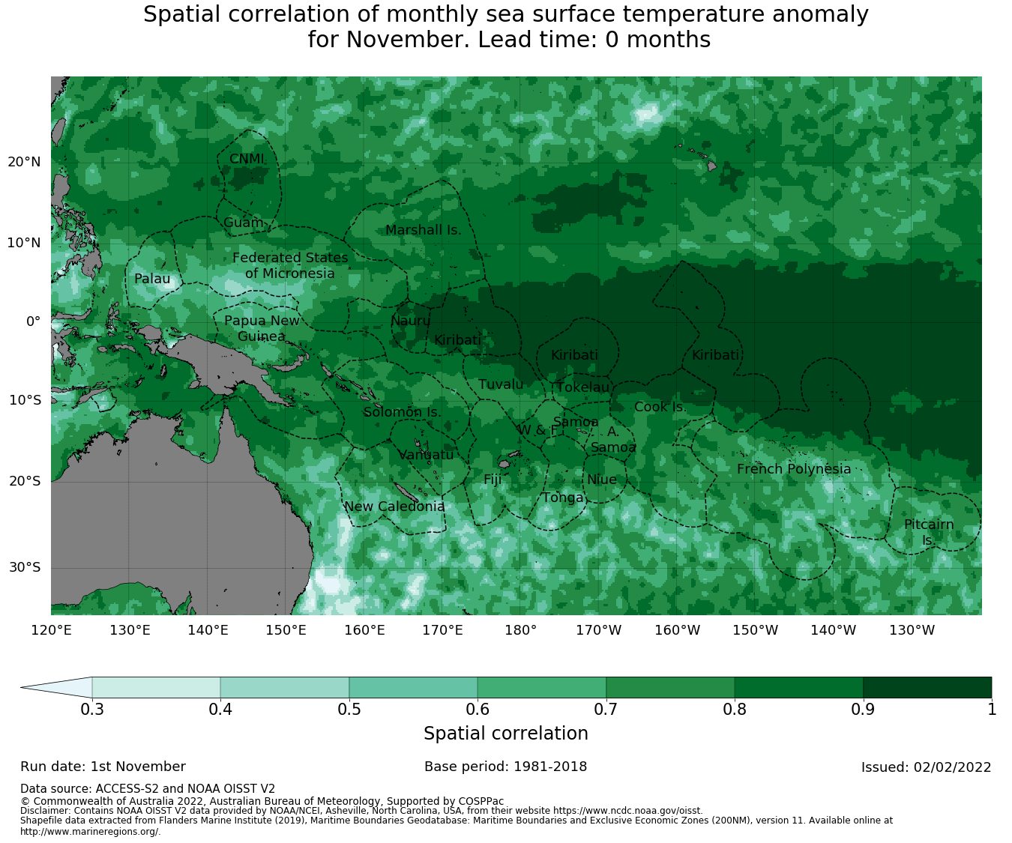
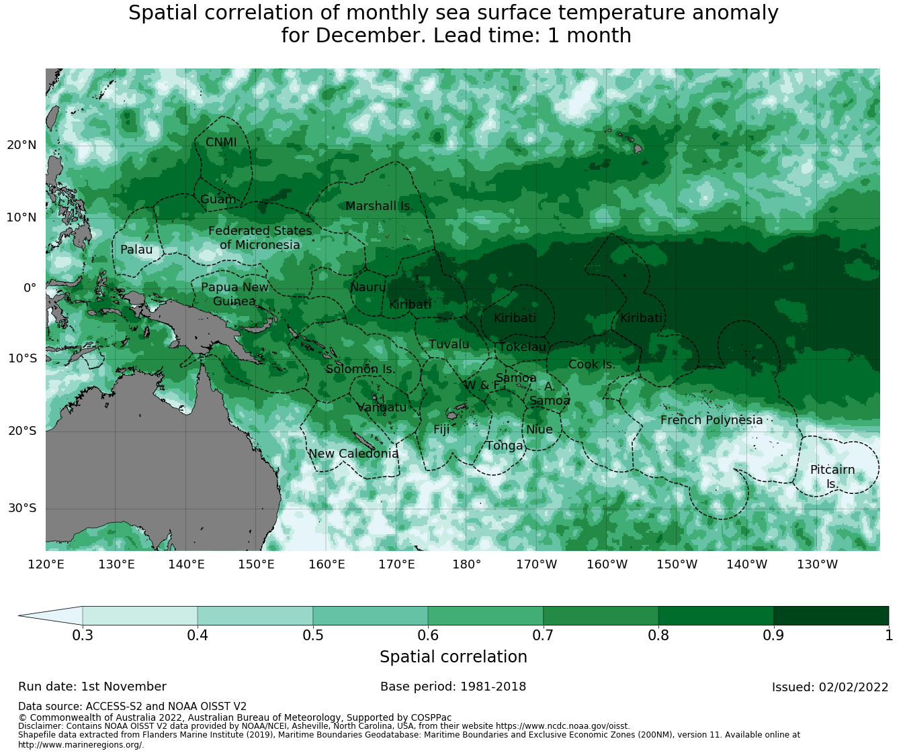
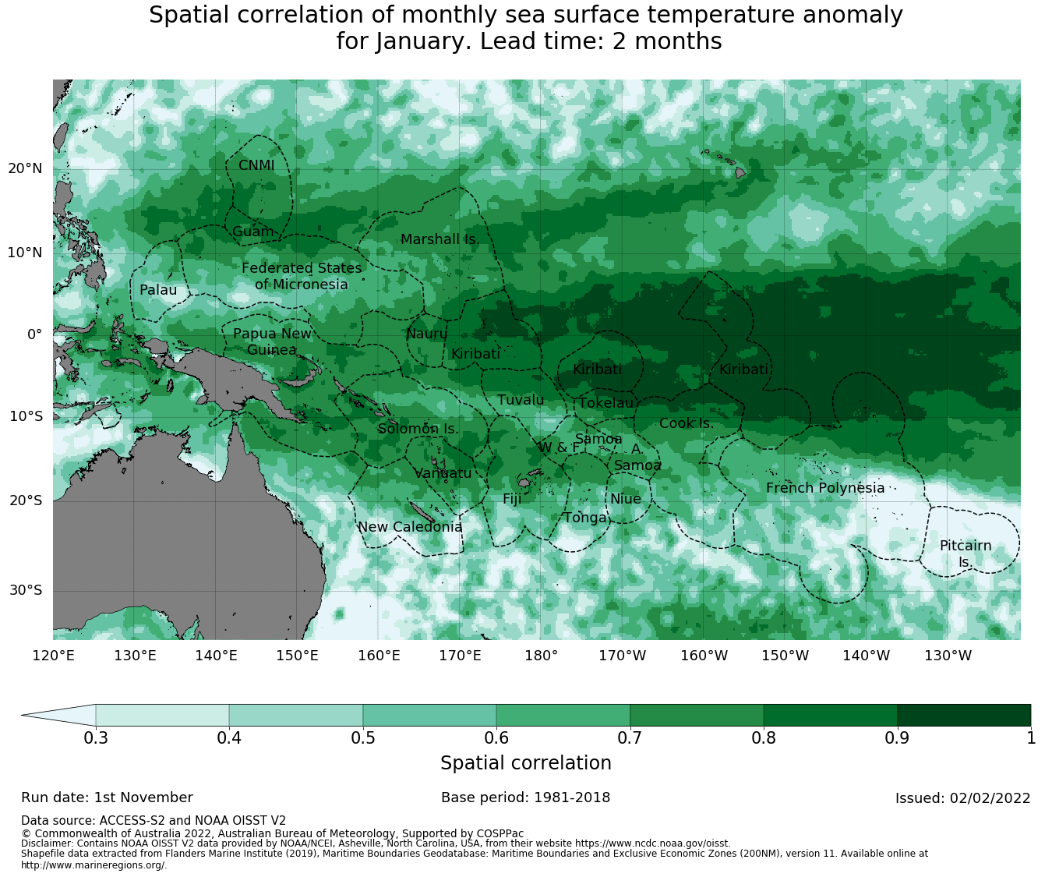
DELETE THIS BOX. PLACE MAP/DIAGRAM/IMAGE HERE
1.0 Sea Surface Temperature – BOM
NOV 2026
DEC 2026
JAN 2027
  Use this space for more text if needed
  Only up to 3 bullet points
  Delete text block if not applicable
Simple Title
NOV 2026
DEC 2026
JAN 2027
Forecast
Above +3°C along the equator east of 170°W (Kiribati), Nov 2026–Jan 2027
Skill
High skill in central and eastern Pacific equatorial region(0.8–1.0); lower south of 20°S
Source: https://access-s.clide.cloud/
Notes:
This is the Bureau of Meteorology ACCESS-S model forecast of sea surface temperature anomalies for November 2026 to January 2027, with its verification skill underneath.
The model shows anomalies above plus 3 degrees along the equator east of 170 degrees West, which agrees with the WMO ensemble on the previous slide.
Skill is high along the equator and lower south of 20 degrees South, so treat the details in the southern part of the map with more caution.

Slide 6
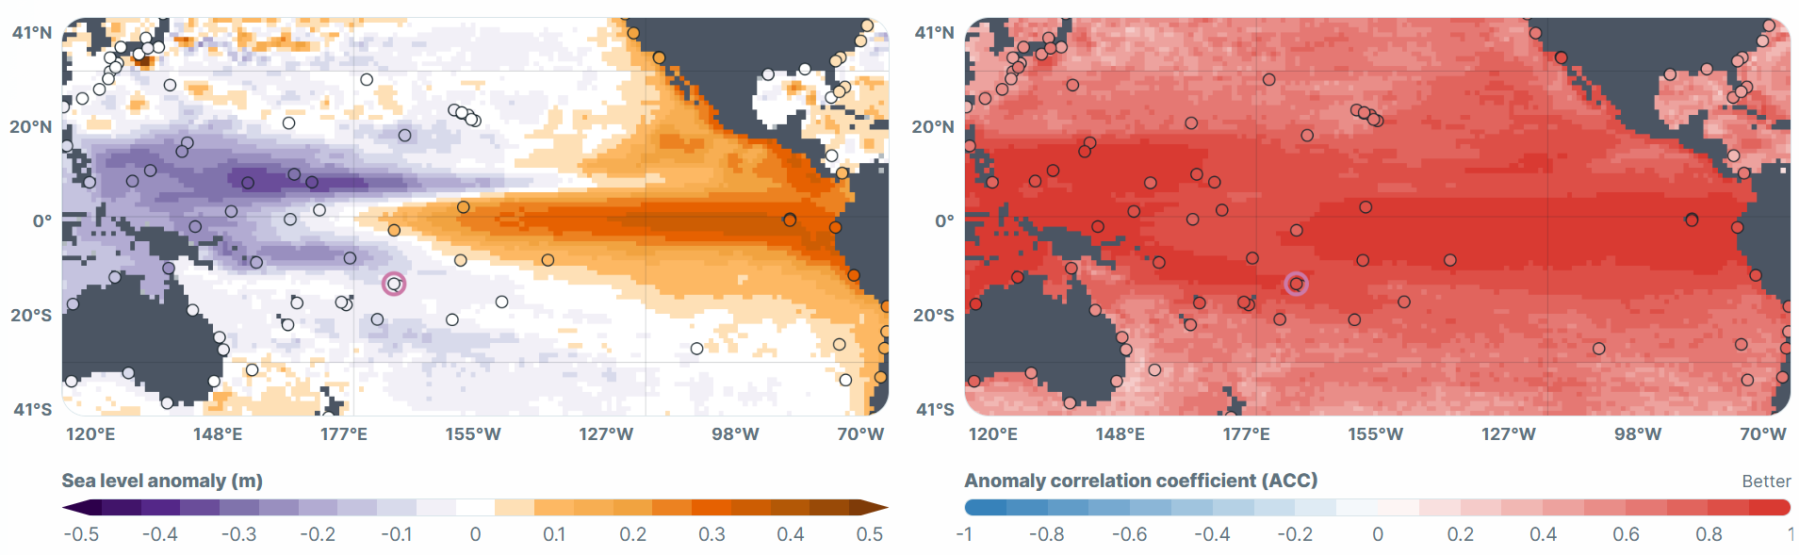
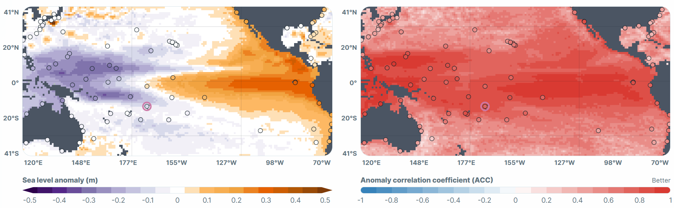
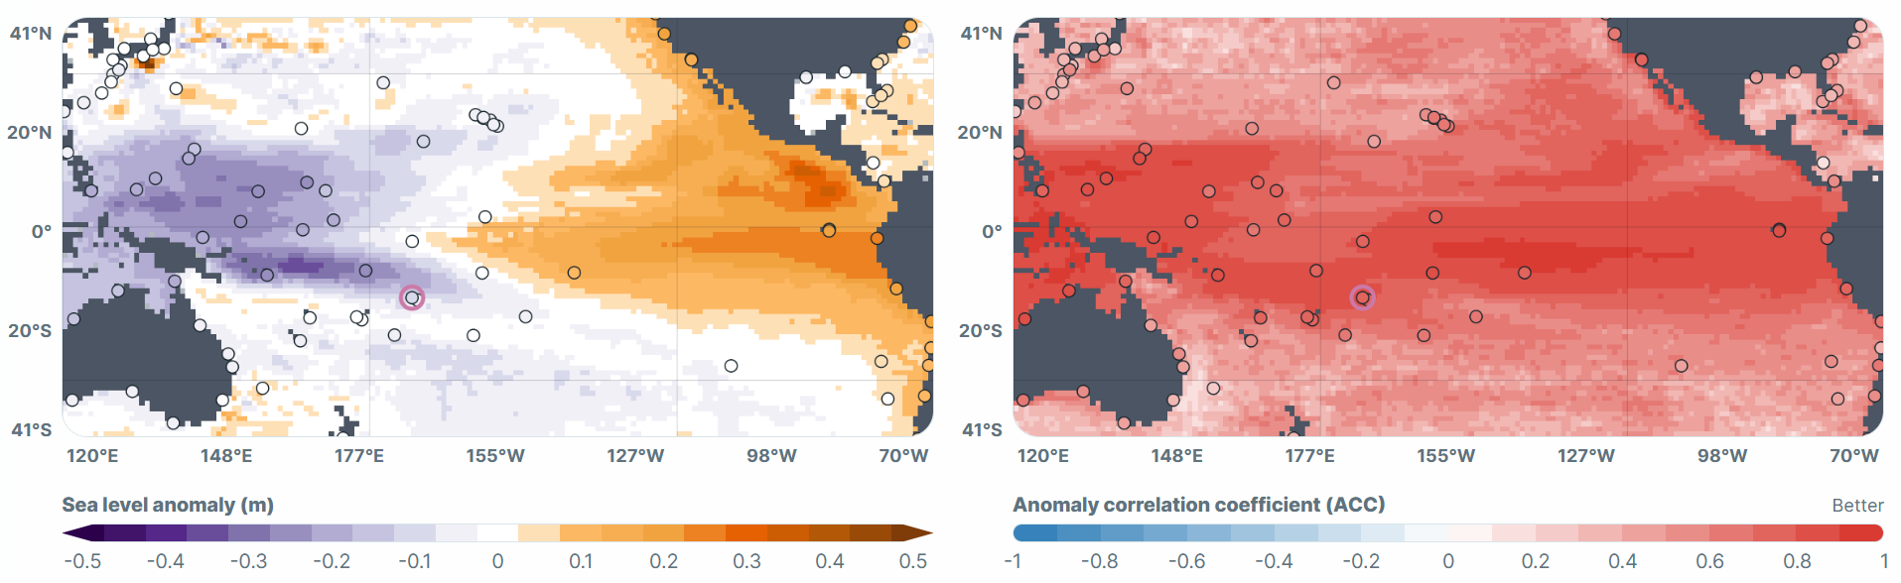
DELETE THIS BOX. PLACE MAP/DIAGRAM/IMAGE HERE
2.0 Sea Surface Heights – University of Hawaii (Top 5 MME)
NOV 2026
Forecast to Dec 2026
West–east contrast holds: well below normal over Palau, FSM, Marshall Is, PNG and Solomon Is; well above normal east of 170°W (Kiribati Line Is)
Central Pacific (Kiribati Gilbert and Phoenix Is): slightly above normal, fading to near normal by Dec
DEC 2026
Simple Title
Skill (right-hand maps)
High skill (ACC 0.6–0.9) across most of the tropical Pacific, strongest along the equator and over Micronesia
Skill eases slightly from Nov to Jan, mainly south of 20°S
Observed Sep 2026
well below normal at Yap (FSM); well above normal at Kiritimati (Kiribati)
JAN 2027
Source: https://uhslc.soest.hawaii.edu/research/monthly_sea_level_forecast/
Notes:
This is the University of Hawaii Sea Level Center Top-5 multi-model forecast of sea level anomalies, from their discussion of 12 October 2026.
In September, sea level was about 21 cm below normal in the western equatorial Pacific and 25 cm above normal in the east. Yap in FSM was 27 cm below its reference; Kiritimati in Kiribati was 31 cm above.
Through to December, this west-east contrast holds: about 24 cm below normal over Palau, FSM, the Marshall Islands, PNG and the Solomon Islands, and about 24 cm above normal east of 170 degrees West, around Kiribati's Line Islands.
This is the typical El Niño sea level pattern. Low sea levels in the west can expose reefs at low tide; high levels in the east raise the risk of coastal flooding at high tide.
The right-hand maps show the skill of this forecast, as the anomaly correlation coefficient from past forecasts. Red means the forecast has matched observations well. Skill is high, 0.6 to 0.9, across most of the tropical Pacific and strongest along the equator and over Micronesia, so we can have good confidence in the west-east contrast. Skill eases a little from November to January, mainly south of 20 degrees South.

Slide 7
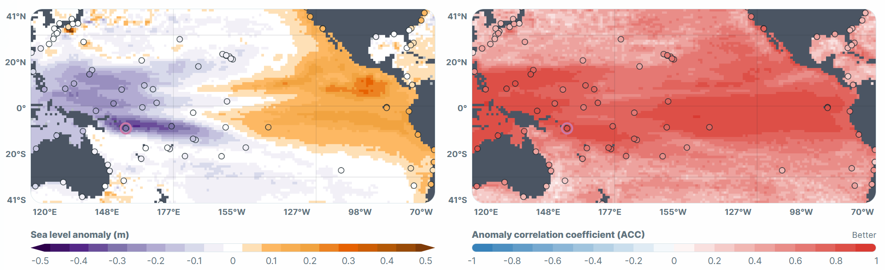
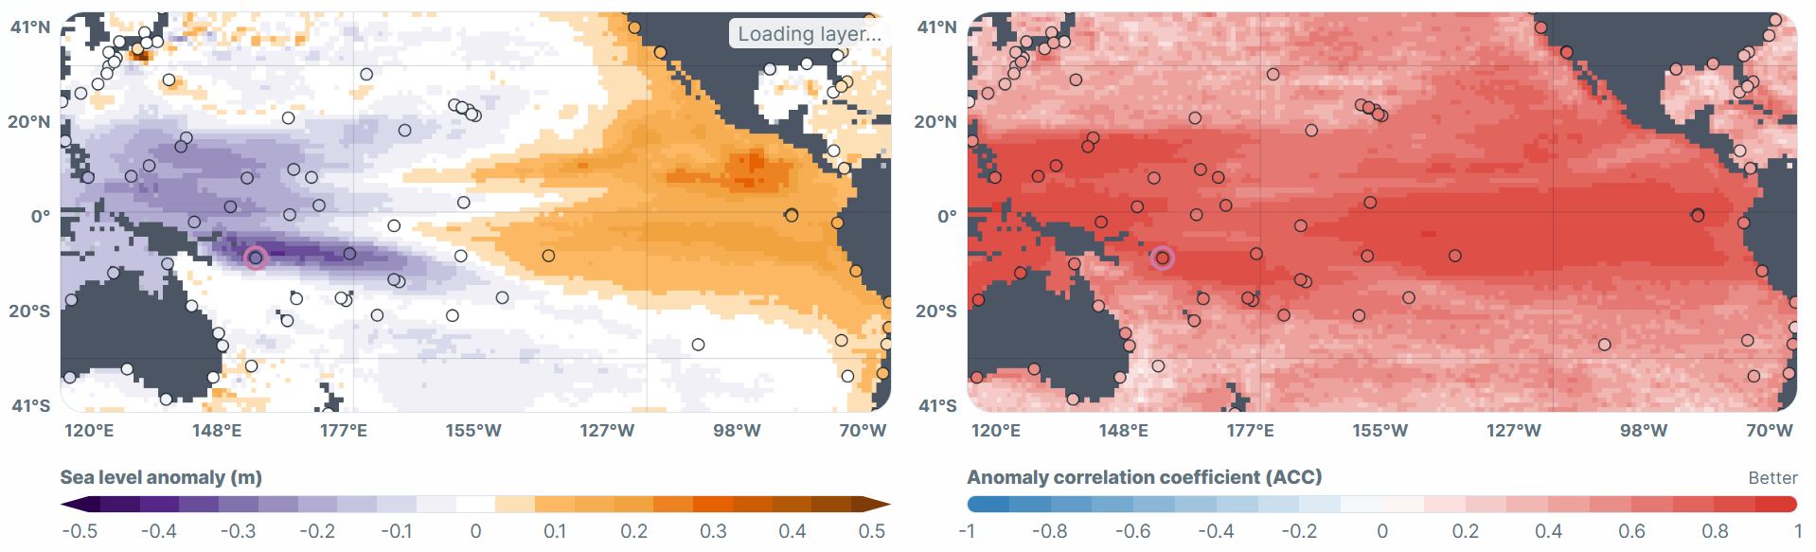
2.0 Sea Surface Heights – University of Hawaii (Top 5 MME)
FEB 2027
Forecast to Mar 2027
Contrast eases: lows weaken but persist, lowest near PNG and Solomon Is; highs ease east of 170°W (Kiribati Line Is); the low tongue reaches Tuvalu and Samoa (slightly below normal)
Low-tide reef exposure: likely wherever sea level is low; already seen in Solomon Is, expected in FSM, Yap, Tuvalu and Samoa, especially early 2027
Simple Title
MAR 2027
Confidence
Higher for Nov 2026–Jan 2027 than for March 2027 or exact coastal levels
Source: https://uhslc.soest.hawaii.edu/research/monthly_sea_level_forecast/
Notes:
Looking further ahead to March 2027, the University of Hawaii forecast shows the contrast easing.
The west eases to about 18 cm below normal, still lowest near PNG and the Solomon Islands. The east eases to about 14 cm above normal around Kiribati's Line Islands. Tuvalu and Kiribati's Gilbert Islands are near neutral.
At Yap in FSM, low tides are likely to fall below the 2nd-percentile level on 25 to 28 November, 24 to 27 December and 22 to 24 January. Communities may see more reef exposure on those dates.
Confidence is higher for the near-term pattern than for March or for exact coastal levels. These are not impact warnings; local surge and waves can differ.
Low-tide reef exposure is not limited to Yap, which is simply the station named in the University of Hawaii discussion. It is already being seen in the Solomon Islands, and Samoa is known to experience it during El Niño, especially in the following year, so early 2027 is a period to watch.

Slide 8
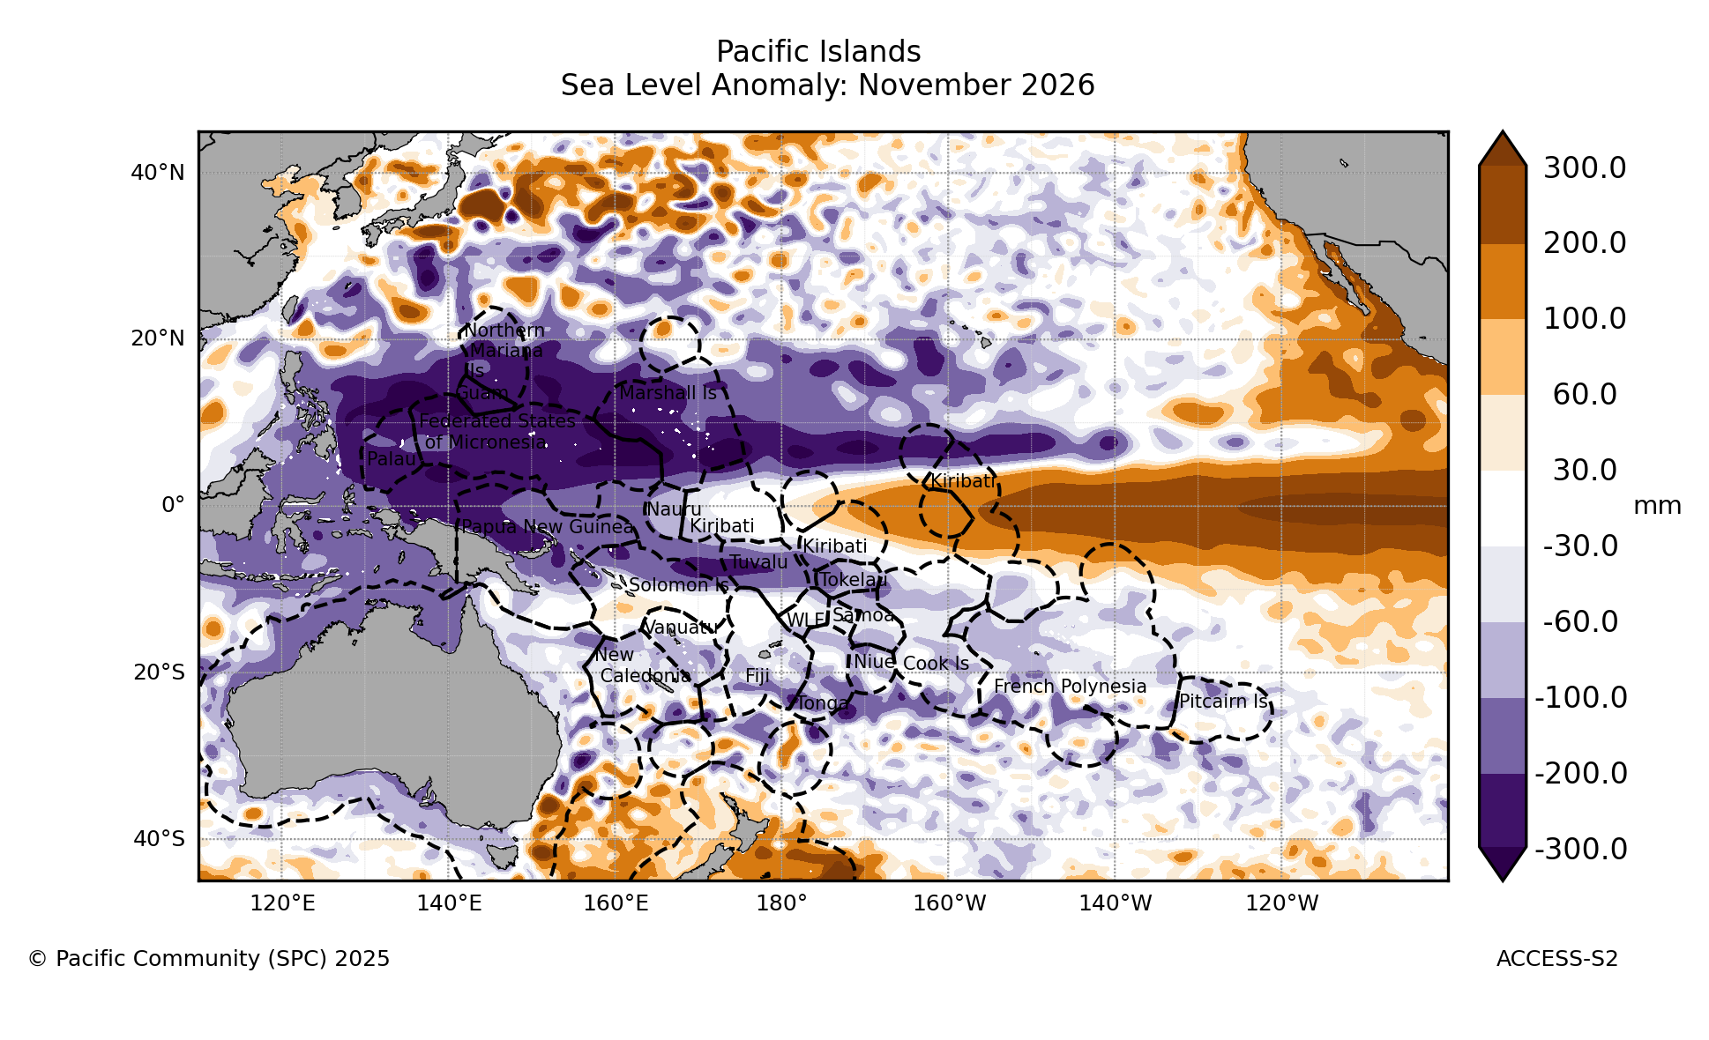
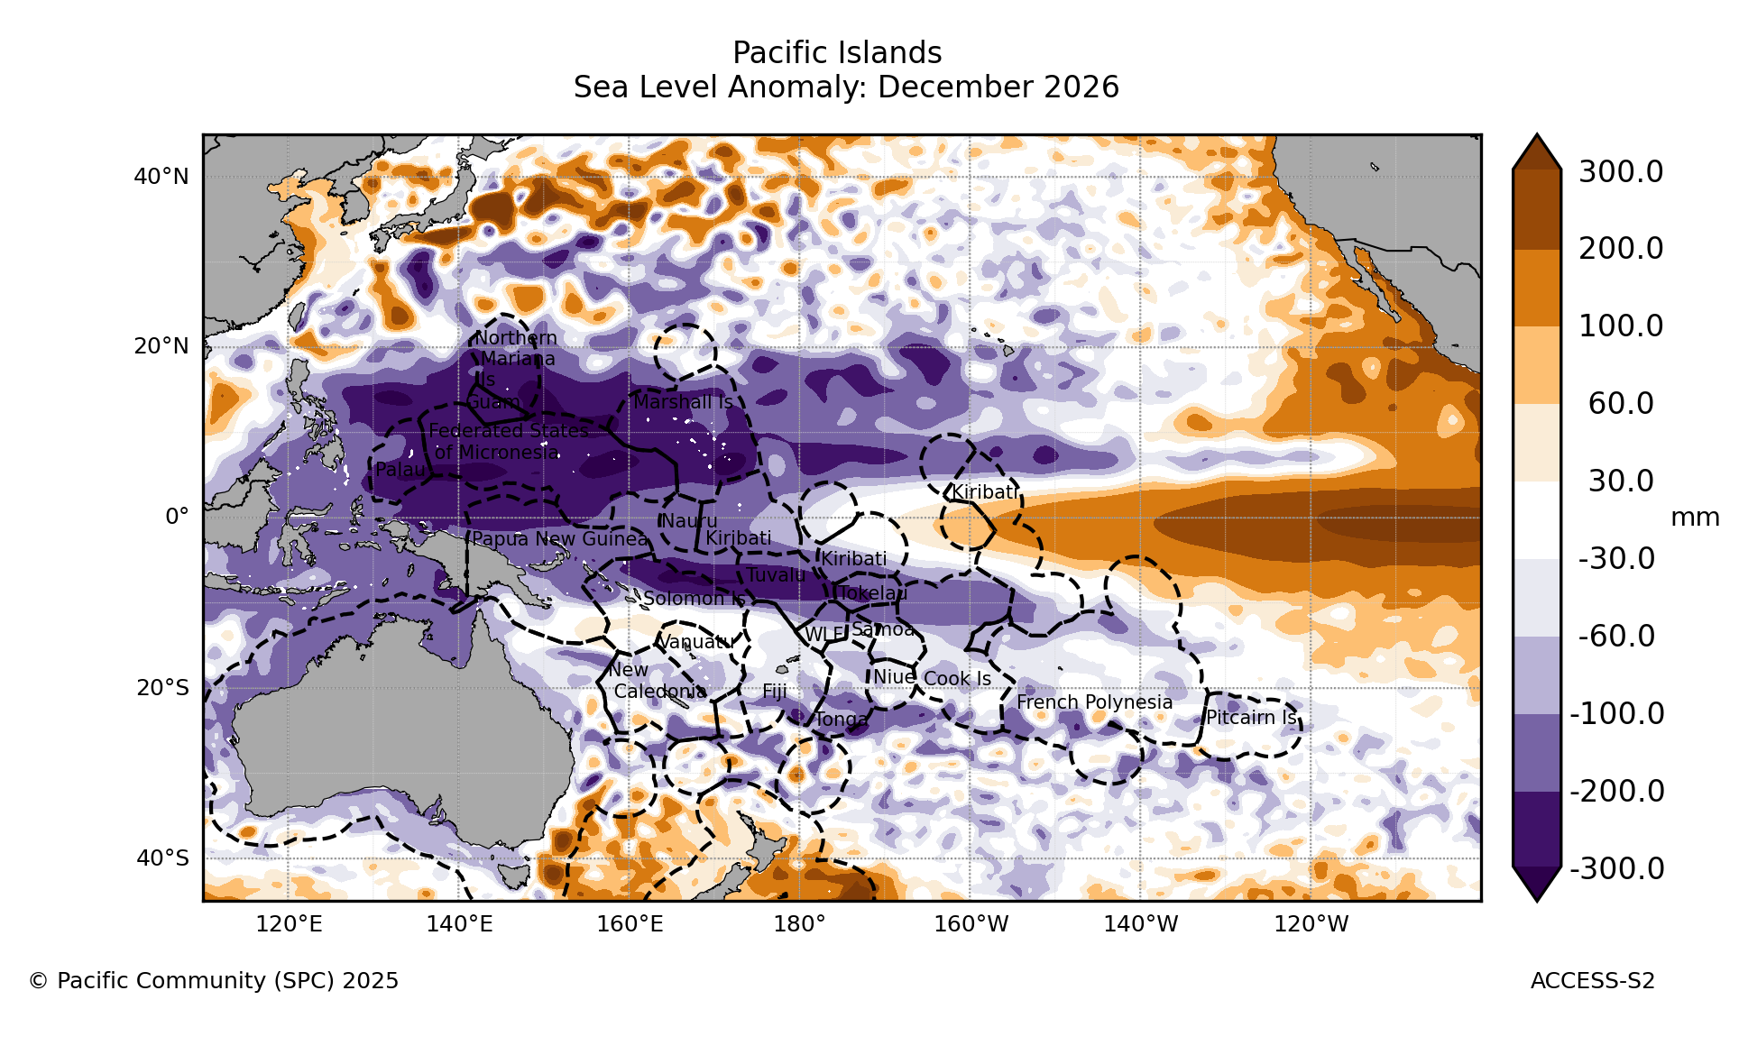
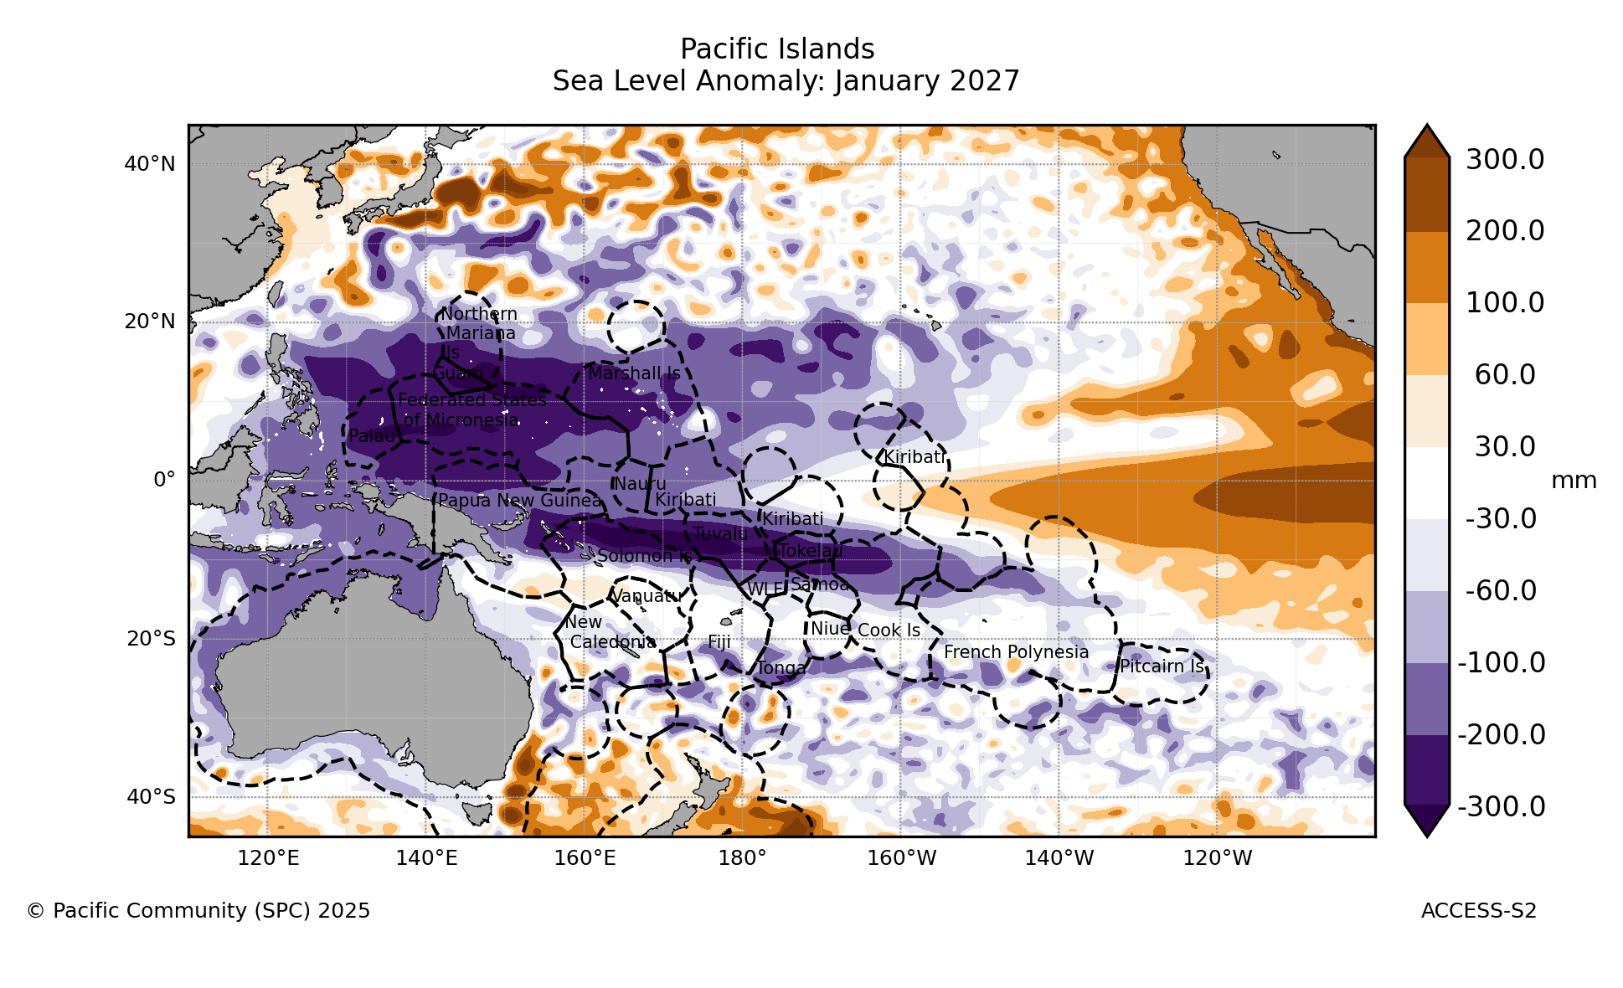
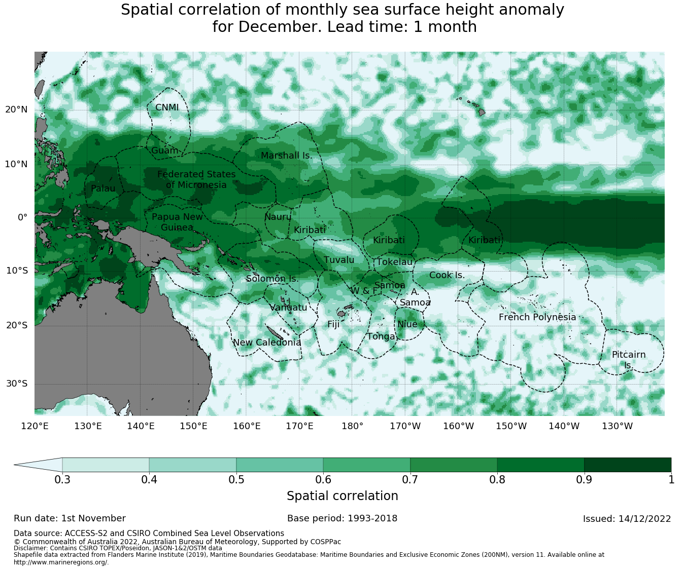
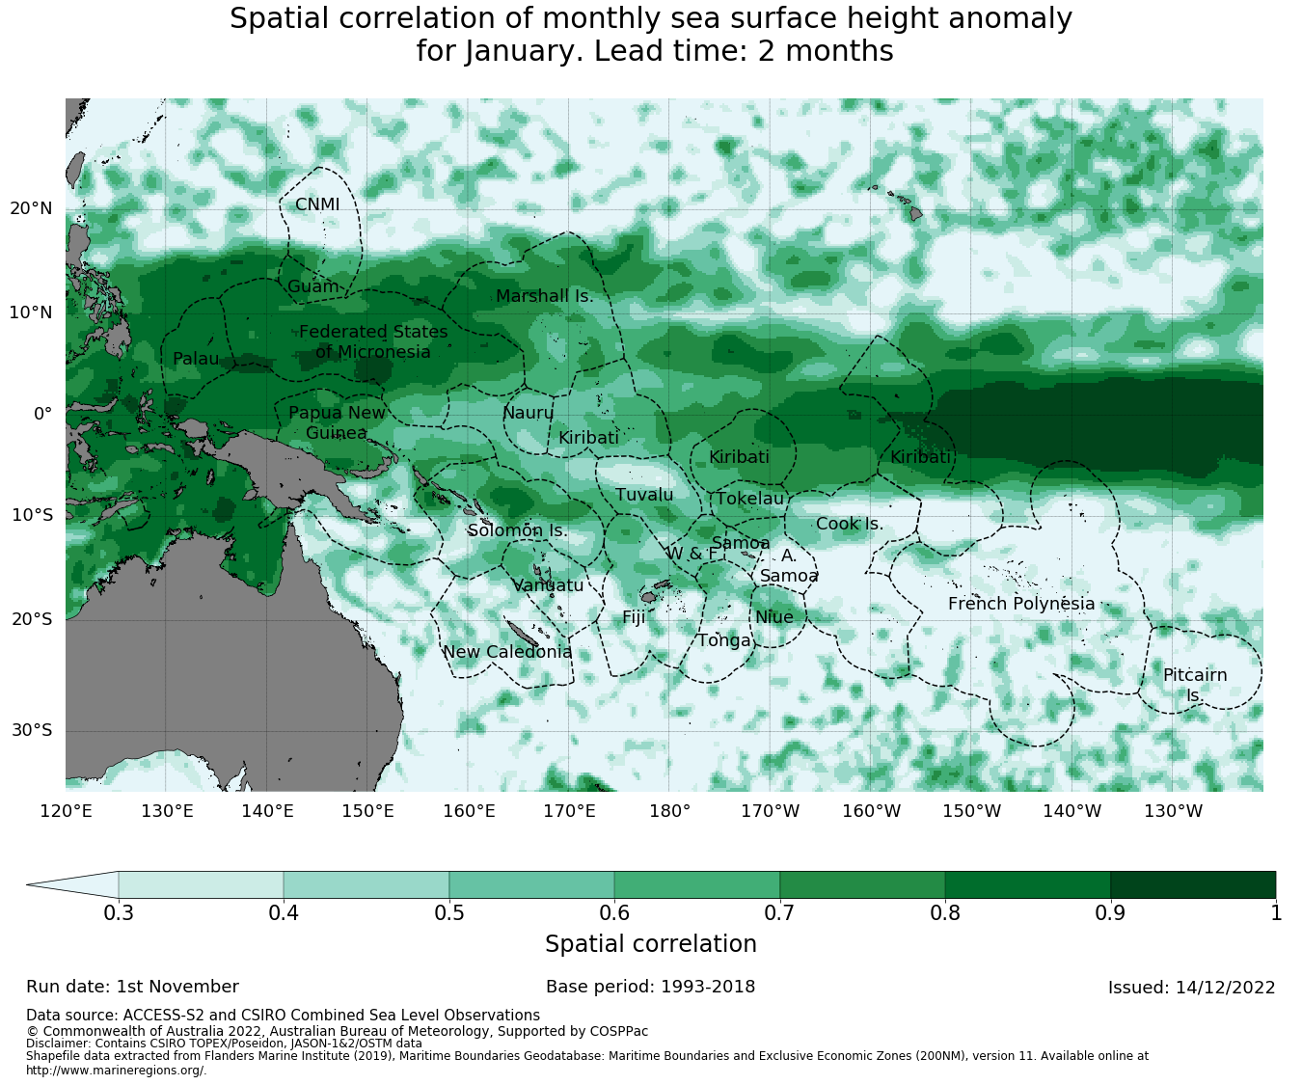
DELETE THIS BOX. PLACE MAP/DIAGRAM/IMAGE HERE
2.0 Sea Surface Heights – BOM
NOV 2026
DEC 2026
JAN 2027
Simple Title
NOV 2026
DEC 2026
JAN 2027
Forecast
100–300 mm below average from Palau and FSM to Nauru, Tuvalu and western Kiribati; above average east of 160°W
The low band spreads to Tokelau and Samoa by Jan 2027
Verification
High skill on the equator east of 160°W and in Micronesia; lower south of 10°S
Source:
Notes:
This is the Bureau of Meteorology ACCESS-S sea level forecast for November 2026 to January 2027, with verification skill on the bottom row.
It shows below-average sea level from Palau through to Nauru, Tuvalu and western Kiribati, spreading towards Tokelau and Samoa by January.
This broadly agrees with the University of Hawaii ensemble on the low sea levels in the west. Where the two differ, for example near Samoa, the multi-model ensemble is generally the more reliable guide.
Note that the bottom-left skill map is labelled for sea level but appears to show SST skill; please check before relying on it.

Slide 9
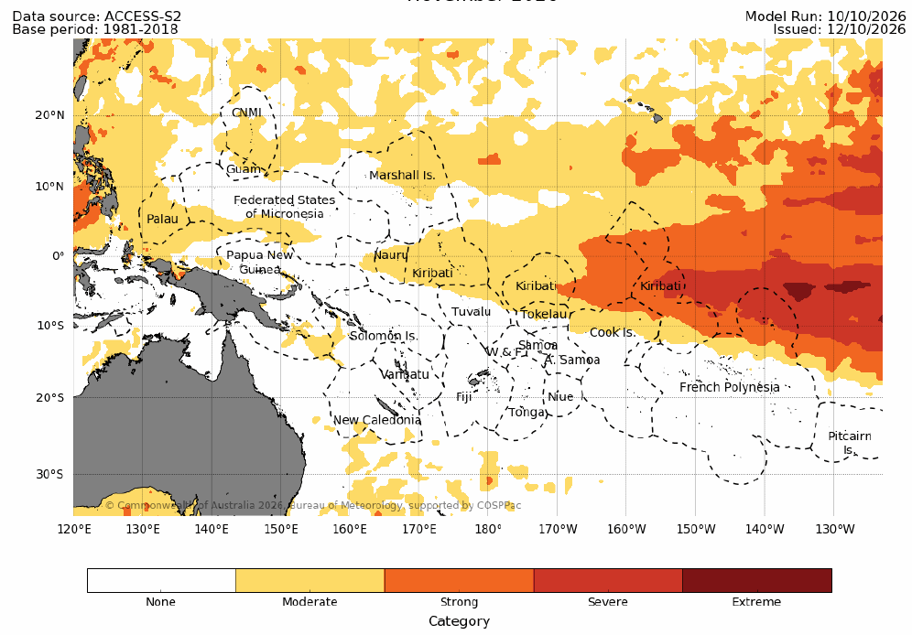
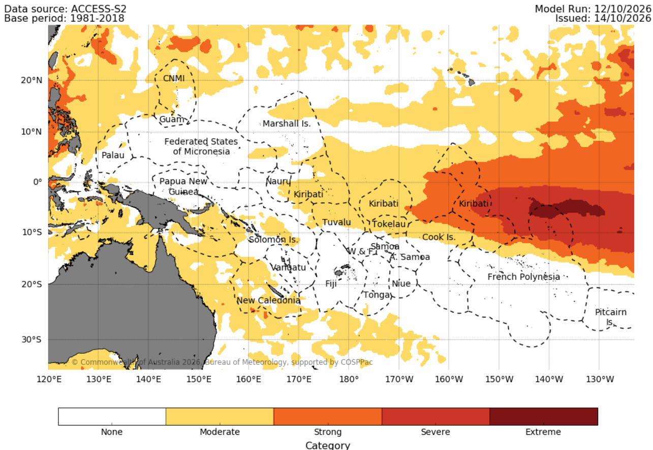
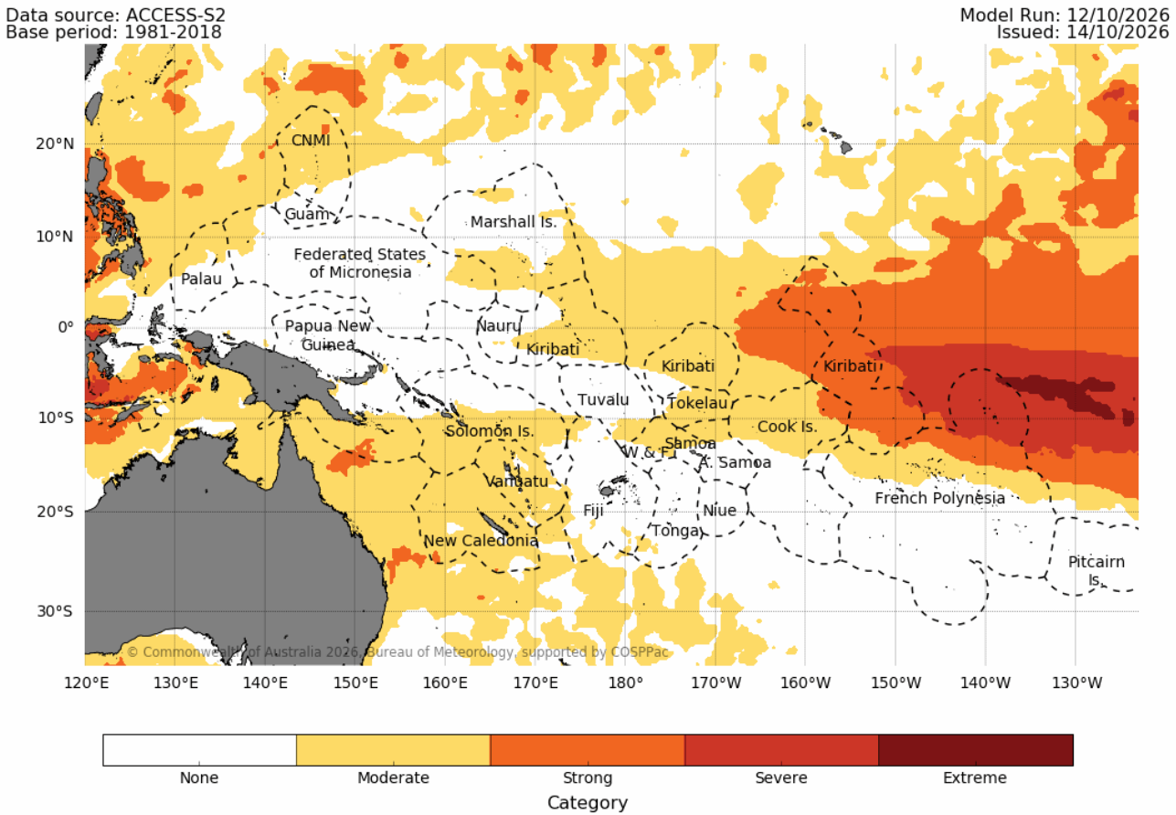
3.0 Marine Heat Wave – BOM
NOV 2026
DEC 2026
JAN 2027
Simple Title
Forecast: November 2026 – January 2027
Eastern Kiribati (Line Is): strong to severe heat wave all three months; the extreme core near 140°W grows by January
Naoero to Cook Is: moderate heat wave around Naoero, western Kiribati, Tuvalu, Tokelau and the northern Cook Is
Southwest Pacific: moderate heat wave spreads to Solomon Is, Vanuatu and New Caledonia by Dec–Jan; none for Samoa, Fiji, Tonga or Niue
Local effects: the model grid does not resolve lagoons and shallow reefs, so localised heat waves can occur in any country where local conditions allow, as seen in Fiji, Tonga and FSM in the recent past
Source: https://access-s.clide.cloud/
Notes:
These are the Bureau of Meteorology marine heat wave category forecasts for November, December and January.
The strongest signal is along the equator in Kiribati's Line Islands: a strong to severe heat wave in all three months, with an extreme core near 140 degrees West that grows by January.
A moderate heat wave is expected around Naoero, western Kiribati, Tuvalu, Tokelau and the northern Cook Islands, and it spreads to the Solomon Islands, Vanuatu and New Caledonia by December and January.
For Fiji, Samoa, Tonga and Niue, no marine heat wave is expected. This fits the cooler SST band we saw earlier.
A note on local effects. Where these regional maps show no heat wave, that does not rule one out locally. The model grid is too coarse to resolve lagoons, enclosed bays and shallow reef flats, which can heat up during calm, sunny spells with weak winds even when the open ocean is near normal. This can happen in any country when those local conditions are met, and we have seen it in the past in Fiji, Tonga and FSM, among others, so local monitoring of in-situ temperatures remains important.

Slide 10
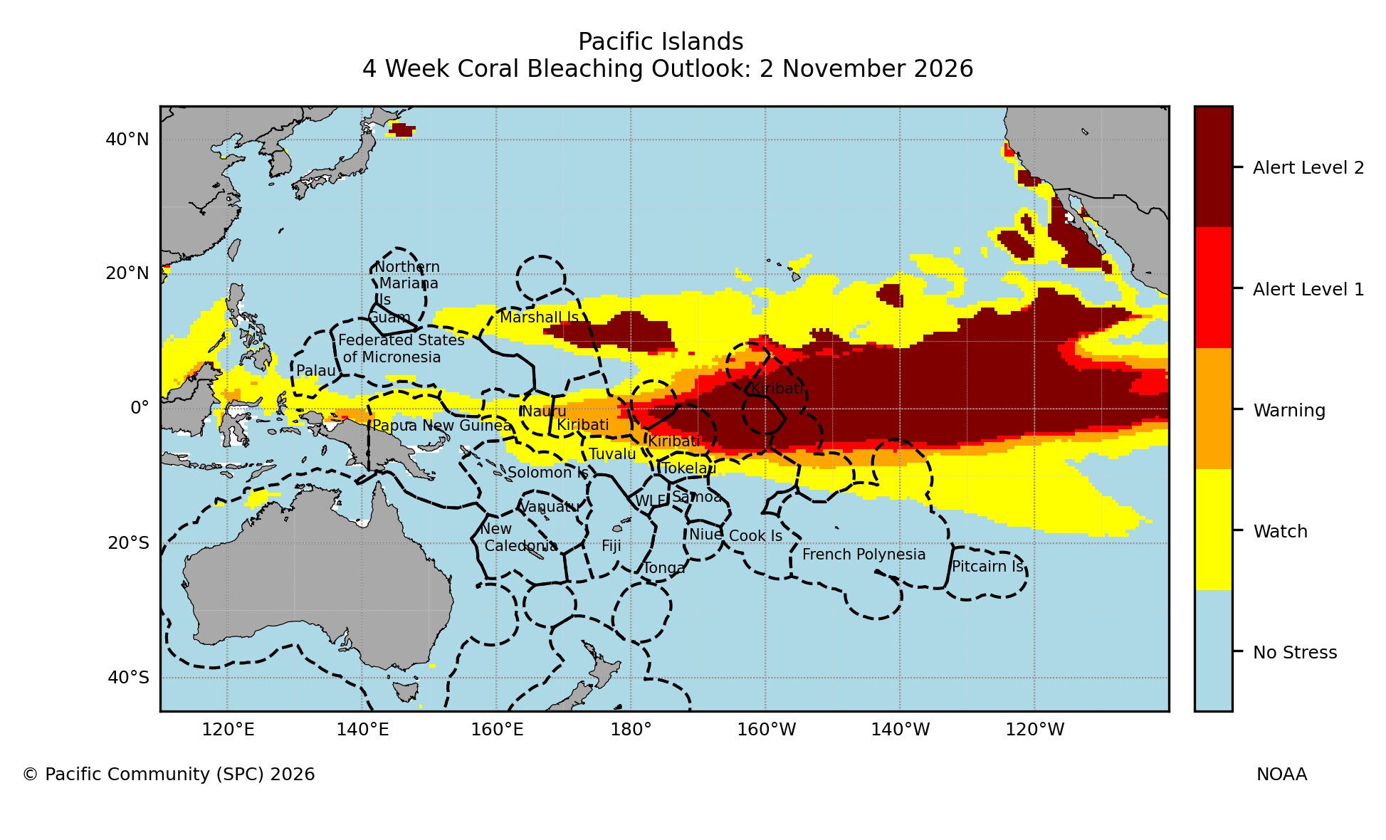
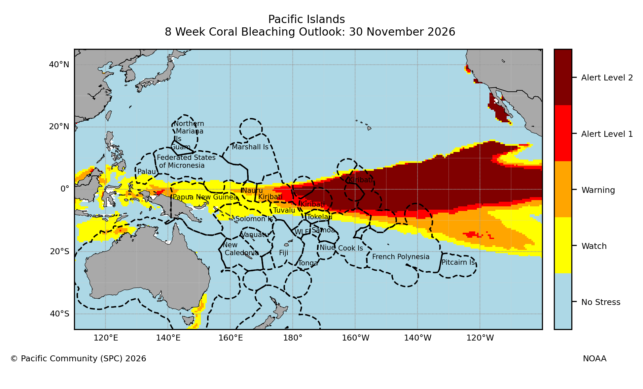
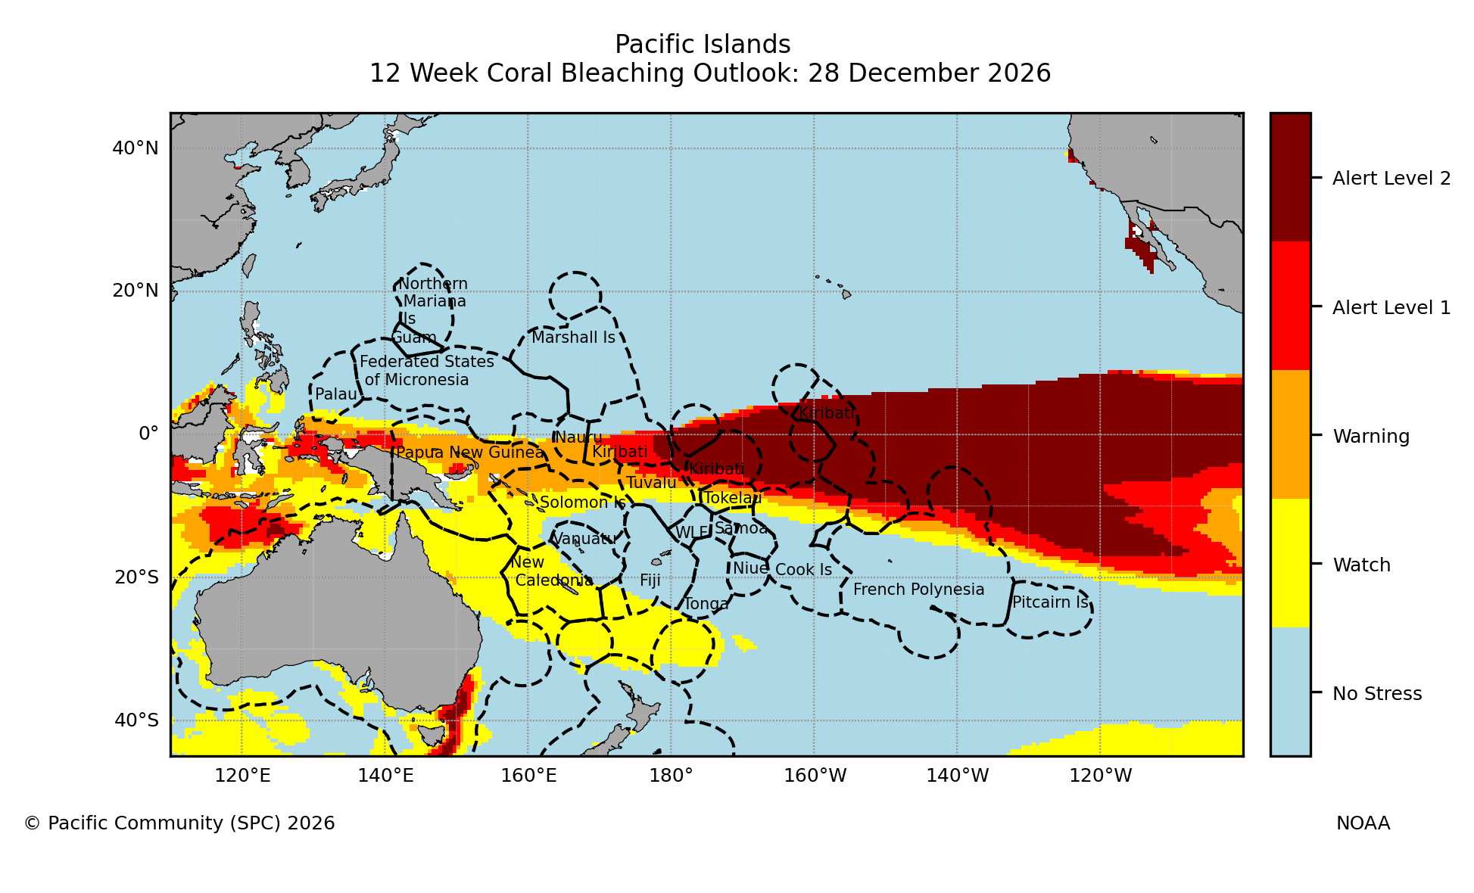
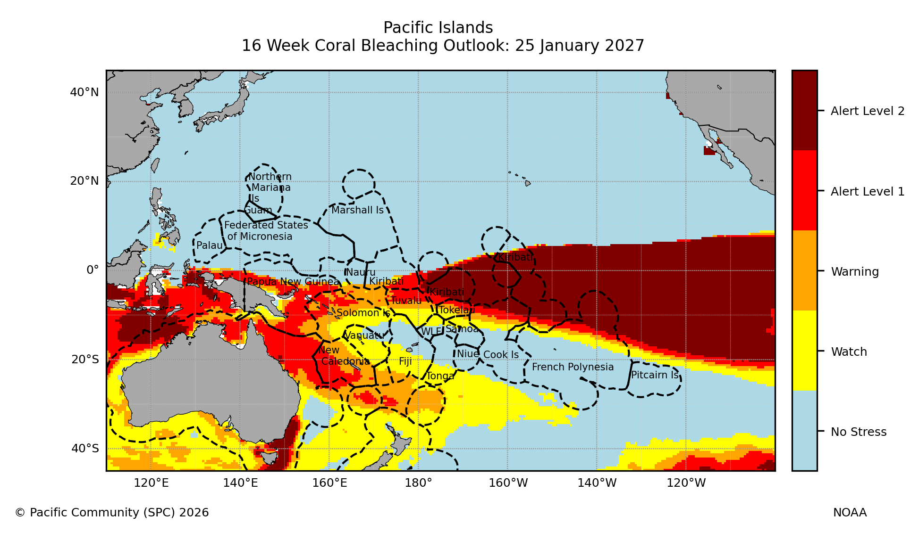
DELETE THIS BOX. PLACE MAP/DIAGRAM/IMAGE HERE
4.0 Coral Bleaching – NOAA (via Pacific Ocean Portal)
Nov: Alert Level 2 across equatorial Kiribati (Phoenix and Line Is); Warning for Naoero and western Kiribati
Dec: Alert Level 2 band holds; Warning to Alert Level 1 spreads to PNG and Solomon Is
Jan: Alert Level 1–2 for PNG, Solomon Is, Vanuatu, New Caledonia and Tuvalu; Warning for Fiji, Samoa and Tonga
2 NOV 2026
30 NOV 2026
Simple Title
28 DEC 2026
25 JAN 2027
Coral bleaching outlook
Source: https://access-s.clide.cloud/
Notes:
This is the NOAA coral bleaching heat stress outlook, via the Pacific Ocean Portal, for outlooks dated 2 November through to 25 January.
In November, Alert Level 2 covers equatorial Kiribati, the Phoenix and Line Islands, with Warning for Naoero and western Kiribati. Alert Level 2 means severe bleaching and significant mortality are likely.
By December the Alert Level 2 band holds, and Warning to Alert Level 1 spreads to PNG and the Solomon Islands.
By January, Alert Level 1 to 2 covers the Solomon Islands, Vanuatu, New Caledonia and Tuvalu, and Fiji, Samoa and Tonga reach Warning level. Reef managers in these countries should plan monitoring from January.

Slide 11
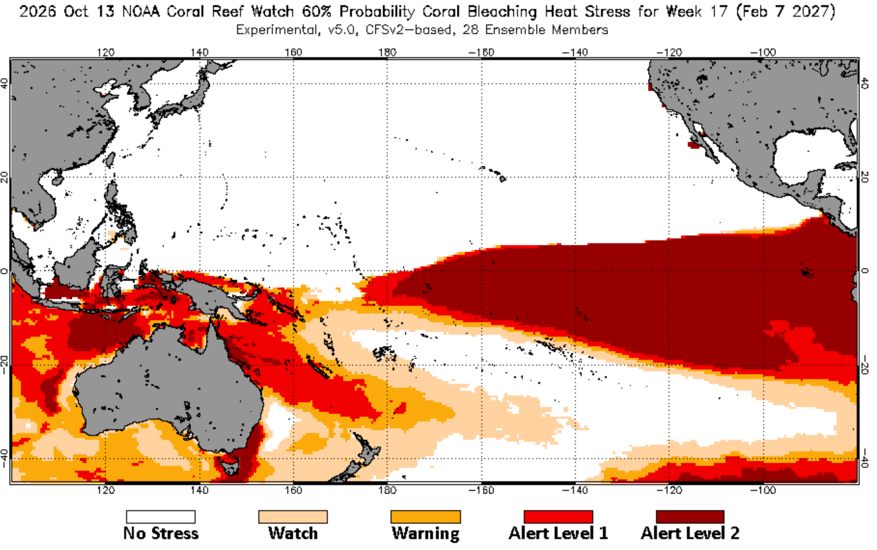
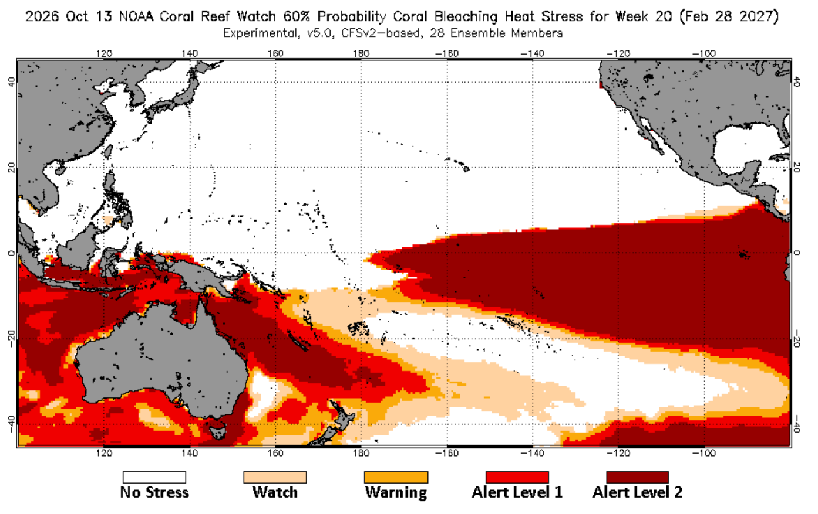
DELETE THIS BOX. PLACE MAP/DIAGRAM/IMAGE HERE
4.0 Coral Bleaching – NOAA Coral Reef Watch
7 FEB 2027
28 FEB 2027
Simple Title
Forecast: February 2027 (60% probability, issued 13 Oct 2026)
Equatorial Pacific: Alert Level 2 east of 180°, covering Kiribati (Phoenix and Line Is), through to 28 Feb
Western Pacific: Alert Level 1–2 for PNG, Solomon Is, Vanuatu and New Caledonia, spreading to all four by 28 Feb
Samoa, Fiji and Tonga: Watch level; no heat stress further southeast towards the Cook Is and French Polynesia
Coral bleaching outlook, February 2027
Source: https://coralreefwatch.noaa.gov/ (Four-Month Outlook, issued 13 Oct 2026)
Notes:
This is the NOAA Coral Reef Watch four-month outlook issued 13 October 2026, showing the 60 percent probability heat stress level for the weeks ending 7 and 28 February 2027.
Alert Level 2 continues east of the dateline across Kiribati's Phoenix and Line Islands through to the end of February.
In the western Pacific, PNG, the Solomon Islands, Vanuatu and New Caledonia sit at Alert Level 1 to 2.
Samoa, Fiji and Tonga ease to Watch level by February, with no heat stress further southeast towards the Cook Islands and French Polynesia.

Slide 12
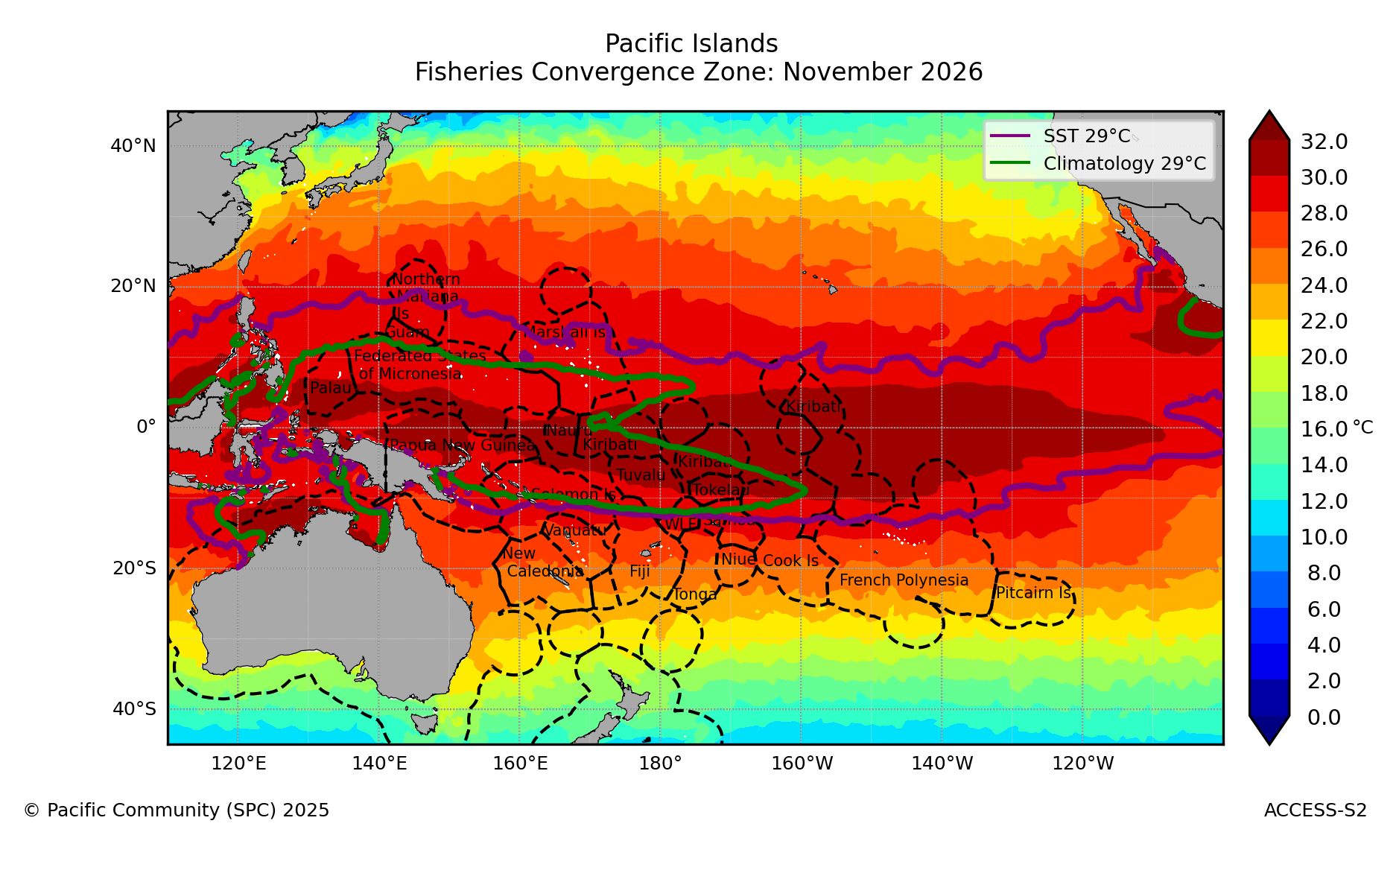
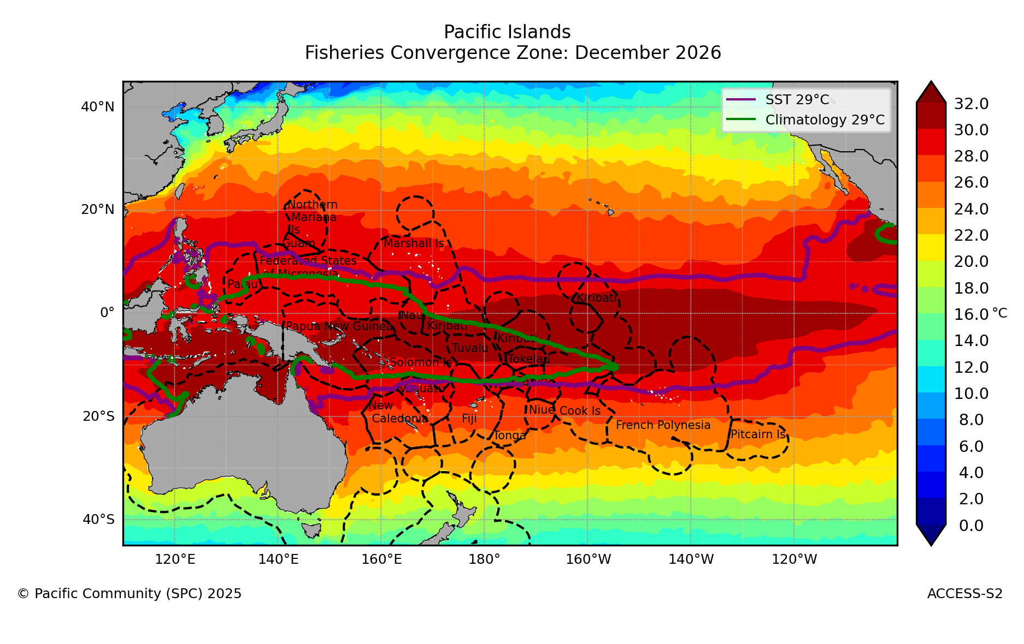
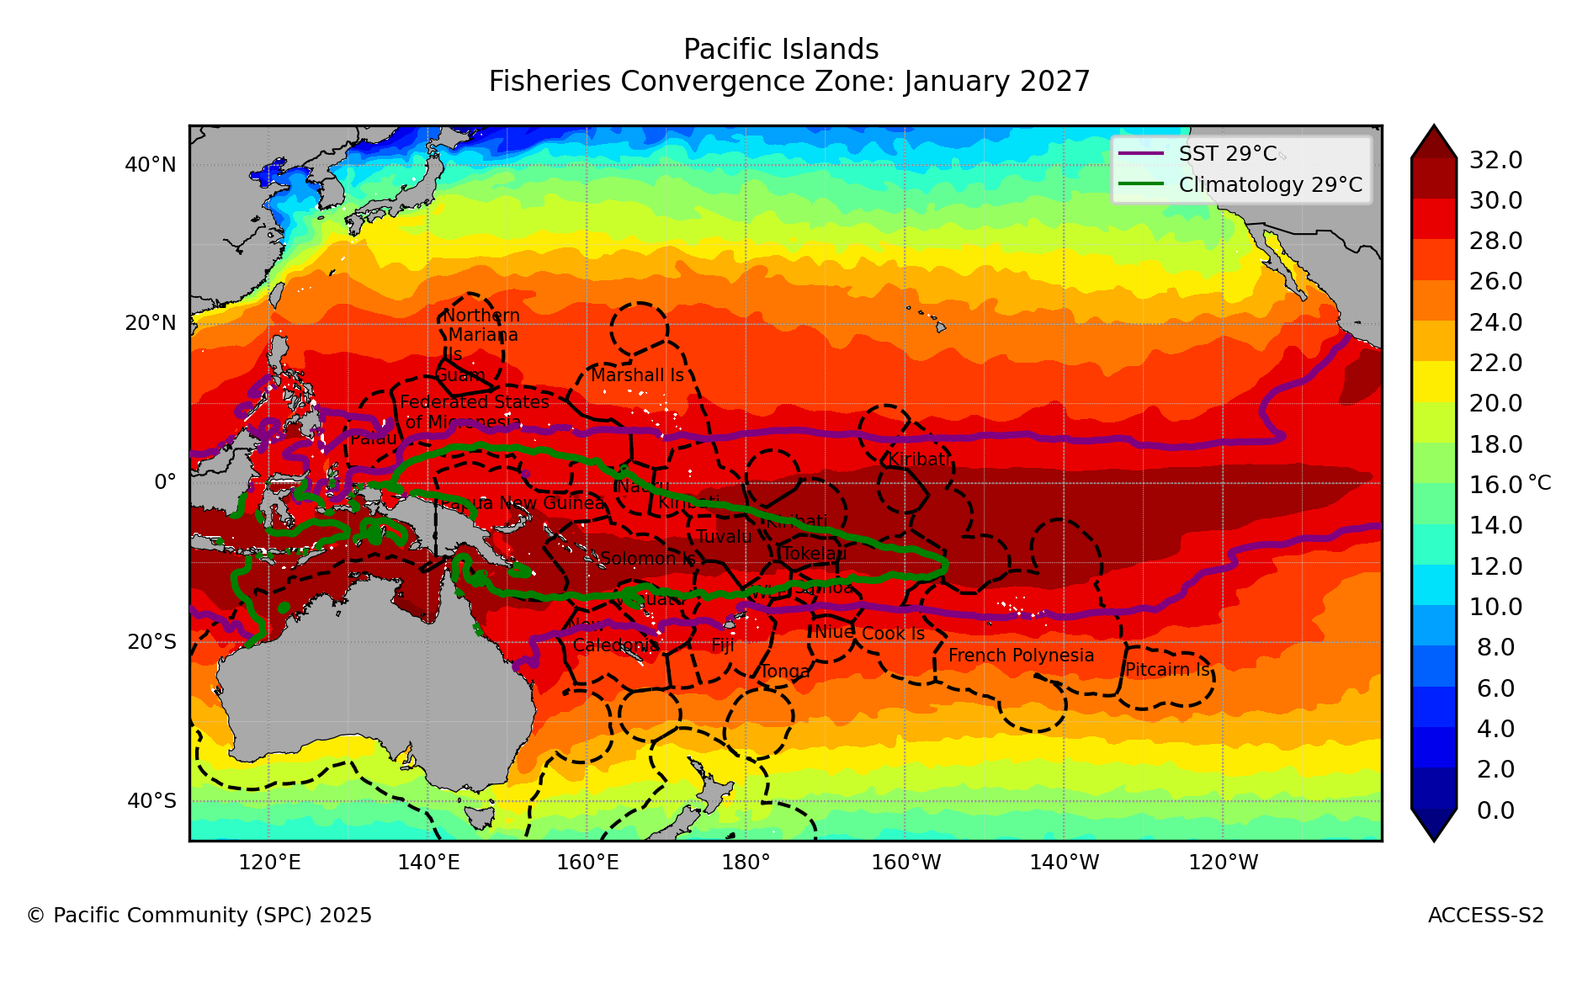
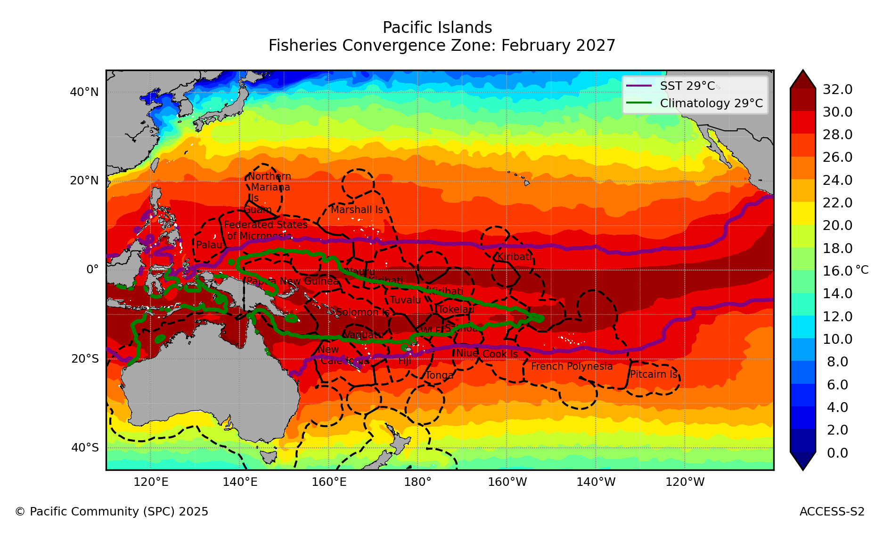
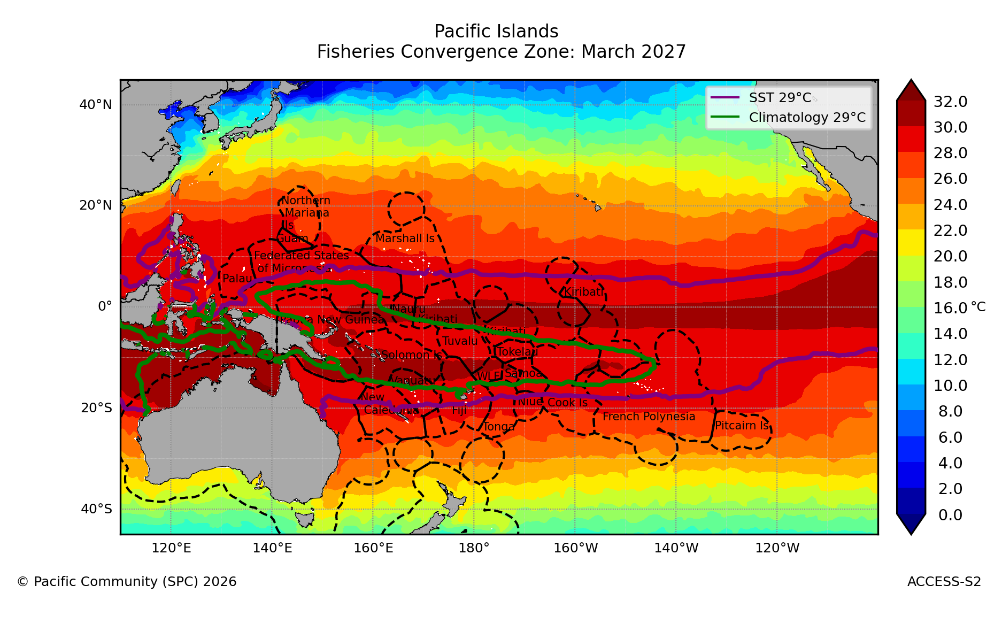
DELETE THIS BOX. PLACE MAP/DIAGRAM/IMAGE HERE
5.0 Fisheries Convergence Zone – Pacific Ocean Portal
NOV 2026
DEC 2026
JAN 2027
Simple Title
FEB 2027
MAR 2027
The forecast convergence zone (purple) reaches ~100°W, far east of its climatological position (green) near 160°W
The zone also widens to about 10°N–15°S, holding from Nov 2026 to Mar 2027
Source: https://access-s.clide.cloud/
Notes:
These maps show the fisheries convergence zone, where the warm pool meets cooler, nutrient-rich water. Skipjack tuna tend to concentrate along this edge.
The green line is the climatological position of the convergence zone, near 160 degrees West. The purple line is the forecast convergence zone.
From November 2026 to March 2027, the 29 degree water extends far east to about 100 degrees West, and the warm pool widens to about 10 North to 15 South.
For fisheries, this means tuna are likely to move east, away from western waters and towards Kiribati's Line and Phoenix Islands. Fleets and licensing planning may need to account for that shift.

Slide 13

6.0 Takeaway Message
Key messages for the PICOF outcomes statement, November 2026 – February 2027
SST: warm core (above normal SST) on the equator persists and spreads west to PNG, Solomon Is, Vanuatu and New Caledonia; a cool band over Fiji, Samoa, Tonga, the Cook Is and French Polynesia in Nov–Jan retreats southeast by Jan–Mar; Palau and the Marshall Is turn cool by Feb–Apr
SSH: above normal for Kiribati (Line Is); below normal for Palau, FSM, Marshall Is, PNG, Solomon Is, Tuvalu and Samoa; strongest to Dec, easing by Mar; low-tide reef exposure likely where sea level is low, already seen in Solomon Is and expected in FSM-Yap, Tuvalu and Samoa (Taimasa), especially early 2027
MHW: strong to extreme for Kiribati (Line Is); moderate for Nauru, Tuvalu and Tokelau, spreading to Solomon Is, Vanuatu and New Caledonia by Jan; localised heat waves possible elsewhere where local conditions allow
Coral Bleaching: Alert Level 2 for Kiribati (Phoenix and Line Is) through Feb; Alert Level 1–2 for PNG, Solomon Is, Vanuatu and New Caledonia; Warning for Fiji, Samoa and Tonga in Jan, easing to Watch by Feb
Fisheries: forecast convergence zone shifts east to about 100°W, well beyond its climatological position near 160°W, and widens to 10°N–15°S from Nov 2026 to Mar 2027; skipjack likely to follow the warm pool edge east along the equator
Notes:
These are the five key messages we propose for the PICOF outcomes statement, one for each ocean variable.
SST: compared with September, the El Niño warming spreads west along the equator to PNG and the Solomon Islands. A cool band sits over Fiji, Samoa, Tonga, the Cook Islands and French Polynesia in Nov–Jan, then retreats southeast. Palau and the Marshall Islands turn cool late in the season.
SSH: the west-east contrast of about 24 cm holds to December, then eases by March. Expect low-tide reef exposure at Yap.
Marine heat waves: highest in Kiribati's Line Islands, then the western Pacific from December. Where the maps show none, localised heat waves can still occur in lagoons and shallow reefs, as seen in Fiji, Tonga and FSM in the past.
Coral bleaching: Alert Level 2 in Kiribati through February; Fiji, Samoa and Tonga reach Warning in January, easing to Watch.
Fisheries: the forecast convergence zone, the purple line, sits far east of its climatological position, the green line, so tuna are likely to move east.
I welcome comments on the wording before we finalise the statement.

Slide 14





Contact
My Email
molenit@spc.int
Notes:
Thank you. These contact details are for follow-up questions on the ocean outlook and on the products shown today.
I am happy to take questions now.

