Slide 1
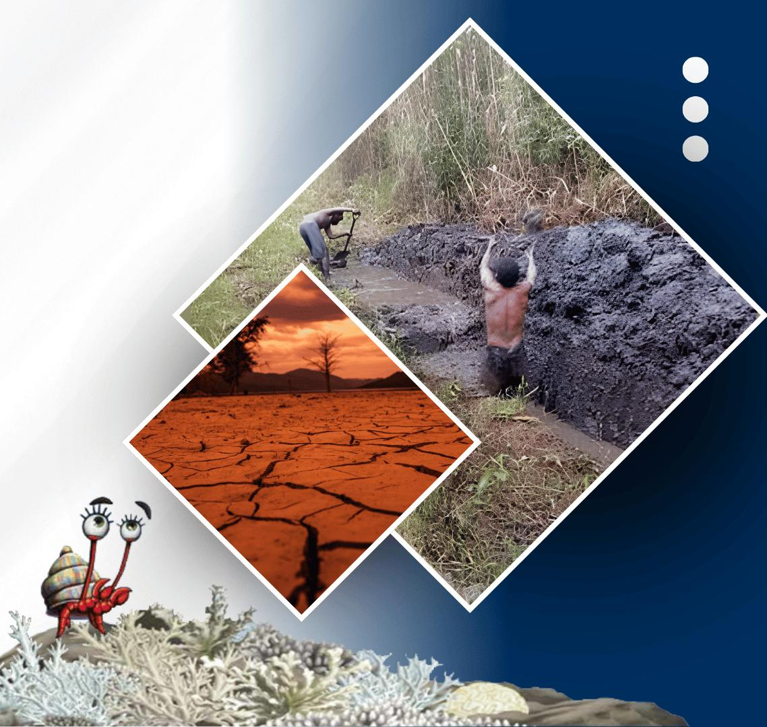




PACIFIC ISLANDS climate outlook forum-19
20 - 21 OCTOBER, 2026
HYBRID
PORT MORESBY, PAPUA NEW GUINEA
& ZOOM
www.pacificrcc.net

Slide 2
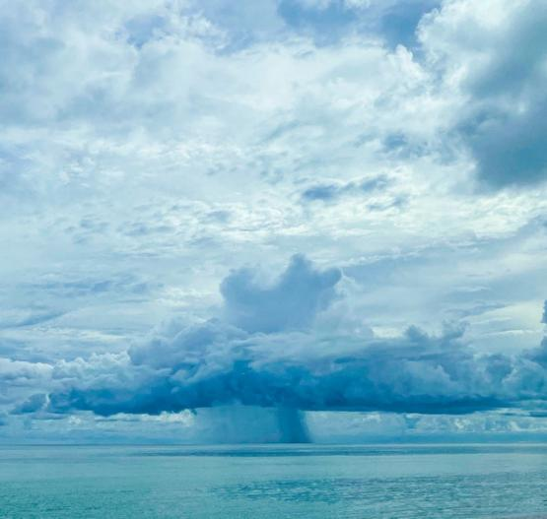
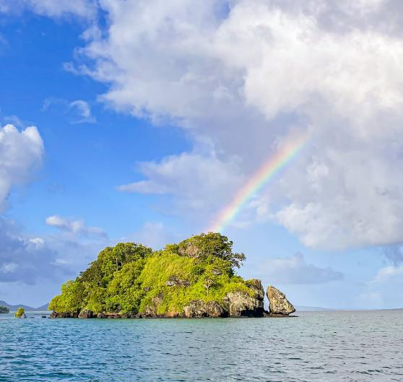




PICOF-19
Micronesia Impacts
Wallace Jacob
WSS/Climate officer
Weather Service Office, Pohnpei FSM

Slide 3
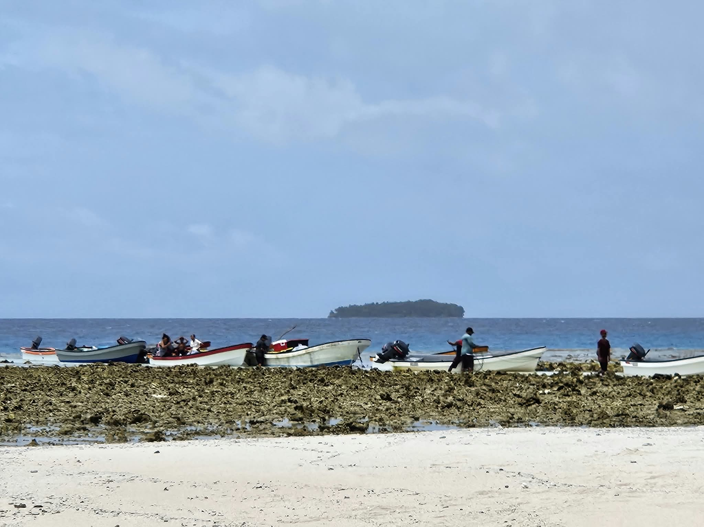
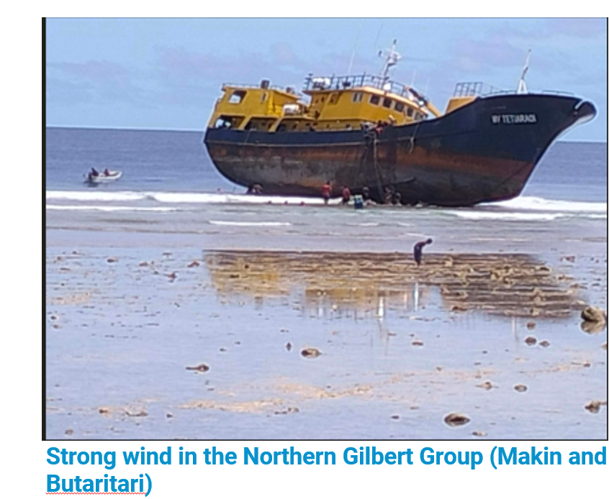

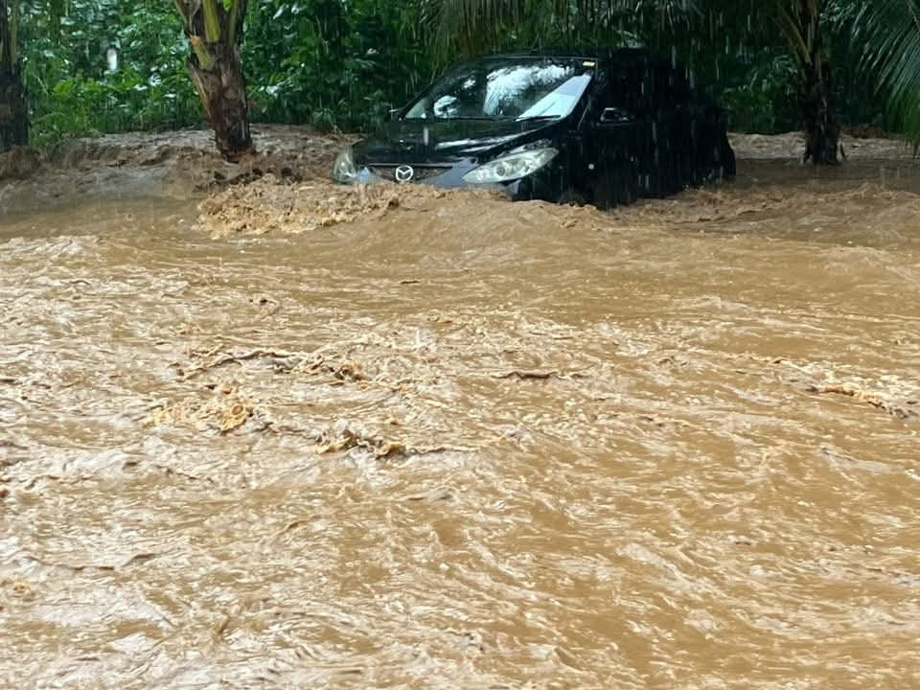
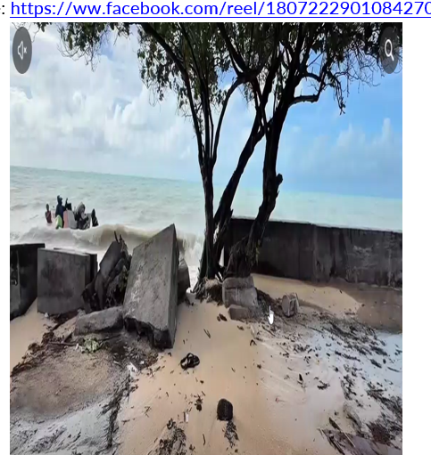

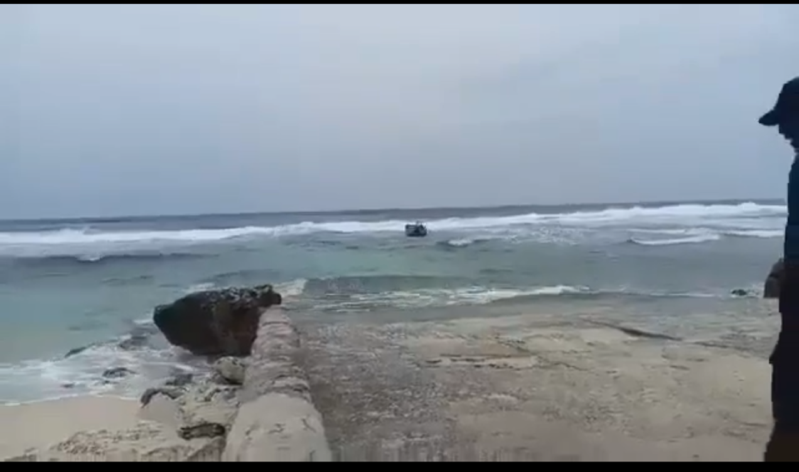
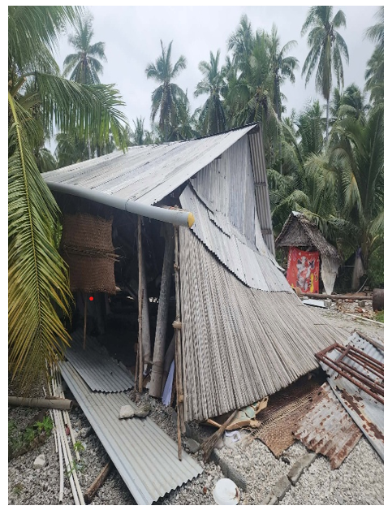
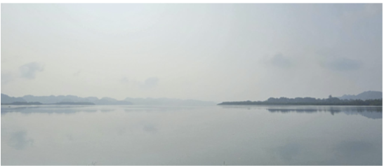

Time line Micronesia events:
May 2026
Jun 2026
Jul 2026
Aug 2026
Oct 2026
Sep 2026
El Niño began, onset declared by WMO, NOAA, and BOM.
Kiribati - Strong Winds
Palau – strong, gusty winds from Monsoon.
Palau - Abnormal dryness.
Nauru – Rough seas and frequent Heavy rainfall.
FSM – Heavy rainfall causing landslides. Coral reefs were exposed during low tides because sea levels were below normal.
Kiribati - Hurricane Lowell, storm surge causing coastal inundation.
Nauru – Flu and dengue outbreak from changes in rainfall patterns and humidity.
FSM – Flooding event & landslides in Pohnpei and Kosrae from heavy downpours
Palau - Haze from Indonesia wildfires
Palau – coral bleaching

Slide 4
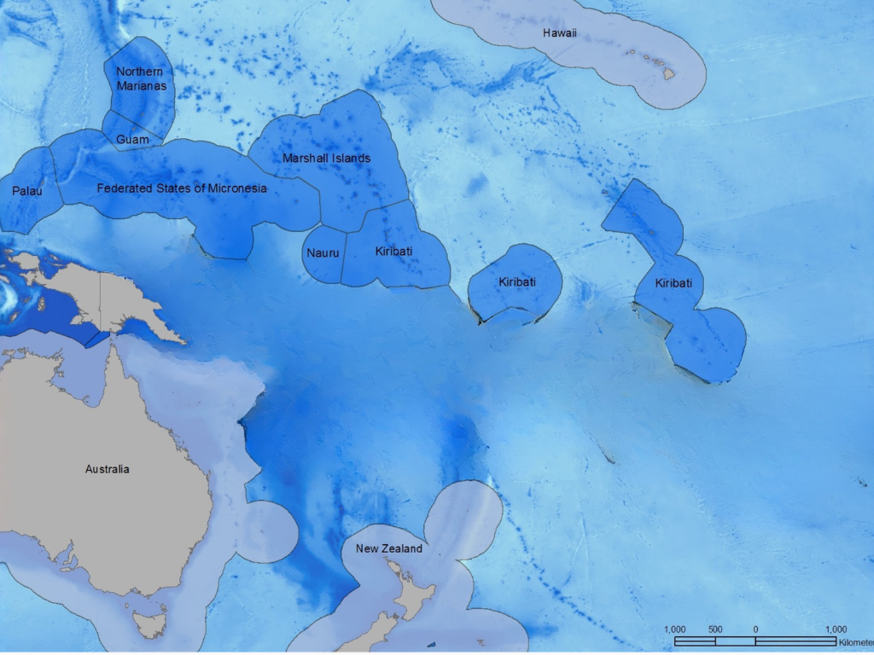
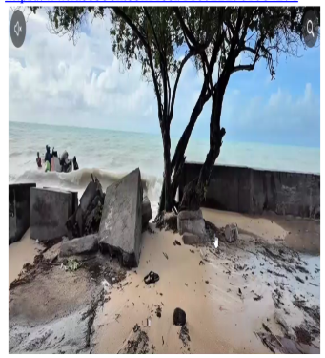
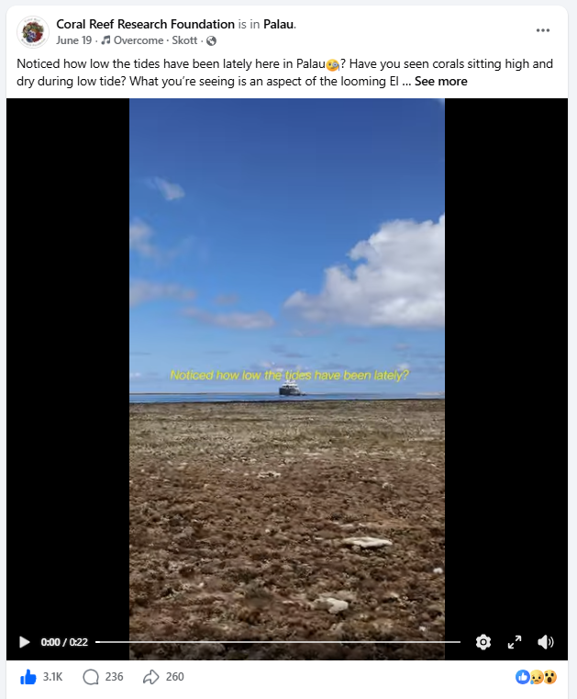
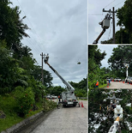

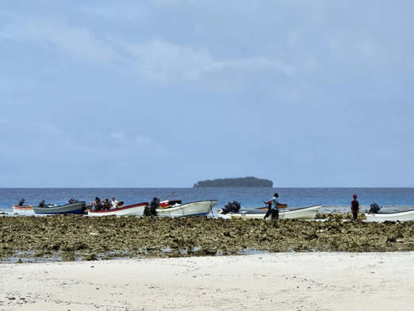


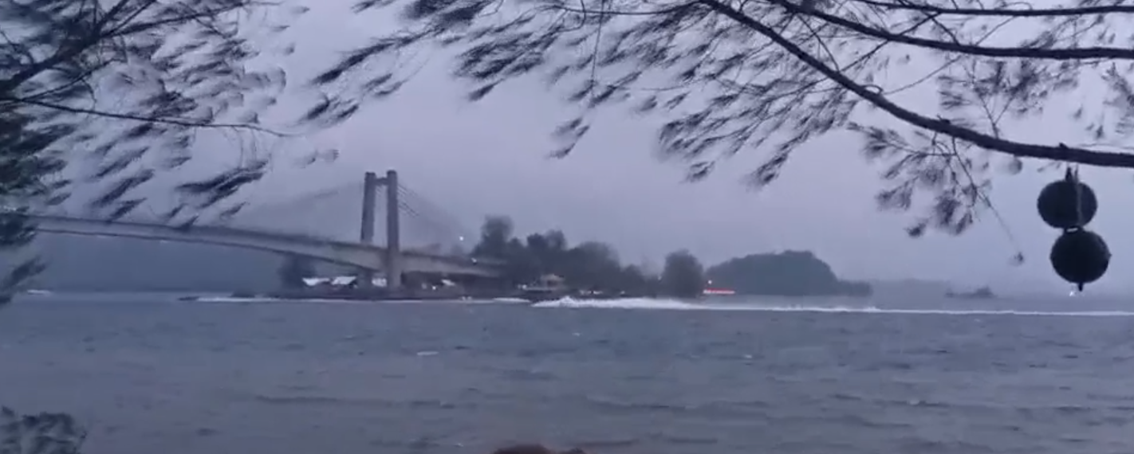
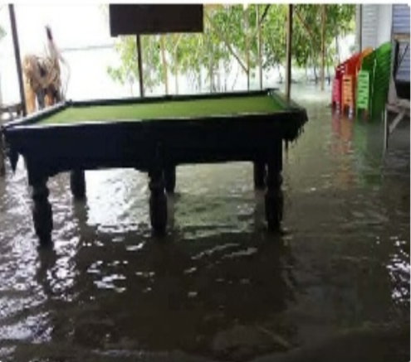
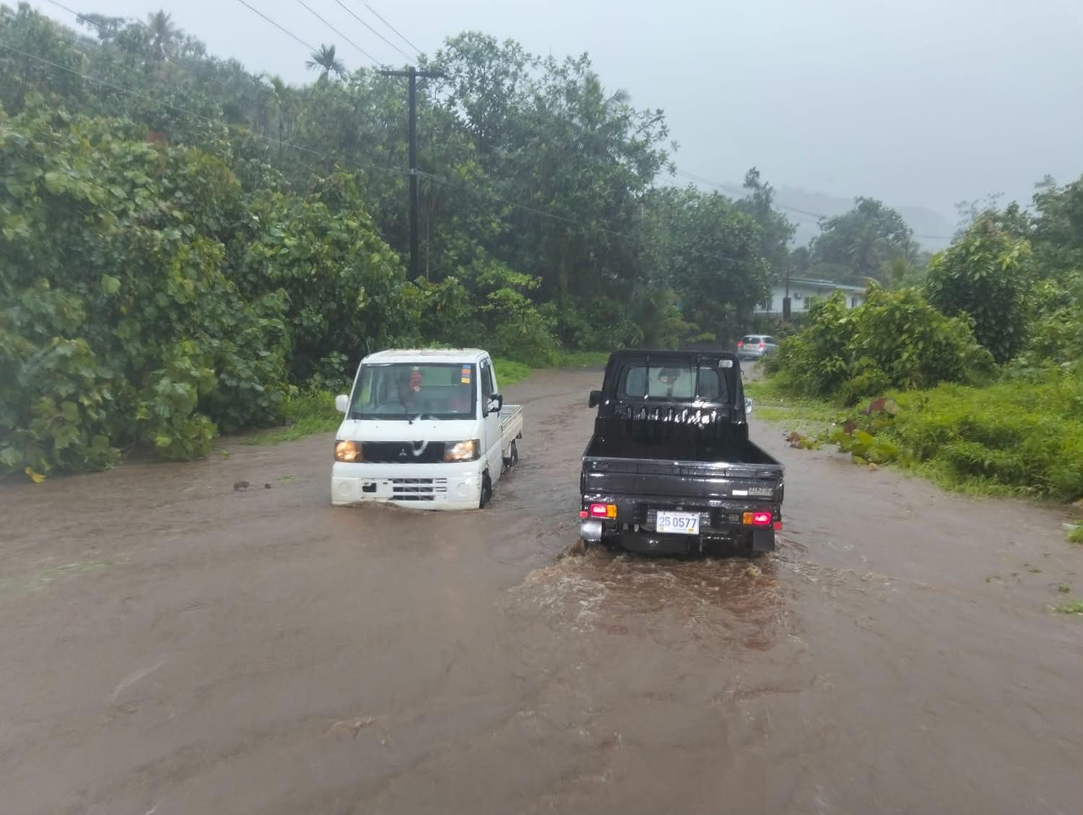
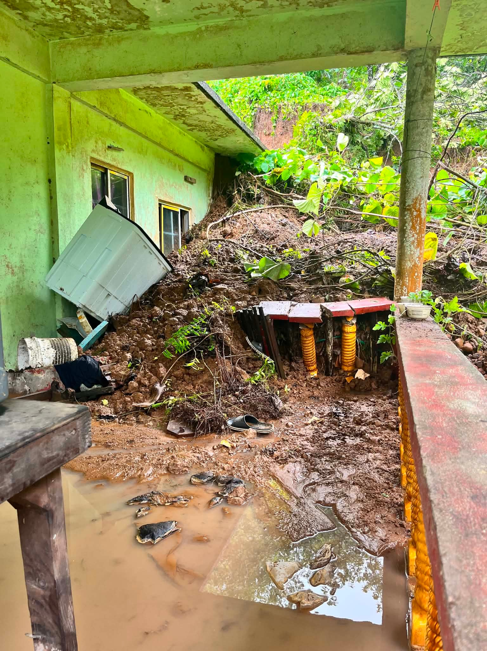

Slide 5

Summary
Add key points which will be included in the PICOF outcomes statement
Impacts show clear signs of an El Niño event
Below-average sea level in the West Pacific, above normal in the central Pacific.
Strong westerlies
FSM first phase of El Niño: above-average rainfall
Increase in TC formation in the Eastern Pacific

Slide 6





Contact
My Email
wallace.Jacob@noaa.gov

