Slide 1
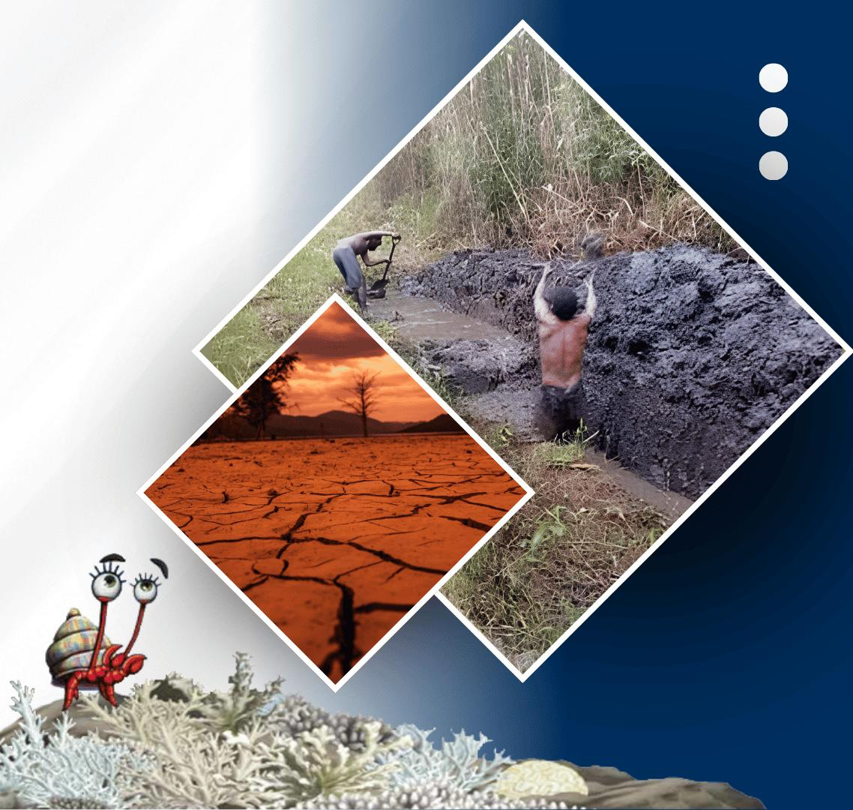






PACIFIC ISLANDS climate outlook forum-19
20 - 21 OCTOBER, 2026
HYBRID
PORT MORESBY, PAPUA NEW GUINEA
& ZOOM
www.pacificrcc.net

Slide 2







PICOF-19
Melanesia-sub Region Climate Impacts

Slide 3

PICOF-19
Fiji Climate Impacts
Samisoni Waqavakatoga
Principal Scientific Officer
Fiji Meteorological Service

Slide 4
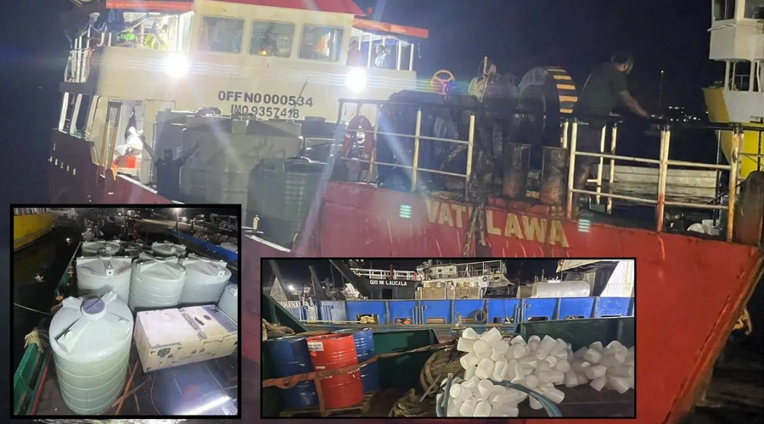
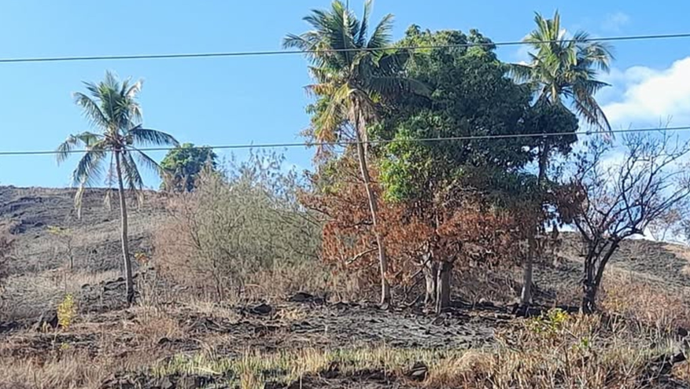

DELETE THIS BOX. PLACE MAP/DIAGRAM/IMAGE HERE
Impacts
Period: May – October 2026
Country: FIJI
ENSO phase: El Nino
 | Synoptic Situation | Type of Hazard | Impacts | Image | Lat/Long | Sectors affected | No. of Deaths
1 | El Niño-driven dry conditions reduced rainfall and depleted rainwater harvesting systems, causing water shortages and health concerns | Water Shortage, with associated waterborne health impacts | Prolonged dry conditions depleted rainwater harvesting systems, causing critical water shortages and an increase in diarrhoea cases. | MLC Vatulawa delivering emergency water supplies to Batiki Island in response to drought and El Niño impacts on September 21. Source: Fiji Sun | 17.783° S 179.150° E | Water supply, Health, Education, Communities/Livelihoods | 0
2 | El Niño-driven prolonged dry conditions caused reduced rainfall, water shortages and drying pasture in the Rakiraki area. | Dry Spell | Water shortages and lack of pasture affected livestock and farming. A farmer in Naqoro was forced to sell and give away her cattle and scale back gardening due to insufficient water and pasture. Crop production was also affected. | Dryland in Rakiraki on the September 21. Source: Fiji Sun | 17.34°S 178.22°E | Agriculture, Livestock, Water supply and Livelihoods | 0

Slide 5
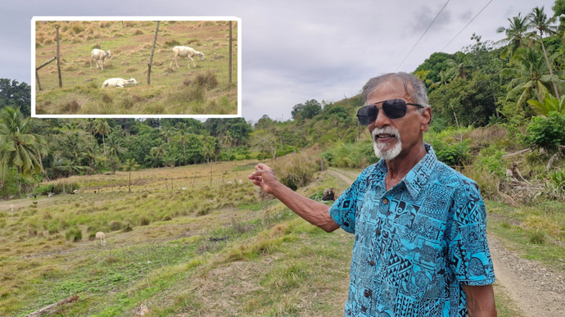
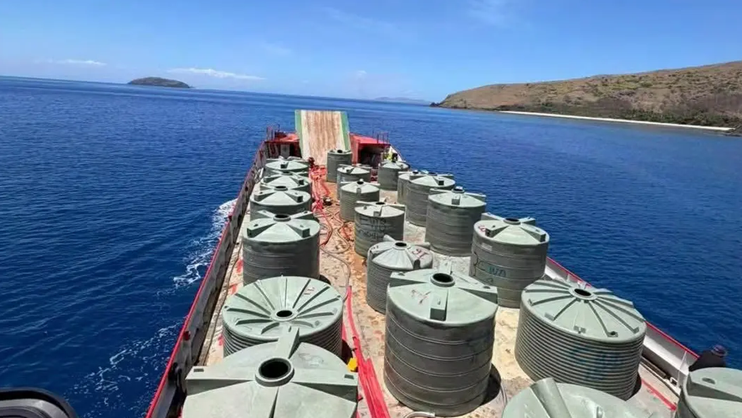
DELETE THIS BOX. PLACE MAP/DIAGRAM/IMAGE HERE
Impacts
Period: May – October 2026
Country: FIJI
ENSO phase: El Nino
 | Synoptic Situation | Type of Hazard | Impacts | Image | Lat/Long | Sectors affected | No. of Deaths
3 | El Niño-driven prolonged dry conditions causing reduced rainfall, pasture shortages and declining water availability in Nagigi, Labasa | Dry Spell | Pasture and water shortages affected livestock and households. Some livestock died, while farmers considered selling animals if dry conditions persisted. Residents were also required to carefully manage limited water supplies for household needs. | Livestock farmer on his farm in Nagigi, Labasa, Northern Division affected by dry conditions on the September 30. Source: FBC News. | 16.39°S 179.38°E | Agriculture, Livestock, Water Supply, Households and Livelihoods | 0
4 | Prolonged dry conditions associated with water shortages affecting western maritime communities. | Prolonged dry conditions | Water shortages affected villages, schools and health facilities across Malolo, Yanuya and surrounding maritime communities. More than 170,000 litres of water were delivered to 11 locations to provide relief and meet daily water needs. | 170,000 litres delivered to Yasawa and Mamanuca communities on the October 10. Source:Fiji Sun | 17.783° S 179.150° E | Water supply, Health, Education, Communities/Livelihoods | 0

Slide 6

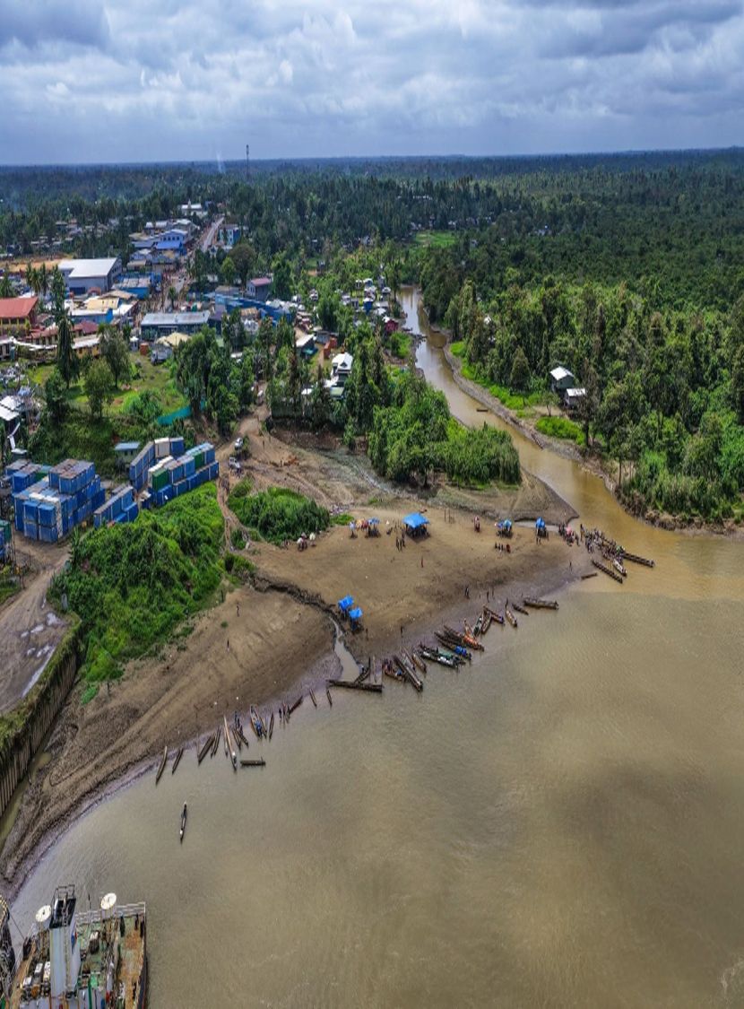
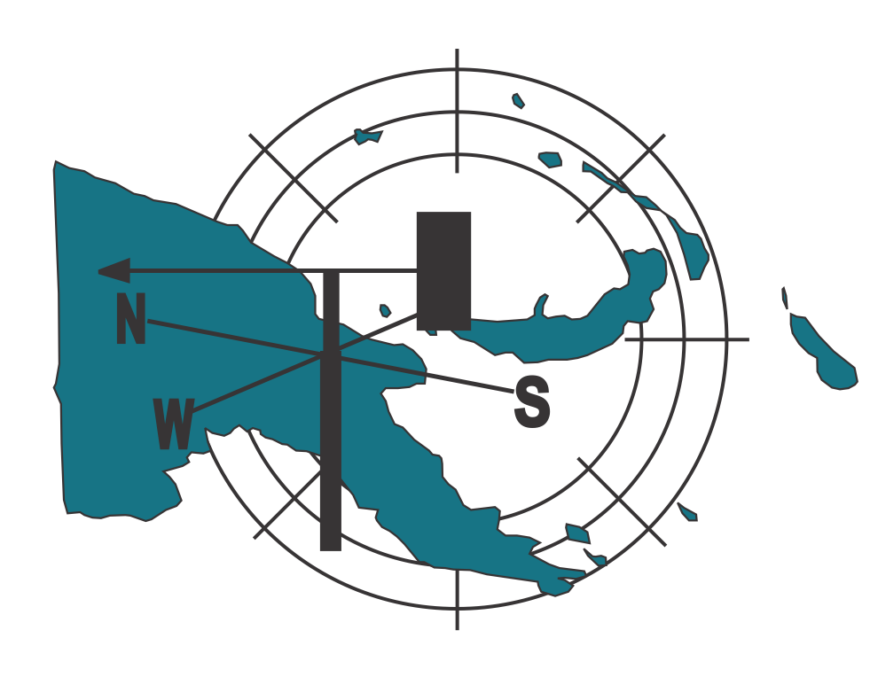

Climate Impacts in Papua New Guinea
Climate & Special Services
PNG National Weather Service

Slide 7

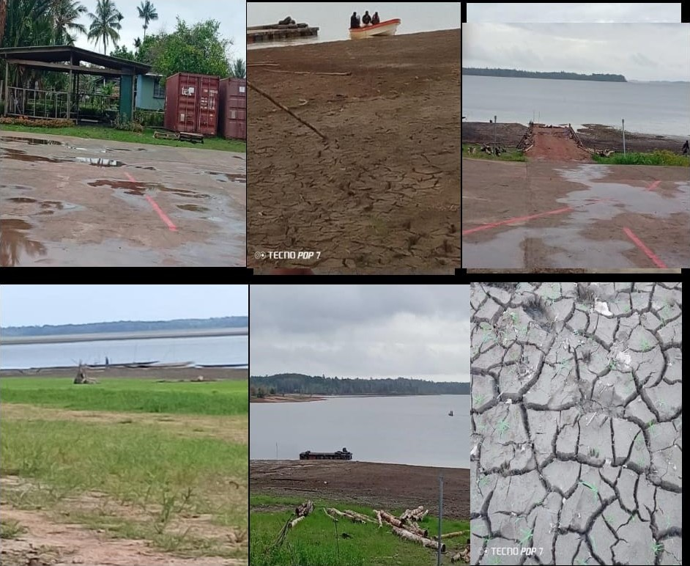
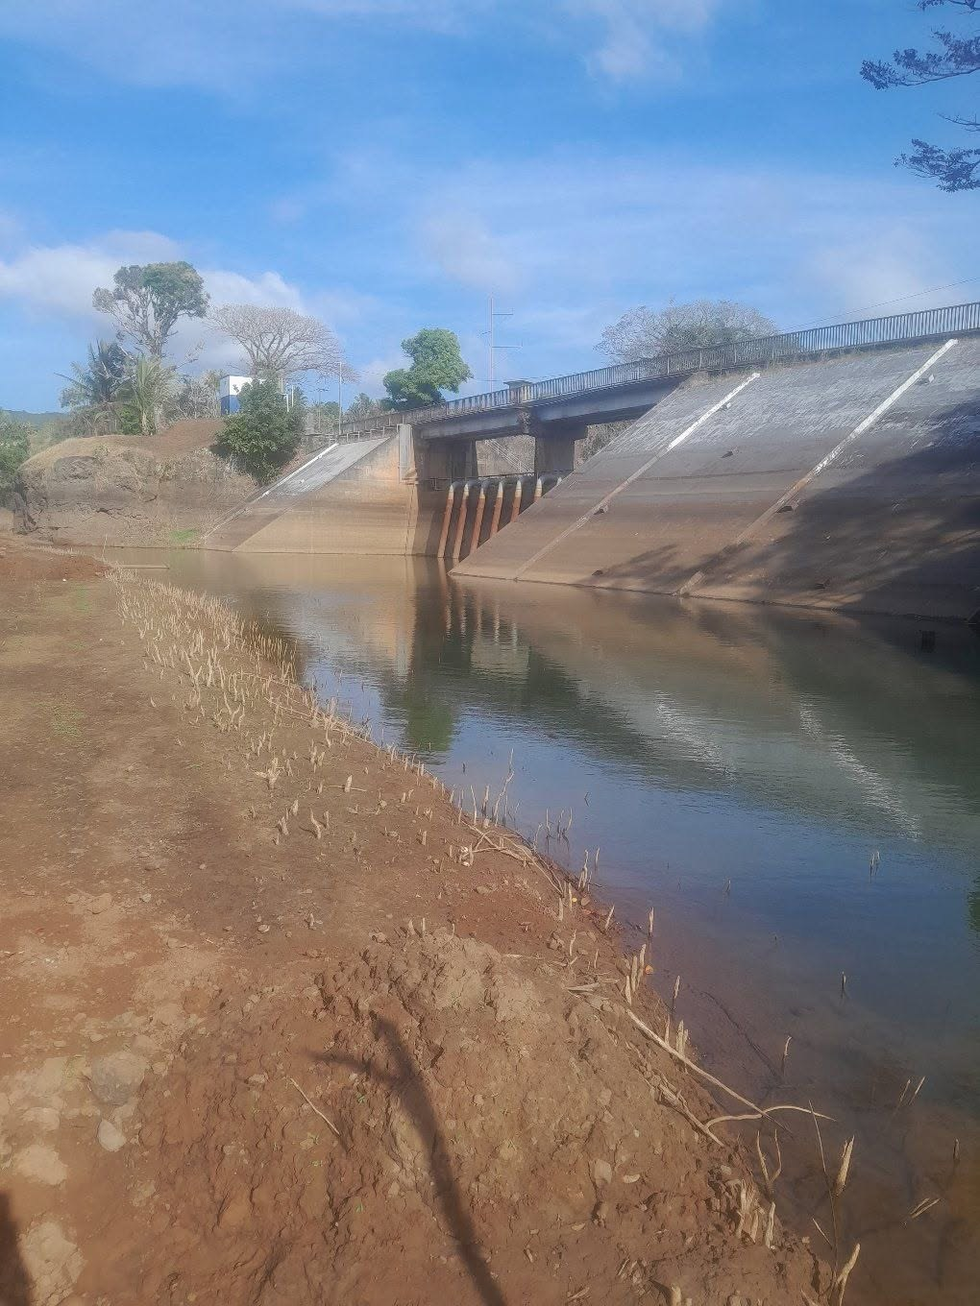
DELETE THIS BOX. PLACE MAP/DIAGRAM/IMAGE HERE
Impacts
Period: May – October 2026
Country: PAPUA NEW GUINEA
ENSO phase: El Nino
 | Synoptic Situation | Type of Hazard | Impacts | Image | Lat/Long | Sectors affected | No. of Deaths
1 | Prolonged dry conditions. | Drought in all 4 regions | Food gardens destroyed, water shortages. | Lake Murray — Exposed lake bed; outlet down 2 m in Western Province & Enga (Aug) Photo: Supplied / NBC PNG |  | Agriculture, Food, Water Security
2 | Prolonged dry periods. | Drought in all 4 regions | Water transport affected, Closure of schools. | Sirinumu Dam — Spillway dry for months; city water supply strained in Central Province & NCD, Enga (11 Aug) Photo: Ilijah Yobwita |  | Transport, Education

Slide 8
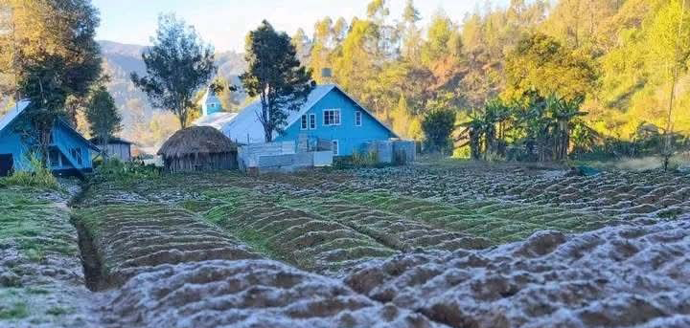
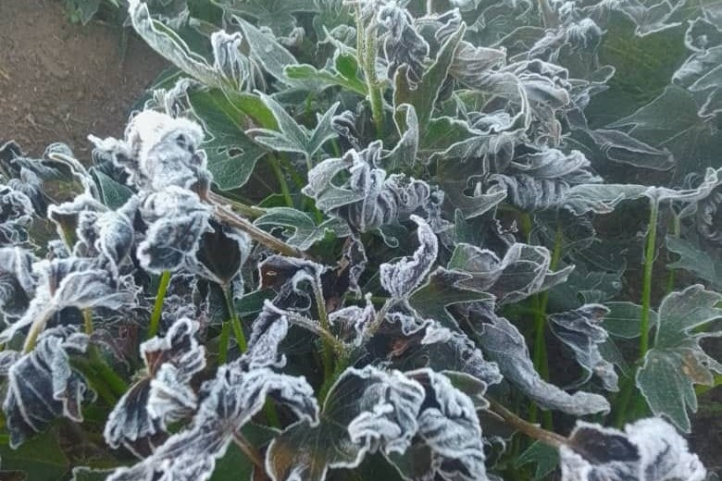
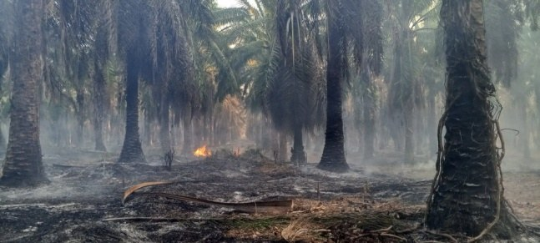
DELETE THIS BOX. PLACE MAP/DIAGRAM/IMAGE HERE
Impacts
Period: May – October 2026
Country: PAPUA NEW GUINEA
ENSO phase: El Nino
 | Synoptic Situation | Type of Hazard | Impacts | Image | Lat/Long | Sectors affected | No. of Deaths
3 | Frost | Frost in Highlands and Central Province | Affected food gardens | Gembogl, Chimbu Province— Frost on vegetable plots in the Highlands & Momase Region (June) Goilala District, Central Province — Frost and dry spells destroy food gardens (Sep) Photo: Supplied / The National & ABC News |  | Agriculture, Food Security
4 | Prolonged dry conditions. | Drought in all 4 regions | A humanitarian emergency: about 5.5 million people affected, with water, food, health and fire impacts | West New Britain, Islands & Milne Bay Province— Wildfire through oil palm and gardens (Sep) Photo: PNG Hous Bung |  | Energy, Health

Slide 9

PICOF-19
Weather & Climate Impacts Solomon slands
Martin Tugumana
Principal Met Officer- Climate
Solomon Islands Meteorological Service

Slide 10
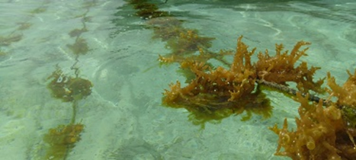
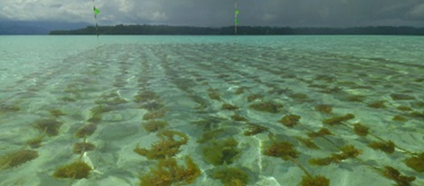
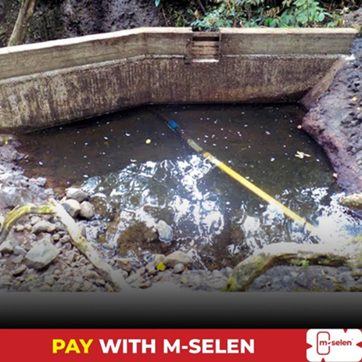

DELETE THIS BOX. PLACE MAP/DIAGRAM/IMAGE HERE
Impacts
Period: May – October 2026
Country: SOLOMON ISLANDS
ENSO phase: El Nino
 | Synoptic Situation | Type of Hazard | Impacts | Image | Lat/Long | Sectors affected | No. of Deaths
1 | El Niño triggered higher Sea Surface Temperatures (SSTs) after the passing of TC Maila | Warmer waters and marine heatwaves to many coastal regions | Excessive algae growth that severely damaged seaweed farms | Excessive algae growth that severely damaged seaweed farms after the passing of TC Maila information on 07th May 2026 Source: Rarumana Youths Facebook Page |  | Marine farming/Livelihoods | 0
2 | El Niño-driven prolonged dry conditions caused reduced rainfall, water shortages in Malaita and Western Province. | Prolonged dry spells | Water shortages with limited water resources – rely heavily on rain to collect water. | Water shortages on Malaita and Western Province Source: The Island Sun News 30 June 2026 |  | Water supply, Communities/Livelihoods | 0

Slide 11
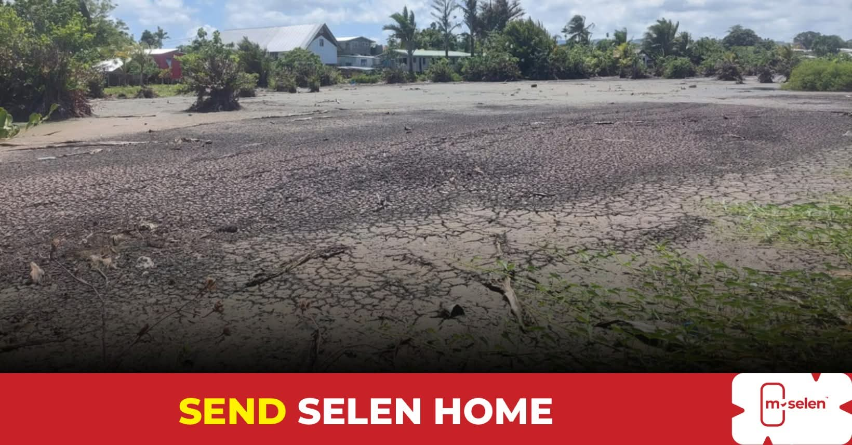
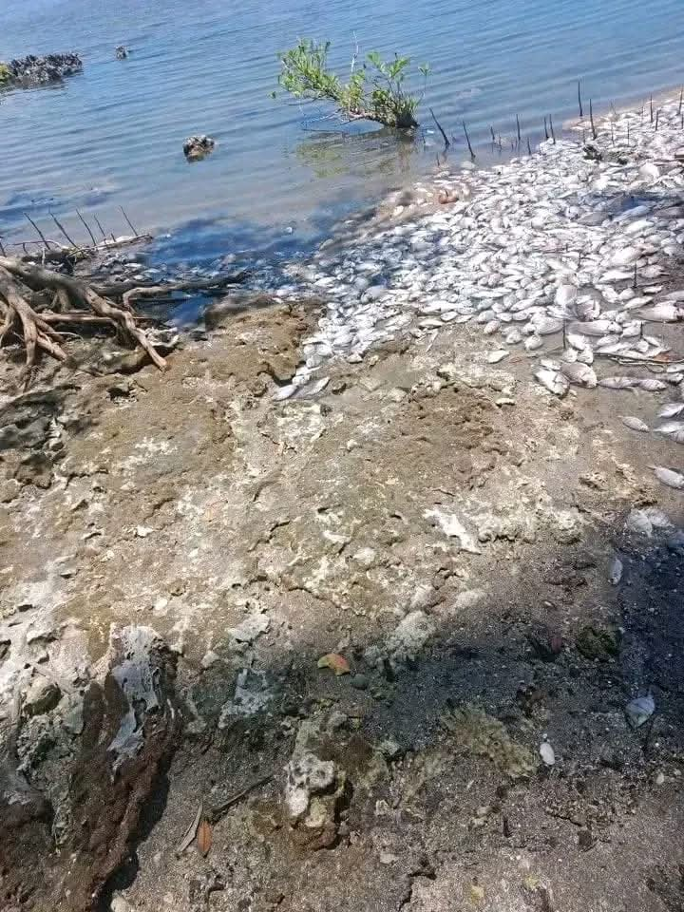
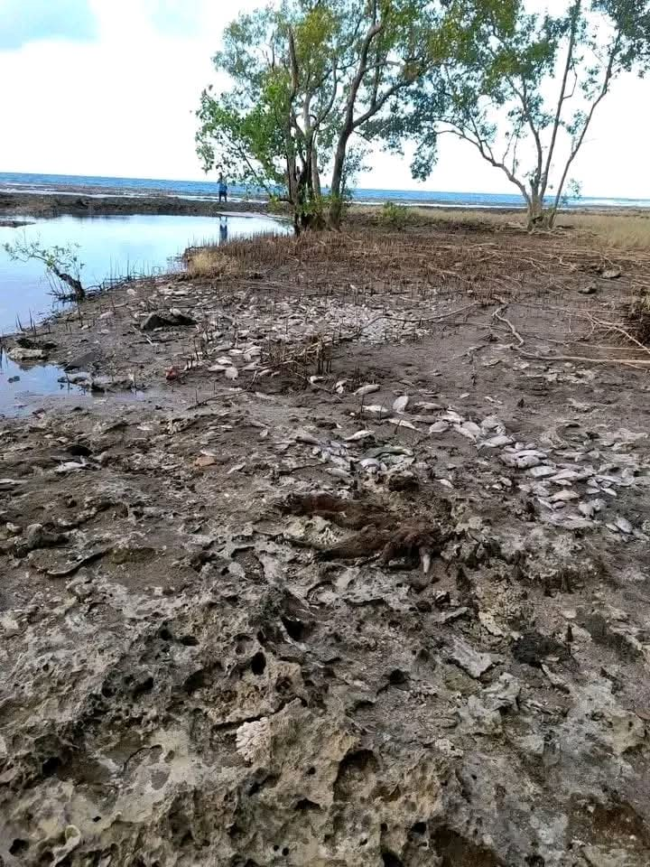
DELETE THIS BOX. PLACE MAP/DIAGRAM/IMAGE HERE
Impacts
Period: May – October 2026
Country: SOLOMON ISLANDS
ENSO phase: El Nino
 | Synoptic Situation | Type of Hazard | Impacts | Image | Lat/Long | Sectors affected | No. of Deaths
3 | El Niño-driven prolonged dry conditions caused reduced rainfall in Taro, Choiseul Province. | Prolonged dry conditions | Creeks to dry up with communities reporting strong foul odours from dead tilapia. | Dry creeks in Taro, Choiseul Province Source: The Island Sun News 03 June 2026 |  | Agriculture, Livestock, Water supply Communities/Livelihoods | 0
4 | El Niño-driven prolonged dry conditions associated with water shortages caused in Dokoso Conservation Area, Western Province | Prolonged dry conditions caused rising temperatures with unusually low water levels | Water shortages lead to tidal pools and parts of the area to dry out and suffocate the marine life. | Water shortages – tidal pools and parts of the area to dry out and suffocate marine life in Dokoso Conservation Area, Western Area Source: Solomon Star 13 October 2026 |  | Water supply, Communities/Livelihoods | 0

Slide 12


PICOF-19
Vanuatu Country Report
John RUBEN
PSO Research & Development – Climate Services Division
Vanuatu Meteorological and Hydrometeorological Services

Slide 13
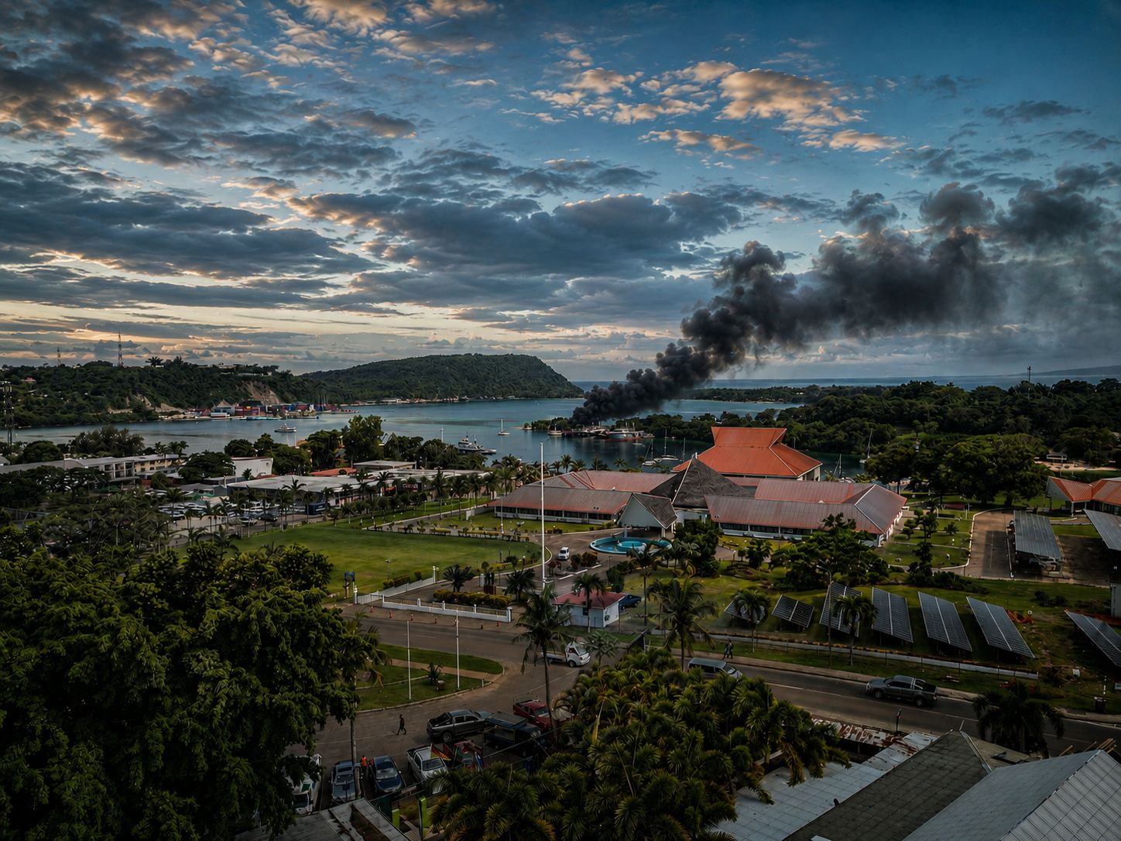
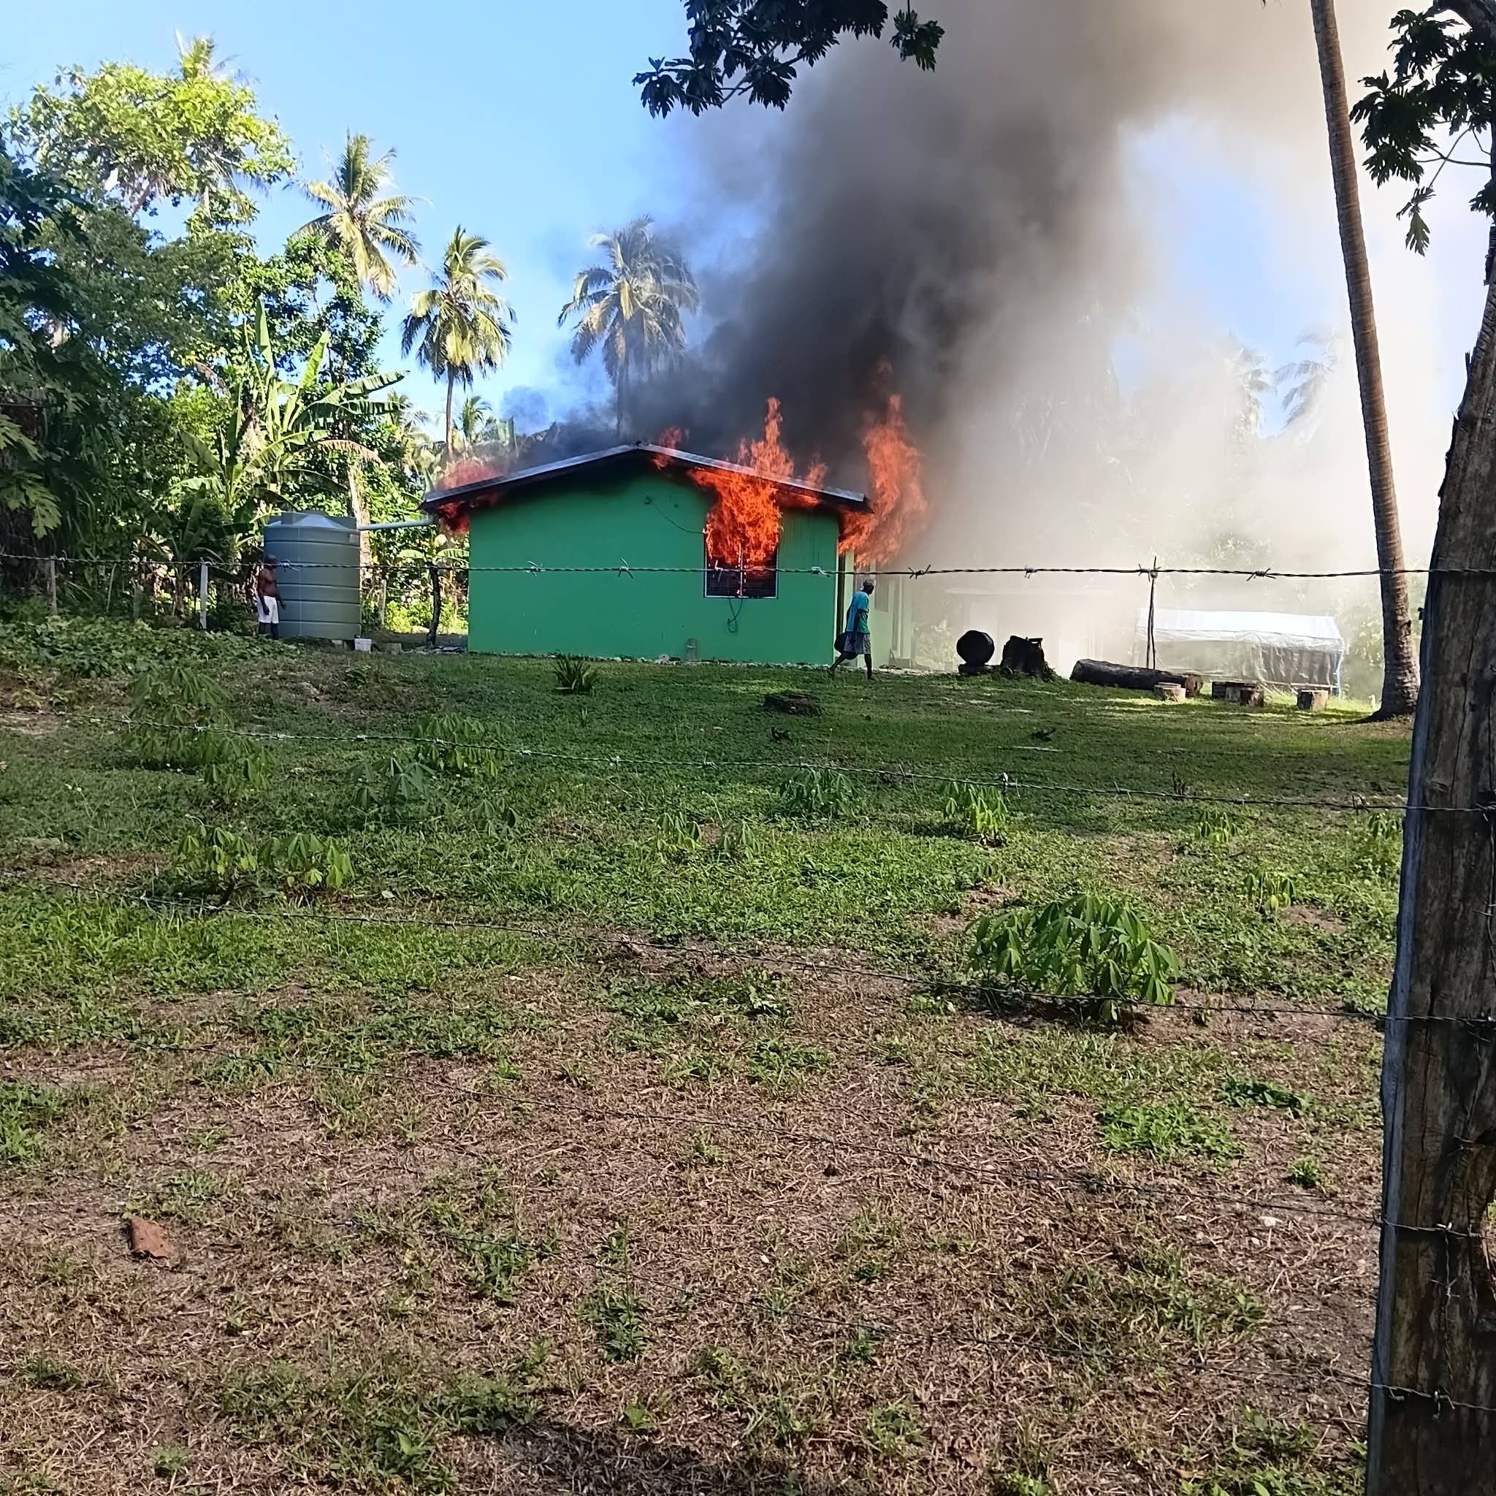
DELETE THIS BOX. PLACE MAP/DIAGRAM/IMAGE HERE
Impacts
Period: May – October 2026
Country: VANUATU
ENSO phase: El Nino
 | Synoptic Situation | Type of Hazard | Impacts | Image | Lat/Long | Sectors affected | No. of Deaths
1 | Prolonged dry conditions due to active El Nino | Bush Fire | Today 27th May 2026, the Iririki island resort is engulfed in smoke this afternoon as fire blazed on the end section of the island |  |  | Tourism and Water Sectors
2 | Prolonged dry conditions | Wild Fire | A fire destroyed the Rah Organic Coconut Virgin Oil factory at Rah on Motalava Island |  |  | Agro Industry

Slide 14
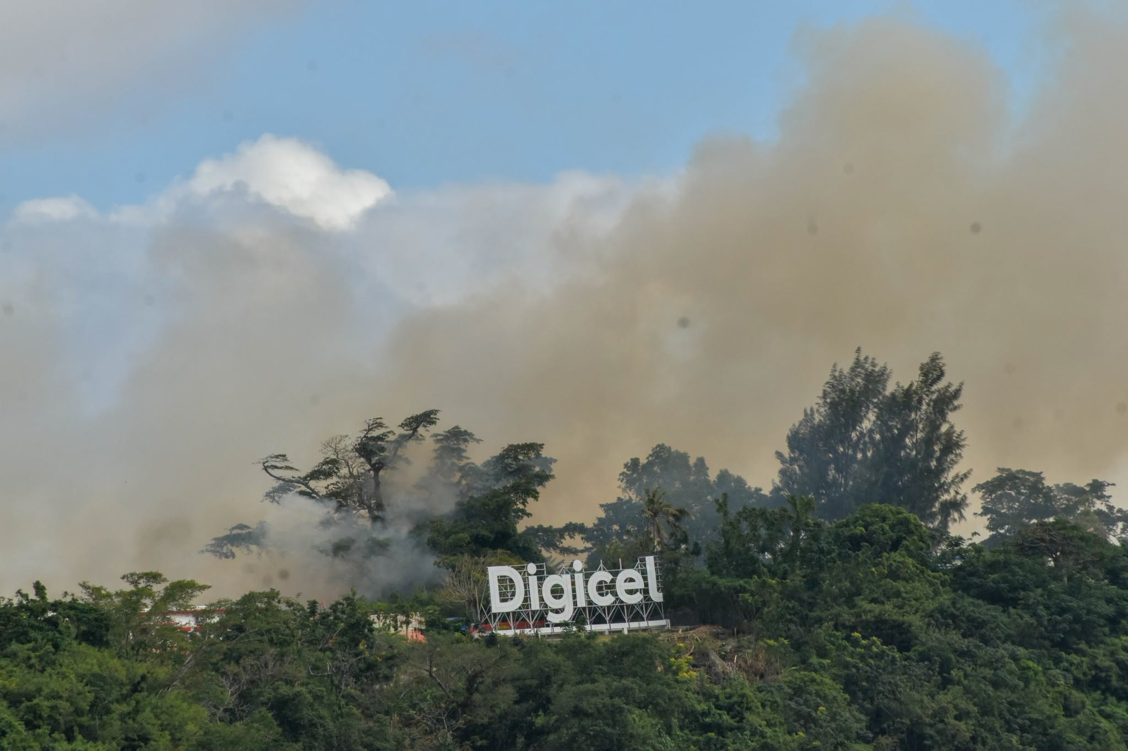

DELETE THIS BOX. PLACE MAP/DIAGRAM/IMAGE HERE
Impacts
Period: May – October 2026
Country: VANUATU
ENSO phase: El Nino
 | Synoptic Situation | Type of Hazard | Impacts | Image | Lat/Long | Sectors affected | No. of Deaths
3 | Prolonged dry and windy conditions | Bush Fire | A fire occurred on the Elluk Plateau during the afternoon of 30 June, releasing a large amount of smoke into the atmosphere. The fire spread rapidly due to the extremely dry surrounding vegetation and strong winds, which created a hazardous environment |  |  | Agriculture Sector
4 | El-Nino related dry conditions | Whooping Cough | Whooping cough (pertussis) Outbreak. A total of 276 cases have been reported, including 4 laboratory-confirmed cases. Most cases are in South Ambae, with cases also reported in North and East Ambae. Two people have been hospitalized and been discharged. No deaths have been reported. |  |  | Health Sector | 0

Slide 15

Summary
Impact summary to key climate-sensitive sectors
El Nino phase caused different impacts to the different countries in the Melanesia-sub Region.
Impacts that affected multiple climate sensitive sectors included:
Heavy rainfall with Flash Flooding
Prolonged dry and Drier than normal conditions
Droughts
Frost
Higher Sea Surface Temperatures (SSTs) with Warmer Waters
Marine Heatwaves
Bush Fires and Wild Fires
FIJI:
The impacts reported across Fiji from June to October 2026 highlight the effects of heavy rainfall, flash flooding and prolonged dry conditions associated with the developing and ongoing El Niño event. The main climate-sensitive sectors affected include agriculture and livestock, water resources, health, education, transport and infrastructure, food security and community livelihoods.
PAPUA NEW GUINEA:
Papua New Guinea experienced severe climate impacts Droughts and Water Shortages, Severe & Damaging Frosts, Agricultural Stress and Crop Losses between May and October 2026 driven by a historic, rapidly intensifying El Niño event putting pressure on Power, Mining, River Transport, Education, Food Supply and Response Cost.
SOLOMON ISLANDS:
Solomon Islands has experienced prolonged dry spells and persistent strong winds over the past six months, worsening water shortages in communities reliant on limited water sources and rainwater. Strong winds and rough seas have also contributed to maritime accidents, resulting in loss of lives and property.
VANUATU:
The current El Nino conditions have brought Below-normal rainfall, decreased cloudiness and windy conditions across Vanuatu. These drier-than-normal conditions have had multi-sectoral impacts, particularly on Water, Agriculture, Maritime, Education, Health, and Fisheries.

Slide 16






Contact
Email:
Samisoni.Waqavakatoga@met.gov.fj
kila.kila31@gmail.com
m.tugumana@met.gov.sb
jruben@meteo.gov.vu

