Slide 1





PACIFIC ISLANDS climate & Ocean forum-19
20 - 21 OCTOBER, 2026
HYBRID
PORT MORESBY, PAPUA NEW GUINEA
& ZOOM
www.pacificrcc.net

Slide 2
Presentation outline
Overview of May to October state of the climate
Evaluation of the last PICOF outlook
Review of PICOF – 18 Outlook

Slide 3
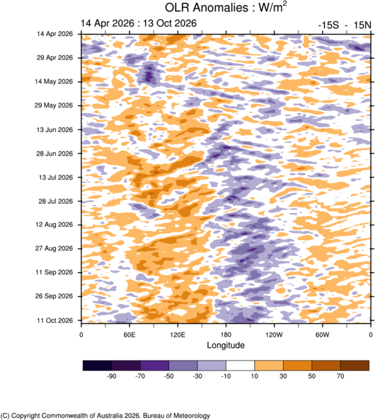
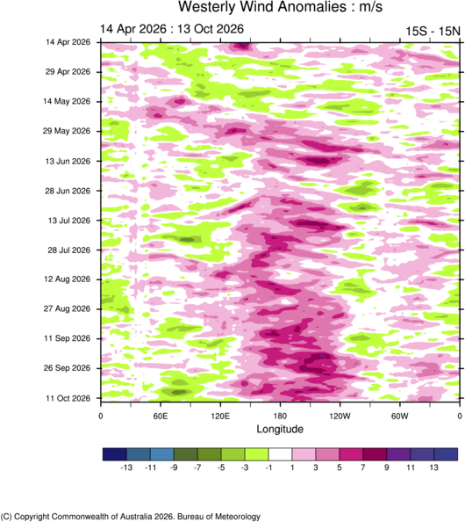
May to October: The hovmoller story
MJO
Persistent westerly wind anomalies =
Weakened trade winds
Reduced convection
Stronger trade winds
Weaker trade winds
More clouds
Less clouds
Rain shifts eastwards
The atmosphere transitioned toward a mature El Niño pattern, with eastward-shifted convection and persistent westerly wind anomalies.

Slide 4
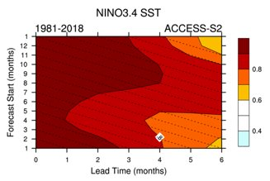
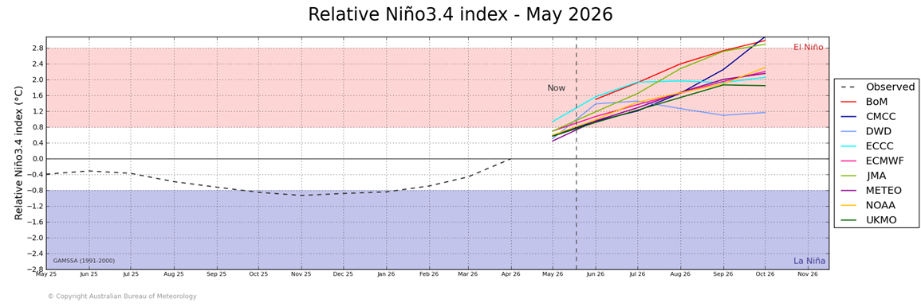
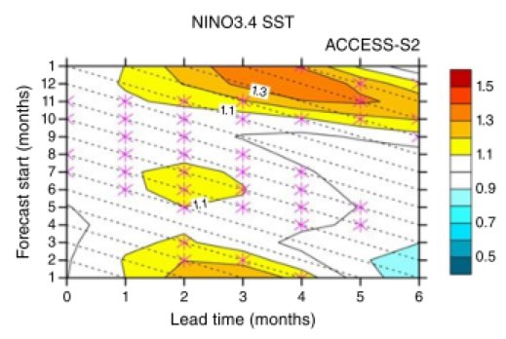
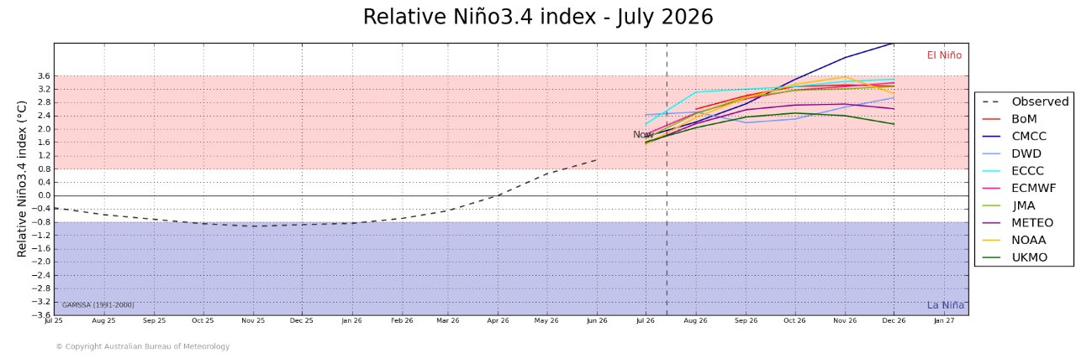
May to October key climate drivers
Correlation:
How well the forecast ENSO matches the observed ENSO.
Normalised standard error:
How big is the error relative to the thing I'm trying to predict?
e.g. 70% of the size of ENSO fluctuations is useful skill, errors above 100% are comparable or larger than the observed ENSO variability, suggesting lower forecast confidence.

Slide 5
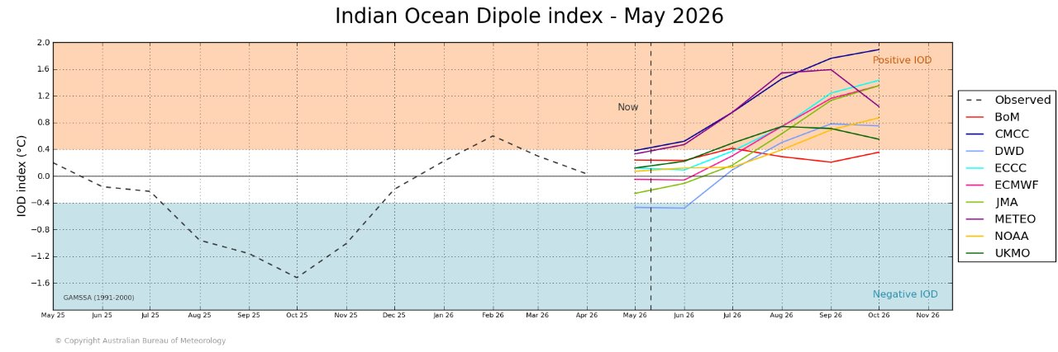
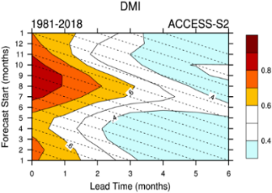
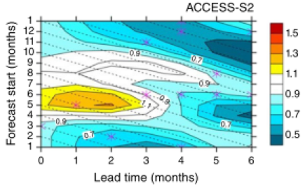
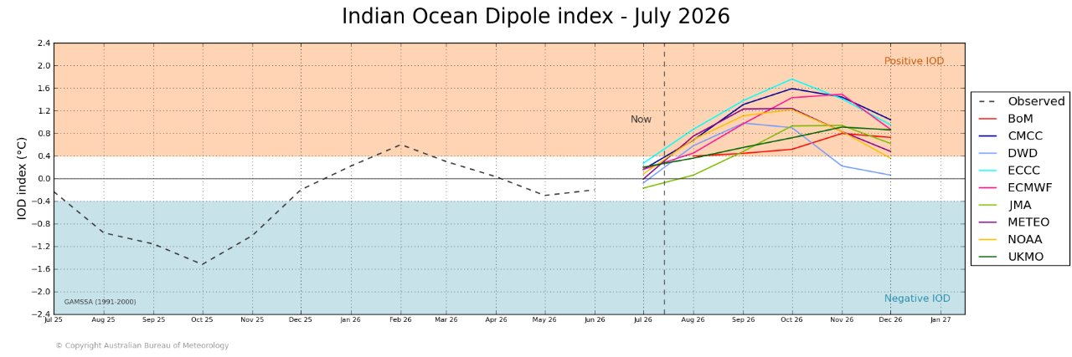
May to October key climate drivers
Correlation:
How well the forecast IOD matches the observed IOD.
Normalised standard error:
How big is the error relative to the thing I'm trying to predict, e.g. 70% of the size of the IOD fluctuations is useful skill, errors above 100% are comparable or larger than the observed IOD variability, suggesting lower forecast confidence.

Slide 6
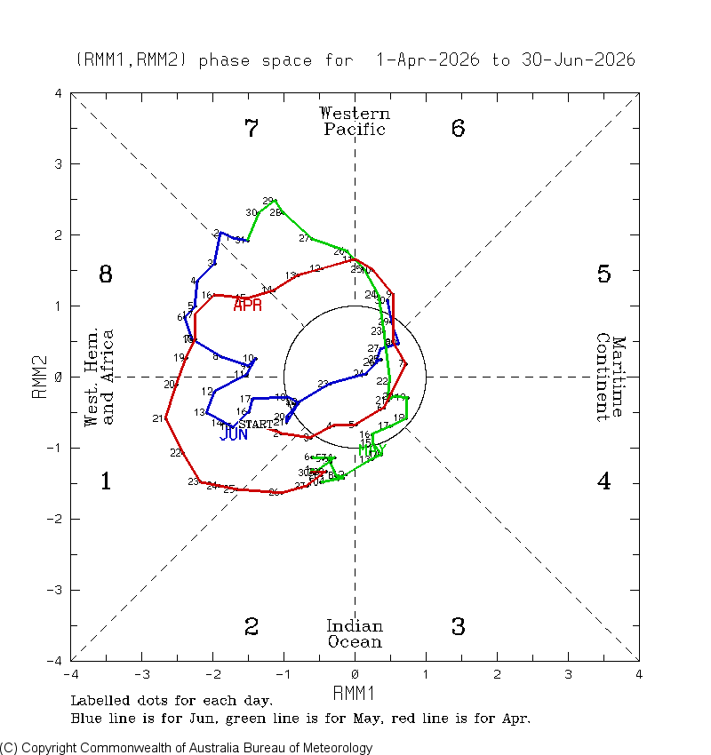
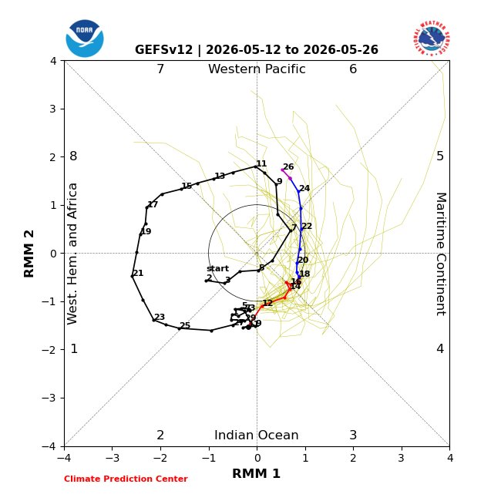
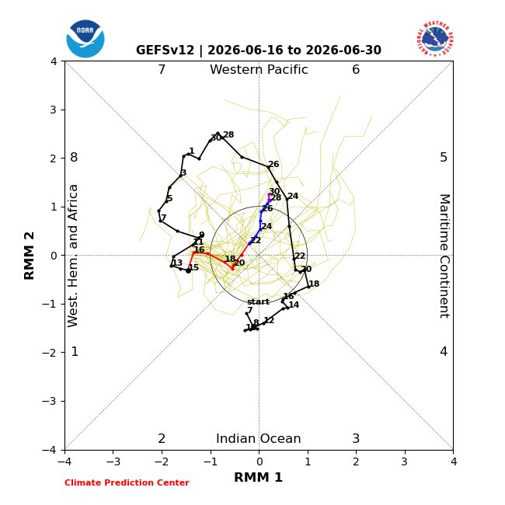
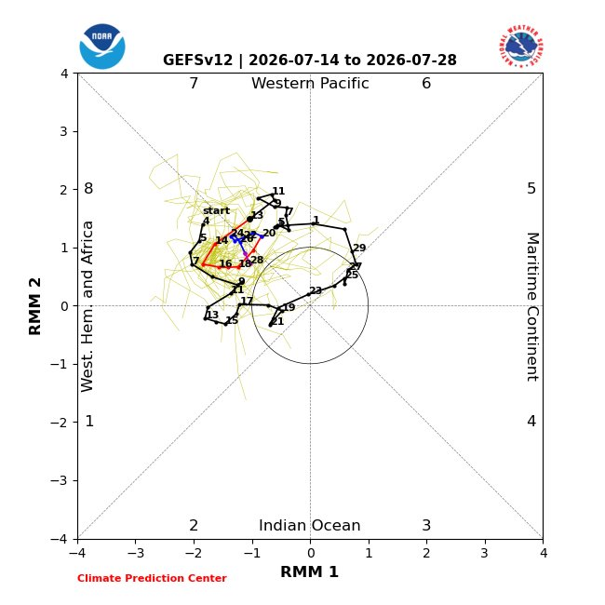
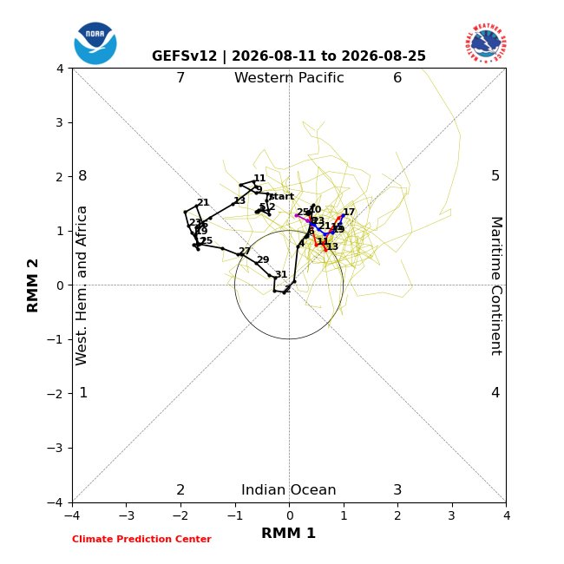
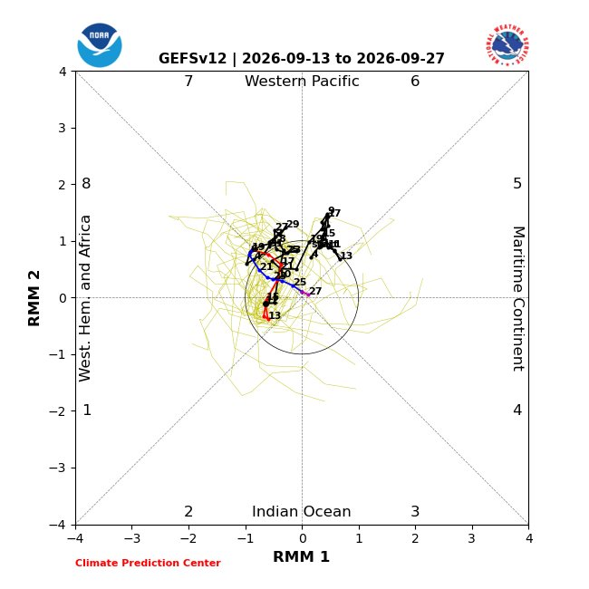

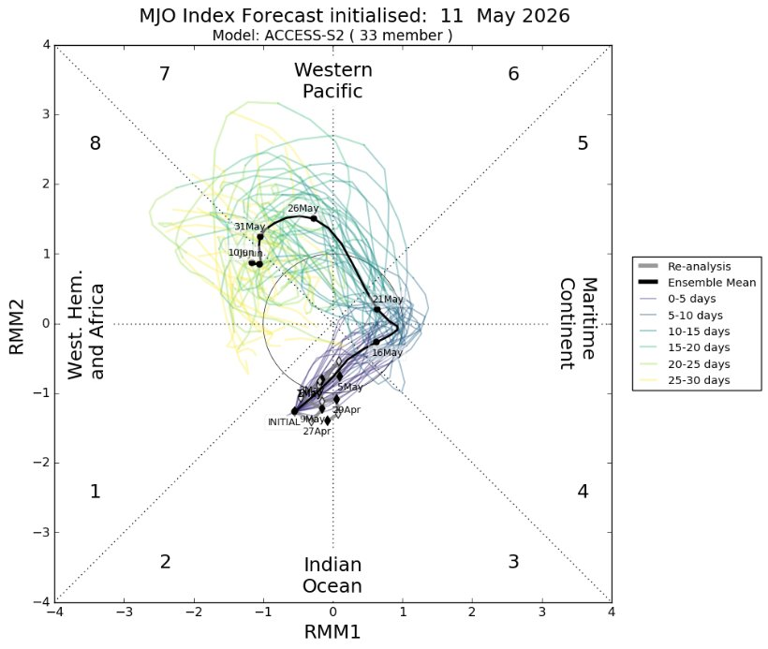
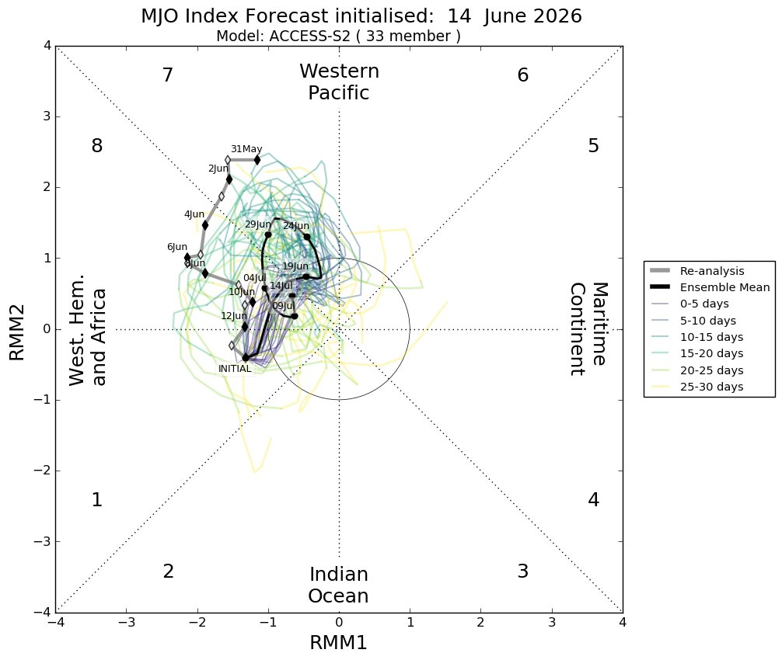
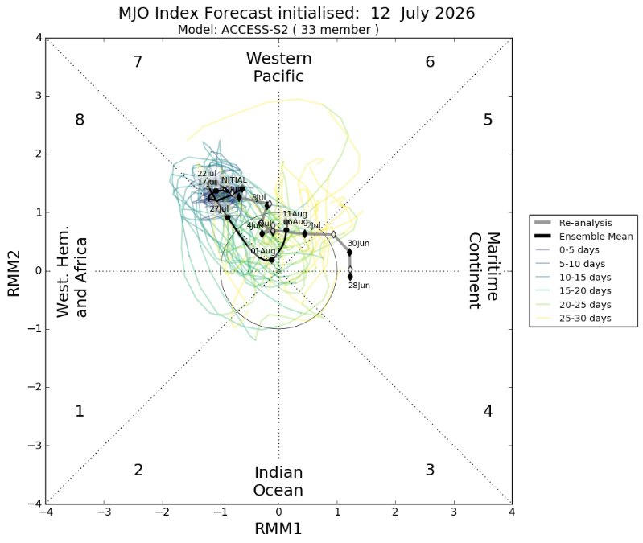
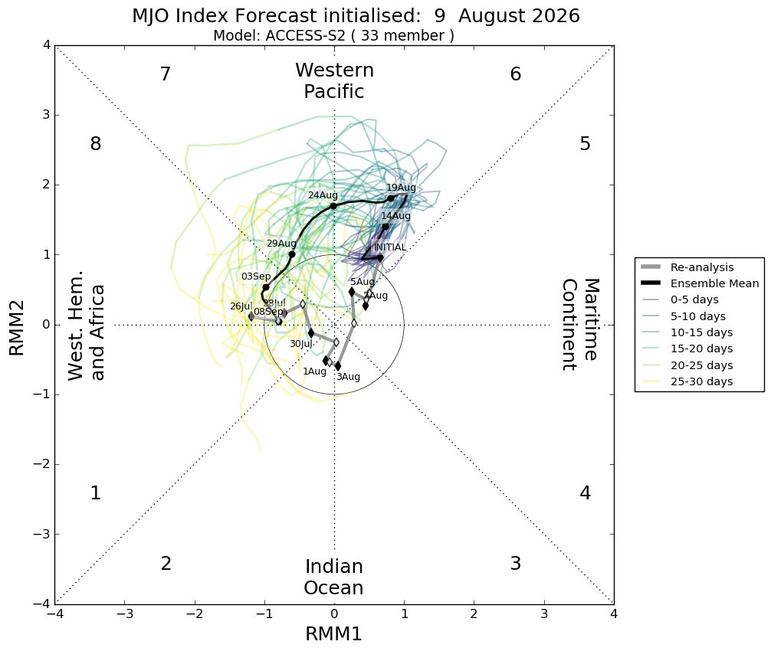
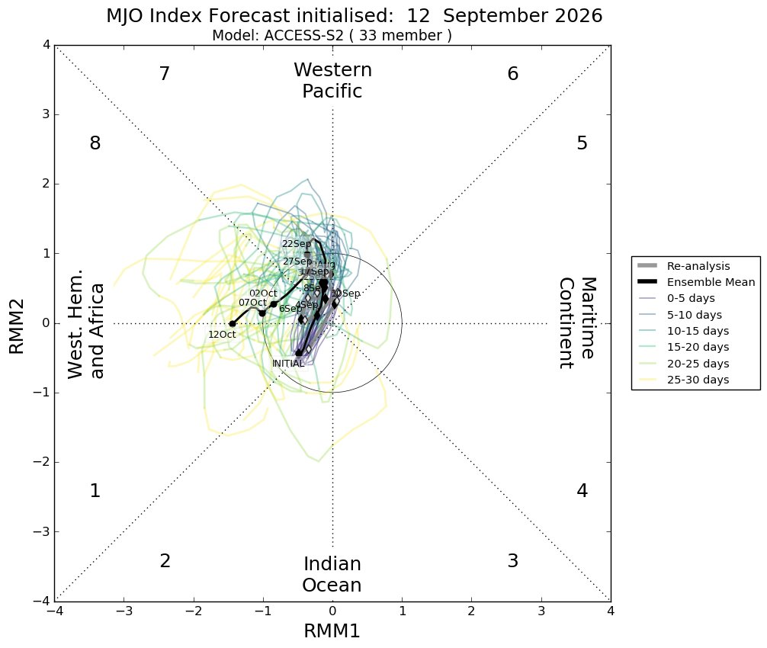
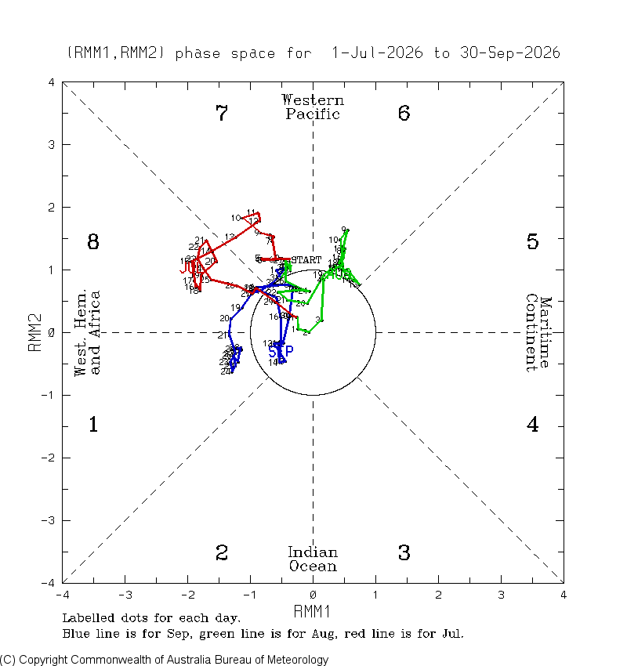
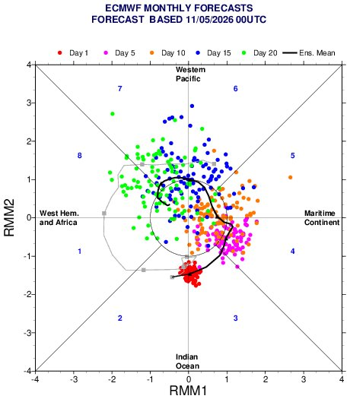
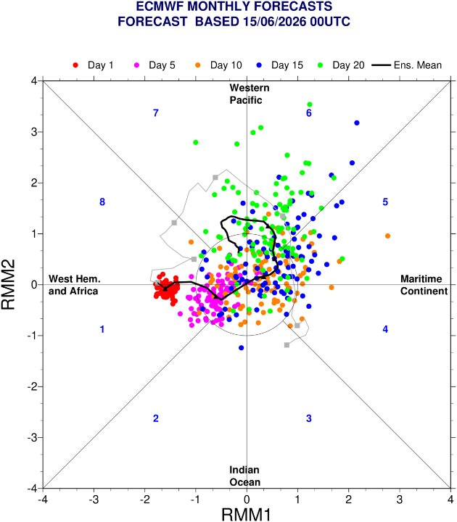
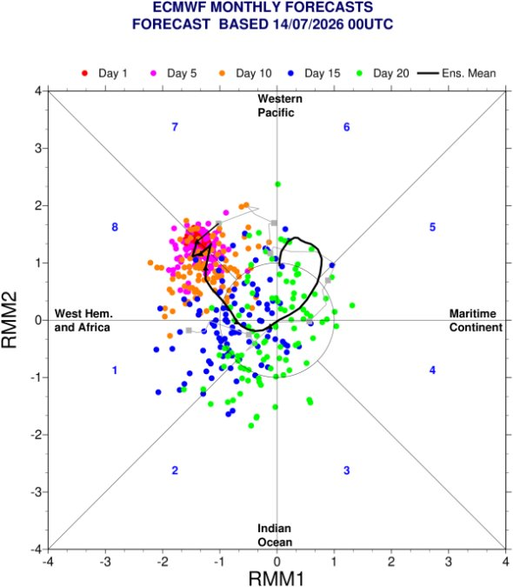
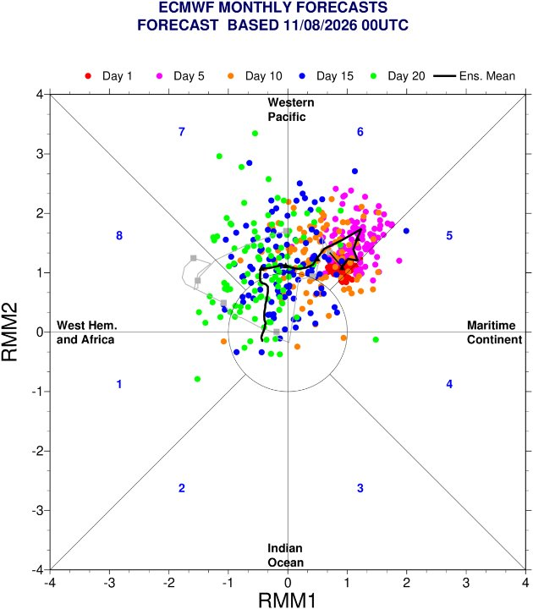
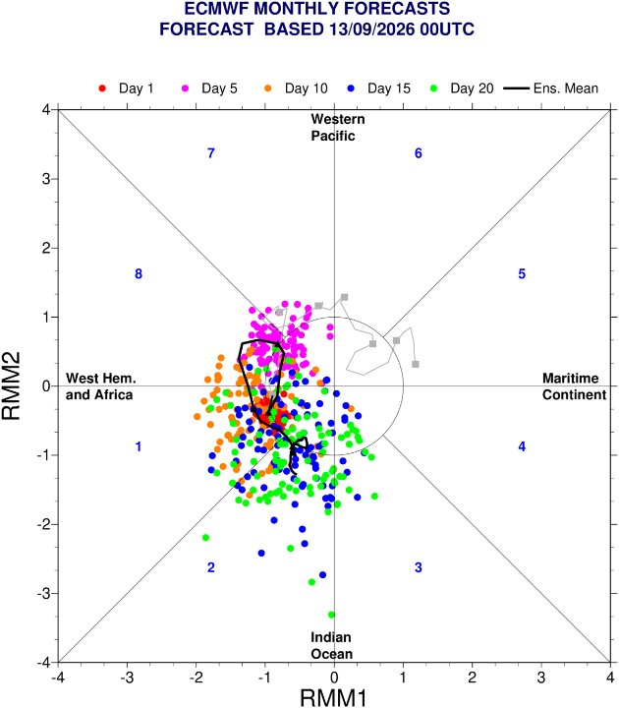
May to October key climate drivers
The tropical atmosphere was dominated by El Nino conditions.
During El Niño development, convection shifts eastward into the central Pacific, causing the RMM to spend more time in phases 7 and 8, even when a true propagating MJO is absent.

Slide 7
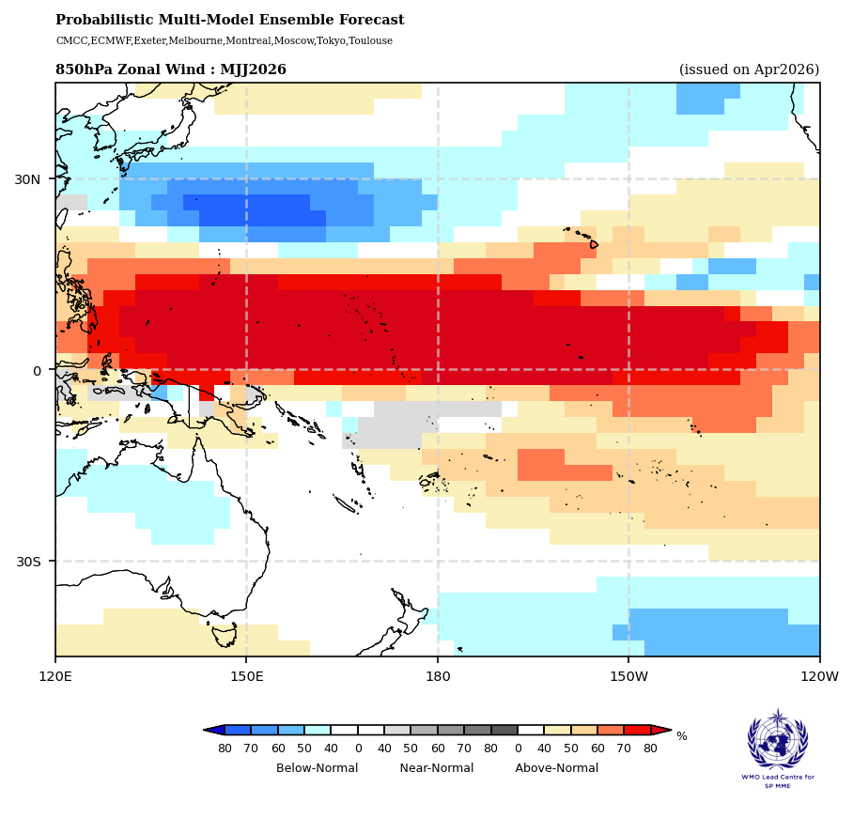
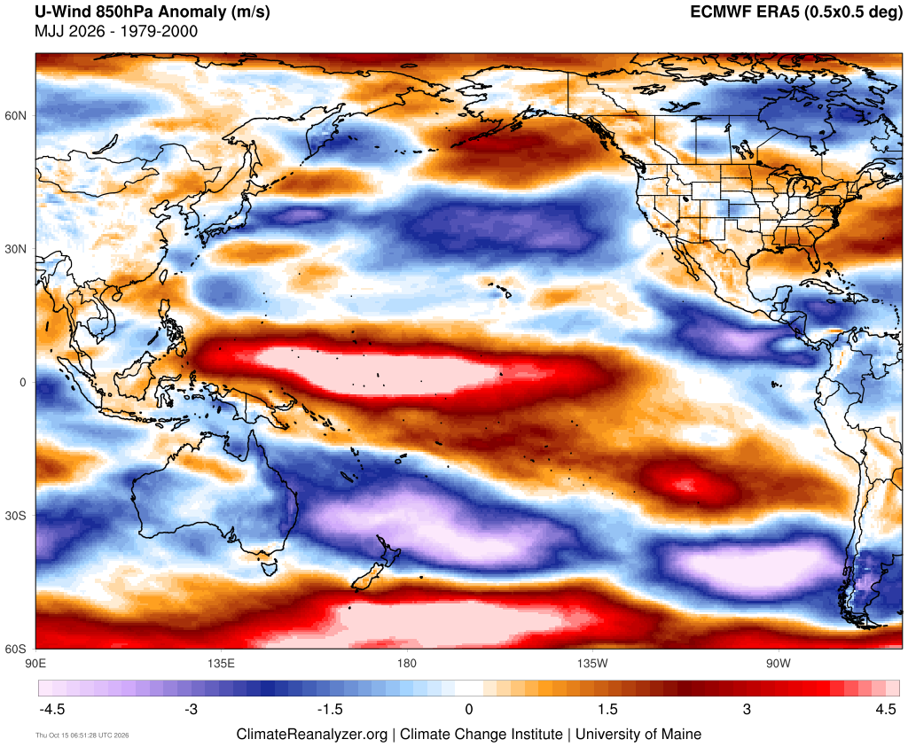
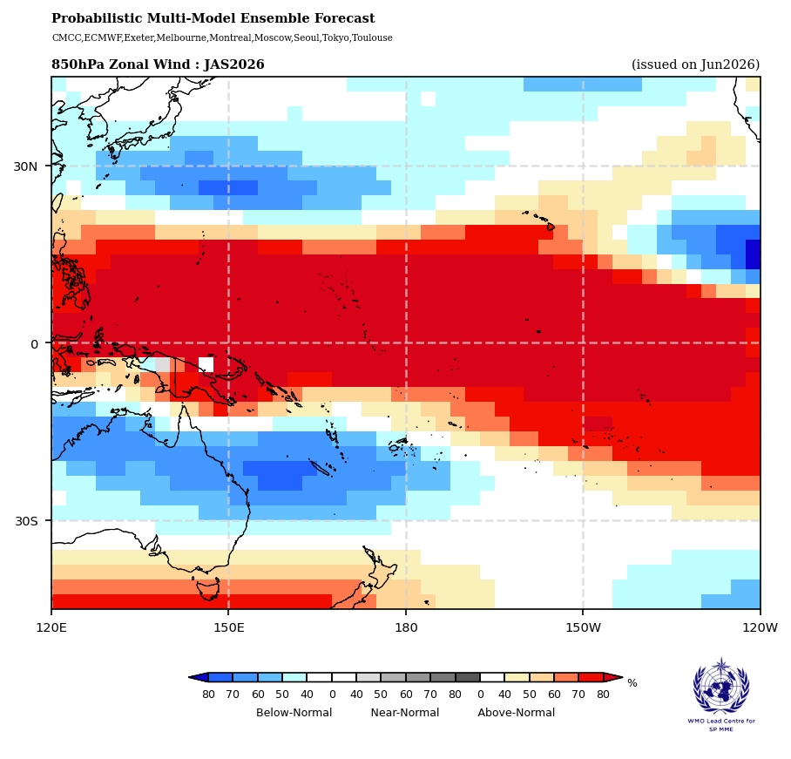
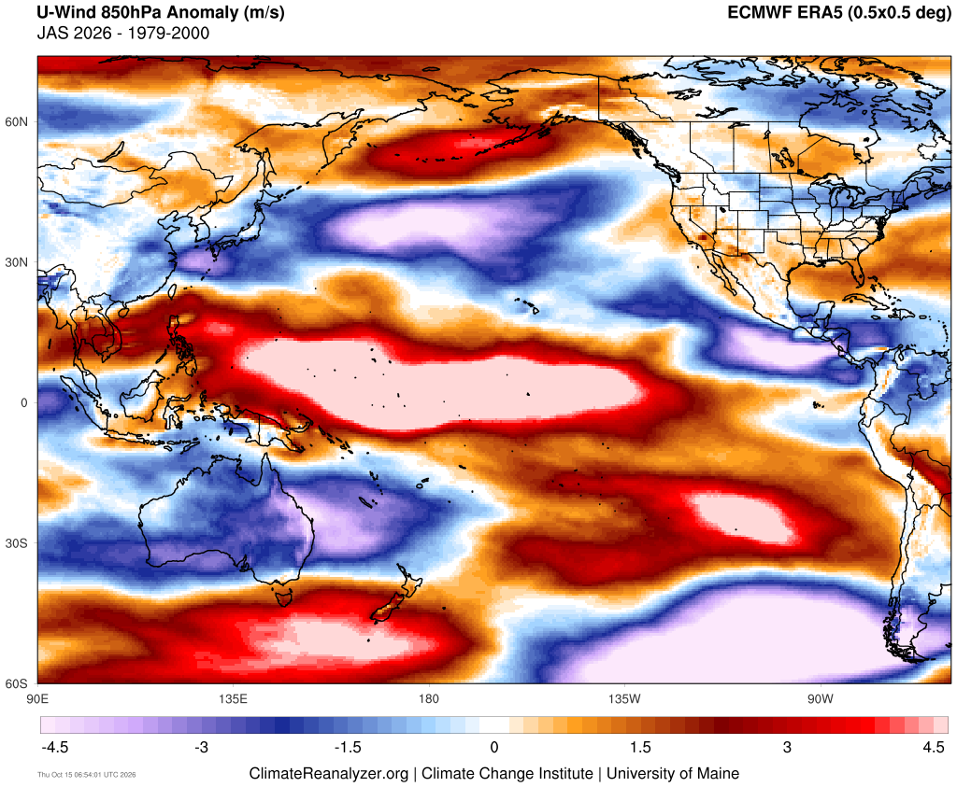
Zonal May to September wind outcomes
Why 850hPa winds:
850hPa is the lower troposphere and perfect for monitoring the trade winds.
Westerly (winds blowing from west to east): Red
Easterly (winds blowing from east to west: Blue
Forecasts captured the weakening and reversal of equatorial trade winds well, with observed westerly anomalies closely matching the forecast pattern and expansion from May-July to July-September. The main forecast deficiency was underestimating the easterly anomalies in the southwest Pacific during May-July.
This dipole is a classic indicator of a weakened Walker circulation, with the easterlies in the South Pacific supporting below-normal rainfall across much of the southwest Pacific.

Slide 8
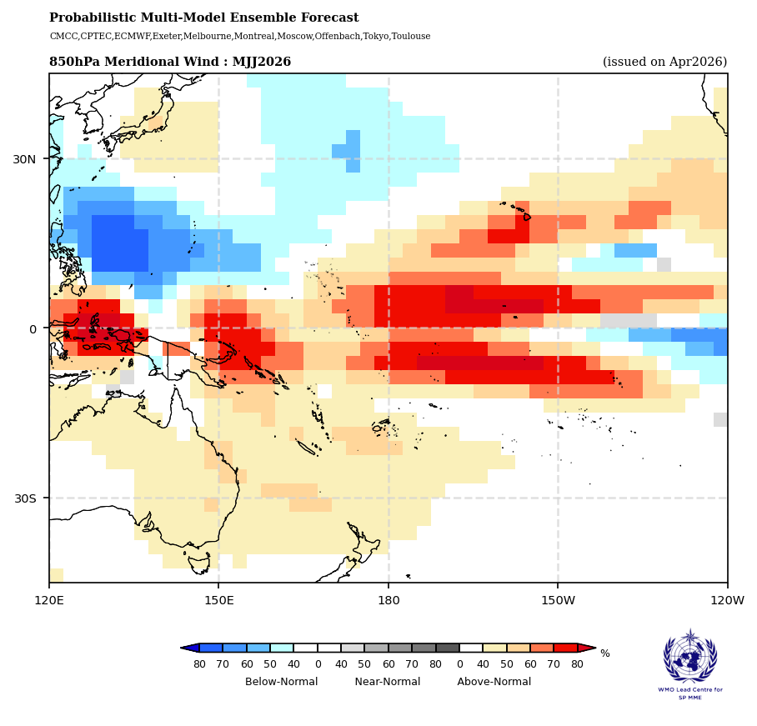
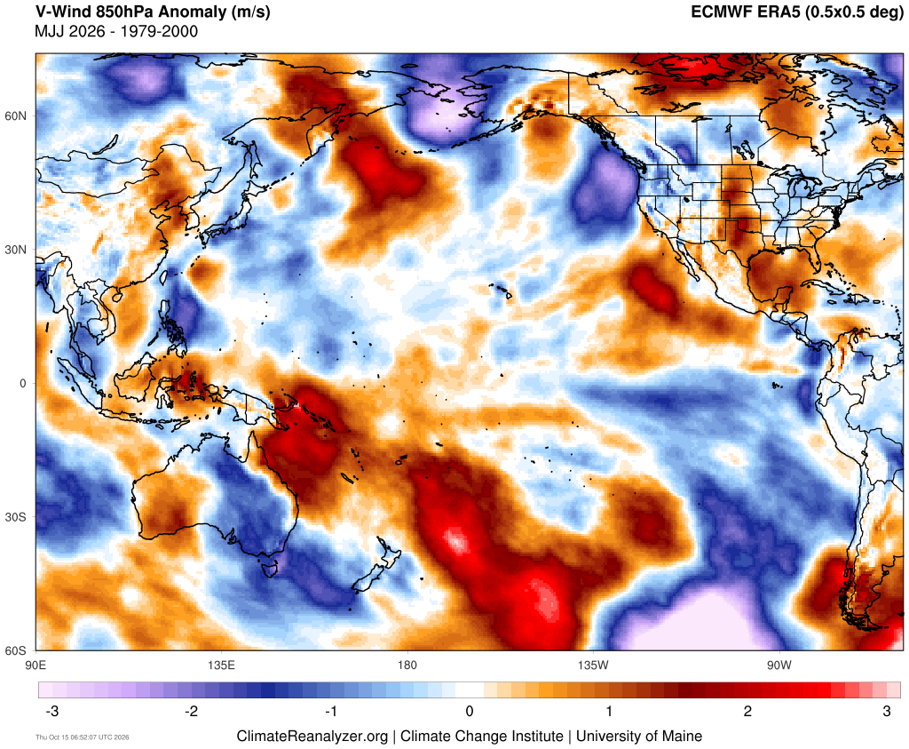
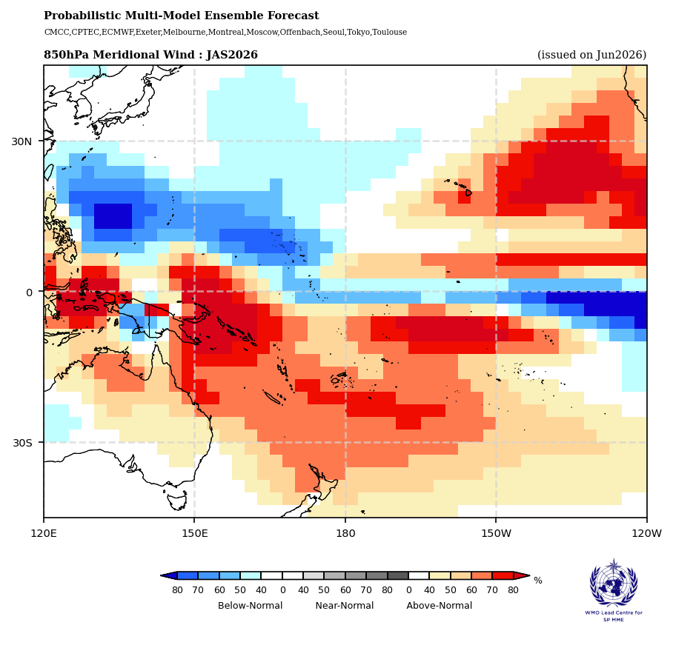
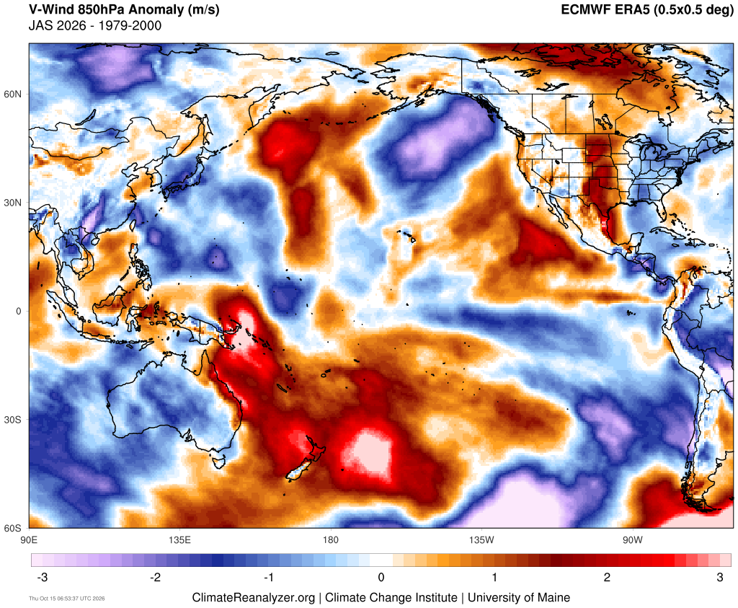
Meridional May to September wind outcomes
Why 850hPa winds:
850hPa is the lower troposphere and perfect for monitoring the trade winds.
Southerly (winds blowing from south to north): Red
Northerly (winds blowing from north to south): Blue
Forecasts successfully captured the convergent flow towards the equator in both hemispheres, with stronger anomalies during August-October. Verification was particularly strong over the South Pacific and near Micronesia.

Slide 9
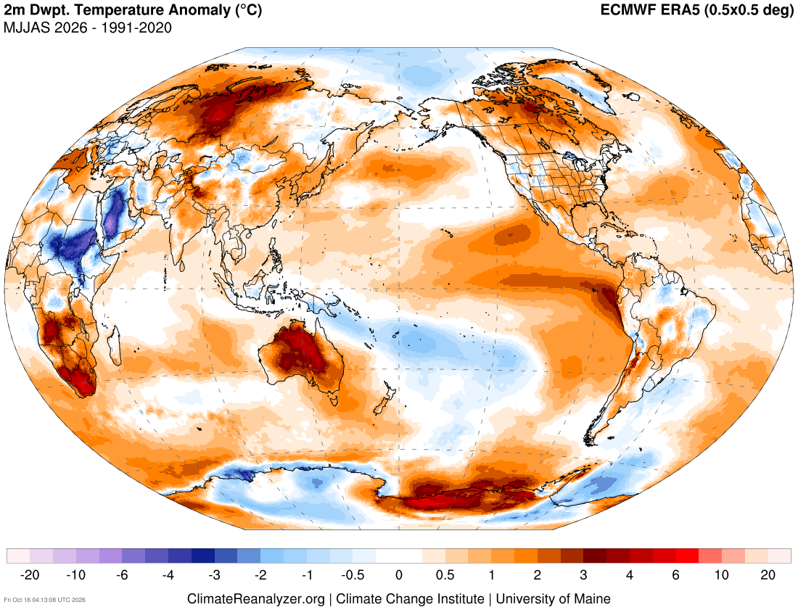
May to September Dew Point Temperatures
Dew Point Temperature:
Dew point temperature and relative humidity are closely related
Note: below normal dew point temperatures over Fiji, Tonga, Niue, Southern Cook Islands and Vanuatu.
We saw in the previous slide a stronger than normal southern air flow in the South Pacific over May to Sept. It therefore makes sense that this air would also be cooler and drier.

Slide 10
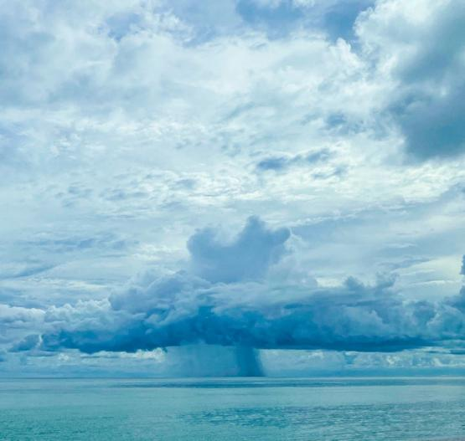
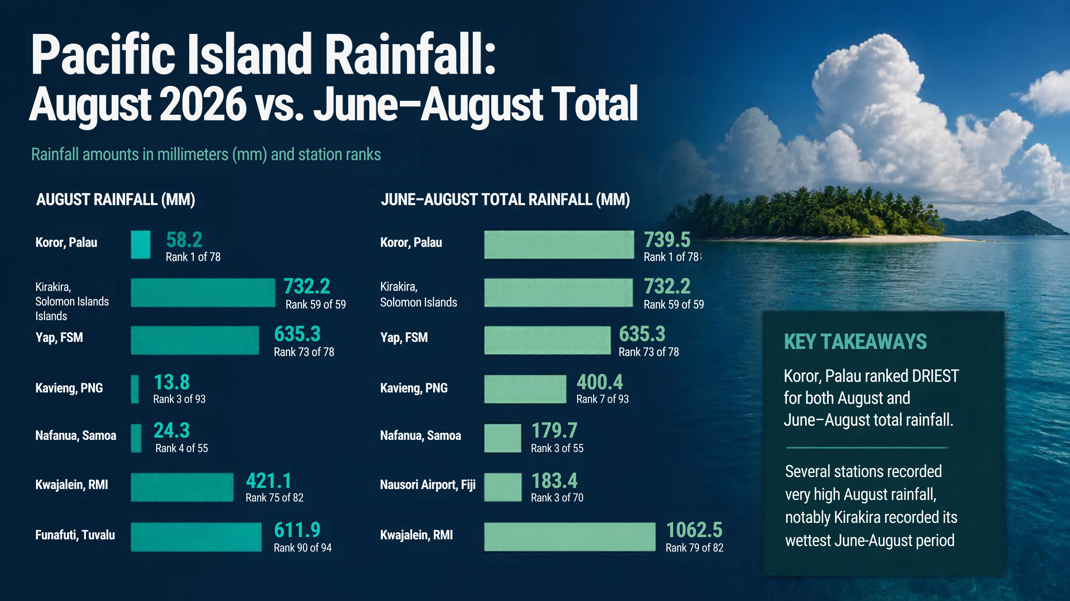
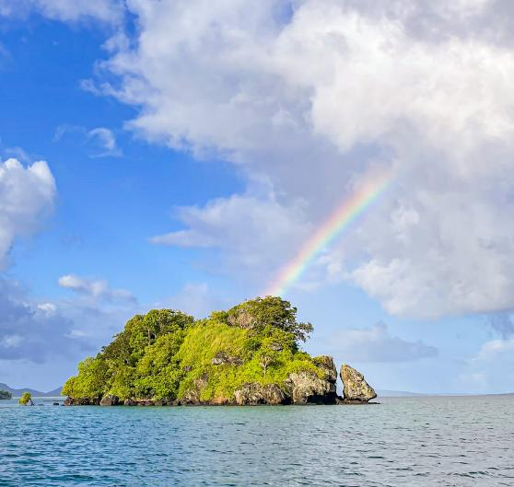
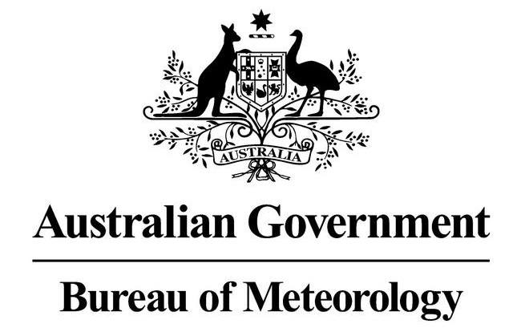




PICOF-19
Looking Back – Review and Evaluation of May to October 2026 Climate Outlook
Elise Chandler
Bureau of Meteorology

Slide 11
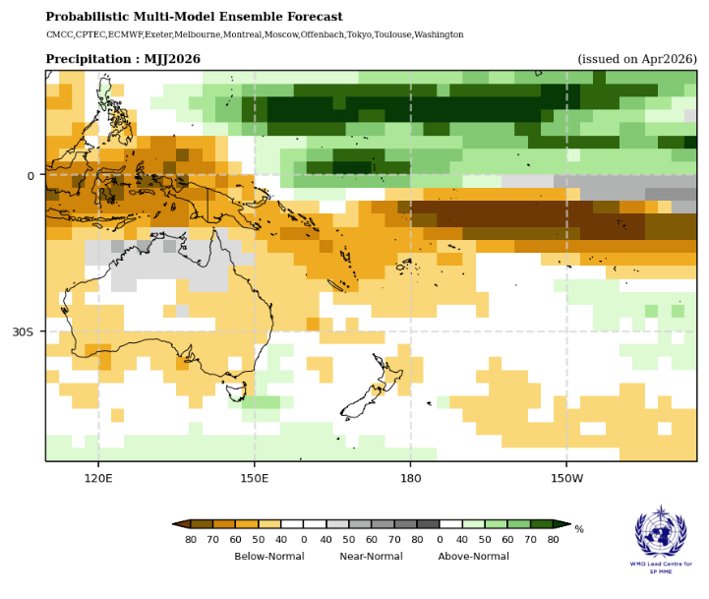
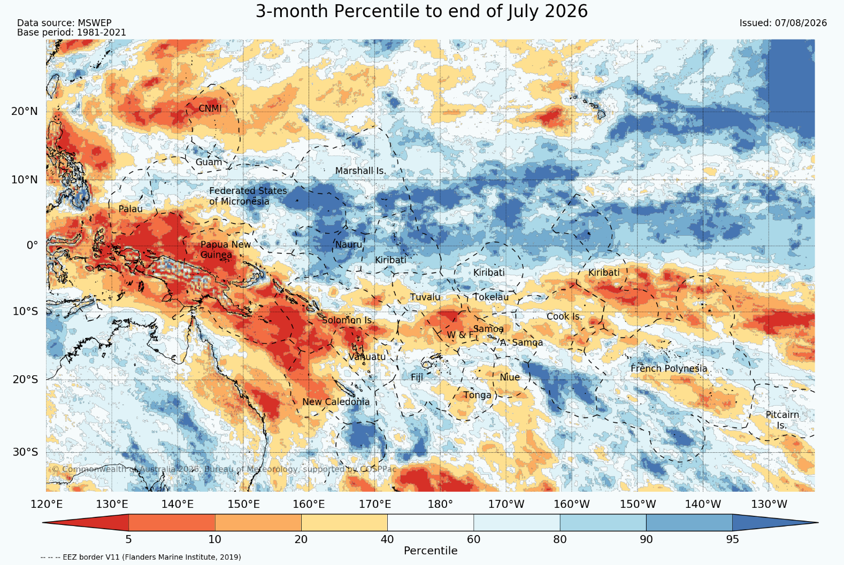
May to July rainfall outcomes
Wet forecast regions
Eastern FSM ✓
Nauru ✓
Gilbert Islands (Kiribati) ✓
Marshall Islands ✓/~
Equatorial central Pacific wet belt ✓
Western FSM ~
Northern RMI ~
CNMI / Guam ✗
Dry forecast regions
PNG ✓
Samoa ✓
American Samoa ✓
Tonga ✓
Niue ✓
Tokelau ✓
Northern French Polynesia ✓
Southern Line Islands (Kiribati) ✓
Cook Islands ✓/~ (generally dry, but more mixed than forecast in places)
Near-normal forecast regions
Central Line Islands ✓
New Caledonia ✗
Vanuatu ✗
Solomon Islands ✗
Eastern PNG EEZ / Bismarck Sea ✗
The forecast captured the dry side of the ENSO pattern much better than the wet side.

Slide 12
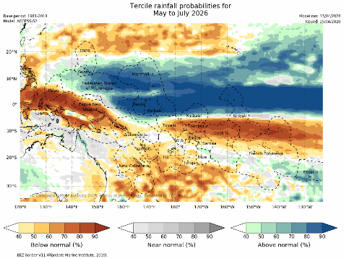
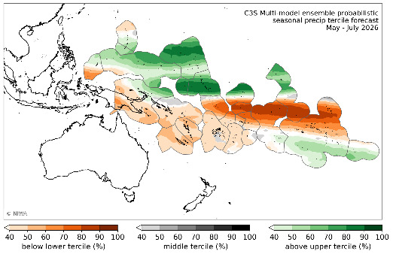
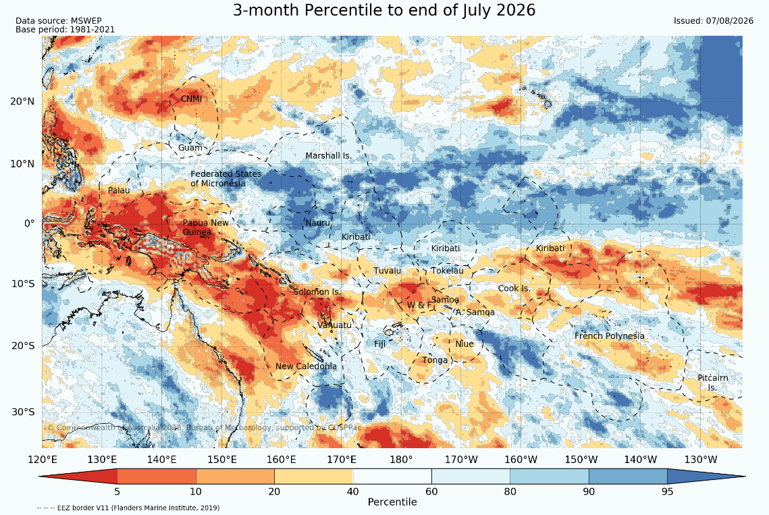
May to July node lead forecast outcomes
Overlapping Misses:
Fiji waters, particularly south of Fiji, were more mixed than forecast.
The Tonga dry signal was overestimated, with observed rainfall generally closer to normal.
The southern Cook Islands were wetter than forecast.
The forecast wet anomaly near Palau was displaced too far north.
Southeastern New Caledonia was wetter than forecast.
Northern Tuvalu was drier than forecast.
C3S misses:
Dry conditions extended further east into the eastern PNG EEZ and Solomon Islands than forecast.
BoM misses:
Eastern Solomon Islands and Northern Fiji was drier than forecast.

Slide 13
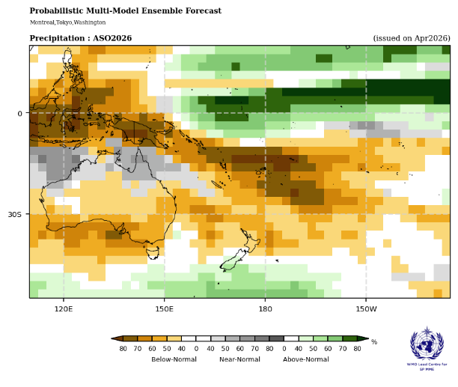
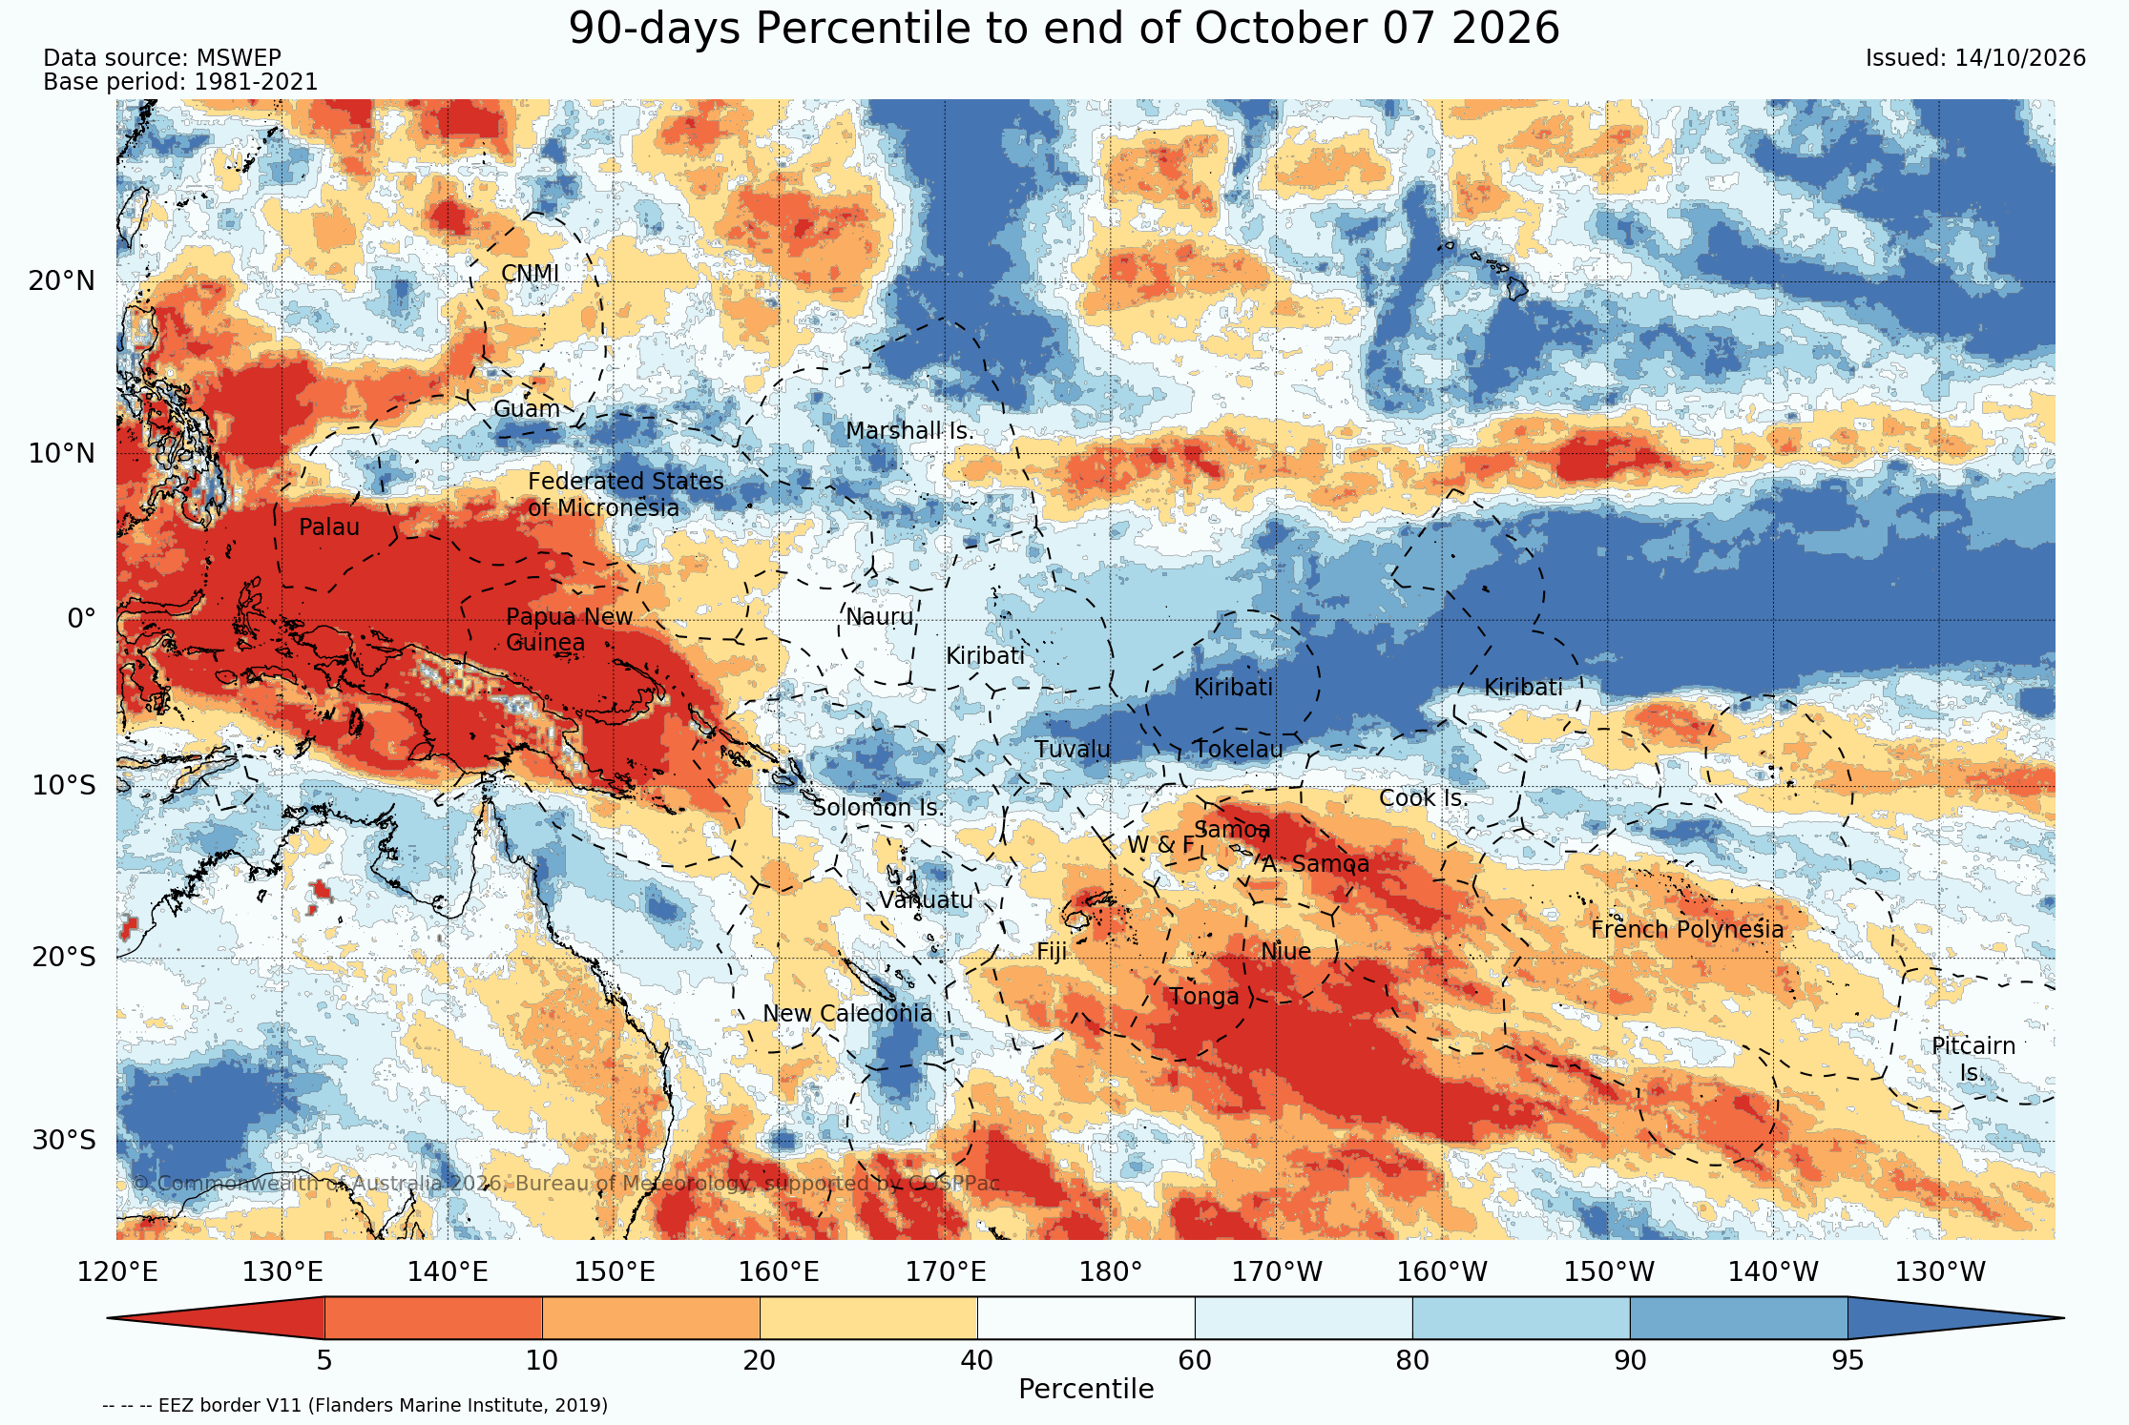
August to October rainfall outcomes
Dry forecast regions
PNG ✓
Samoa ✓
American Samoa ✓
Tonga ✓
Niue ✓
Tokelau ✓
French Polynesia ✓
Wet forecast regions
FSM ~
RMI ✓
Nauru ✗
Tuvalu ✗
Solomon Islands ✗
The forecast captured the dry side of the ENSO pattern much better than the wet side.

Slide 14
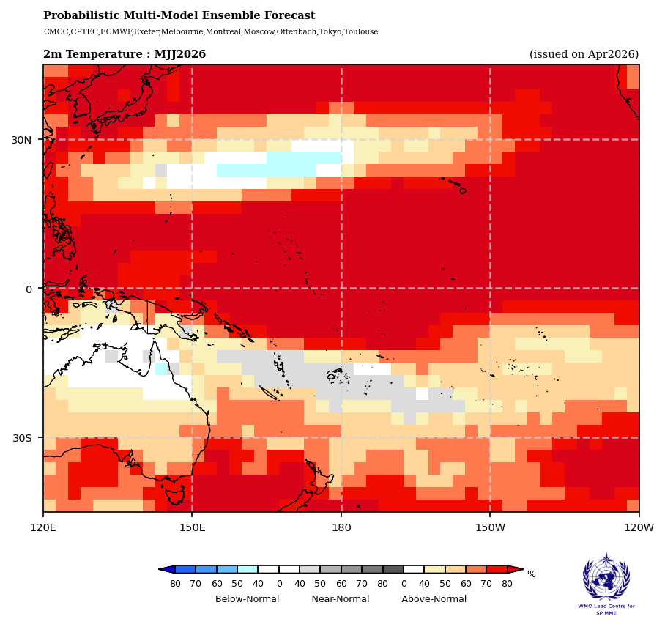
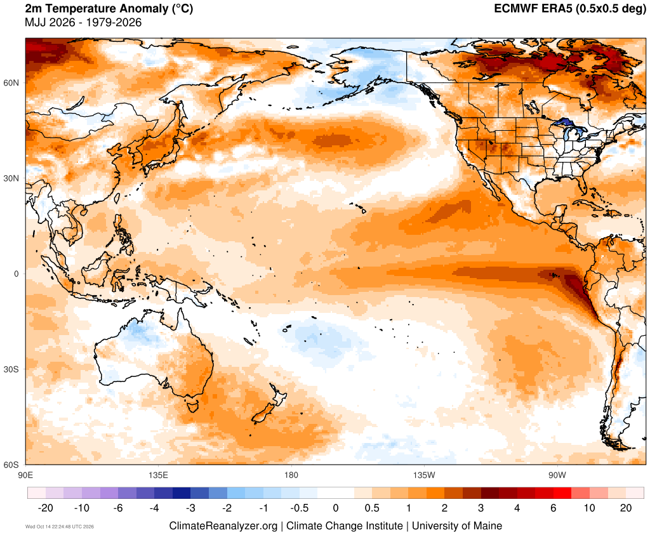
May to July air temperature outcomes
Near-normal forecast regions:
Solomon Islands ✓
Vanuatu ✓
New Caledonia ✓
Fiji ✓
Niue ✗
Southern Tonga ✗
Southern Cook Islands ✗
Southern French Polynesia ✗
Warm forecast regions:
PNG ✓
Tonga ✓
Samoa ✓
American Samoa ✓
FSM ✓
Nauru ✓
Marshall Islands ✓
Kiribati ✓
Cool forecast regions:
North Pacific subtropics ✗

Slide 15
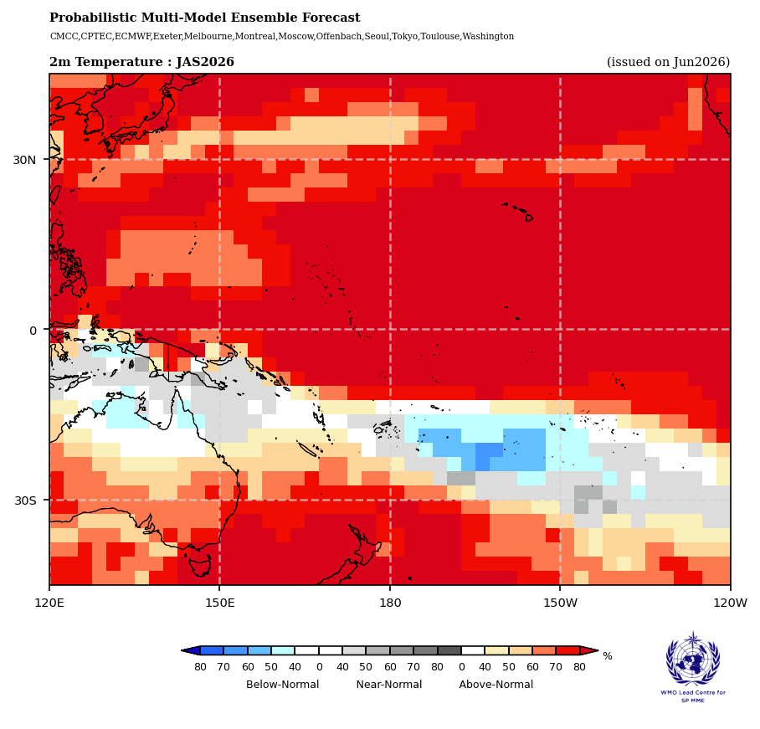

July to September air temperature outcomes
Near-normal forecast regions:
Solomon Islands ~
Vanuatu ✗
New Caledonia ~
Fiji ~
Tonga ~
Warm forecast regions:
PNG ✓
Samoa ✓
American Samoa ✓
Tokelau ✓
FSM ✓
Nauru ✓
Marshall Islands ✓
Kiribati ✓
Cool forecast regions:
Niue ✓
Southern Cook Islands ✓
French Polynesia ✓
Pitcairn ✓

Slide 16


May to July Mean Sea Level Pressure outcomes
  Above normal mean sea level pressure (MSLP) anomalies (higher pressure; stable weather)
  Below normal mean sea level pressure (MSLP) anomalies (lower pressure; blue) associated with converging winds and increased cloudiness.
  The strongest observed negative anomalies occurred across parts of the subtropical South Pacific whereas the forecast emphasised the equatorial and north-central Pacific.
  The strong observed positive anomalies around New Zealand and the Tasman Sea are not present in the forecast.
  What does AI say: I'd rate this as a good forecast (around 7–8/10).
  The forecast suggested a stronger equatorial pressure dipole, while observations show a broader, more diffuse pattern extending into the subtropics.
Notes:
https://www.climatereanalyzer.org/research_tools/monthly_maps/

Slide 17


July to September Mean Sea Level Pressure outcomes
  Above normal mean sea level pressure (MSLP) anomalies (higher pressure; stable weather)
  Below normal mean sea level pressure (MSLP) anomalies (lower pressure; blue) associated with converging winds and increased cloudiness.
  The western Pacific high pressure anomalies were forecast well in spatial location, although the strongest anomalies were observed further south through southern Australia.
  Good forecast of the central equatorial Pacific low pressure.
  Forecast missed the positive anomalies extending eastwards of New Zealand.
  What does AI say: I'd rate this as a great forecast (around 8.5-9/10).
  The sign of the anomalies was correct almost everywhere, the location of the major pressure gradient was excellent, and the forecast captured the ENSO state very well.
  Why not 10/10?
  The observed anomalies were stronger and more organised, some latitude errors.
Notes:
https://www.climatereanalyzer.org/research_tools/monthly_maps/

Slide 18
PICOF 18: What were our outlook comments
Predictions of air temperature and rainfall for May to July and August to October 2026 seasons are typical of El Niño-like patterns when compared to observations of the same periods across past events.
The rainfall outlook over May to July 2026 favours above normal rainfall between Guam , CNMI, FSM, RMI, Nauru, Gilbert and northern Line Islands (Kiribati), and southern French Polynesia. Below normal rainfall is forecast over Palau, PNG, Solomon Islands, Vanuatu, New Caledonia, Fiji, Tonga, Tuvalu, Kiribati (southern Line Is.), Niue, Wallis and Futuna, Samoa, American Samoa, northern Cook Islands and northern French Polynesia. Confidence in this outlook highest along the equator and in the far western Pacific, although there is acceptable skill for most of the off-equatorial Pacific region.
The El Niño-like rainfall outlook pattern continues over August to October 2026, albeit with reduced confidence due to the longer lead time of the forecast period. Below normal rainfall is forecast to persist over Palau, CNMI, Central RMI, PNG, Solomon Is., New Caledonia, Vanuatu, Fiji, Tonga, Niue, Wallis and Futuna, Samoa, American Samoa, Kiribati (southern Line Is.), Tokelau, Cook Islands, and northern French Polynesia, with above normal rainfall forecast over eastern FSM, northern and southern RMI, Nauru, Kiribati (Gilber, and northern Line Is.), and Tuvalu.
Above normal air temperatures are favoured across the Pacific for May to July 2026 for all countries except for near normal air temperatures are predicted eastern PNG mainland, New Caledonia, Vanuatu, Fiji, Tonga, and Niue.
Dry outlooks verified better than the wet outlooks
Dry outlooks verified better than the wet outlooks
?
Didn't verify well east of the Dateline

Slide 19
Review of PICOF-18 outlook
The air temperature outlook for August to October 2026 is a similar pattern as for the previous season, with the inclusion of the cool anomalies being forecast along the subtropical Pacific over most of Fiji, Tonga, Wallis and Futuna, Samoa, American Samoa, Niue, central Cook Islands, and western French Polynesia
There is excellent agreement between the Pacific Regional Climate Centre node for long range forecasting lead models and the WMO lead centre multi-model ensemble over the coming six months. Good agreement between high quality models is common during phases of El Niño and La Niña.
The forecasts for both the mean sea level pressure and wind patterns for the coming season indicate the atmosphere is reflecting a El Niño-like pattern and aligns well with forecasted rainfall and air temperature patterns.
?
Missed the extent of the cool anomalies in the South Pacific

Slide 20

Summary
Climate models performed well when forecasting key climate drivers, such the developing El Niño and positive IOD event. The Madden-Julian Oscillation (MJO) was well forecast over the last six months when predicting the location and strength of the MJO for the coming weeks, with the models verifying well in terms of being able to capture the consistent lack of MJO activity in the region.
The WMO Lead Centre for long range forecasting multi-model ensemble performed very well when forecasting the coming seasons rainfall, this was supported by the individual forecasts from node leads the Bureau of Meteorology and Earth Science New Zealand. Notably rainfall predictions were most accurate away from the South Pacific Convergence Zone (SPCZ), and alongside regions of forecasted below normal rainfall.
Air temperature across the region was generally well forecast by the WMO multi-model ensemble when compared to observations, although an observed persistent cooler region in the South Pacific across both seasons was not well forecast.
Wind forecasts were presented as zonal and meridional components for each season. These forecasts supported a quickly developing El Niño event and perfectly captured the weakened Walker circulation which was subsequently observed in the Pacific winds, particularly for the August – October season.

Slide 21





Contact
Elise.chandler@bom.gov.au

