Slide 1
El Nino, potential impacts on fisheries across the Pacific region
Simon Nicol
Principal Fisheries Scientist
Fisheries, Aquaculture and Marine Ecosystems Division
SPC

Slide 2
El Niño and Ocean Conditions
Oceanographic changes
During El Niño, the warm pool in the western Pacific moves eastward, bringing warmer surface water and shifting rainfall toward the central and eastern Pacific.
Warming of 1-2°C or more can trigger coral bleaching on the reefs that coastal fisheries depend on.
  the 1997-98 and 2015-16 events caused widespread bleaching across parts of Micronesia, Kiribati, Fiji, and elsewhere.
Sea levels in the western Pacific drop temporarily, which can expose reef flats and stress shallow reef and seagrass habitats.
Changes in rainfall and runoff alter nutrient delivery and salinity in lagoons and nearshore waters.

Slide 3
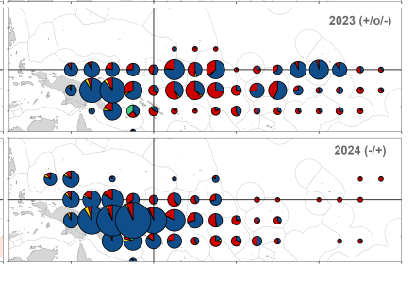
El Niño and regional tuna fishery distribution
short El Niño
Purse seine vessels follow the fish, so fishing effort shifts east, concentrating in the waters of the central Pacific nations.
Because the fish move, countries in the east can see higher demand and prices for fishing days, while western members may see fewer days sold or reduced catch.
Several eastern countries have benefited sharply from the shift, for example Kiribati in strong El Niño years, which has seen its licensing revenue rise.
neutral/La Niña
Free school
(unassociated)
FADs
Source: TFAR 2025

Slide 4
Economic and social effects
Many Pacific island governments depend heavily on tuna access fees, which can account for a large share of government revenue in countries like Kiribati, Tuvalu, Nauru, and Tokelau. El Niño can therefore create winners and losers in public finances.
Domestic industries are affected, since canneries and processing plants in the west (such as in PNG, Solomon Islands, and Fiji) may face supply swings.
Small-scale and artisanal tuna fishers using nearshore FADs and longlines may also see changes in availability, along with the transshipment and port activity that comes with it.
Longline fisheries (yellowfin, bigeye, albacore) are affected by changes in catch rates linked to thermocline depth, which influences vessel profitability and the economics of bases like Fiji, Samoa, and French Polynesia.

Slide 5
Effects on coastal fisheries
Reef fisheries: Bleaching and coral mortality reduce habitat quality. Herbivores can increase at first as algae grow, but over time reef fish abundance and diversity decline, especially for coral-dependent species.
Invertebrates: Giant clams, sea cucumbers, and trochus are sensitive to heat stress and to changes in salinity.
Pelagic species: Skipjack and yellowfin tuna shift their distribution with the warm pool, moving east during El Niño. Nearshore and artisanal fishers in the western Pacific may see fewer fish, while the central and eastern islands (Kiribati, Tuvalu, Cook Islands, French Polynesia) often gain access.
Nearshore productivity: Reduced upwelling and nutrient supply can lower plankton production, affecting the food web that supports small pelagics and reef fish.

Slide 6
Socioeconomic effects
Many communities rely on coastal fish as a primary protein source, so declines threaten food security and household income.
Drought, which often accompanies El Niño in the western Pacific, adds pressure on freshwater and agriculture, which can push people to fish more heavily.
Fishing effort can increase on already stressed reefs, worsening overfishing.

Slide 7
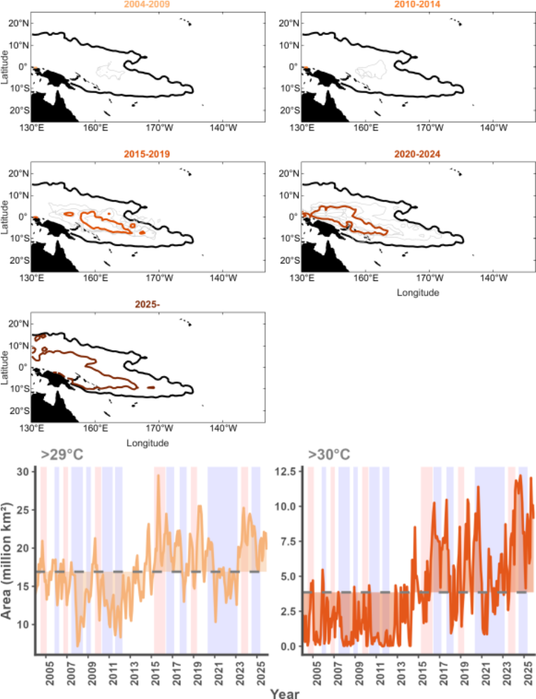
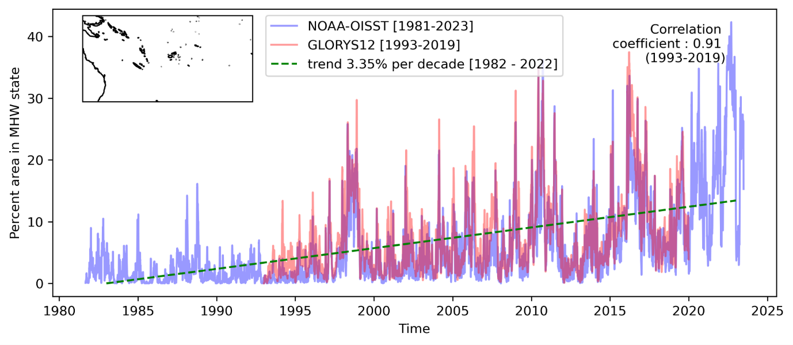
Compounding effects

