Slide 1
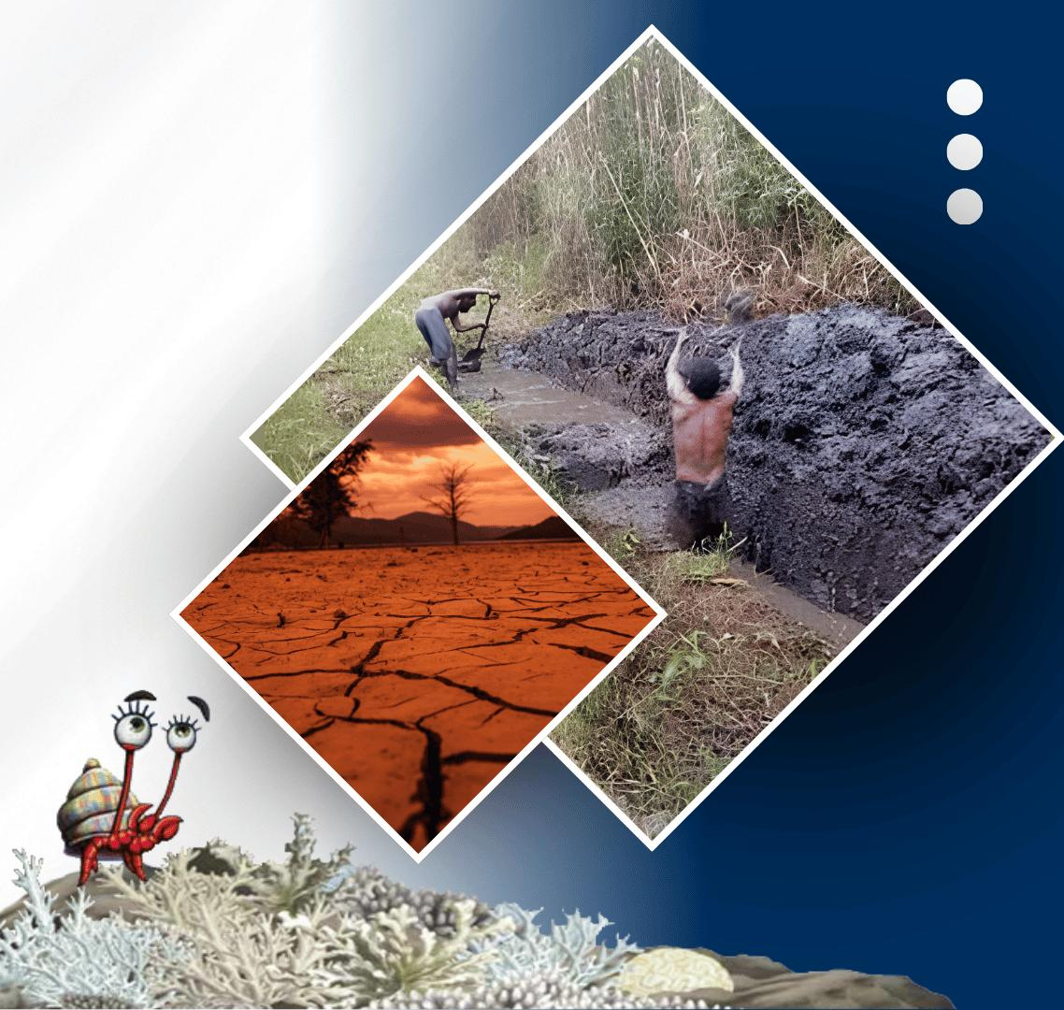




PACIFIC ISLANDS climate & Oceans forum-19
20 - 21 OCTOBER, 2026
HYBRID
PORT MORESBY, PAPUA NEW GUINEA
& ZOOM
www.pacificrcc.net

Slide 2
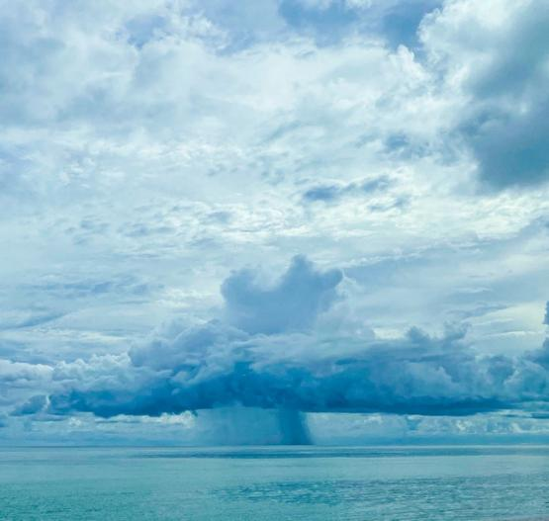
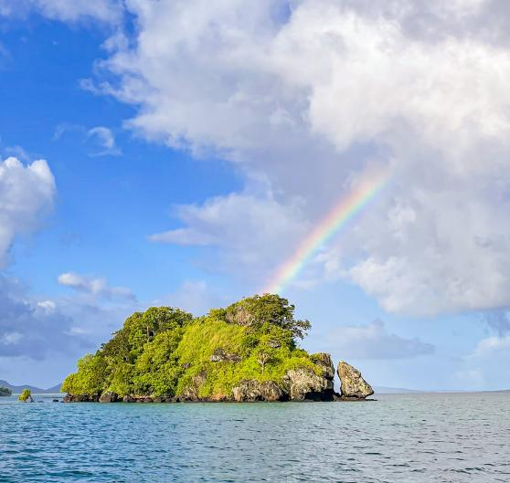




PICOF-19
WNP TCs Through October 2026
Brandon Bukunt
Agenda 2iii - Overview of TCs over May to October
Meteorologist NOAA NWS

Slide 3

Bottom Line Up Front
2026 Western North Pacific (WNP) tropical cyclone (TC) activity through Oct 18 has been above normal.
Activity matches what one would expect during a developing El Niño (more activity and an eastward shift in the TC genesis region). Record TC activity has occurred across the North Pacific east of the dateline.
Pre peak season (March-April) messaging focused on…
high likelihood of a busier than normal year for most islands
preparedness actions with emergency managers and relevant stakeholders

Slide 4
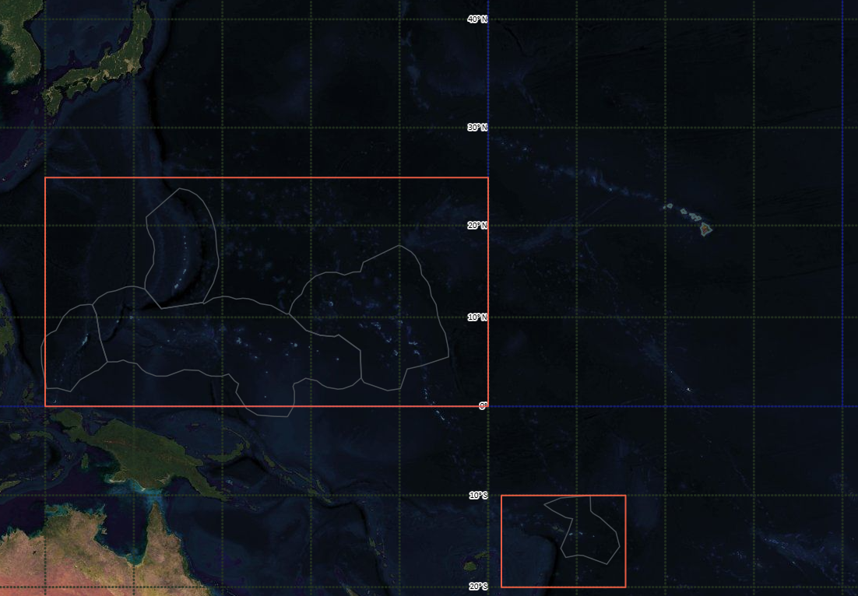
RSMC
Japan
Joint Typhoon Warning Center
Central Pacific Hurricane Center
WFO Guam Area of Responsibility
NWS Pacific Region HQ (PRH)
WFO Honolulu
Central Pacific Hurricane Center (CPHC)
Pacific Tsunami Warning Center (PTWC)
International Tsunami Information Center (ITIC)
WFO
Guam
WSO
Yap
WSO
Pohnpei
WSO
Chuuk
WSO
Majuro
WSO Palau
WSO Pago Pago
RSMC
Fiji
NWS Weather Forecast Office Guam Area of Responsibility & NWS offices in the Pacific
Source: NOAA NWS

Slide 5
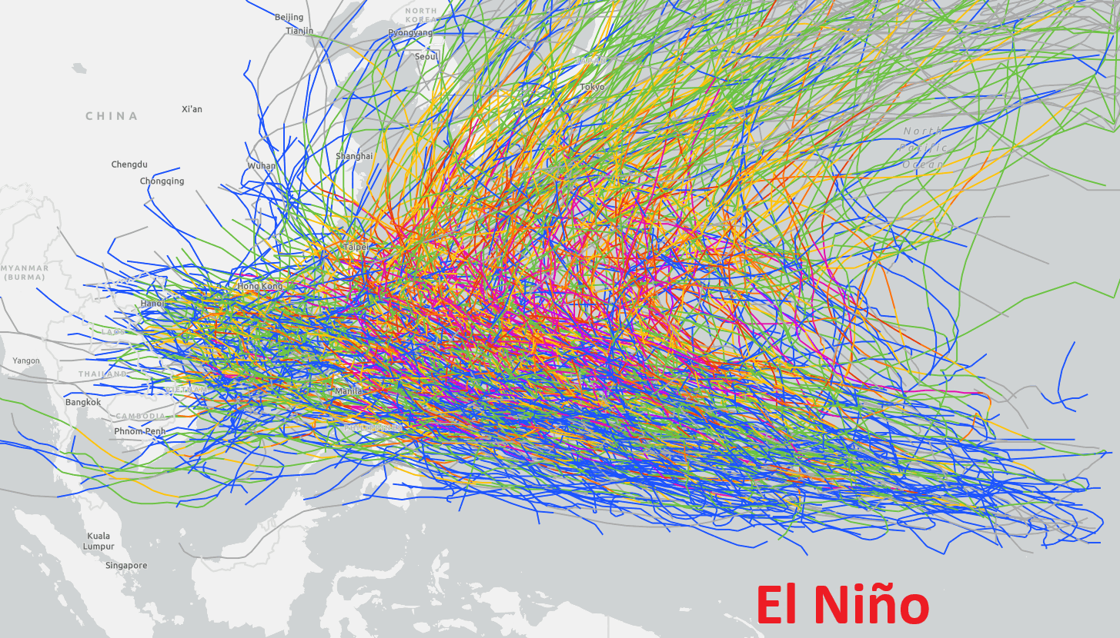
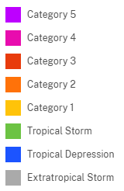
On average, the annual number of tropical cyclones (TCs) in the western North Pacific (WNP) does not vary much
While the total number does not change much year to year, the location of TC genesis can fluctuate significantly
The state of ENSO is the dominant driver of this year-to-year climate variability with the location of TC genesis
Japan
Taiwan
PI
Guam
Currently:
“The 2026/2027 El Niño continues to strengthen, with a strong-to-very strong El Niño likely through January-March 2027. Chances remain high for a historic event”
-NOAA Climate Prediction Center ENSO Team
TC Tracks and ENSO State in the WNP basin
Source: NOAA Historical Hurricane Tracks (IBTrACS data)

Slide 6
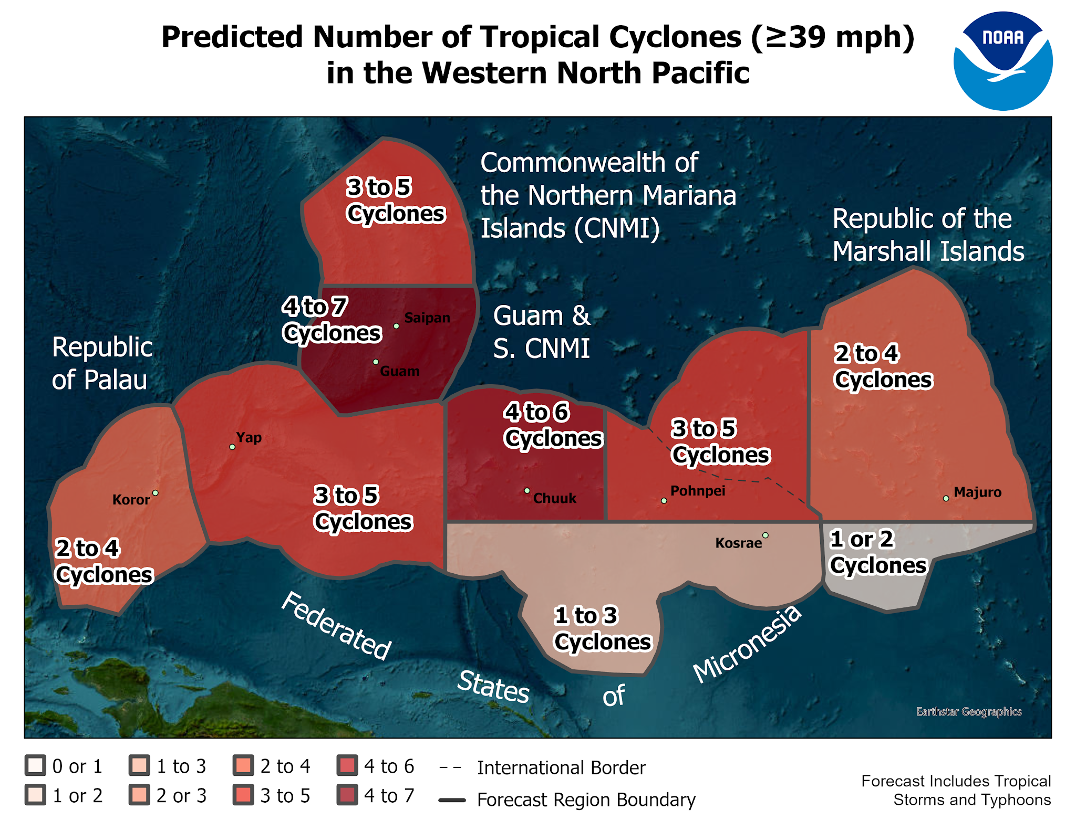
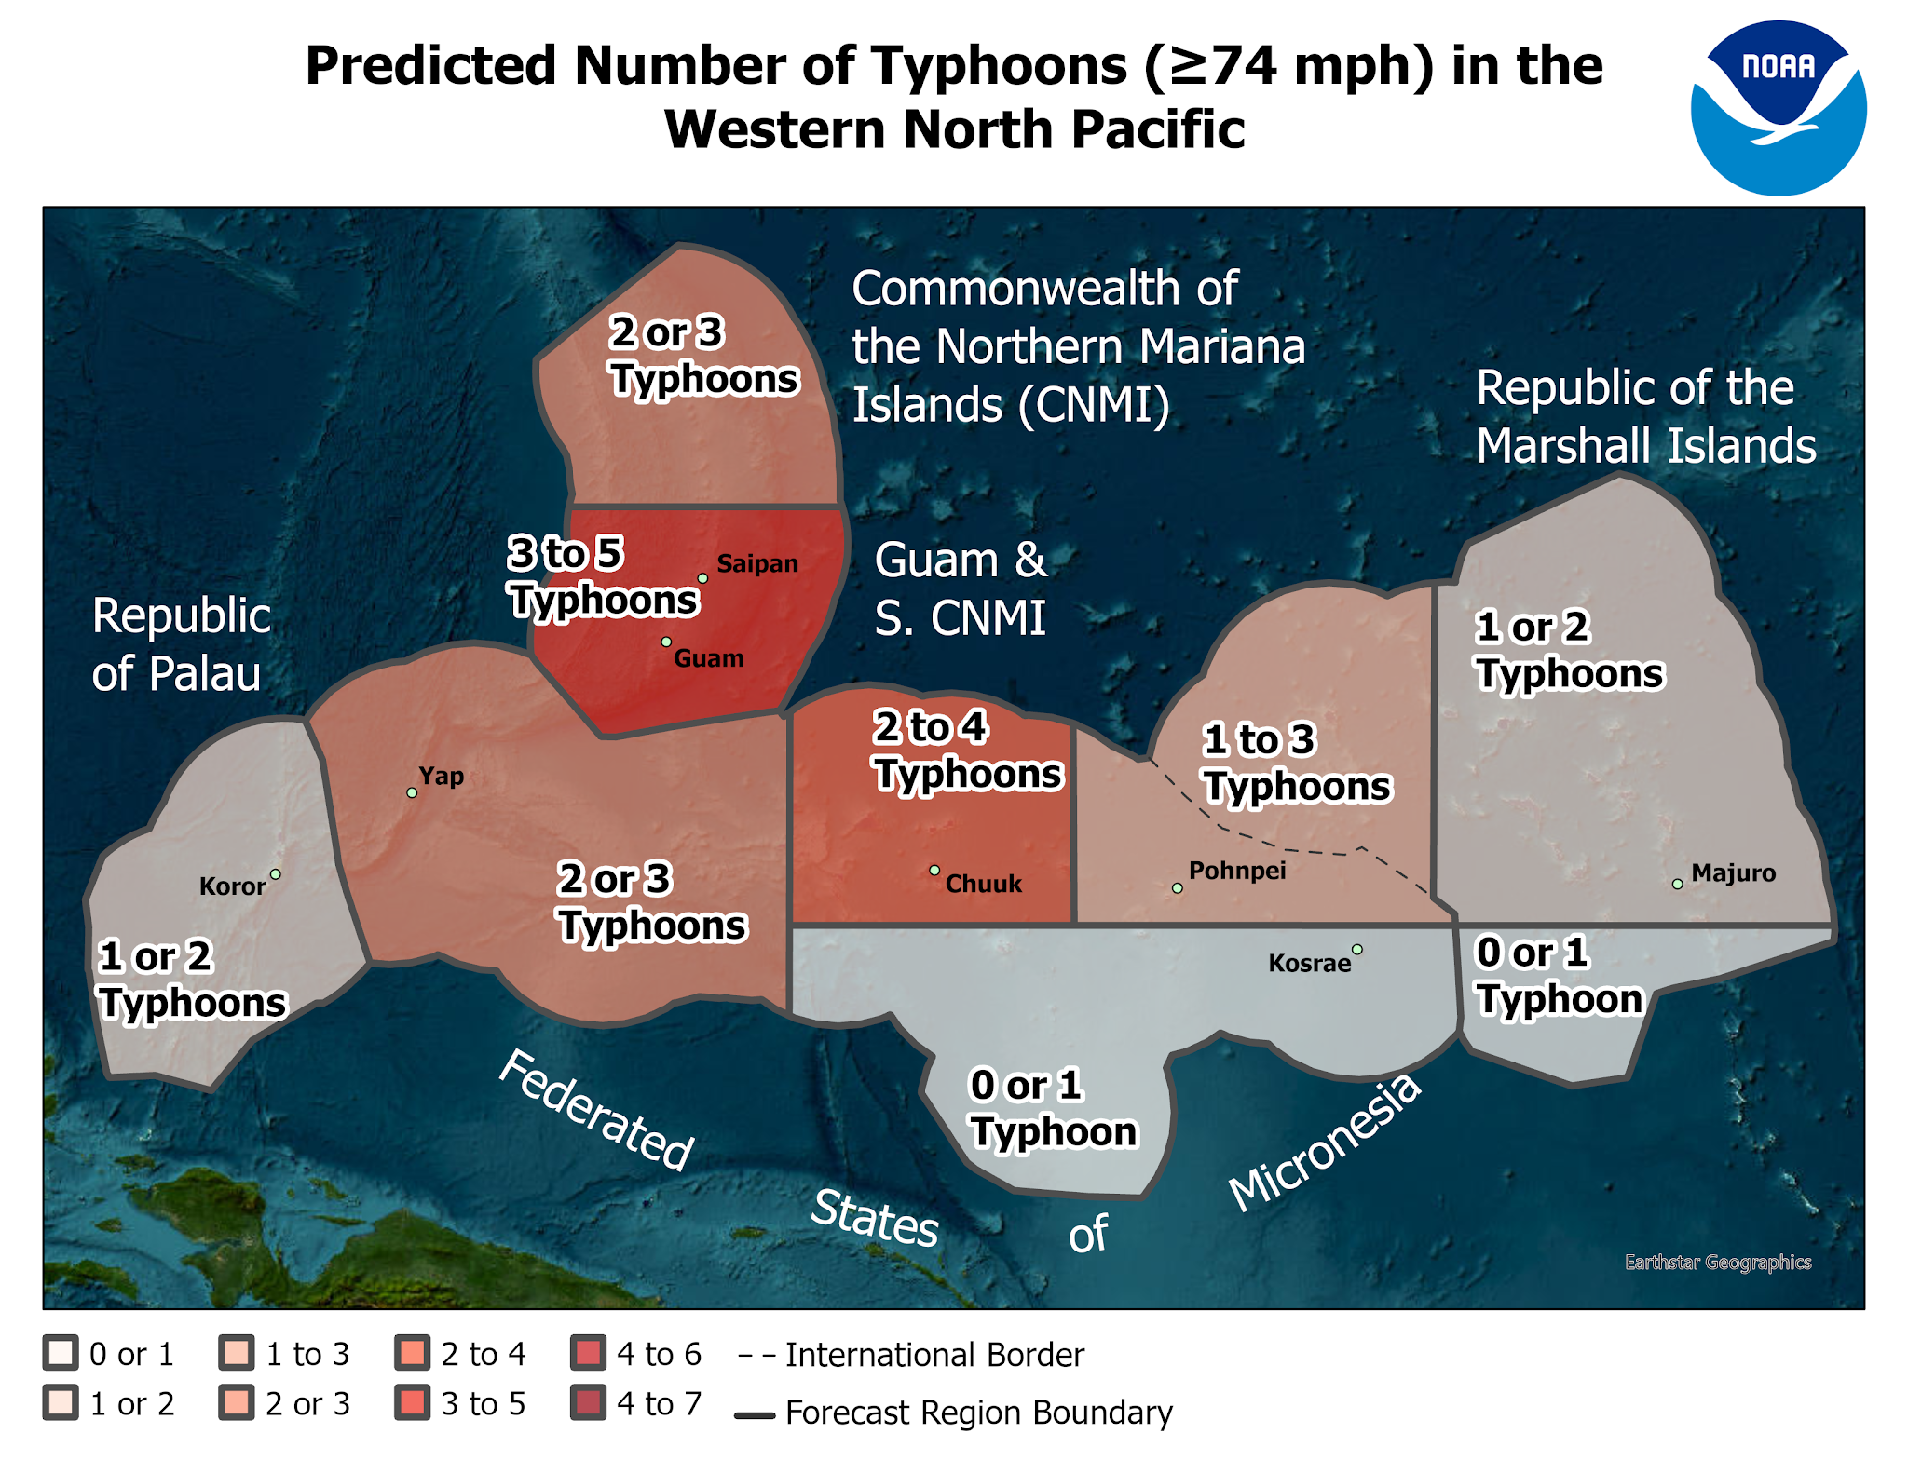
Western North Pacific TC Outlook (released June 5, 2026)
Source: NOAA NWS WFO Guam

Slide 7
Overview
Above normal activity across the Marianas, Chuuk State, Pohnpei State and the RMI
Near normal activity to below normal for western Yap State and the Republic of Palau
Western North Pacific TC Outlook (released June 5, 2026)
Source: NOAA NWS WFO Guam

Slide 8
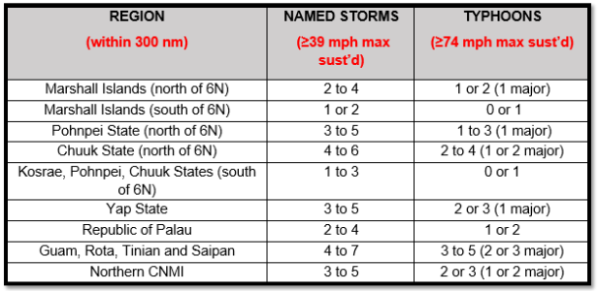
(2) (0)
(0) (0)
(2) (1)
(2) (1)
(1) (0)
(1) (0)
(1) (0)
(6) (3)
5
(4) (3)
(Activity so far in 2026 - thru Oct 18)
Western North Pacific TC Outlook (released June 5, 2026)
Source: NOAA NWS WFO Guam

Slide 9
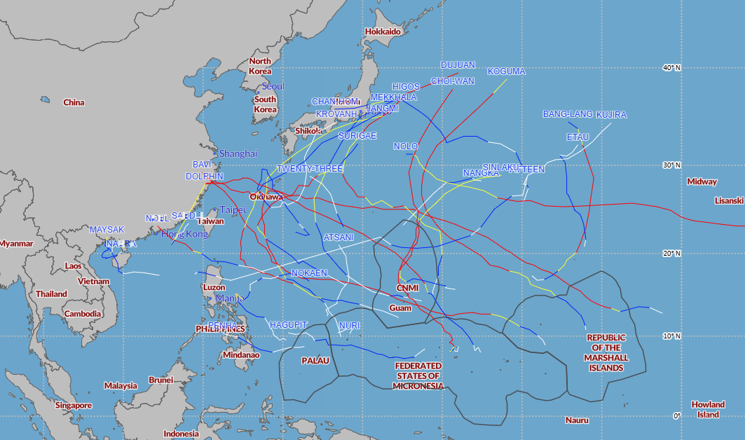
NWS Guam Area of Responsibility
2026 WNP Tropical Cyclones Tracks… through Oct 16
Source: Joint Typhoon Warning Center / FEMA / NOAA
*does not include Champi that recently passed just south of Guam
Preliminary Data

Slide 10

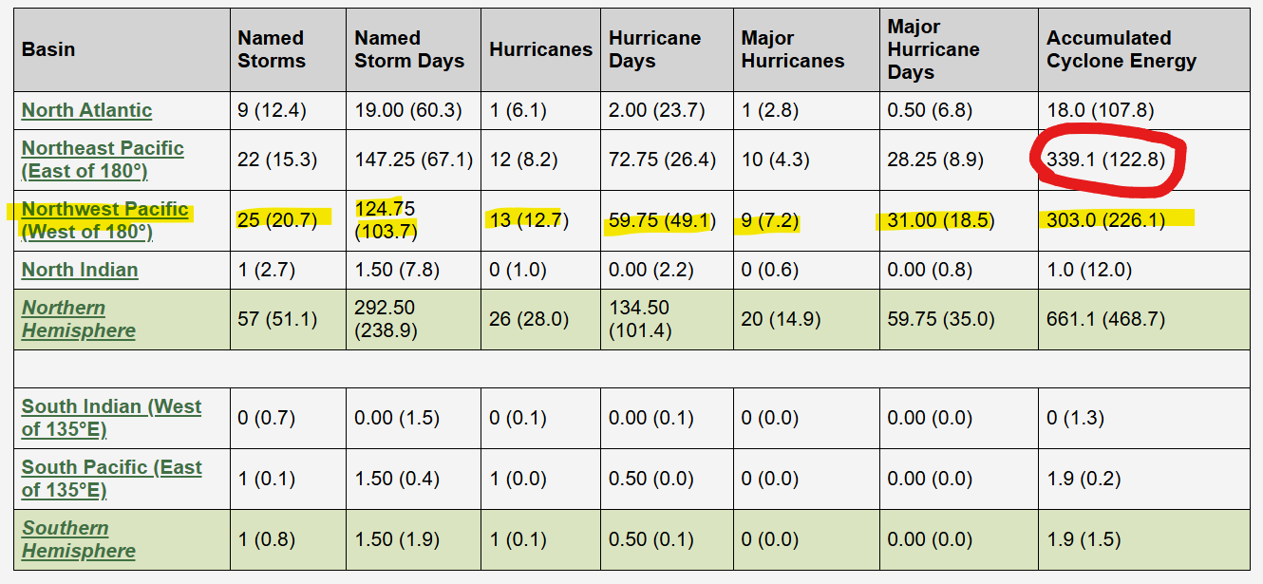
2026 Tropical Cyclone Activity (through Oct 17)
***All metrics above normal
***North Pacific east of the dateline at record ACE levels
2026 so far (through October 17)
Source: JTWC data via https://tropical.atmos.colostate.edu/Realtime/

Slide 11
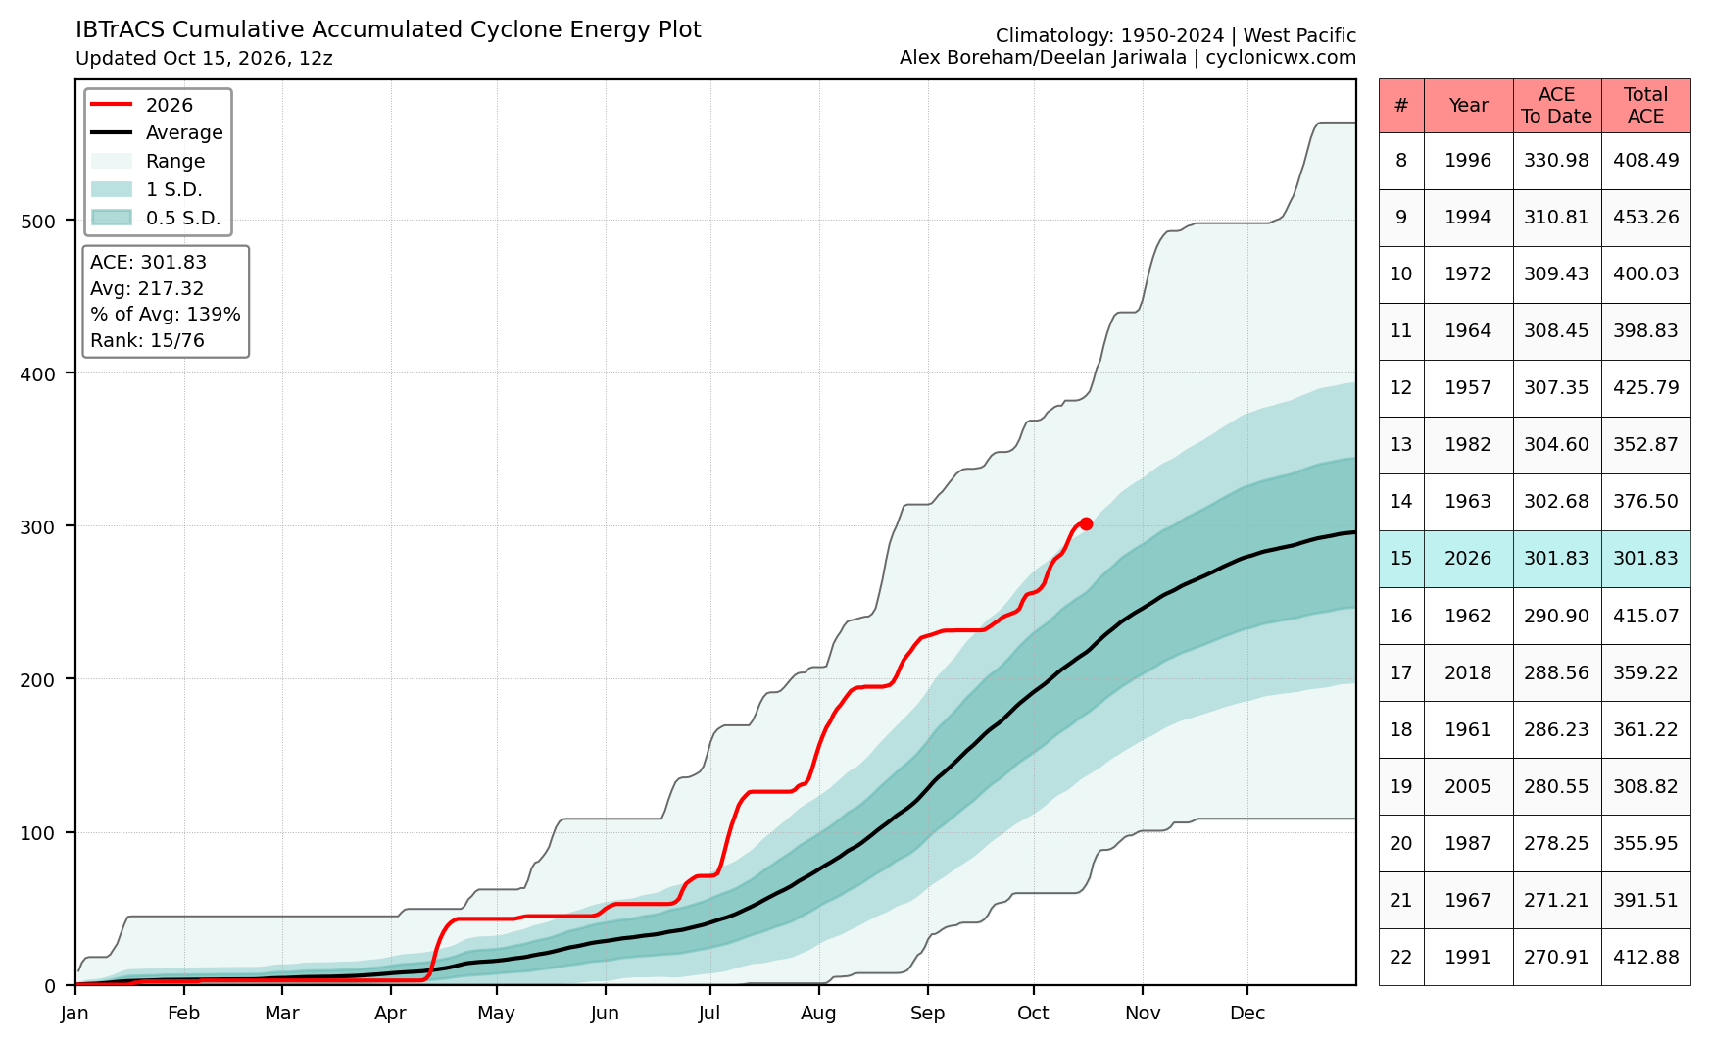
Accumulated Cyclone Energy (ACE) for the WNP Basin (west of the dateline)
ACE is a measure of TC activity…
  Weaker, short-lived TCs produce minimal ACE whereas very intense, long-duration TCs produce big ACE values
2026 ACE is ~139% of normal
  Higher than normal ACE aligns with El Niño
  Why? storms tend to form farther east and so they last longer
Slow start..
2026 so far (through October 15)
Source: https://cyclonicwx.com/

Slide 12
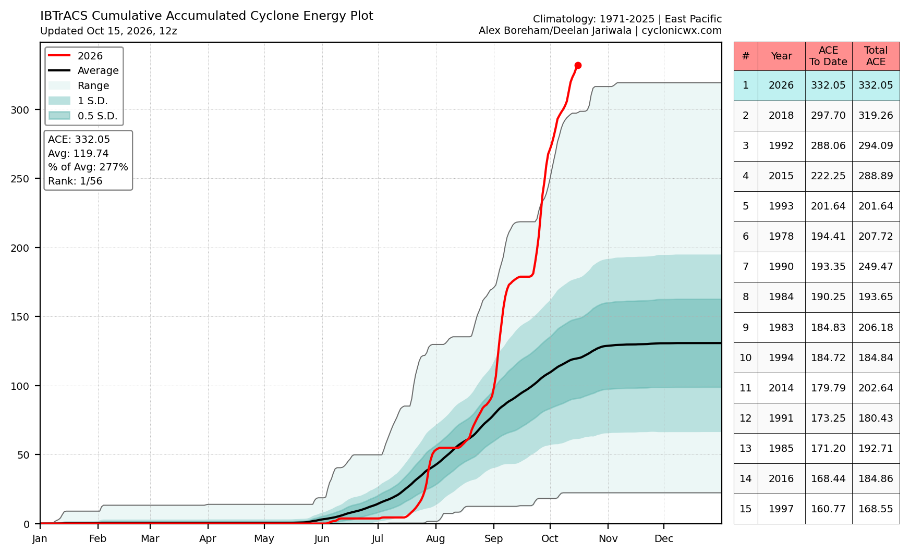
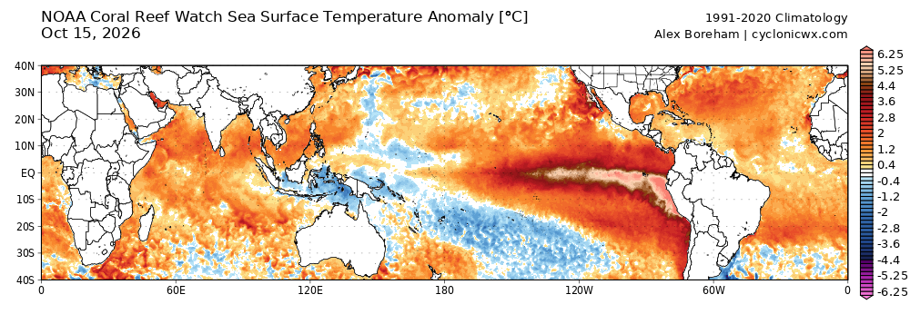
Quick Look at the
Eastern/Central Pacific
Record ACE for the North Pacific east of the dateline!
Ties in very well with the overarching purpose/existence of TCs… to distribute heat from the tropics to higher latitudes
  where is the source of this excess heat? the very strong El Nino!
Slow start..
2026 so far (through October 18)
Source: https://cyclonicwx.com/

Slide 13
2026 WNP Basin Overview
Preliminary Data
Fairly classic El Nino pattern for TCs with a distinct eastward shift in TC genesis
The Marianas have been a nexus of activity with multiple major typhoons (Sinlaku in April, Bavi in July, Saudel in August, Choi-wan in October, Champi in October)
Nolo developing in East Pacific and maintaining itself into the West Pacific
Impactful TCs to Hawaii, central to eastern Micronesia, Marianas
2026 WNP Tropical Cyclones… through Oct 18
Source: Joint Typhoon Warning Center / FEMA / NOAA

Slide 14
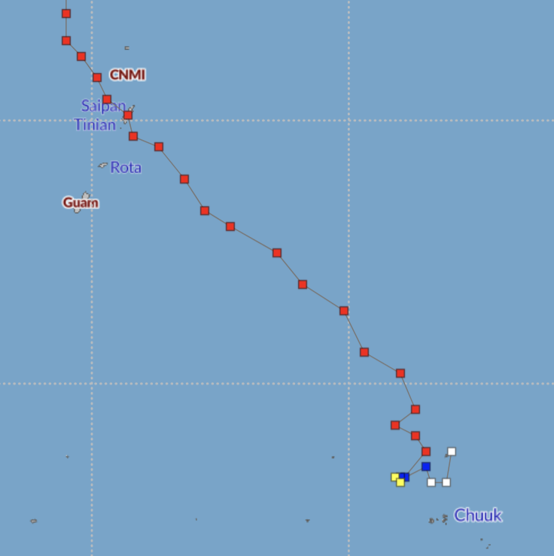
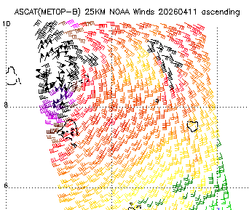
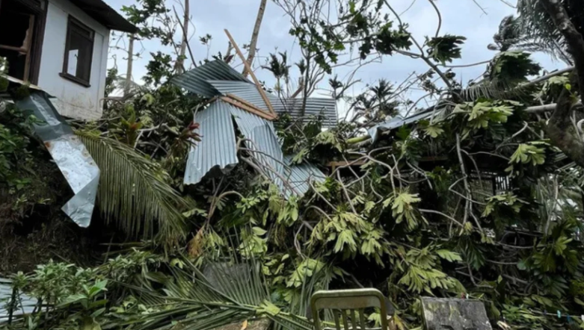
Sinlaku (04W) – Mid April
strengthened in northern Chuuk State to category 1-2 typhoon
prolonged impacts across Chuuk State (+ eastern Yap State) due to size, intensity and longevity (9 deaths)
category 4 Super Typhoon for Saipan/Tinian
extremely long duration typhoon event for the Marianas (including Guam) with nearly 36 hours of typhoon conditions on Saipan and Tinian
BIG…. Sinlaku was not only strong, but it was BIG… leading to substantial coastal impacts across Marianas, Chuuk State and eastern Yap State
Sinlaku (04W)
Source: JTWC / FEMA / NOAA / NASA / Lahaina Philip

Slide 15
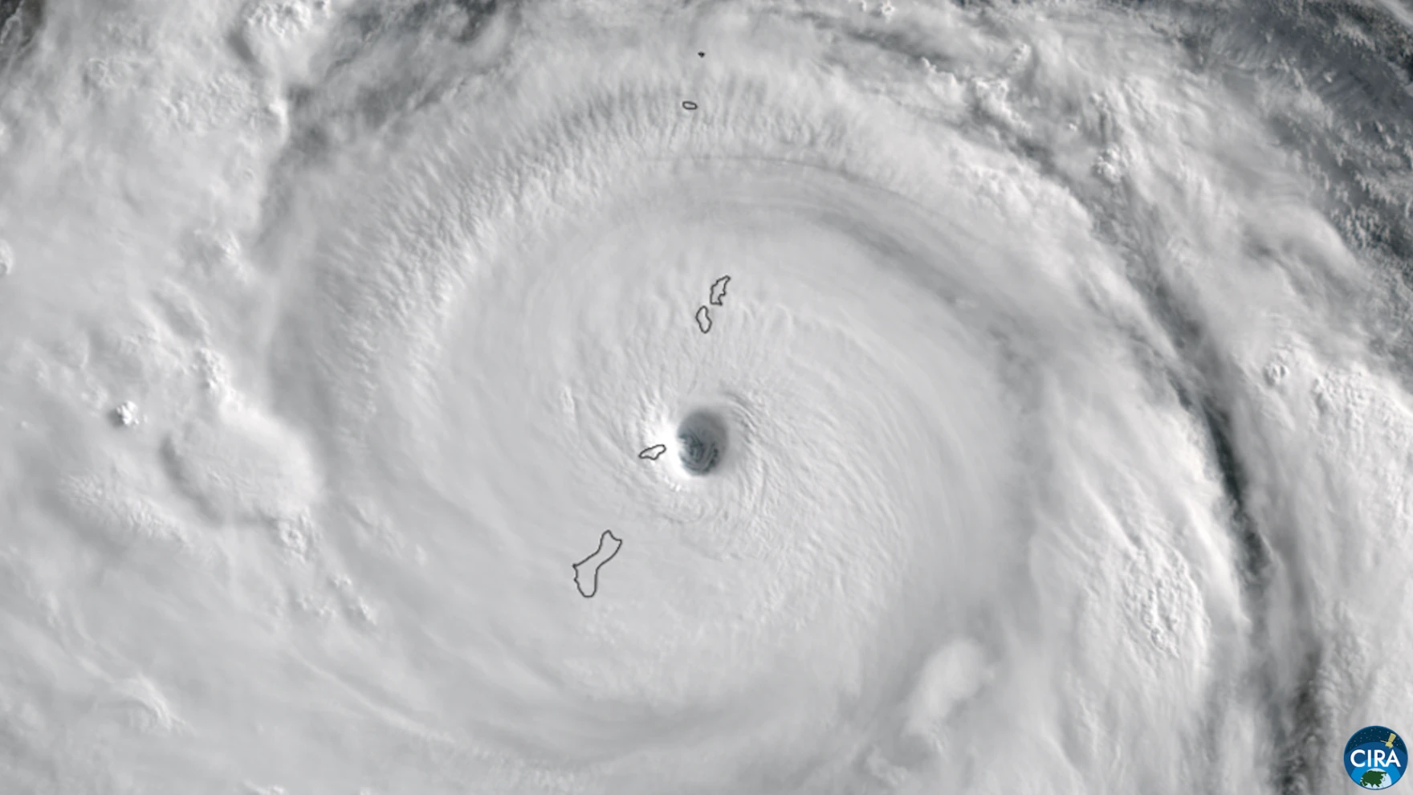
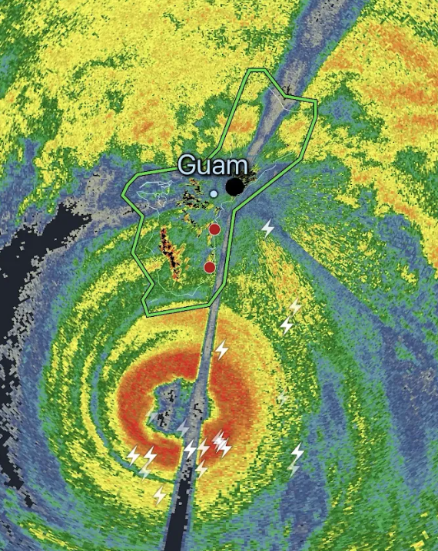
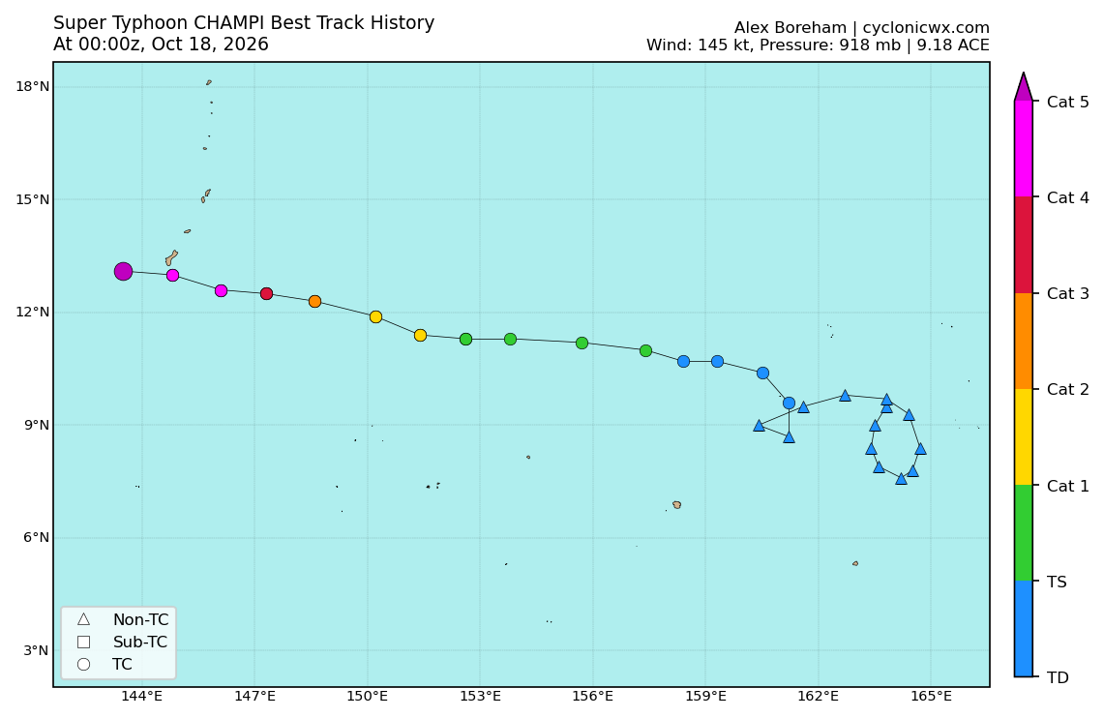
Bavi (09W) – July
Champi (29W) – October
direct hit to Rota as a Category 5 Super Typhoon
Gradual development in eastern Micronesia with minimal impacts
Center of Cat 4+ Champi passed just south (~21km of Guam on 10/18 with only strong tropical storm impacts to Guam
Bavi (09W) Satellite & Champi
Source: CIRA / FEMA and NASA, Radarscope, CyclonicWx

Slide 16
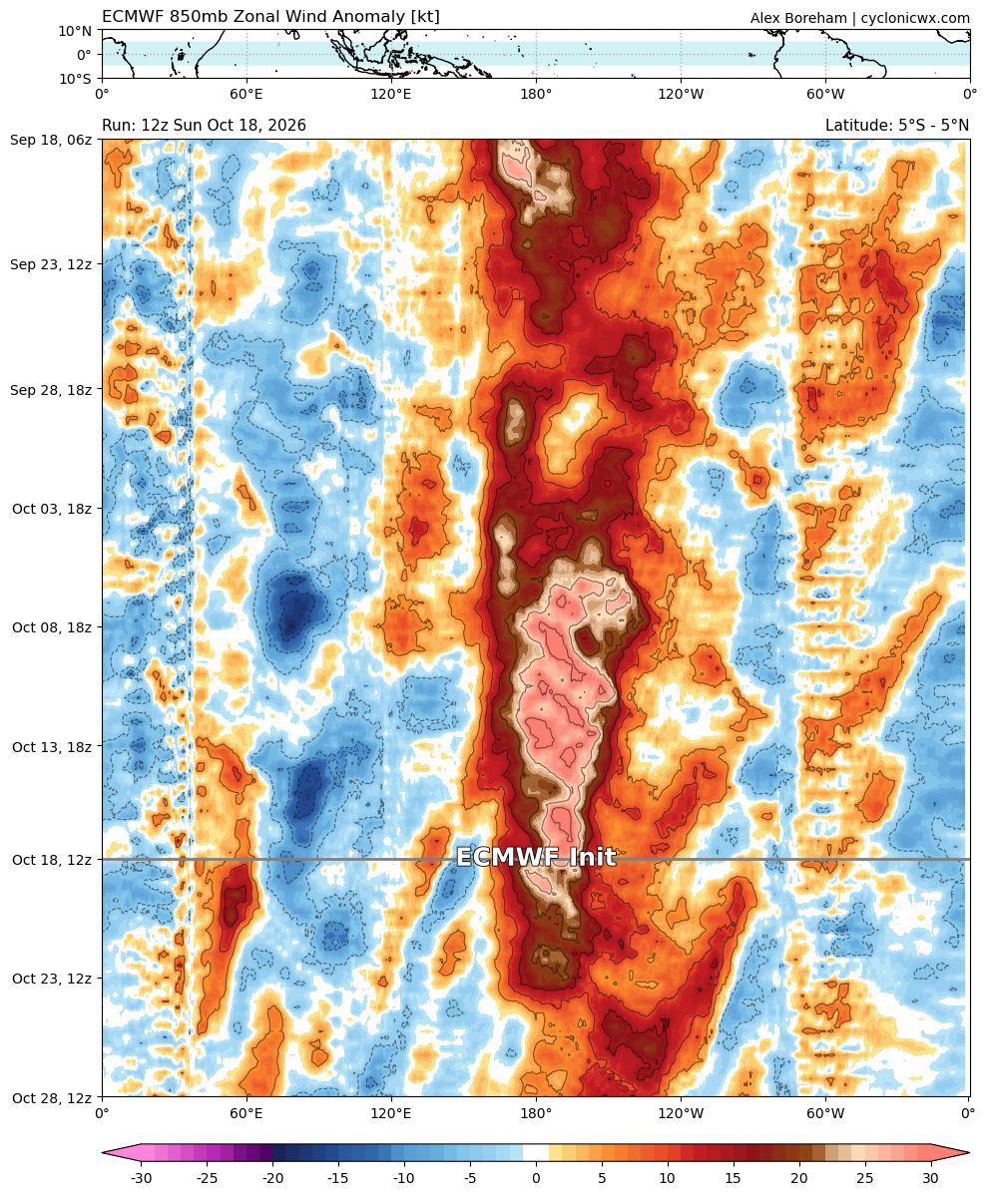
Quick Note on Westerly Wind Bursts
Westerly wind bursts (WWBs) have been extremely impressive across the eastern Micronesia region the last several months
While not directly tied to TCs, these WWBs often serve as precursors to TC development
These WWBs have led to notable impacts across the FSM and the RMI (50kt severe west wind event in Majuro on September 21, etc)
Westerly Wind Bursts
Source: CyclonicWx

Slide 17
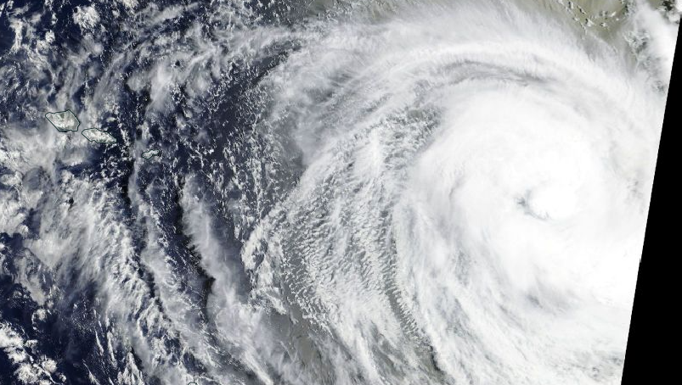
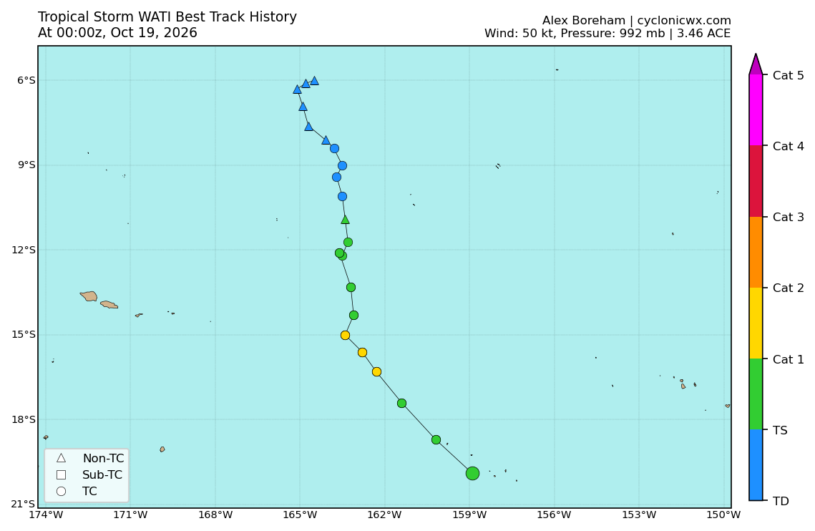
Wati (01P)
The recent extremely strong WWB helped spawn 01P Wati
Wati (01P)
Source: NASA / CyclonicWx

Slide 18
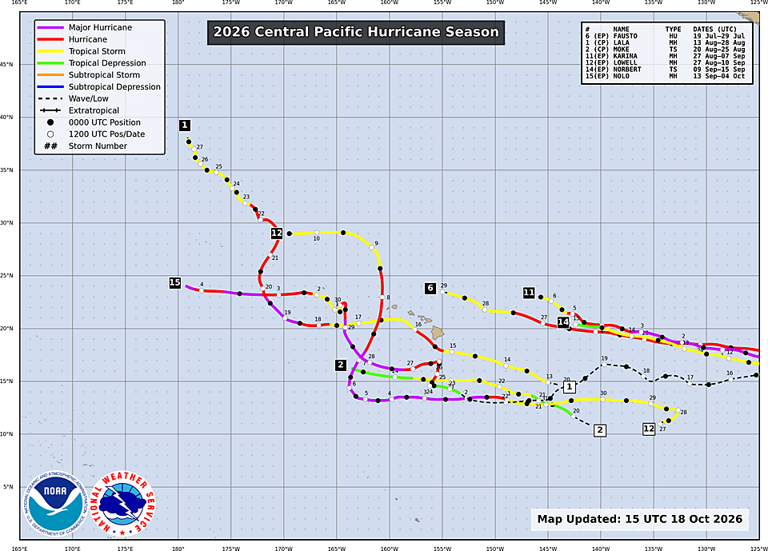
2026 Central Pacific: Quick Look at Impactful TCs
7 named TCs so far in 2026 (typical year closes out with 4-5 TCs)
High impact year for Hawaii with Lala, Lowell and Nolo
  Lala: Category 1 just south of Big Island with catastrophic flooding due to slow, pivoting motion. 2 deaths. Many downed trees across all islands due to wind/rain
  Lowell: Cat 2 just west of Kauai. Big coastal impacts to south side of Kauai
  Nolo: Mainly flooding impacts to Big Island and Kauai
2026 Central Pacifc Tropical Cyclones… thru Oct 18
Source: NOAA

Slide 19

Summary
Weather Forecast Office (WFO) Guam’s tropical cyclone (TC) outlook, issued early June 2026, focused on a heightened risk of TCs for the Marianas, central/eastern states of the Federated States of Micronesia, and the Republic of the Marshall Islands. Reduced activity was favored for the Republic of Palau and far western Yap state. This outlook was based on initial atmospheric signals and seasonal model support for a very strong El Nino.
Through mid October, TC genesis has been farther east across the Micronesia region due to the development of the ongoing very strong El Nino. All TC metrics have been above normal.
Very strong El Nino onset years tend to see an extended TC season through the end of December, or even the first month or two of the following year. Island residents are encouraged to stay calm and prepared for more TC activity.

Slide 20





Brandon Bukunt
My Email
brandon.bukunt@noaa.gov
Special thanks to WFO Guam and the Micronesia WSOs for their unrelenting service to their communities so far during this active El Nino year

